Slide 1
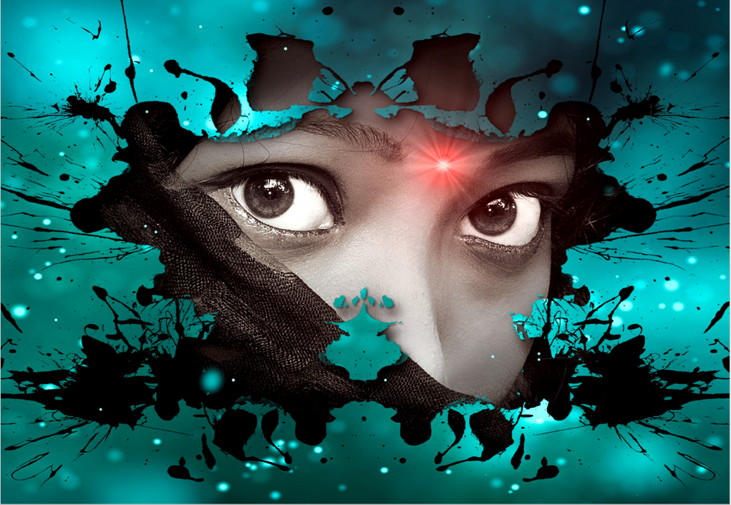
Erin could not pinpoint what it was, but she knew something was off about the new town.
It had taken her mother months to decide to move there since the death of her maternal grandmother. It was the elderly woman’s dying wish that they’d come and take over her old cottage situated at the heart of the woods.
Moving to the new area was a hassle, not because Erin and her mother had a lot of property or no money but because the town had so many stringent rules. The inhabitants were no more than a thousand; there was a ban on wearing clothes with sequins, and shops were instructed to close before nine at night.
Erin’s mother was not one for trouble, and the pair managed not to break any of the set rules during their first few weeks in town; however, an emergency was underway, and they had no choice but to get to the town’s centre.
They started the drive reluctant that night, eager to find a pharmacy that would be open some minutes after nine, but they were greeted with eerily quiet streets. Earlier, they had passed through the neighbourhood nearest to them and noticed no one had their porch lights on, but the duo had just assumed it was an honest oversight.
Unfortunately, that oversight began to replay in their memories as they reached the centre of town. The crickets that chirped were the only residents who seemed not to care about the instructions. Everywhere was dark, except for the streetlights that beamed into the shadows. As the silence became overwhelming, the emergency that brought the pair to town seemed insignificant as Erin’s mother decided that the best option was for them to go back home.
As though some higher power had heard her mother’s thoughts, a few stores had their lights turned on. Her mother stalled and parked the car close to the pharmacy when a more senior citizen came out from the store.
No later did Erin’s mother see the woman did she lose all colour from her face. Erin could not judge her mother as she too, was also paralysed with fear. Fortuitously, the older woman did not see their faces, but they could recognise her anywhere. It was Erin’s grandmother.

