Slide 1
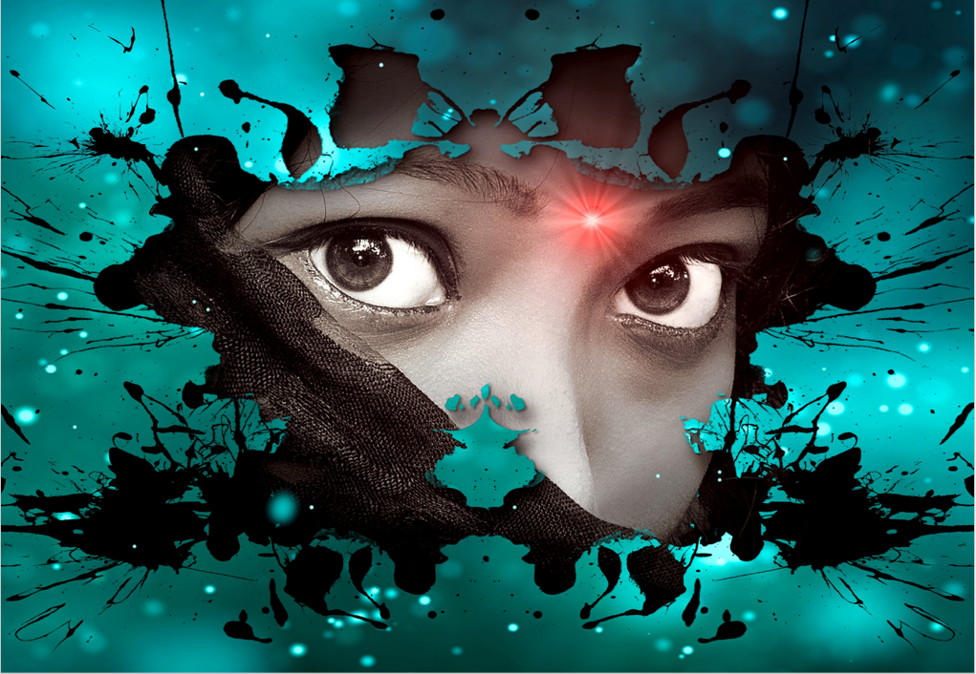
Every individual is blessed with specific types of power, be it a rhythmic heart, oxygen or a body that keeps us alive. However, one of these powers supports a different kind of living. It is often dubbed the ‘lonely power’ and colloquially termed ‘privacy’. It is not the kind where one suggests to a parent not to rummage through their belongings, nor the kind where a random stranger is not expected to open a locker that is not theirs. It is the kind where social etiquettes demand people are not asked unnecessary questions.
I can vividly remember seeing children clamour around one of their peers who had a disability and barrage him with questions ranging from his birth to looking for a cure or a fix. Intriguingly, I’m sure his peers meant no harm, but it was outstanding they were not sensitive enough to see the discomfort written on his face. His brows were folded, and although he tried to maintain a smile, his wanting eye never left his interviewer, begging him to stop.
Over time, I have realized that respecting an individual’s lonely power is just as important as the oxygen we breathe. Inquisitive nuisances are as sensitive as a stranger walking into a home, sitting in front of the TV, and asking his unintended hosts for dinner.
Unfortunately, many don’t fully grasp that privacy is a human right. Personal privacy is beneficial to many individuals because it allows them to maintain their sense of self. Worse still, if this invasion of privacy is not something that we can report to the police or an adult about, we are stuck in a place where we feel like we can’t do anything, which is the most challenging place to be.
If you are genuinely interested in a person, let friendship be your guide, and if they deem it worthy of telling you about the situation, they will disclose it. Learn to build trust before asking individuals very private questions.

