Slide 1
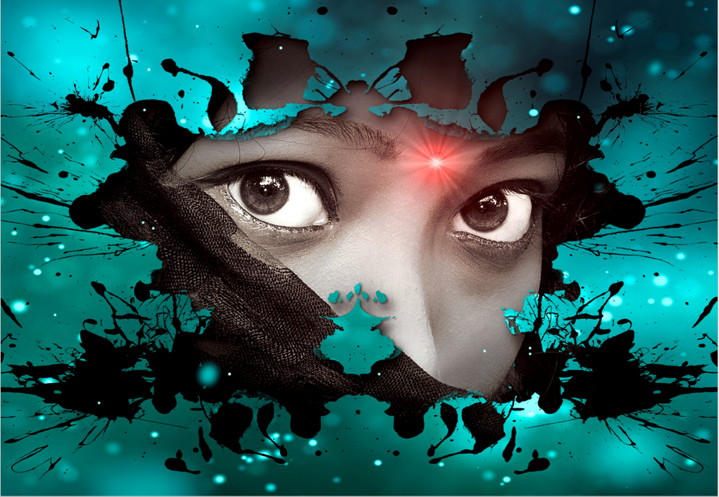
My colleagues had rushed past me, each one a student eager to participate in the following afternoon activity, yet, I stood still, resolute and enamoured with what lay in front of me. The numerous artwork of past students and now legends decorated the white walls of the hallway.
I passed that particular route daily, yet none of them called to me like that day. Each artwork was a house encased in a thin blue and gold frame. Most of them were of unpleasantly clashing colours, yet they would be considered art to the untrained eye. However, I knew better. They were paintings from amateur students who had probably managed to pass their first-year exams.
Nonetheless, It was the content of those frames that stopped me dead in my hurried tracks. It seemed as though those houses had come to life. They were moving.
I have always loved images. I was particularly intrigued by the kinds you would have to think to decipher what the artist was to convey. I believed they were the best tools to capture moments and freeze time. However, my obsolete thoughts were corrected that day as the moving houses told the past, present and future.
Rather than freeze, they allowed time to course through them. Every brush stroke told me what the artist envisioned at the time, and every etch on the canvas told me how his ideas kept morphing into something beautiful. Most importantly, every mistake in his technique said that the artist was not perfect and would continue to improve.
Of utmost importance, these moving houses told me the emotional state of their maker. As I continued to stare, I was astonished to feel the emotions that emanated in the room the day these houses were drawn. That was the day that changed how I perceived my art. It was the day I realized I have the ability to make anything come to life.

