Slide 1
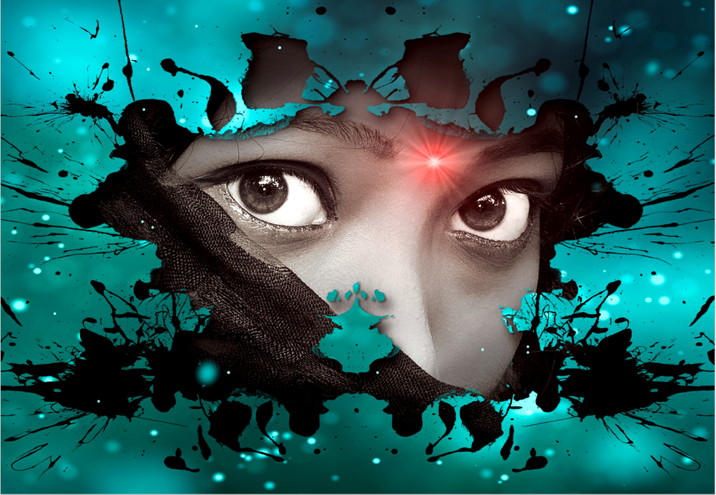
Her skin beamed red as adrenaline rushed through her veins. Jendi could feel her new powers surging through her body. Every 5 years, the Gods gifted her with new powers which she used to protect the planet. Jendi’s eyes rolled back in her head and her limbs went numb. A bolt of lightning struck the ground in front of her as animals scampered. She stood tall and opened her dark eyes. Jendi looked down at her feet which were now hovering above the ground. “I can fly,” she muttered pleasingly to herself.
In that moment, the ground rumbled. Earthquakes and storms had been ravaging the earth for years. Humans had destroyed their own planet and were now paying the price. Fortunately, the Gods had sent Jendi to save lives and provide relief.
She flew to the epicenter of the earthquake and began pulling people from the rubble. Screams could be heard for miles as the ground continued to rumble. Jendi gathered as many people as she could and flew them to safety. Her heart raced but her mind was calm.
The largest building in the area was still standing. “Help!” cried a young girl from beneath it. Without even thinking, Jendi flew down, but the girl was trapped under piles of rocks. Jendi moved rock after rock to no avail. The earth continued to move, and the building began to collapse. The voice of the girl faded and to her left, she noticed a swell in the ocean…a tsunami was on its way.

