Slide 1
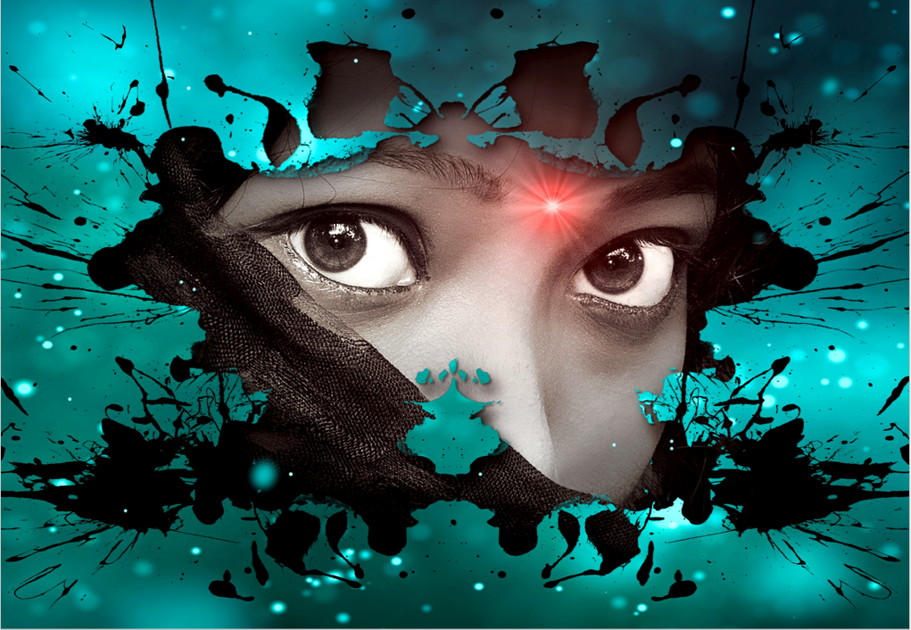
Philly was always taught that life was a dog eat dog kind of situation. She lived a life where the planet was constantly evolving, and there was new trouble daily.
It was a difficult life her kind experienced, and they had no choice but to allow terror to be their mantra. They were not gliders like the birds of the air, and neither could they be admired for their beauty like the ground crawlers.
Nature had found a way to cheat them out of the good things that life had to offer. Their heads were too big for their body, and they had to have a large tail to balance such odd proportions. Their hind legs were built for speed, yet they kept crashing into objects because their tiny hands could not help them stir.
Worse still, more approachable creatures like Philly could not make friends. Every time she stared down at her reflection in the water, she was always met with large sharp teeth, sure to turn away the friends she had met through the years.
She couldn't blame them for always assuming that she wanted to eat them, for that was the way of the Tyrannosaurus rex. Eventually, she would come to learn how to thrive in solitude, but until then, she was on a quest for someone her kind called Metros.
Metros could take the deepest desires from anyone and bring them to fruition. Rumour had it that he had turned a Velociraptor into a Brachiosaurus because he wanted to impress a girl. Nonetheless, as good as the story sounded, Metros never did anything for free and would require his customers to give up something they loved the most.
For Philly, it would be her parents, who had loved her and cared for her. They had always gone out of their way to make sure she was comfortable. Still, she wanted more, and still, she considered visiting Metros daily.

