Slide 1
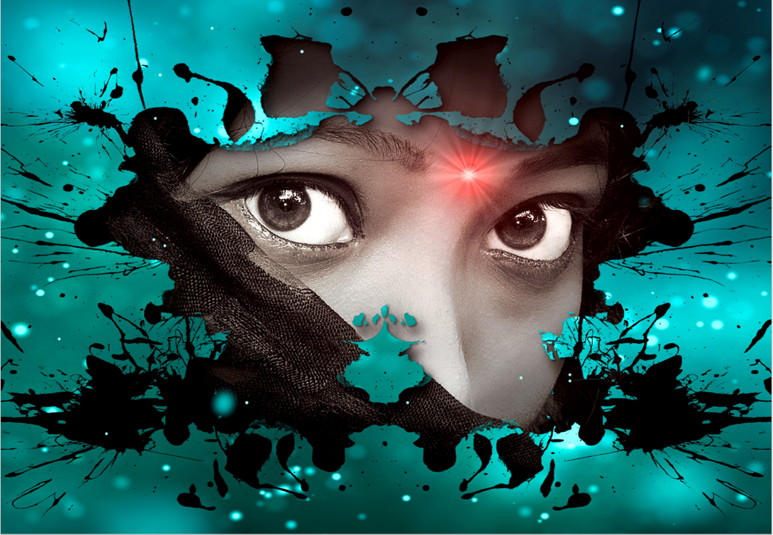
The owl had given us a sound warning that something terrible would happen, but we were not exactly the brightest duo in the room, and our ears were indeed built porously to filter information.
On that fateful day, my comrade and I made it to and stalled at the top of the hill. We knew we shouldn’t be there, but then again, we were too excited about the freedom bestowed upon our shoulders. As we looked at each other, we understood what was next. The race began.
It was magnificent, our bodies were filled with adrenaline, and the joy of moving at such a high speed chased away all our inhibitions. Eventually, like all good things, the end had come. I grabbed the brake lever of my bike and pushed down hard, but none of the brakes took. I swallowed hard and knew that I would crash into a horrible bend. The owl was right. I should have known it was wrong to best an old sage.
My head became light, and panic overtook my being. My friend had already halted, and I just flew past him. I kept trying to slam on the breaks, but nothing happened. Nature decided to help my predicament, and a massive stone at the corner made contact with my front tyre, and I was thrown high into the air. I gasped and screamed, and my body finally landed on the ground. I was glad I did not hit my head and have a concussion. However, the skin on my arms and legs were in shambles. I lay there on the ground, and the adrenaline that filled my veins began to wear out.
Anguish and pain washed over me, and I began to cry. My eyes became laced with tears, and I could not move my left leg. My friend had come, and he stood over me. Luckily, he had his phone in his pocket and proceeded to call the emergency number. He told me not to try to get up and informed me that I had possibly broken a bone. As I gazed at the sky, I could see the wings that belonged to none other, and I knew the sage had come to gaze upon his defaulter.

