Slide 1
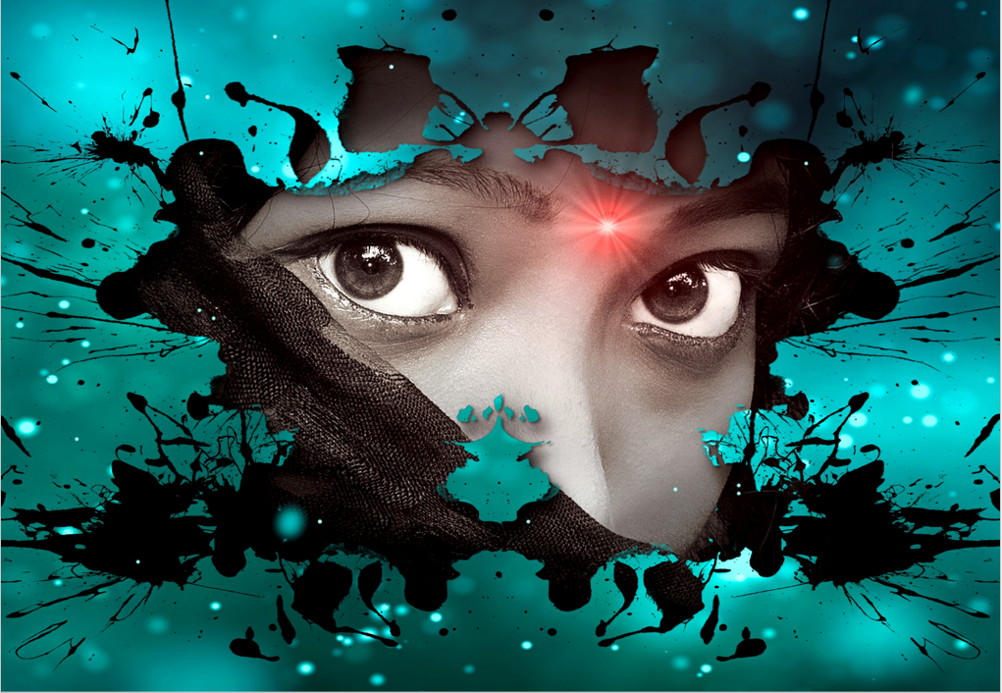
I have always wondered what obsessions humans have with time. Is it because we are not content with the life we live, or we are too obsessed with the mistakes of the past.
Pondering and questioning, I have concluded that it is more the latter.
It is often difficult to move forward if dark clouds are hanging over one's head, and the tendency to gawk at doom, no matter how near or far, is innate in all of us.
The past is a life lived, and it cannot be changed. Even with the idea that infinite possibilities might exist, there is no guarantee modifying our choices would change the future. I believe everyone has a set destiny, and it is a constellation of the decisions made through the years.
Hence the limitations of time travel come to play as the challenges that would arise with trying to adjust critical decisions would overwhelm anyone.
What is more outstanding is that with every choice altered, there is a ricochet of new possible outcomes that would also need to be changed, which would eventually prove futile as destiny is a constant.
With all said, I'd rather not stay obsessed with what could have or should have. Life is too short and beautiful to keep staring at dark clouds a mile away. Clouds are only seasons that are gone in the blink of an eye. The constants, however, remain night and day. Constants were created to remind us to choose the easier route to destiny during the day and opportunities to reminisce our decisions while it is night.
Life is such a beautiful journey that memories are best left as what they are — simply avenues to remind us of where we have come from, how we have made our journey and where we are going.

