Slide 1


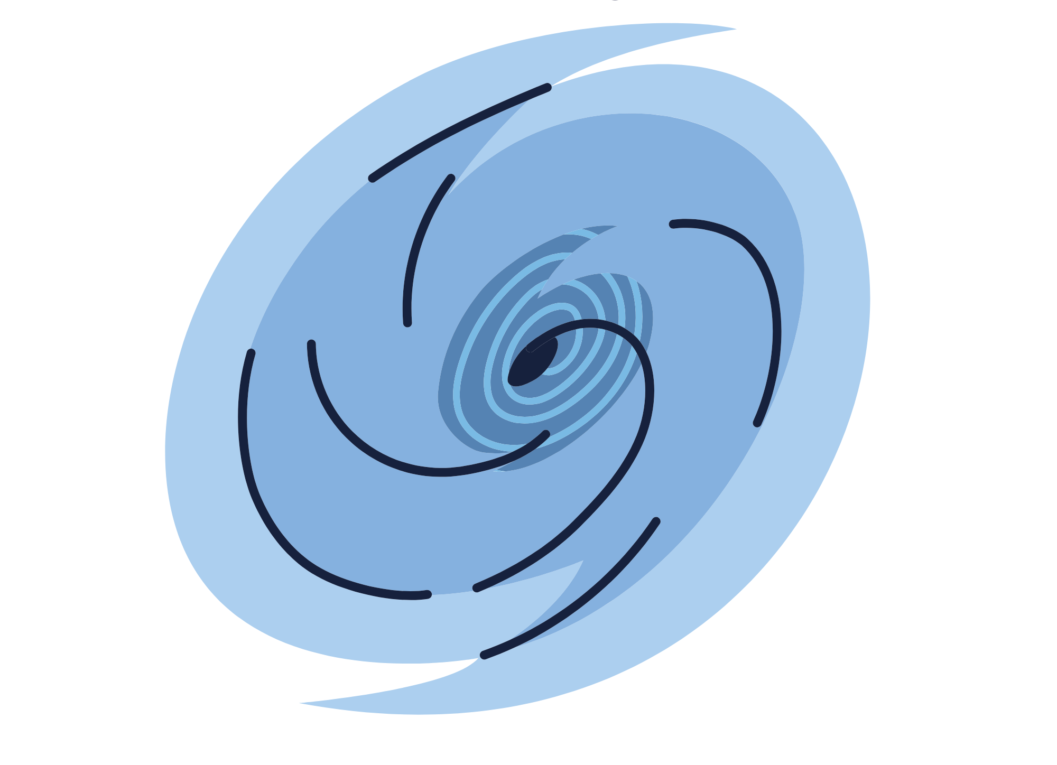
David's father told him to wait in the store, and all colour washed from the young man's face. There was never a time when his father had left him alone, so he knew something was amiss this time.
As the young boy looked out of the window, he could see the angrily grey balls of condensation coming towards them. It looked like a warrior charging into battle and certainly looked like it was ready to win.
It was not the kind of weather that was indecisive because it came with the wind as its supporter. If care were not taken, the wind would be the actual warrior, leaving the clouds to be nothing but background spectators.
David knew that his father had understood what kind of fight the clouds had come in with, and he was also ready to put up his argument. His father would protect him and their little stall, situated at the entrance to the beach. The little booth put food on the table and helped his father pay their mountain of hospital bills.
The battle line was drawn, and it would be a fight to the finish.
David began to look at the clouds the way his father had always taught him to look at things— smaller than what they imagined. At first, it seemed that the more he stared, the more menacing the storm became. It had even become more dramatic, calling on its thunderous hype men to scare the little boy.
Nonetheless, David kept looking, and as he glowered, he could see what lay behind the storm—rays of sunlight pursuing the grey condensation.
It began to dawn on the little lad that the storm was just like him; it was scared and dramatically running away from a bigger foe. All the noise it made was just a way for people to know it was there, and it needed to remain relevant.
The storm was nothing important, just a frightened child looking for comfort.

