Slide 1
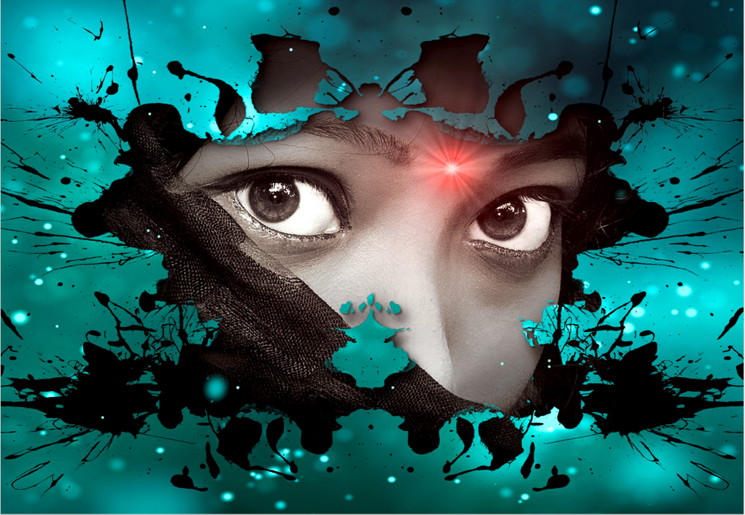
My hands shook as I held the letter, we had buried in the beach some many years ago. It was a wonder that a piece of paper we had planted in a bottle, cliché as it might sound, was all that I had left. I know she was excited that day which made this moment even more emotional, and the tragedy that had unfolded even more painful. Tears rolled down my cheek as I unraveled our mystery, and I could not help but feel such a burning in my chest and a whole in my heart.
To my shock, the letter in the bottle displayed a message that read:
“I am alive. Follow the signs. Find me.”
I stood in awe, staring at the paper as if it was alive. What did it mean? Was this some kind of joke? At that moment, the wind died, and the waves fell silent. It was as if the ocean was talking to me. A path in the sand led me off the beach and into the forest.
A wave of emotions came over me as I made my way forward. “Is she really alive,” I muttered painfully to myself.
The accident happened 9 months ago, and my life spiraled out of control. She was the glue in my life and was taken suddenly, leaving me in pieces. But now, what seemed like a dream, was an opportunity to see her again.
The trees in the forest stood tall and daunting. There was no path but somehow my feet knew the way. The wind guided me and the leaves blew ferociously towards my destination.
I came to the edge of the forest and my heart skipped a beat. The sun shone directly at a spot on the ground where a girl lay motionless…

