Slide 1
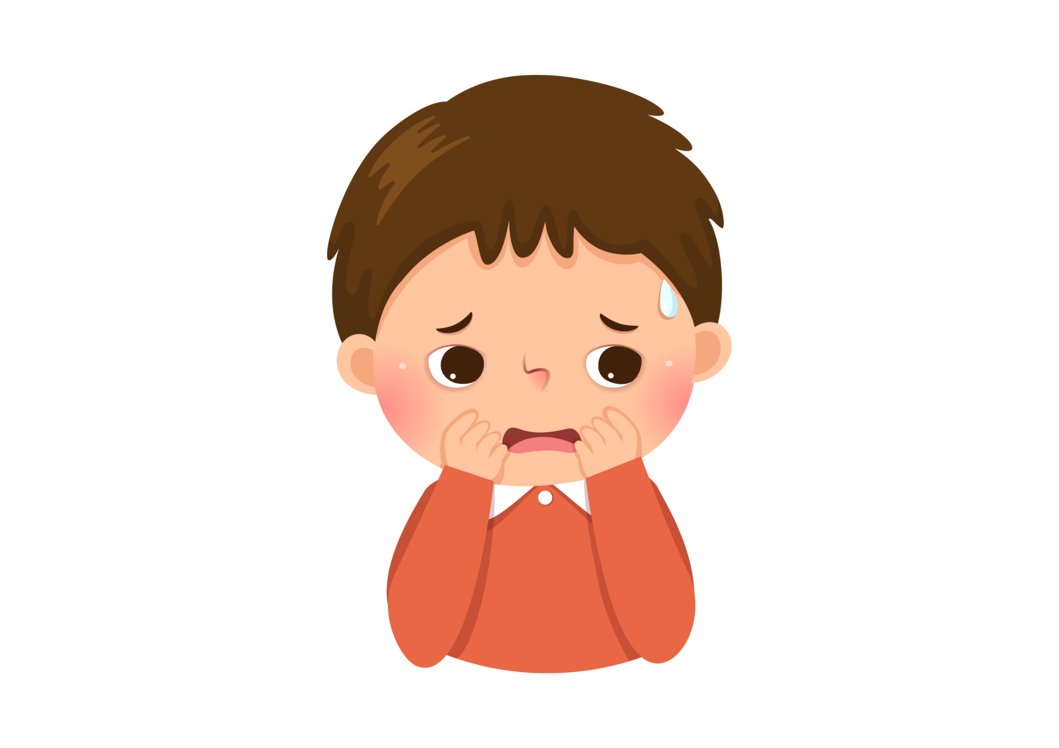
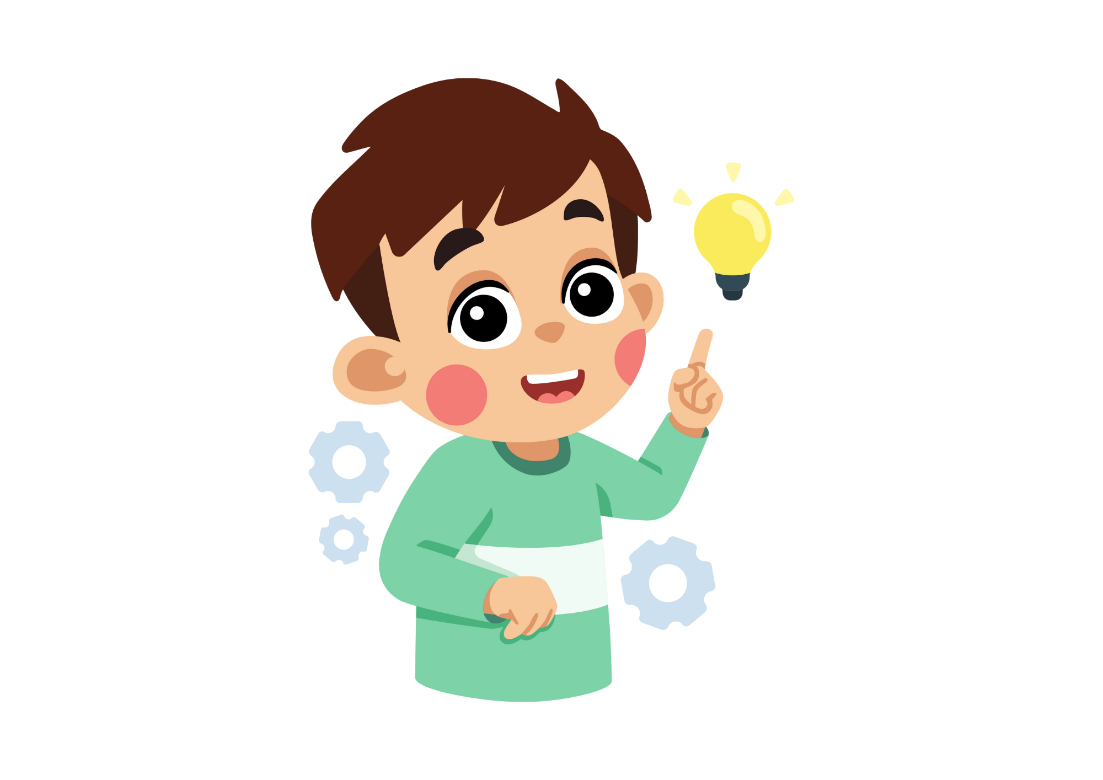
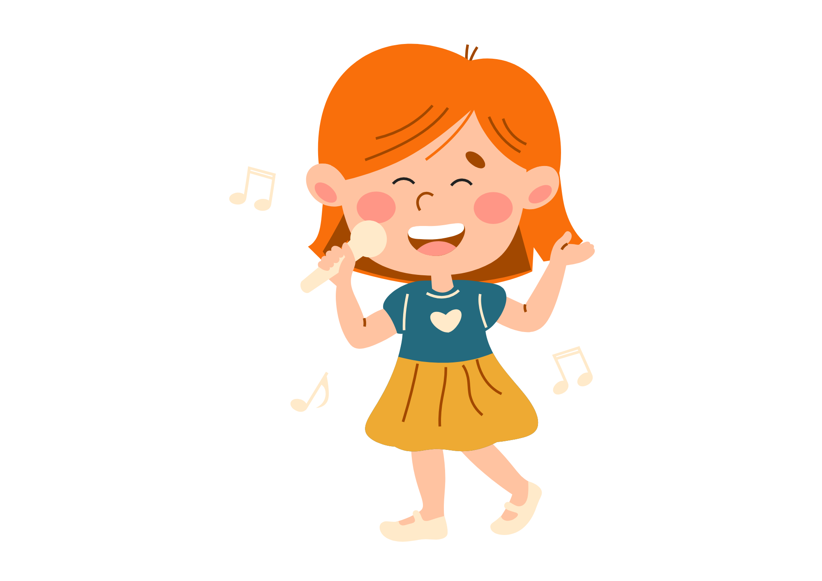
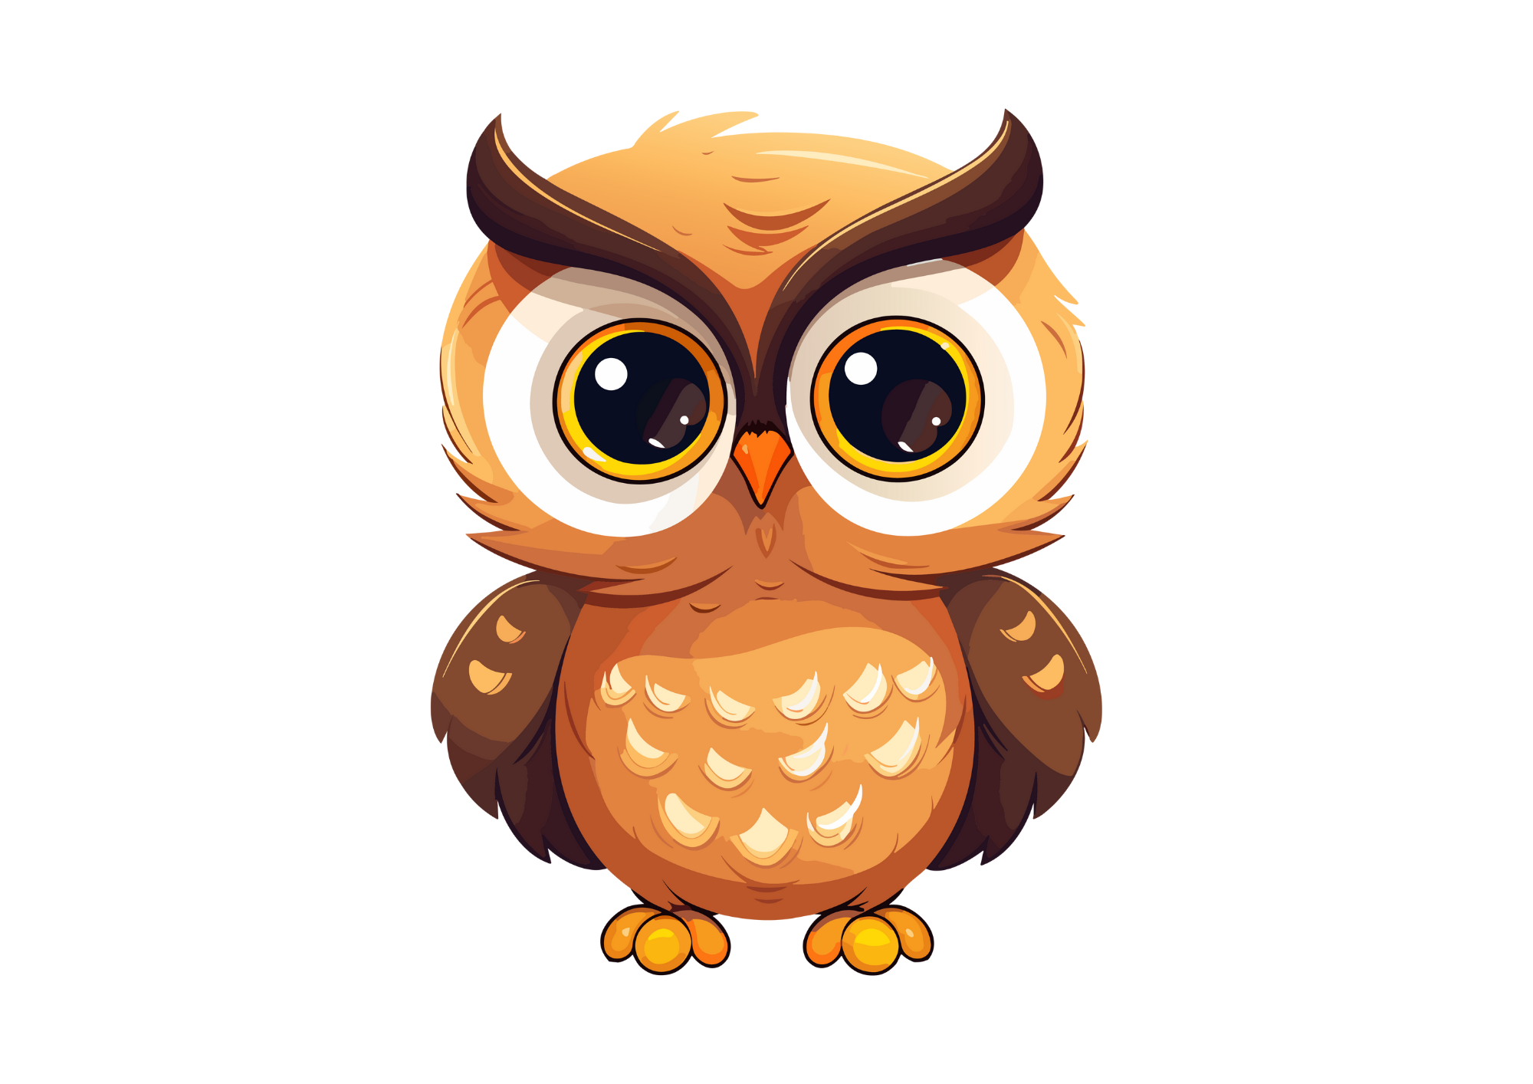

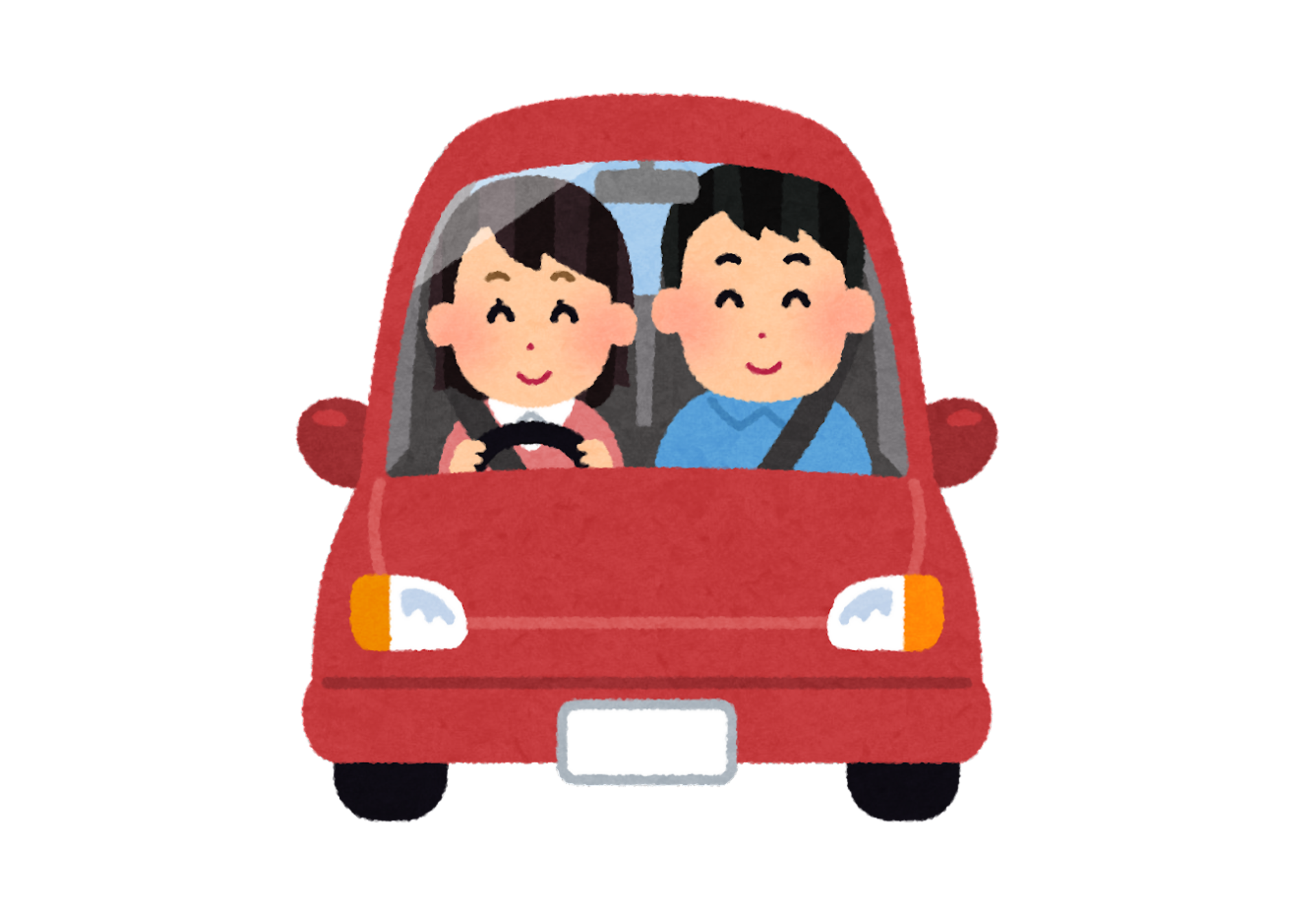
Amazing Adverbs

Slide 2
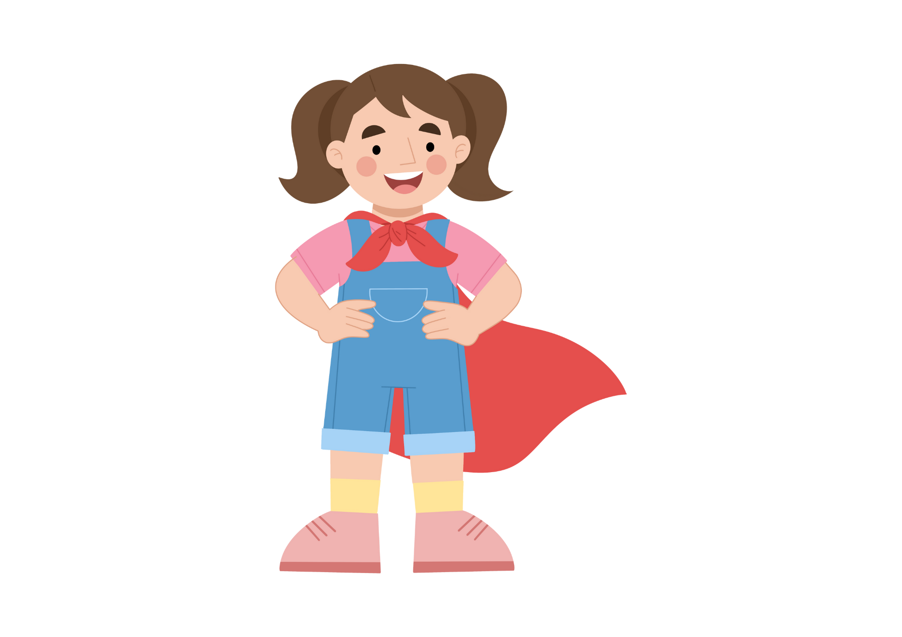

Lesson Objectives
By the end of these lessons, I will be able to:
Define adverb
Give examples of adverbs
Identify adverbs in sentences
Use adverbs to up level sentences

Slide 3
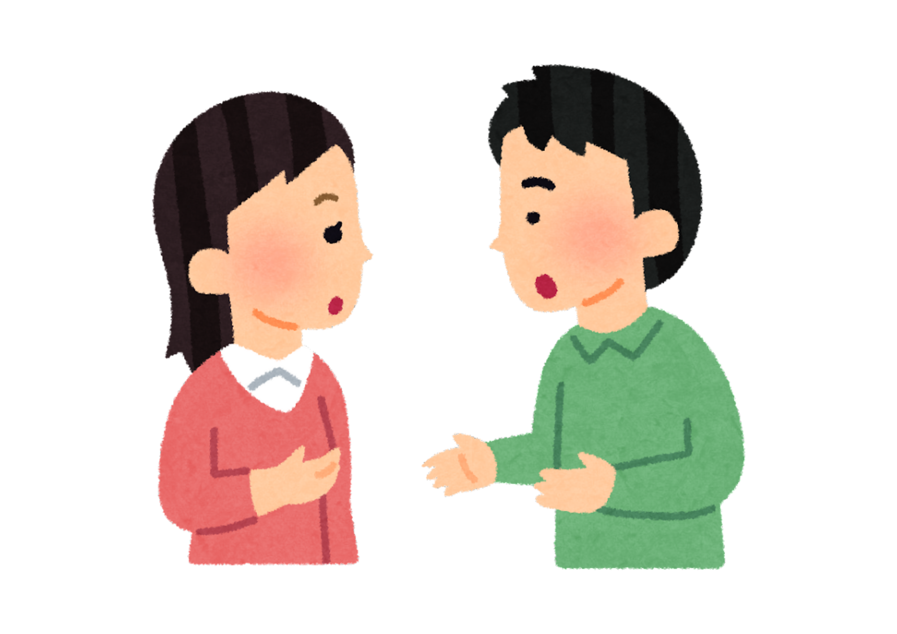
I Do
What are Adverbs?
Adverbs are words that modify verbs, adjectives, or other adverbs in a sentence. They typically provide information about how, when, where, or to what extent something happens. Adverbs can answer questions such as "how?", "when?", "where?", "why?", or "to what extent?".
For example:
She sings beautifully. (modifies the verb "sings")
He speaks slowly. (modifies the verb "speaks")
They arrived yesterday. (modifies the verb "arrived")
She is very intelligent. (modifies the adjective "intelligent")
Adverbs can also appear in different positions within a sentence depending on the emphasis or clarity desired. They can come at the beginning, middle, or end of a sentence.

Slide 4
I Do
Types of Adverbs
Adverbs can be tricky because there are a number of types of adverbs.
Manner | Time | Place | Frequency | Degree | Interrogative | Relative | Conjunctive
Quickly | Yesterday | Here | Always | Very | How | Where | However
Slowly | Now | There | Never | Extremely | When | When | Therefore
Carefully | Soon | Everywhere | Often | Quite | Why | Why | Meanwhile
Nouns
Adverbs of manner: These adverbs describe how an action is performed.
Adverbs of time: These adverbs indicate when an action takes place.
Adverbs of place: These adverbs specify the location or direction of an action.
Adverbs of frequency: These adverbs indicate how often an action occurs.
Adverbs of degree: These adverbs modify the intensity or degree of an action or adjective.
Interrogative adverbs: These adverbs are used to ask questions about manner, time, place, reason, etc.
Relative adverbs: These adverbs introduce relative clauses and show the relationship between the clause and the rest of the sentence.
Conjunctive adverbs: These adverbs connect clauses or sentences and show the relationship between them.

Slide 5
I Do
Adverbs of Manner
Because there are so many types of adverbs, let’s focus on adverbs of manner this week. These types of adverbs are the best for up levelling writing!
Adverbs of manner often end in –ly
They’re great for up levelling your writing
Try not to overuse them – it can make your writing clunky
Gracefully
Carefully
Beautifully
Slowly
Happily
Calmly
Loudly
Courageously
Easily
Quickly
Sadly
Quietly
Roughly

Slide 6

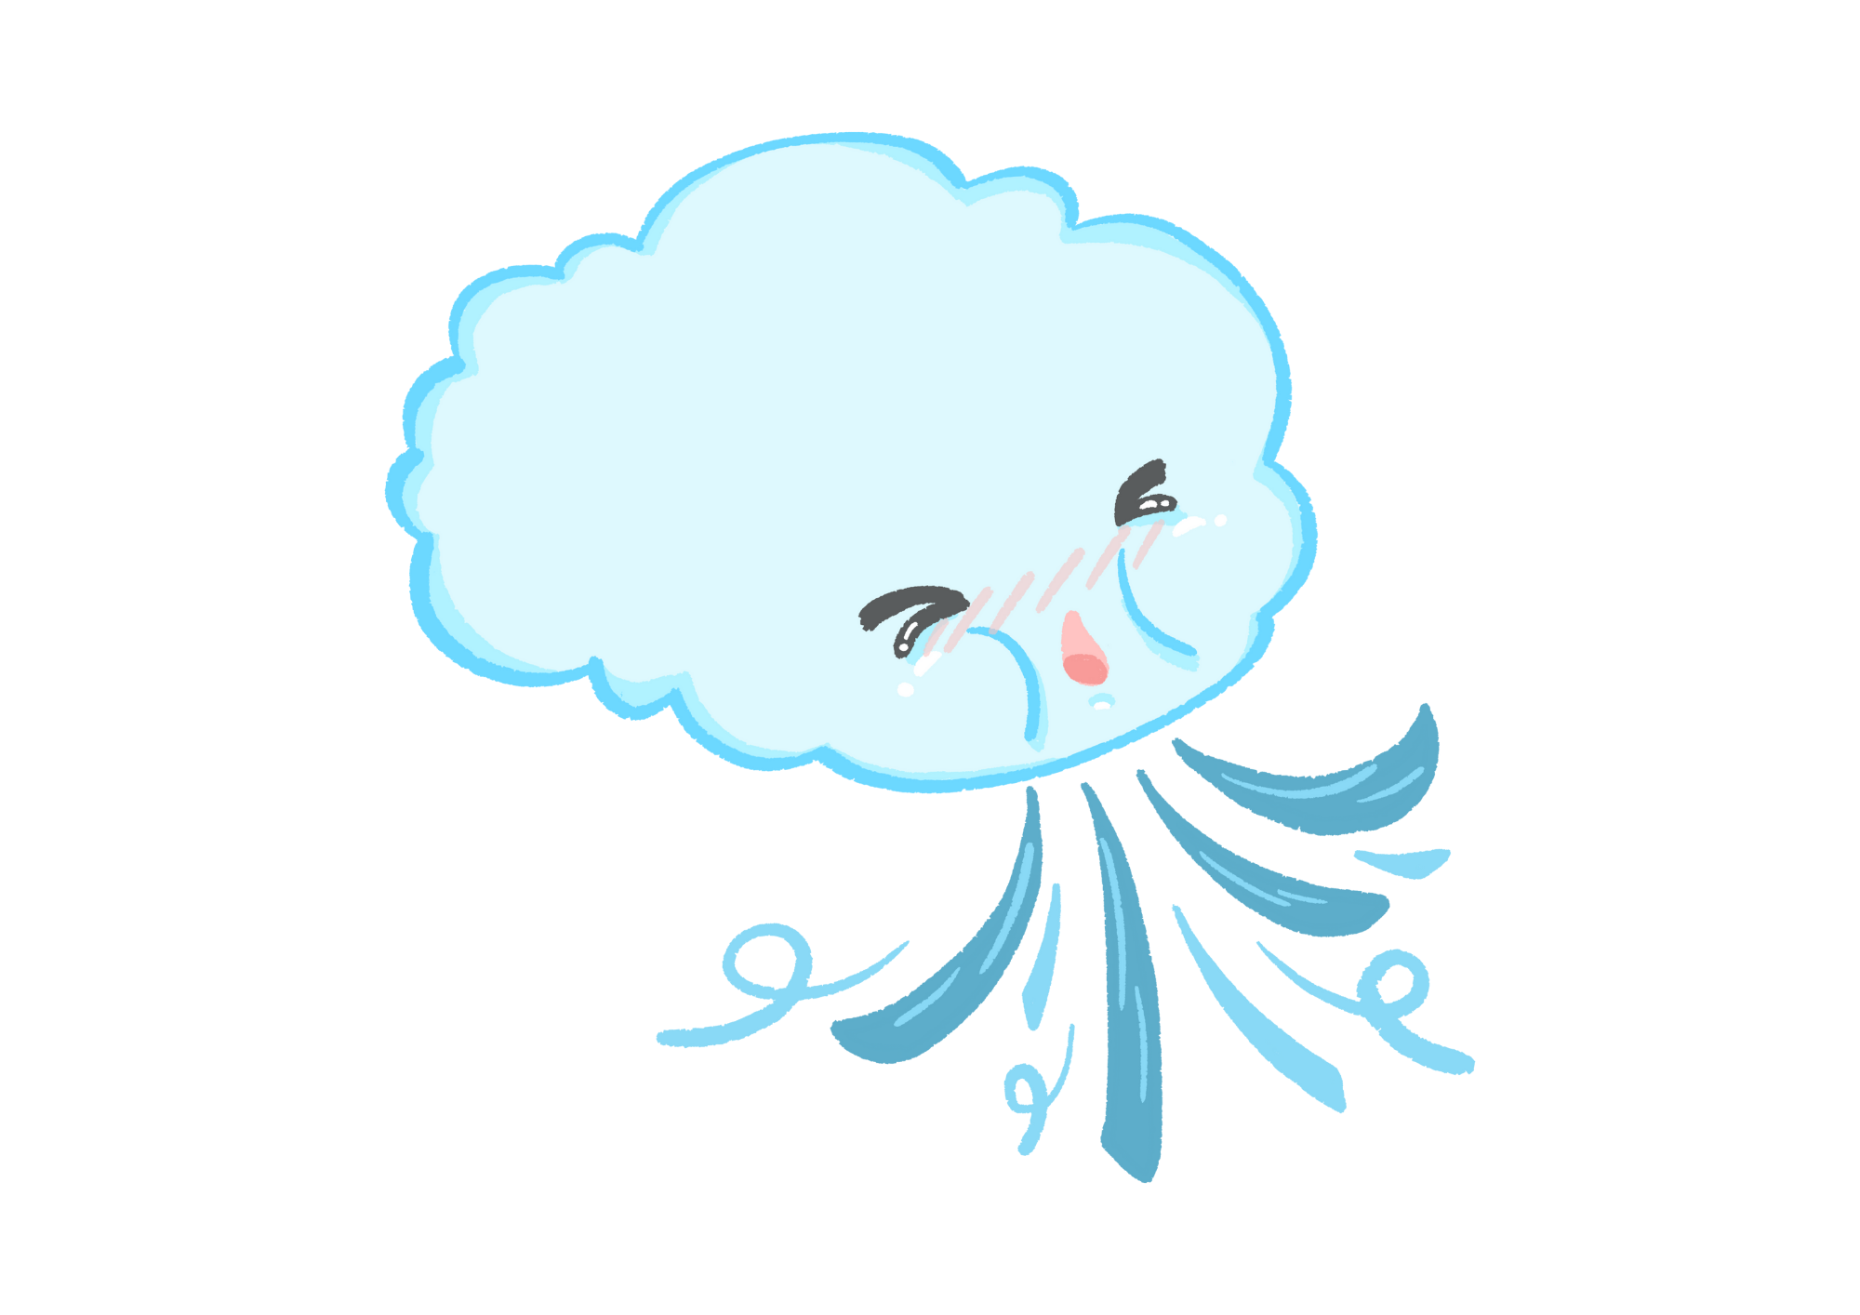

I Do
Adverbs
Circle the adverbs in each sentence.
She danced gracefully across the stage, captivating the audience.
He typed quickly on his keyboard, finishing the report in record time.
The children giggled happily as they played in the park.
The chef sliced the vegetables carefully.
The wind blew fiercely, rattling the windows and sending leaves swirling through the air.

Slide 7
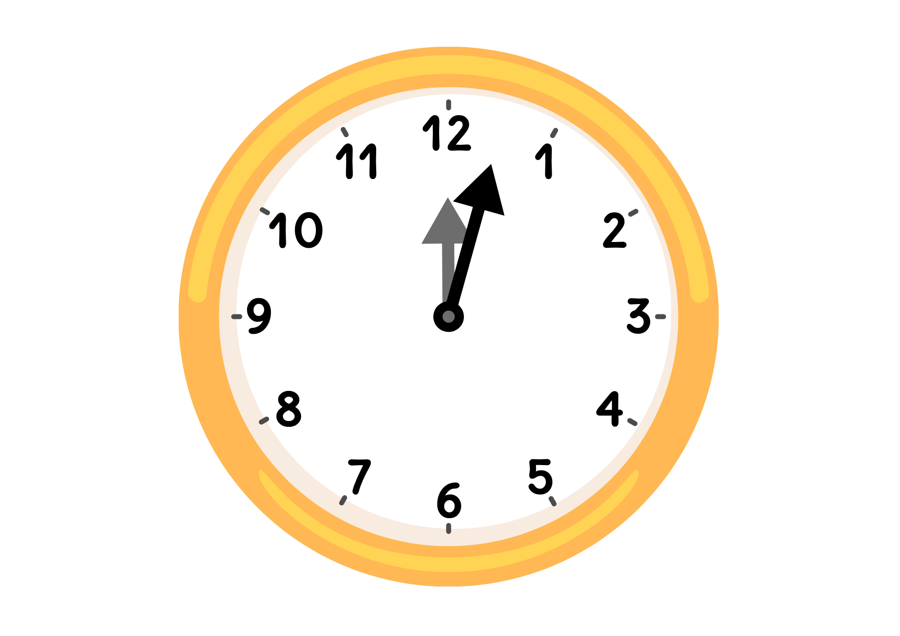
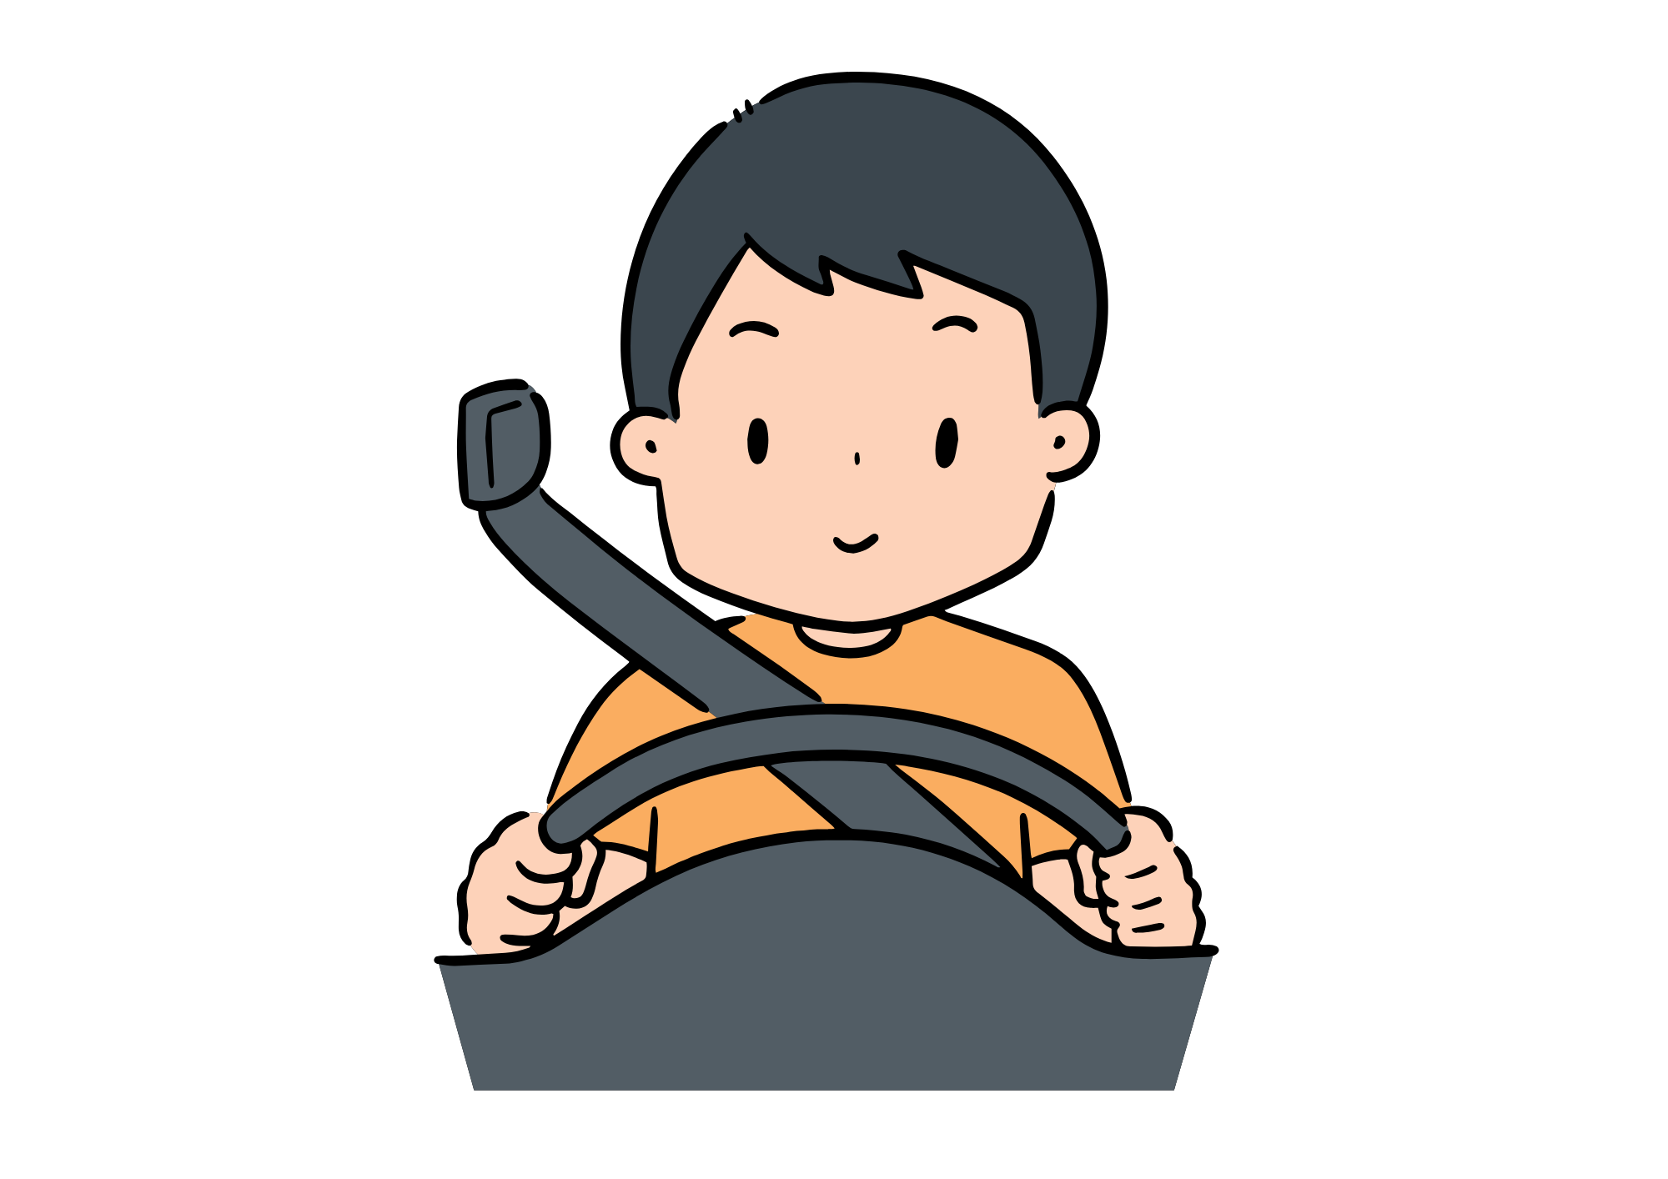
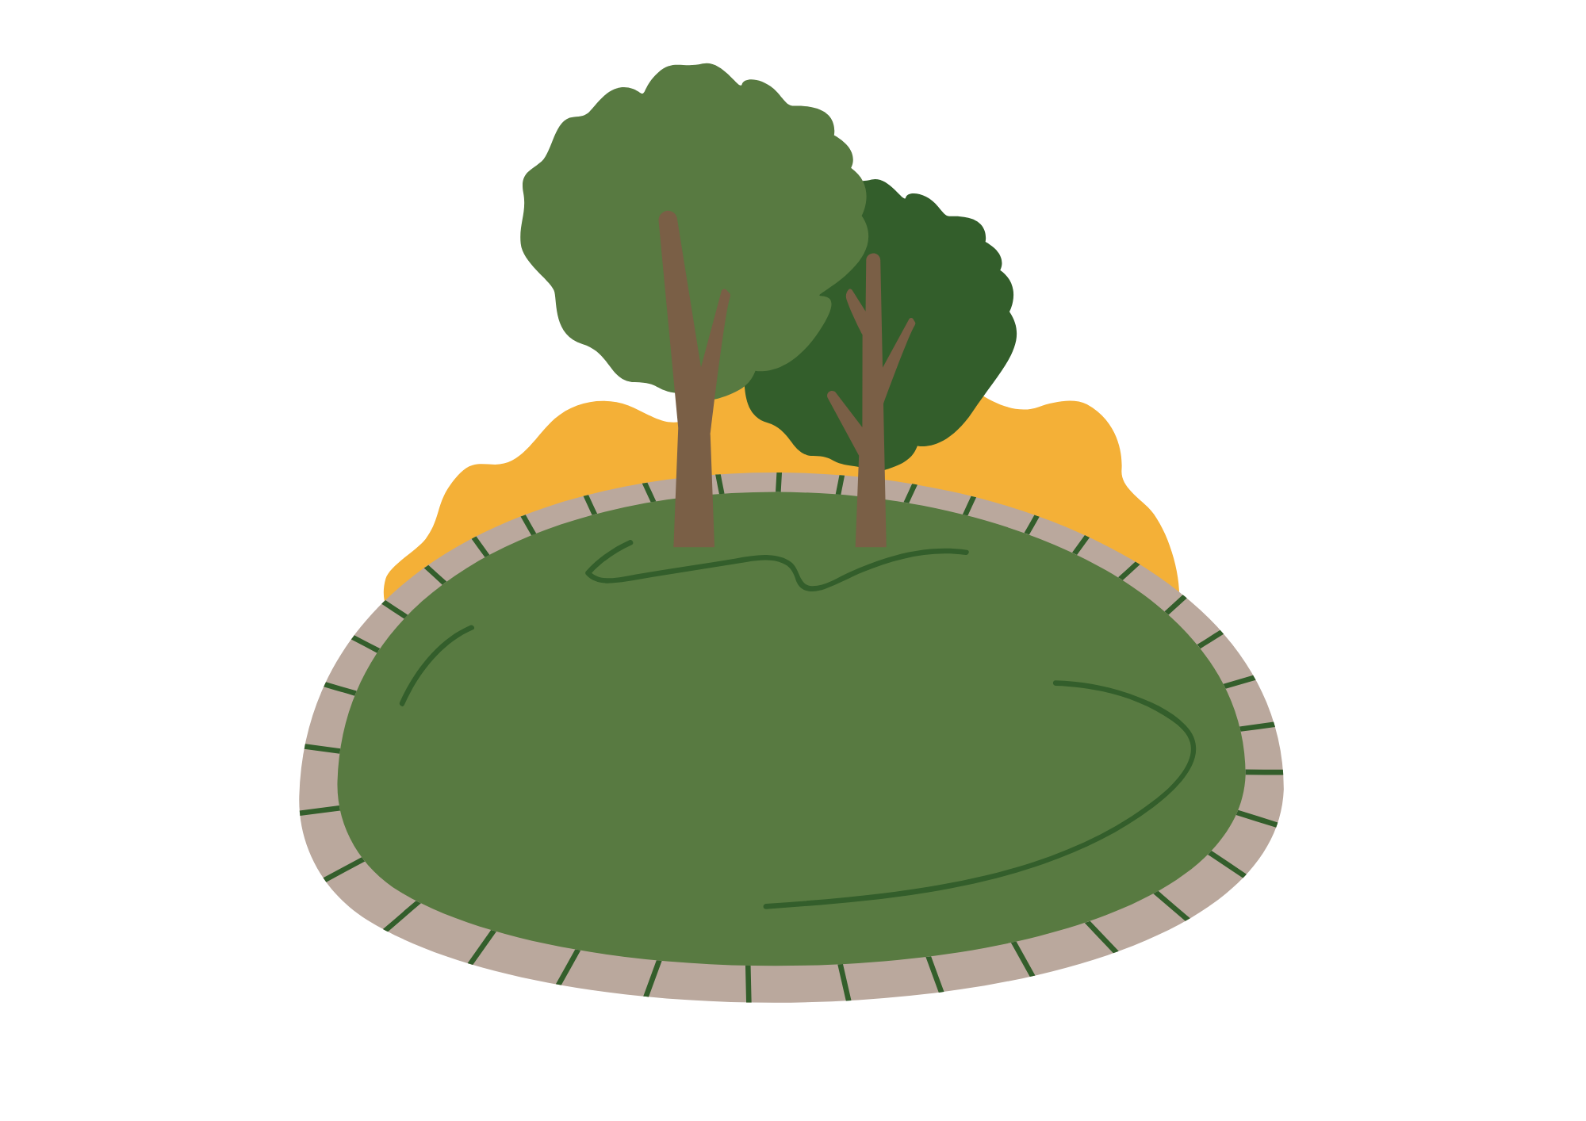
We Do
Monday
Adverbs
Circle the adverbs in each sentence.
She sang passionately, mesmerizing the audience.
He drove carefully and patiently through the dense fog.
Slowly, the clock ticked in the kitchen.
The team worked efficiently to complete the project.
She walked around the park quietly.

Slide 8
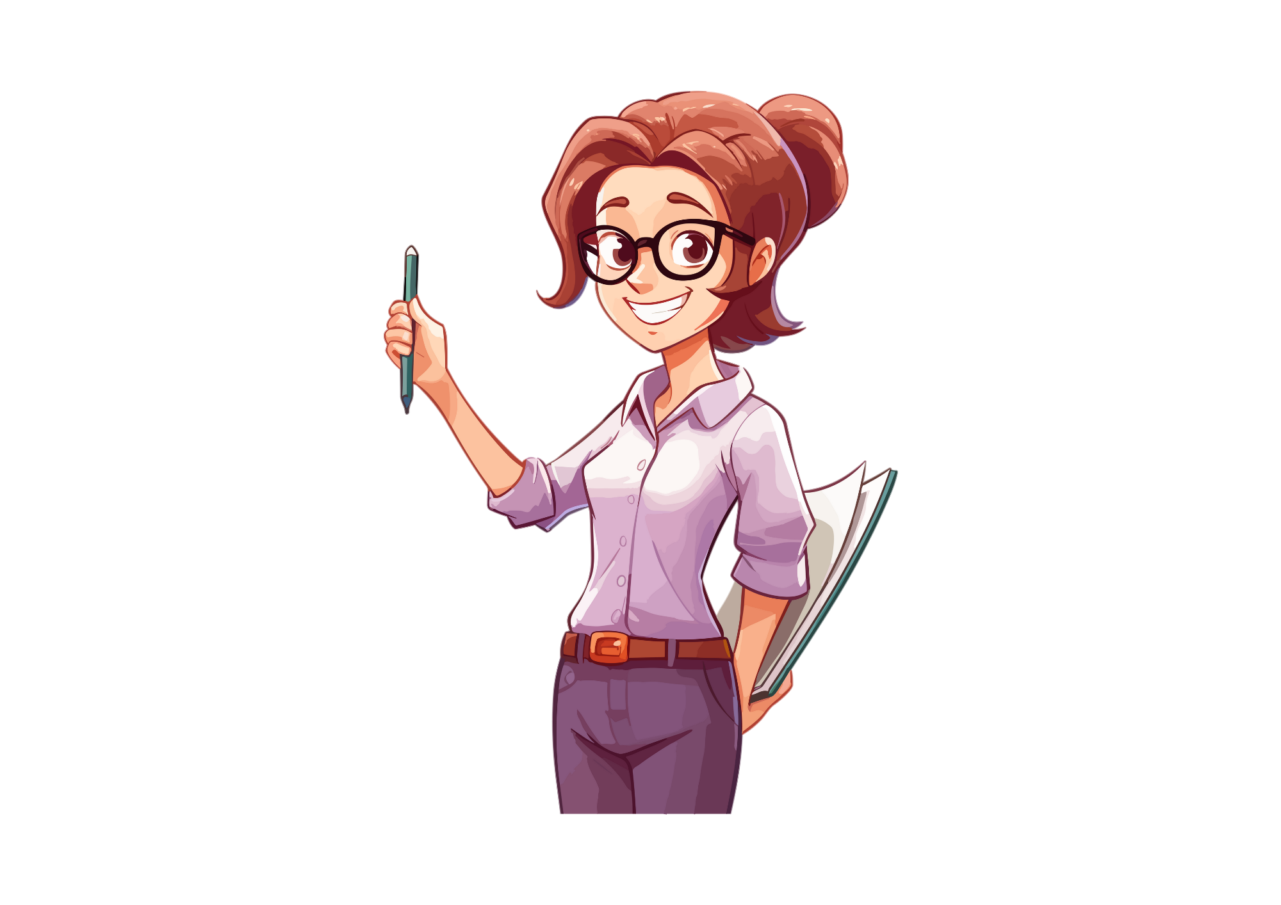
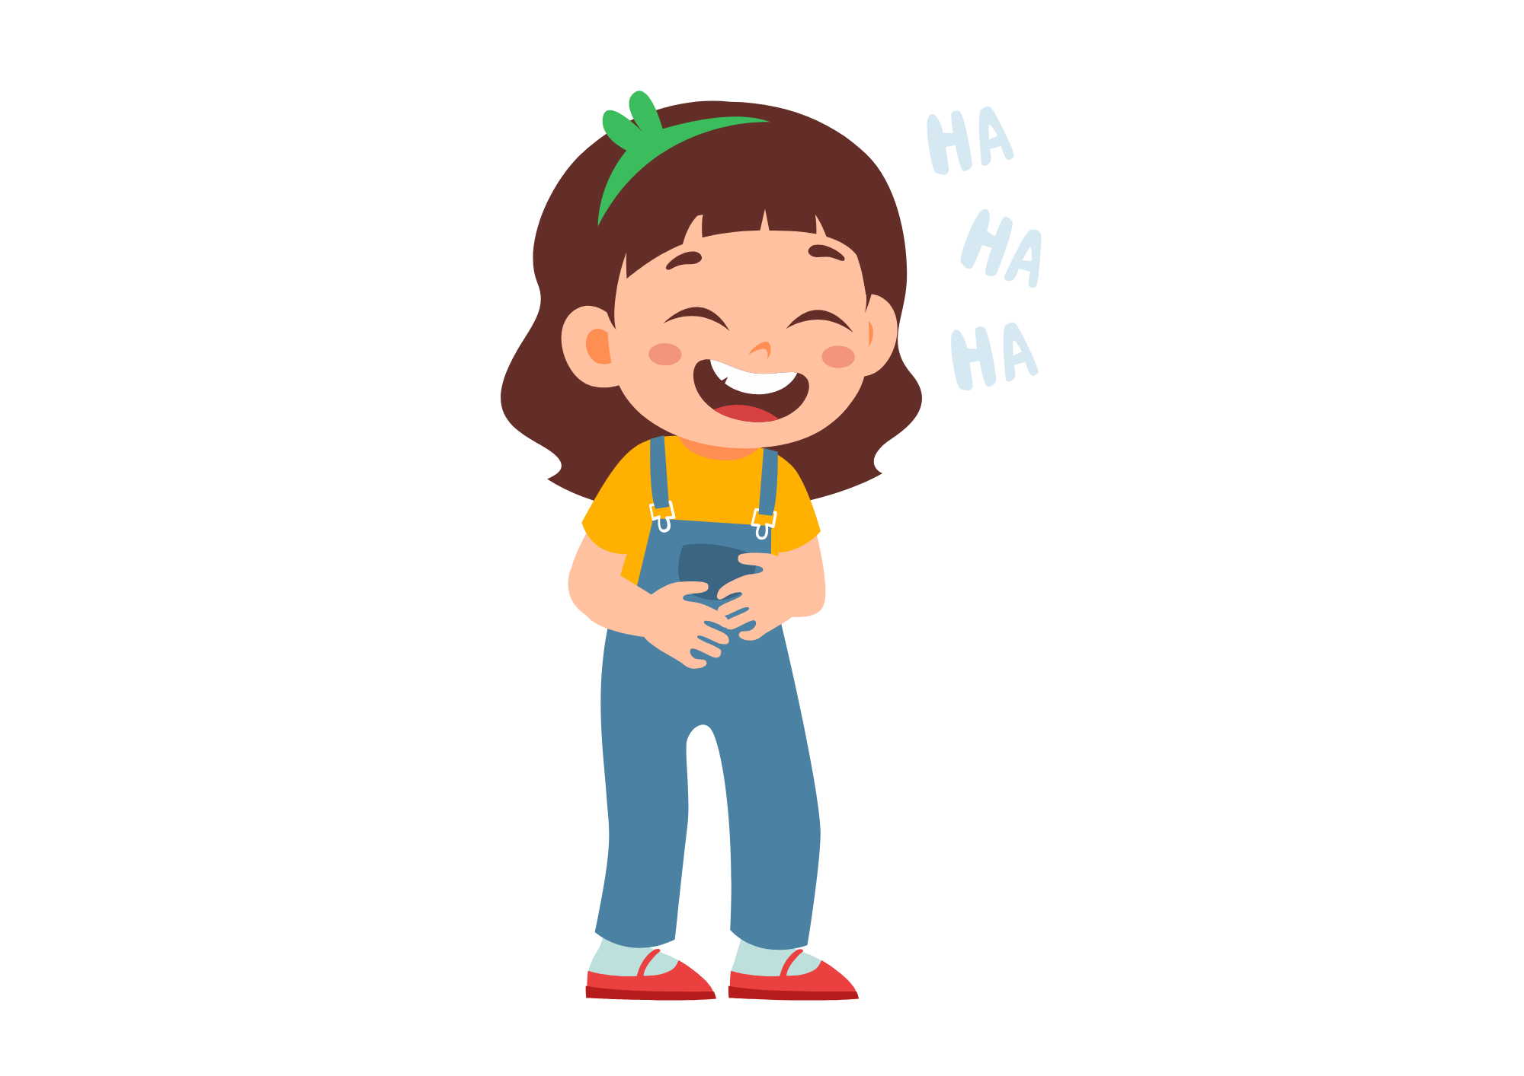

You Do
Monday
Adverbs
Circle the adverbs in each sentence.
She spoke softly and gently to the class.
He ran gracefully across the finish line.
Attentively, the students listened to the teacher.
The bird chirped cheerfully and merrily
They laughed happily but quietly in the library.

Slide 9
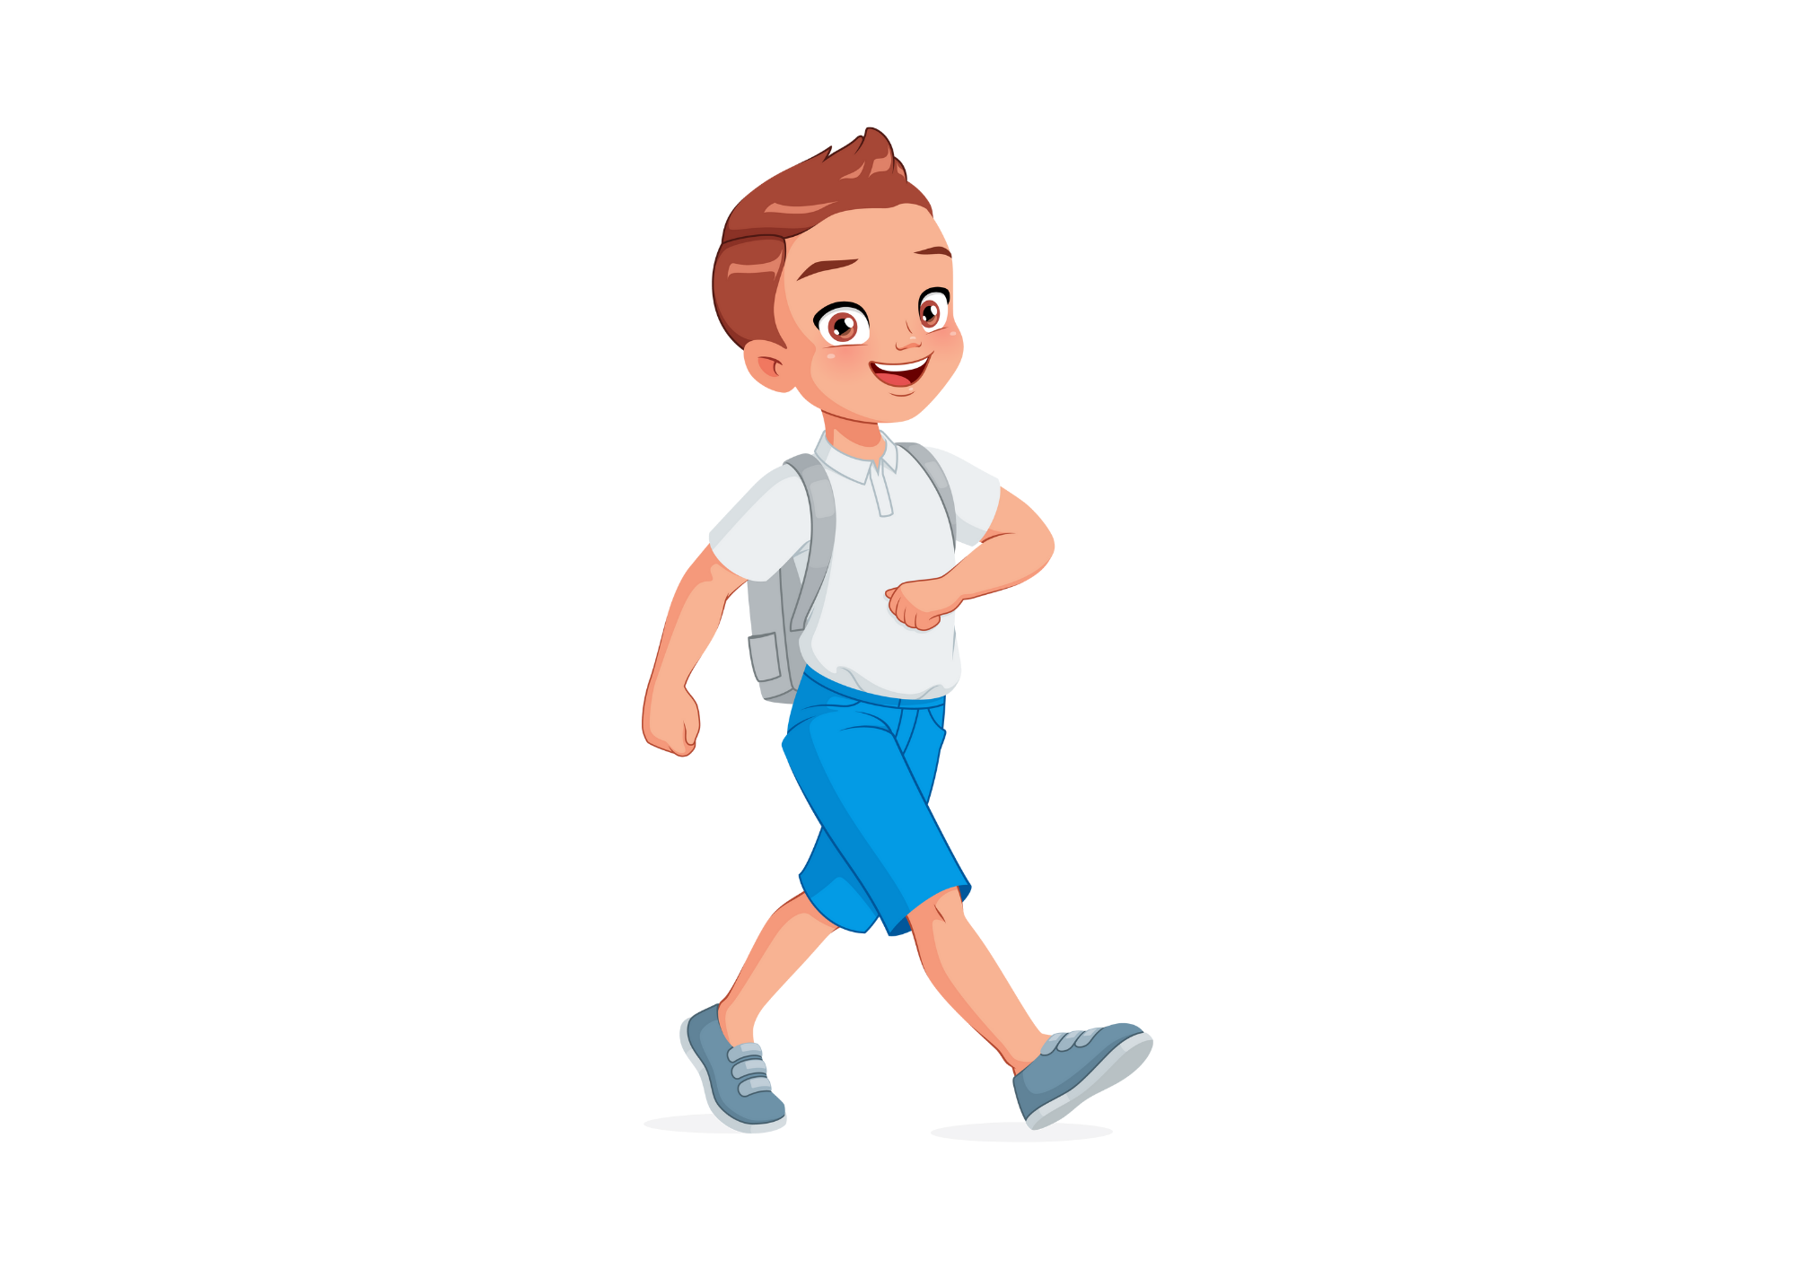

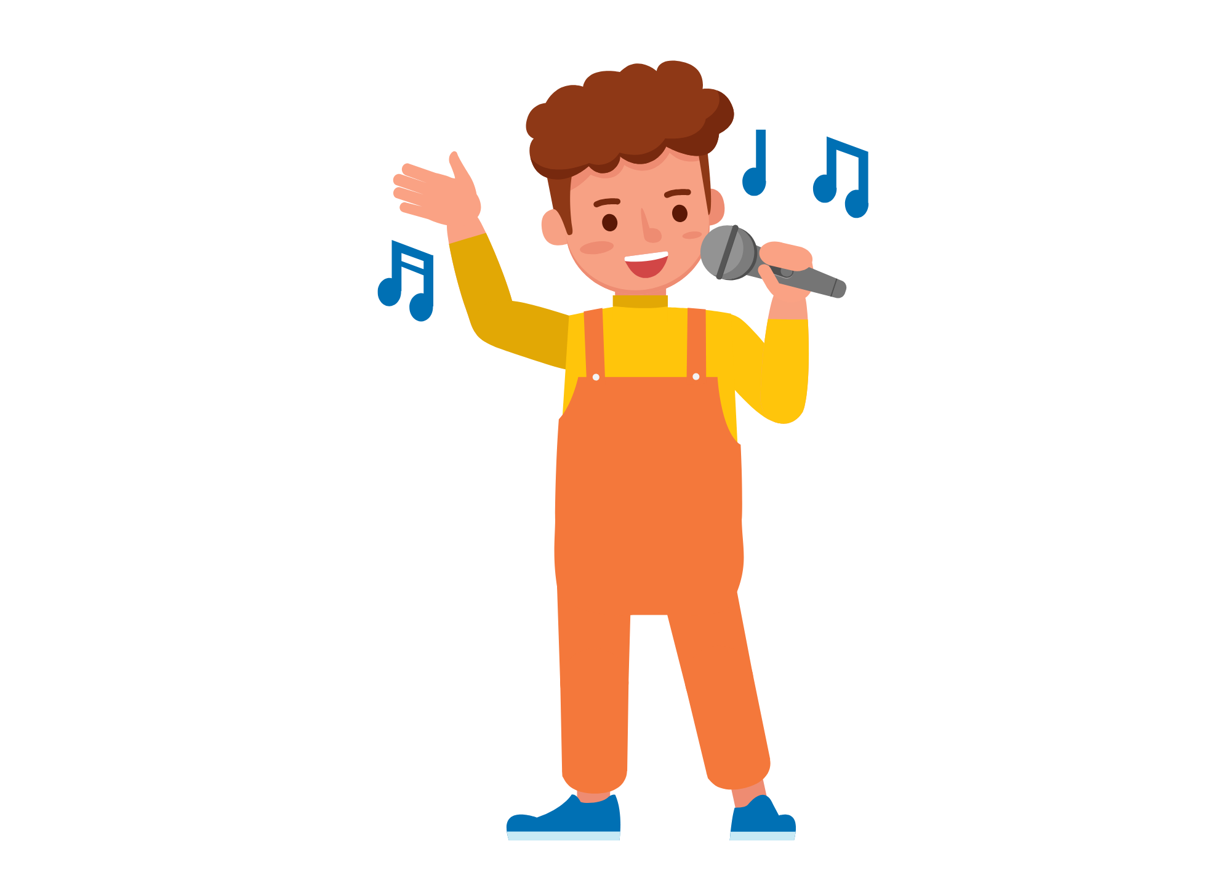
We Do
Tuesday
Adverbs
Work with a partner to complete the sentences with adverbs.
She sang ________ at the concert last night.
________, he walked down the street, enjoying the warm breeze.
They danced ________ across the ballroom floor.
The cat purred ________ as it curled up in the sunbeam.
________ , the chef chopped the vegetables.

Slide 10
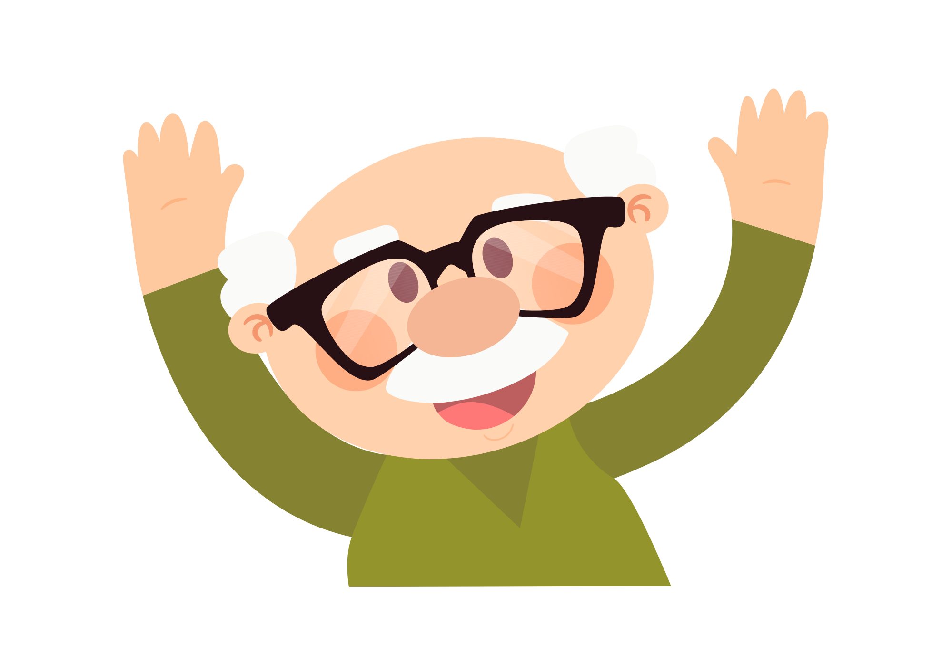
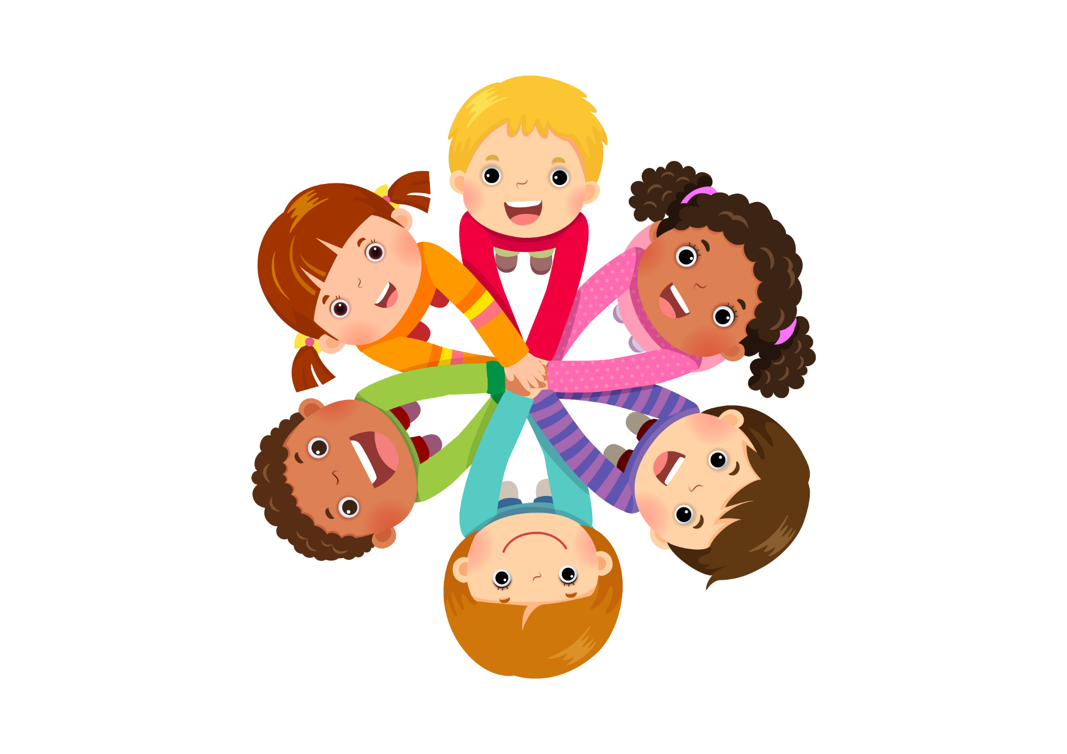
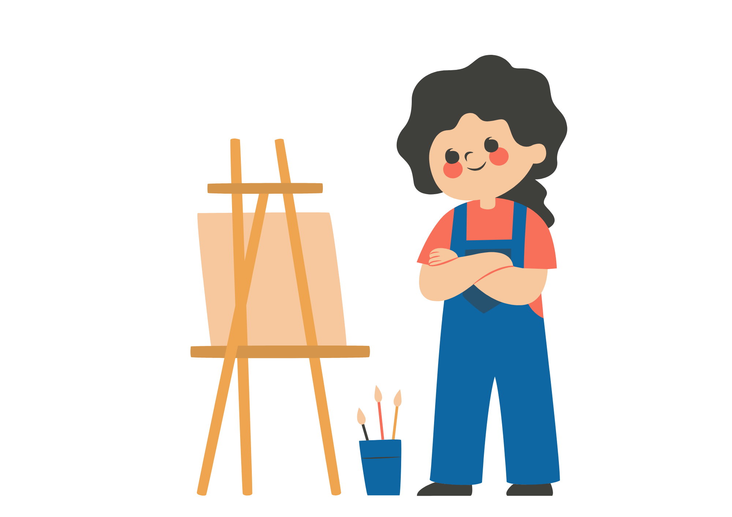
You Do
Tuesday
Adverbs
Write these sentences in your book and add adverbs.
The children played ________ in the park until sunset.
________ , the old man walked along the icy sidewalk.
She spoke ________ during the presentation.
The athlete ran ________ towards the finish line.
________ , the artist painted the portrait.

Slide 11
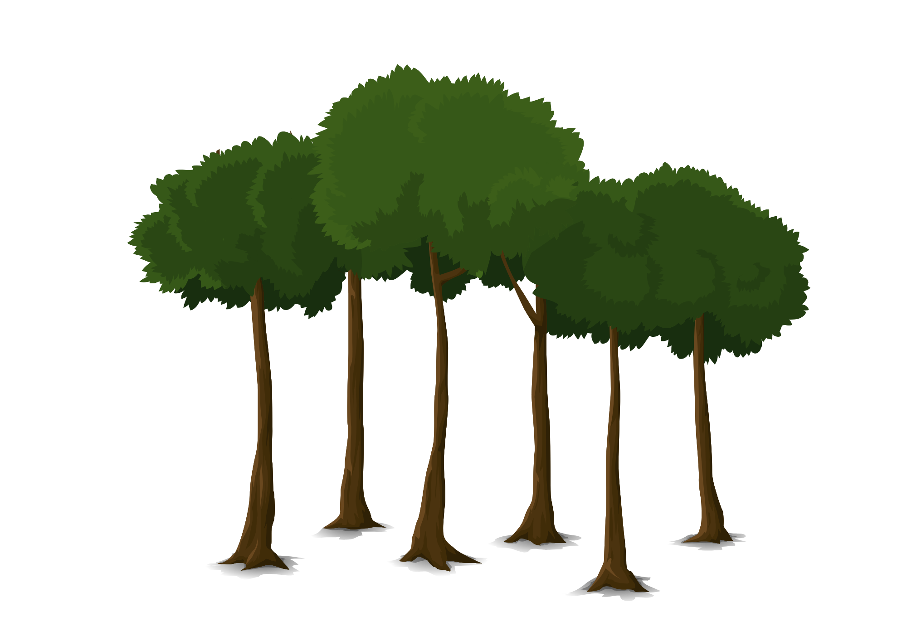
I Do
Wednesday
Adverbs
Here are some different ways to use adverbs.
At the start – Quietly, Peter made his way through the woods.
Before the verb – Peter quietly made his way through the woods.
At the end – Peter made his way through the woods quietly.

Slide 12
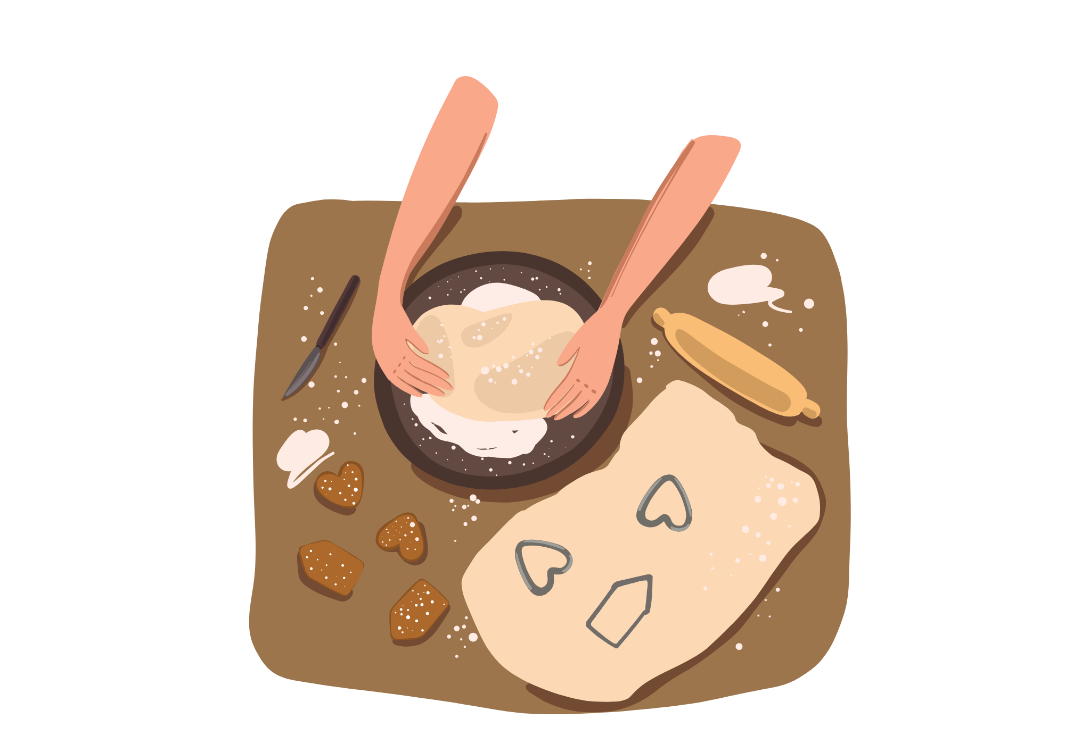
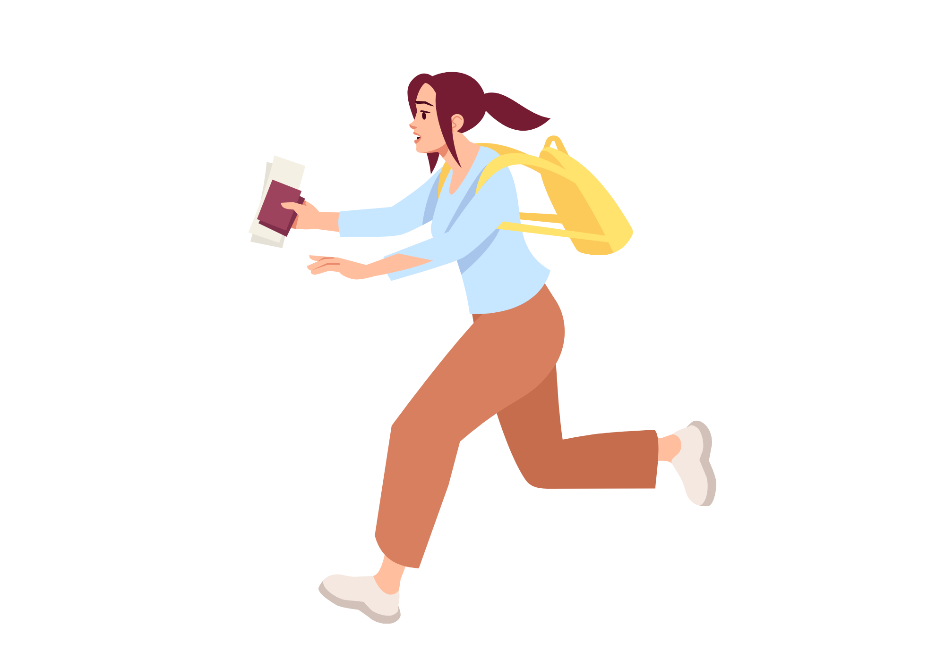

We Do
Wednesday
Adverbs
These sentences are too basic. With a partner, up level them with adverbs.
The cat walked along the river.
She ran to school because she was late.
John’s new teacher shouted the class.
Their dad painted a picture.
Mary cooked a cake.

Slide 13
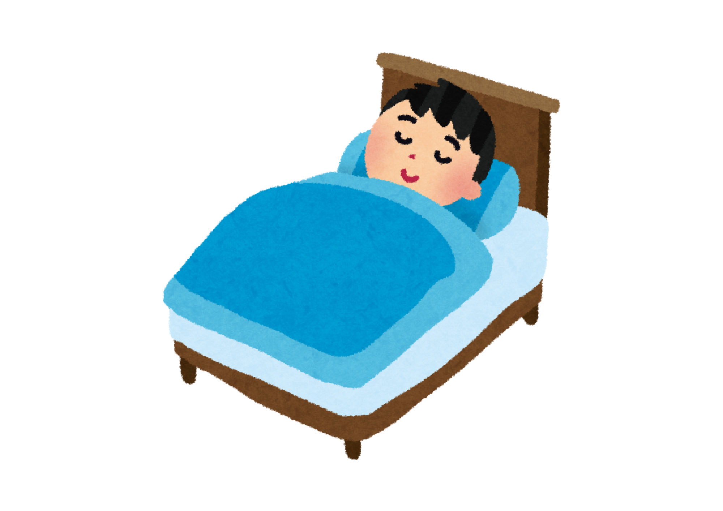

You Do
Wednesday
Adverbs
Up level these sentences with adverbs in your book. Circle your adverbs.
Peter drank his drink in the library.
They did their shopping at the supermarket.
Max walked through the dark forest.
She drove to the garden on the other side of town.
He slept in the bunk bed.

Slide 14


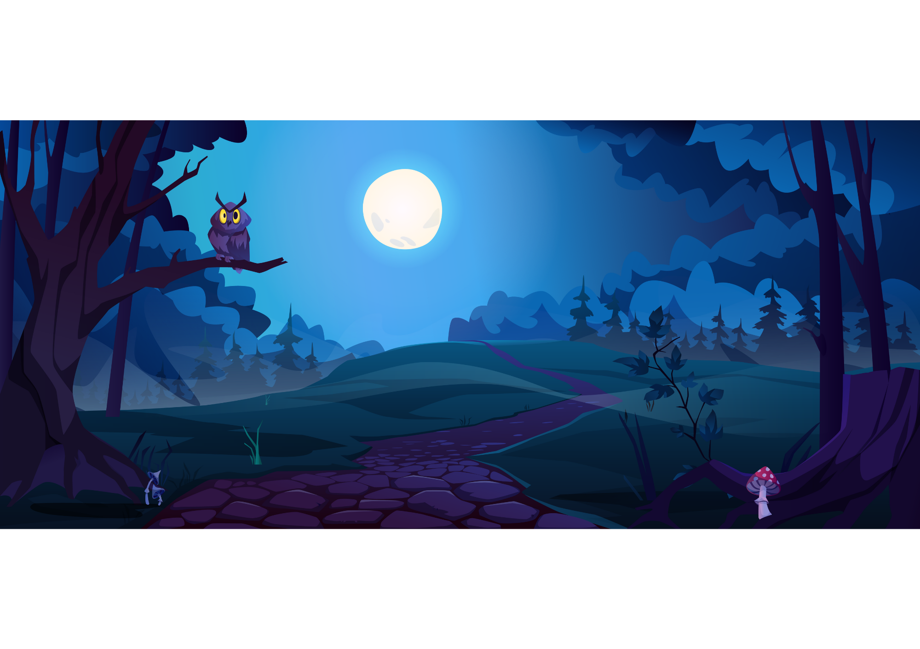
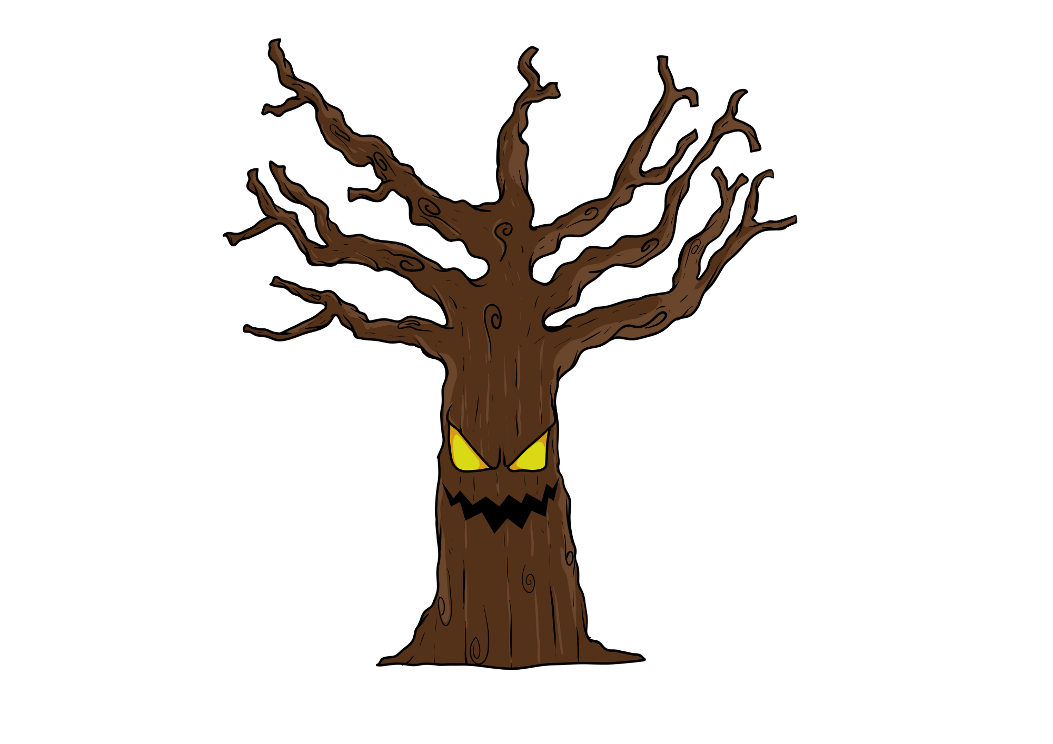
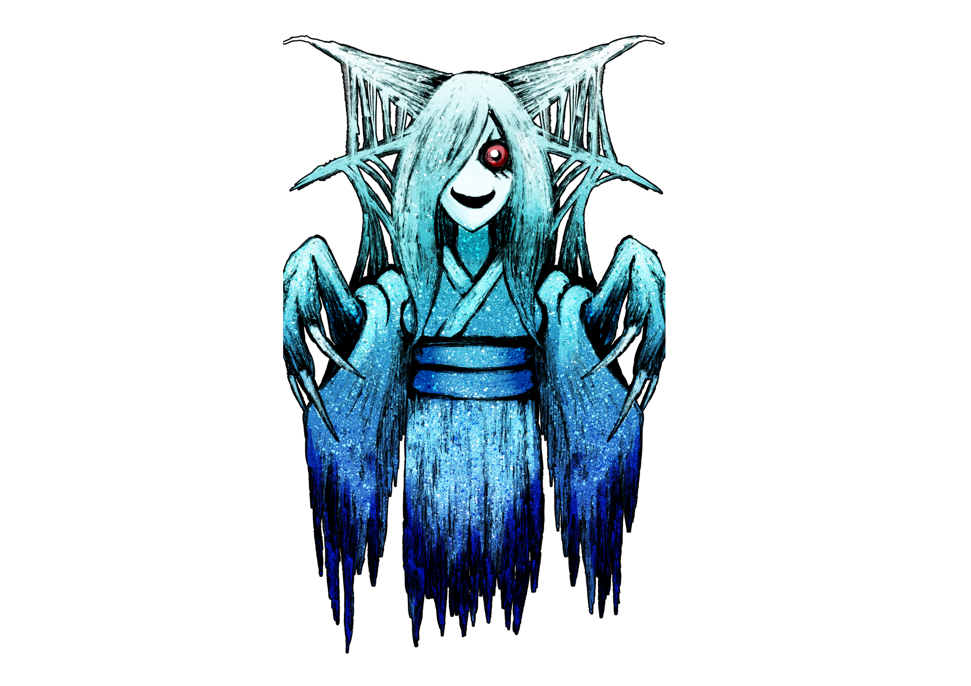
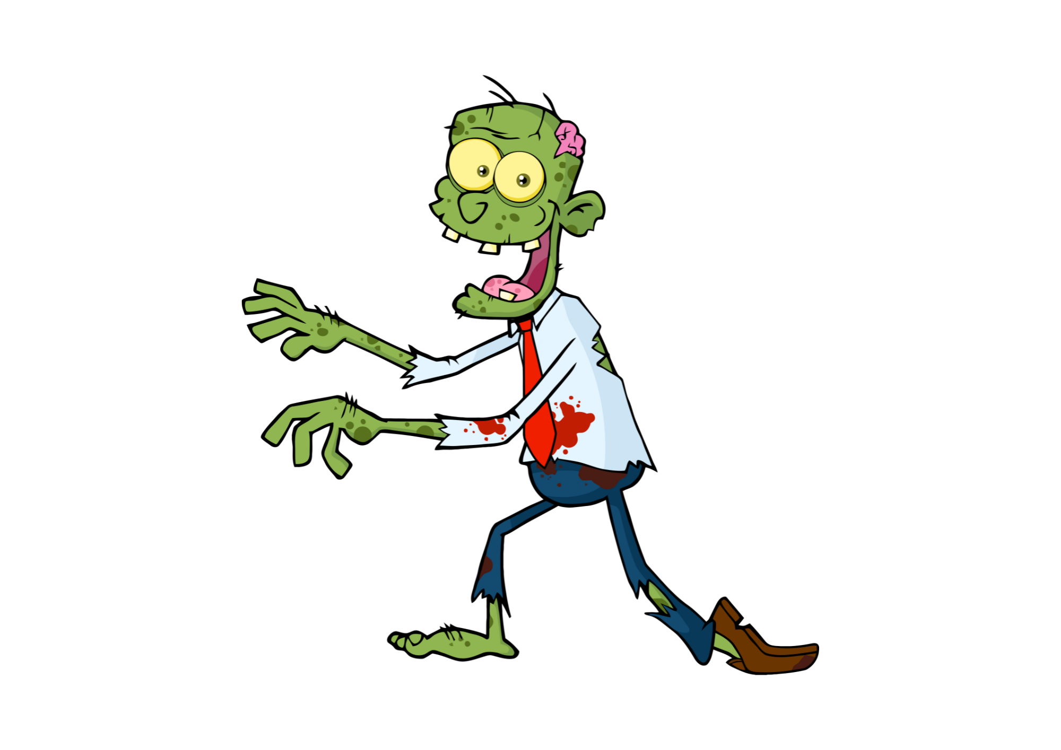
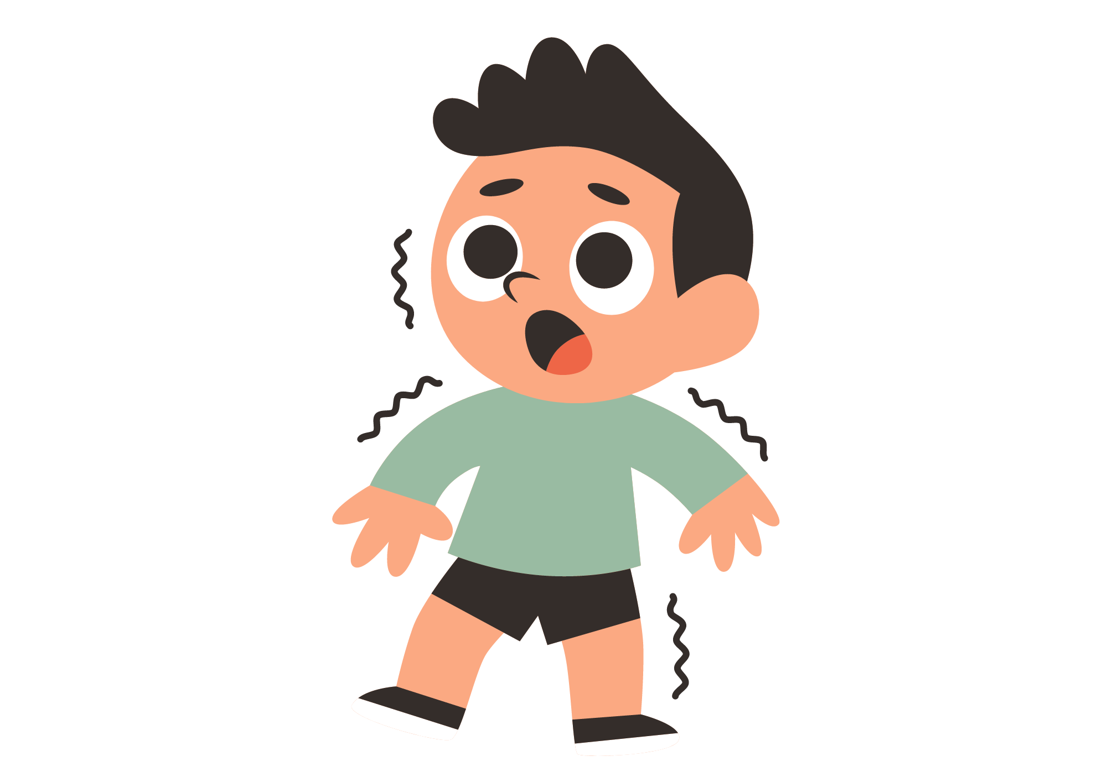
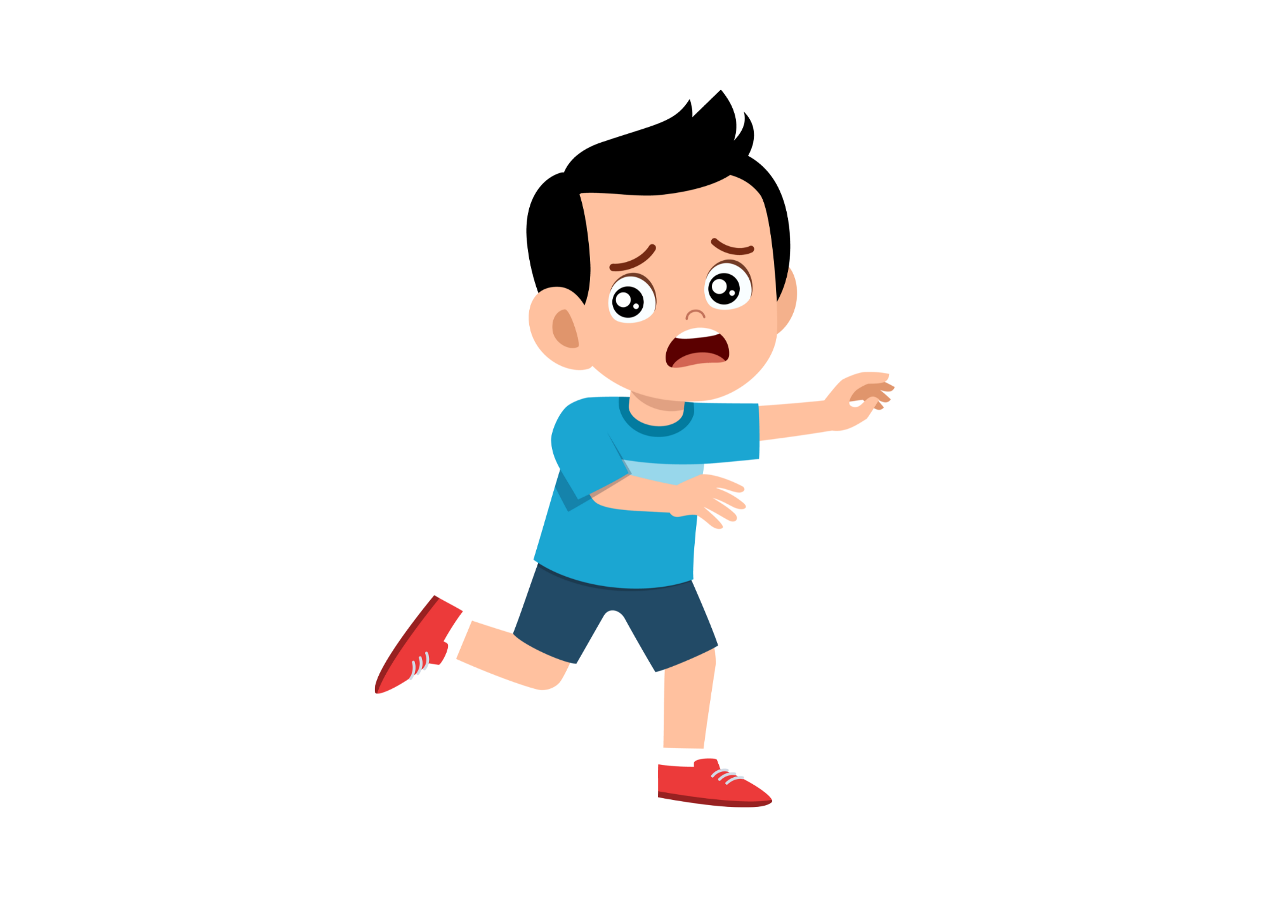


Adverb Comic
Create a comic strip using adverbs. Add an adverb in each part of the story.
Sam walked cautiously through the gloomy woods. | He listened carefully for “monsters”. | Foolishly, Sam stopped in front of a large tree.
A green zombie silently appeared. | Sam Fearfully backed away. | Then quickly ran home…

