Slide 1

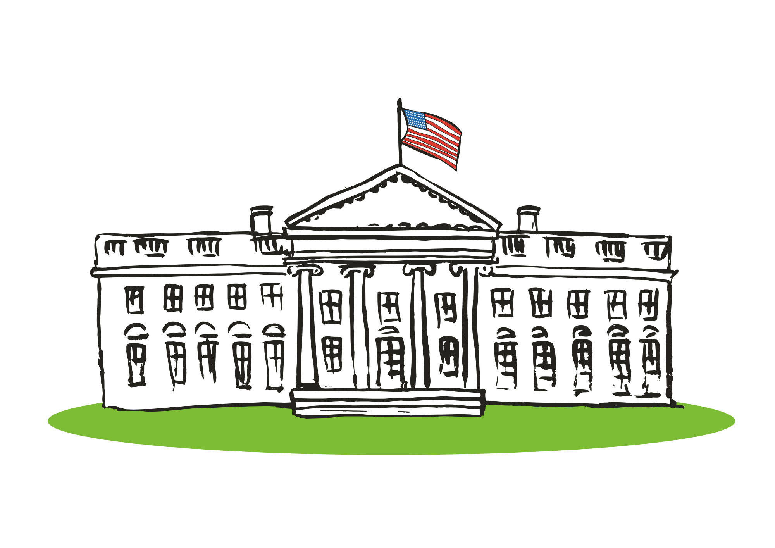
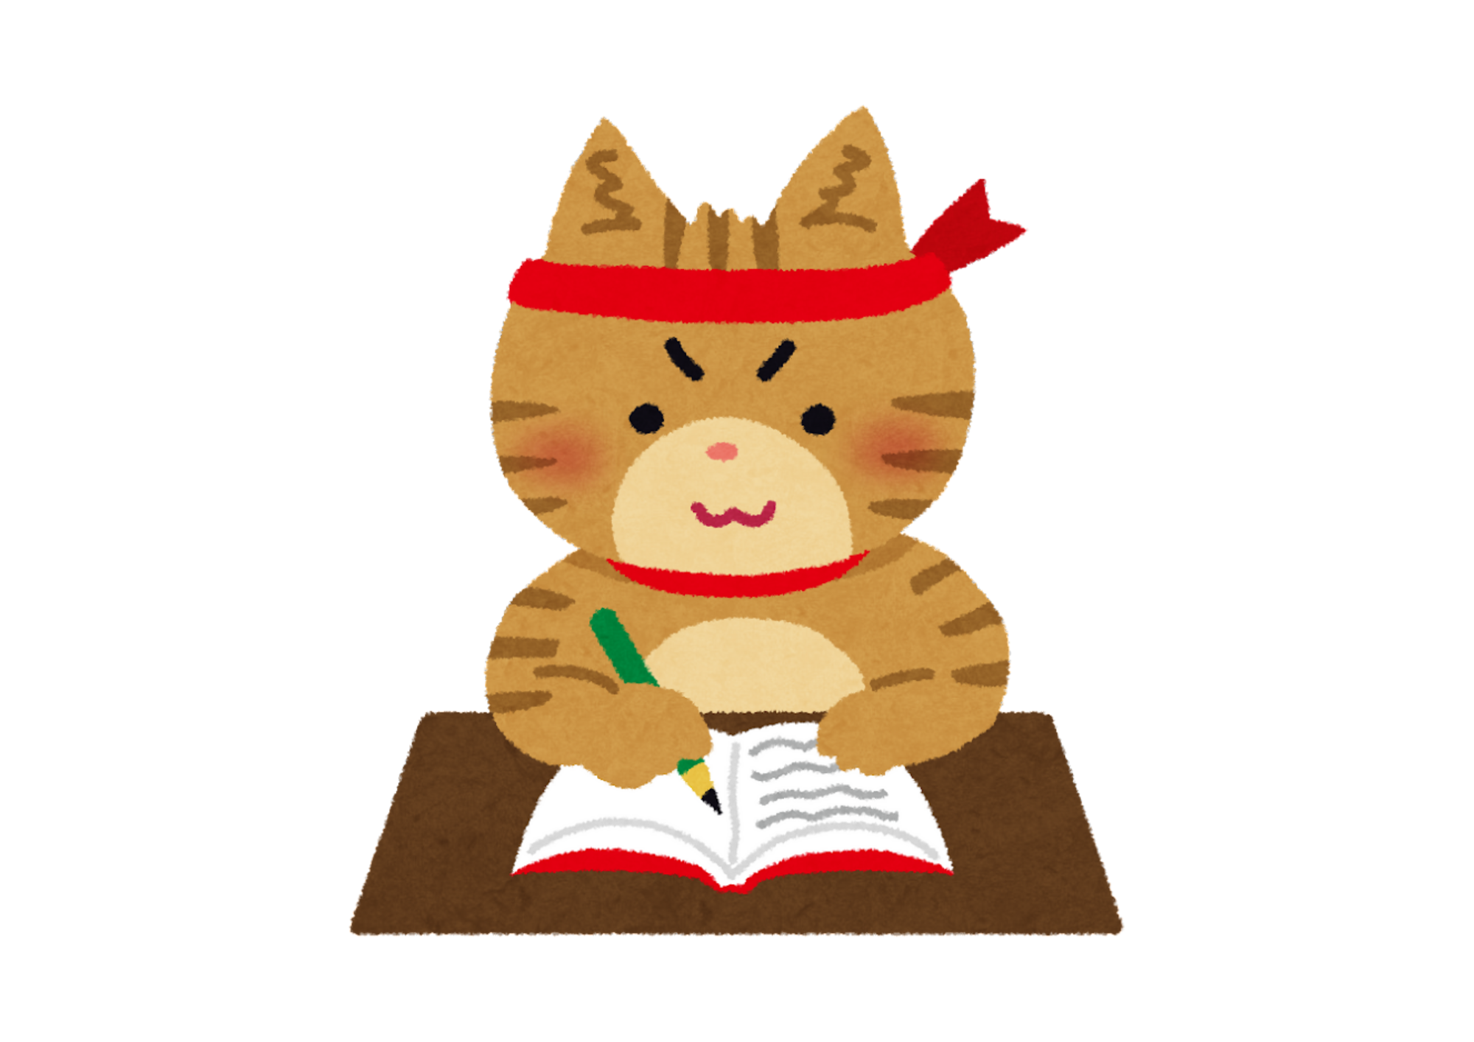
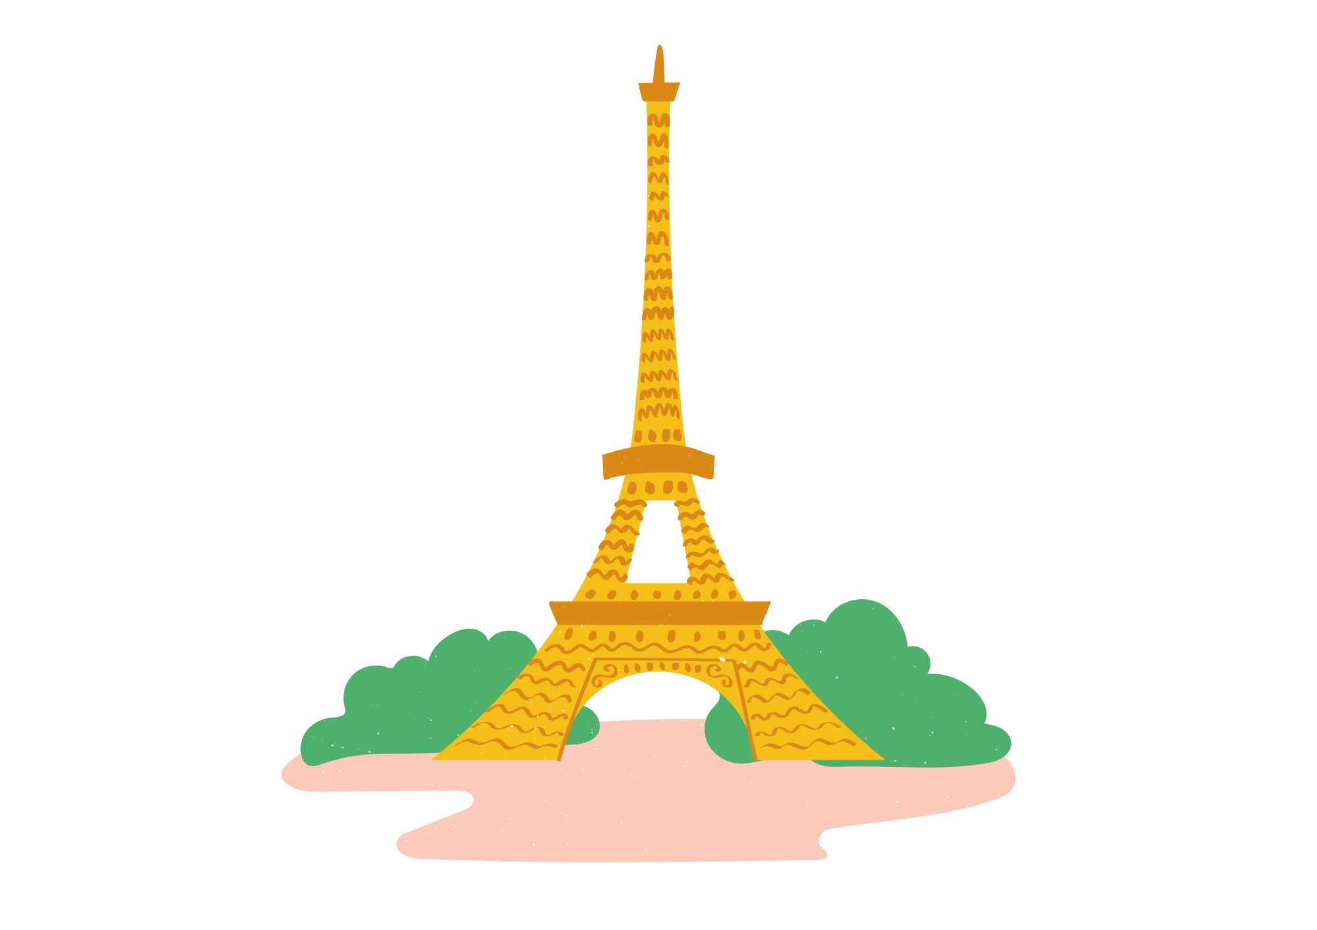
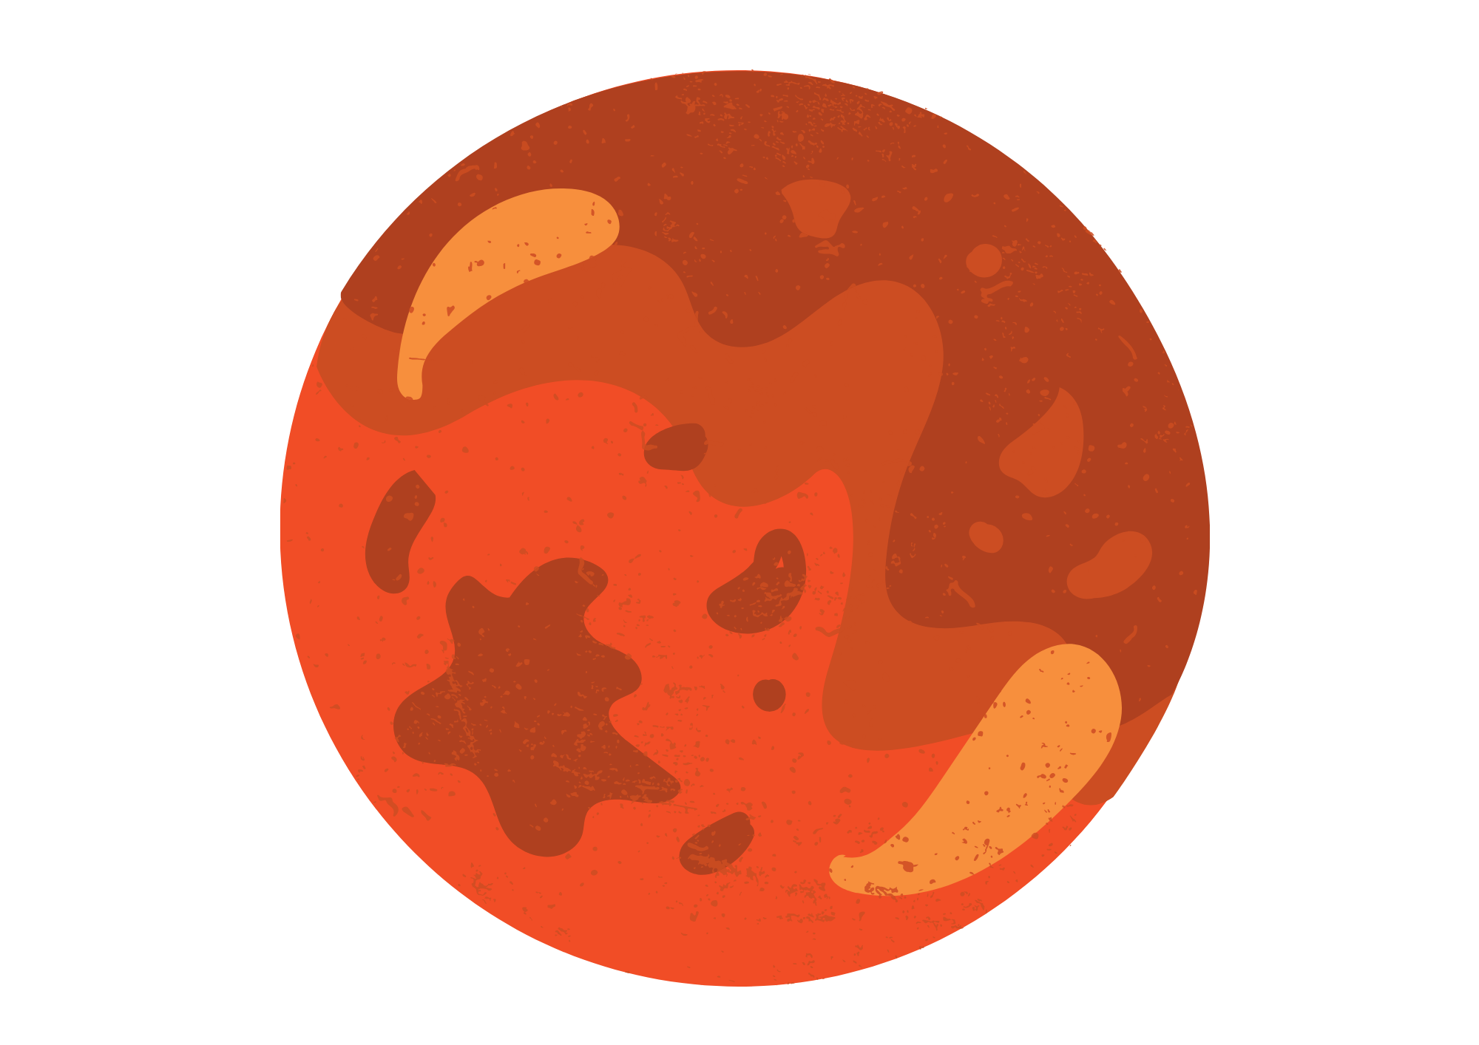
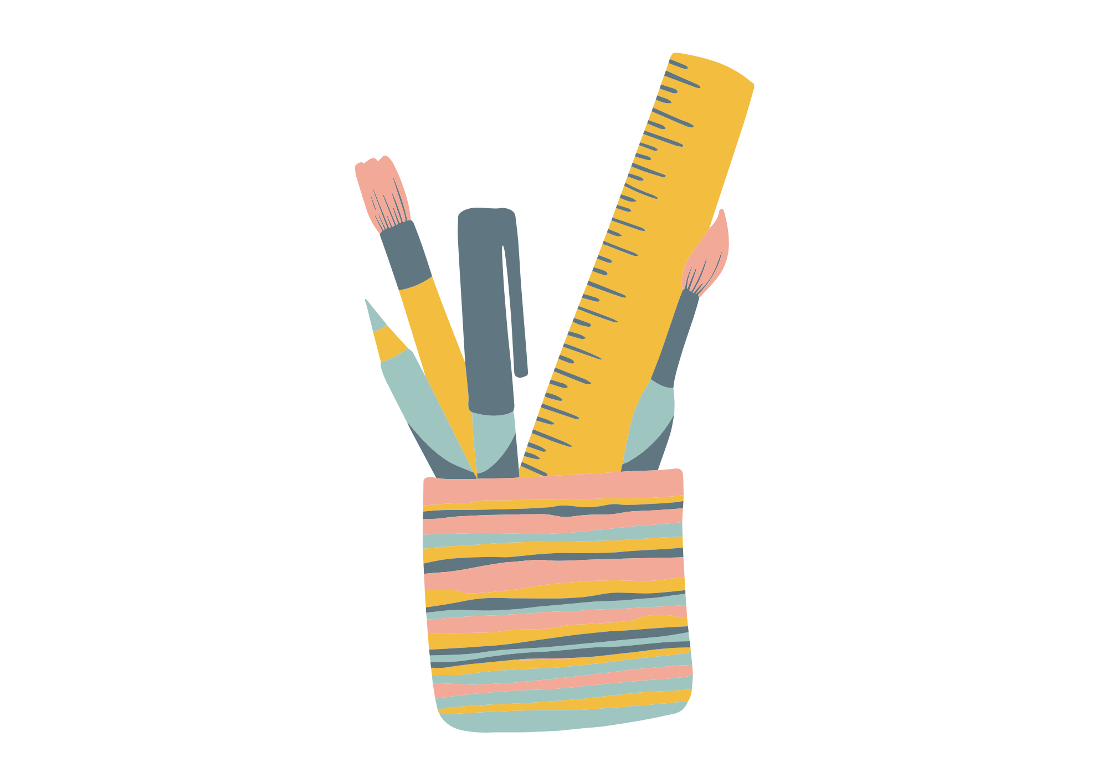

Capitalisation of Proper Nouns

Slide 2
Lesson Objectives
By the end of these lessons, I will be able to:
Define proper noun and give examples
Identify proper nouns and add capital letters

Slide 3
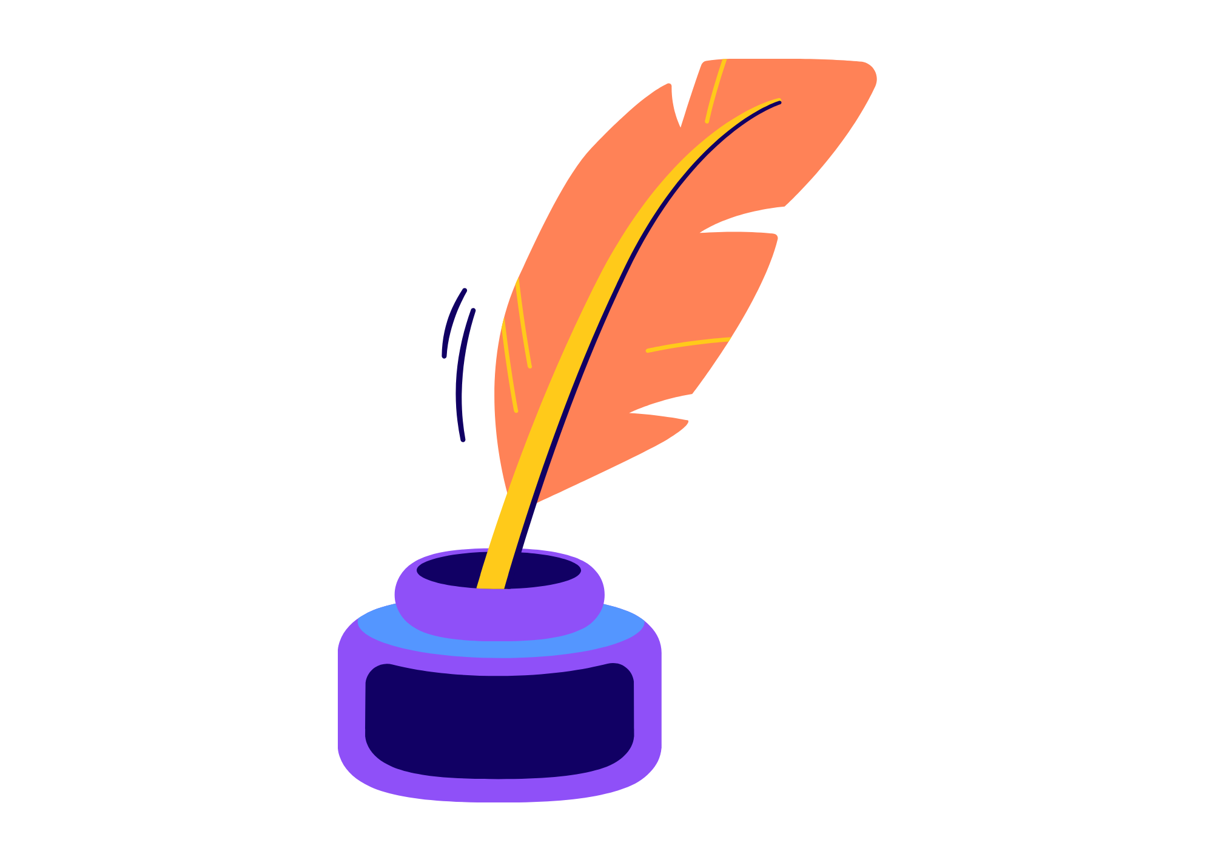
I Do
Proper Nouns
A proper noun is the name of a specific person, place, or thing. Unlike common nouns, which refer to general items, proper nouns are capitalized because they refer to unique entities.
Examples of proper nouns include…
Names of people (e.g., John, Mary)
Names of places (e.g., New York, Paris)
Names of organizations (e.g., NASA, Red Cross)
Titles of books, movies, or songs (e.g., Harry Potter, The Lion King).

Slide 4


I Do
Proper Nouns Tips
Proper nouns have to be specific.
Examples…
mountain Mount Everest
river Nile River
A white house The White House
building Empire State Building

Slide 5
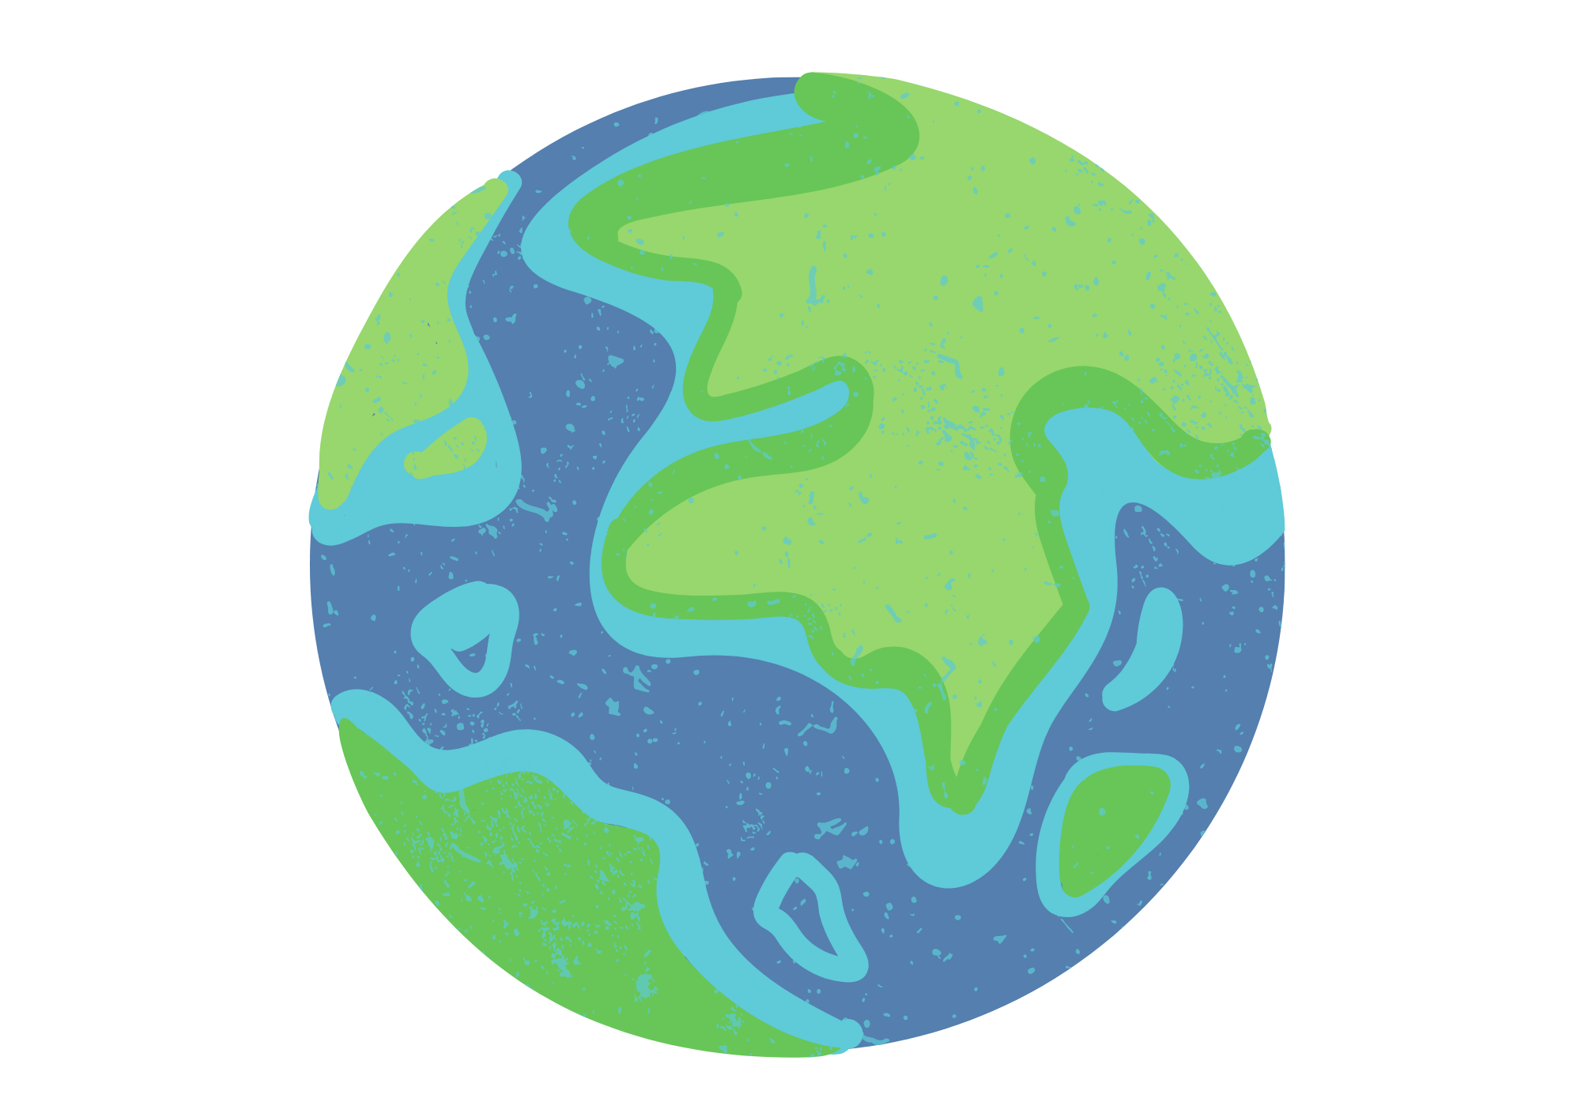
I Do
Proper Nouns
Common Nouns | Proper Nouns
country | Australia
city | Paris
name | Bill
company | Microsoft
river | Amazon River
book | Harry Potter
website | Wikipedia
monument | The Eiffel Tower
planets | Venus
languages | Italian
Tip: Seasons are not proper nouns.

Slide 6
We Do
Monday
Proper Nouns
Word with a partner to rewrite the sentences with correct capital letters.
The boy’s friend, peter, didn’t want to go to mcdonalds.
Her new dog, patsy, loved watching paw patrol on television.
‘The nile river is so long,” said amy.
harry potter was written by j.k. rowling.
The company microsoft is owned by bill gates.
Peter
Mcdonalds
Patsy
Paw Patrol
Nile River
Amy
Harry Potter
J.K. Rowling
Microsoft
Bill Gates

Slide 7
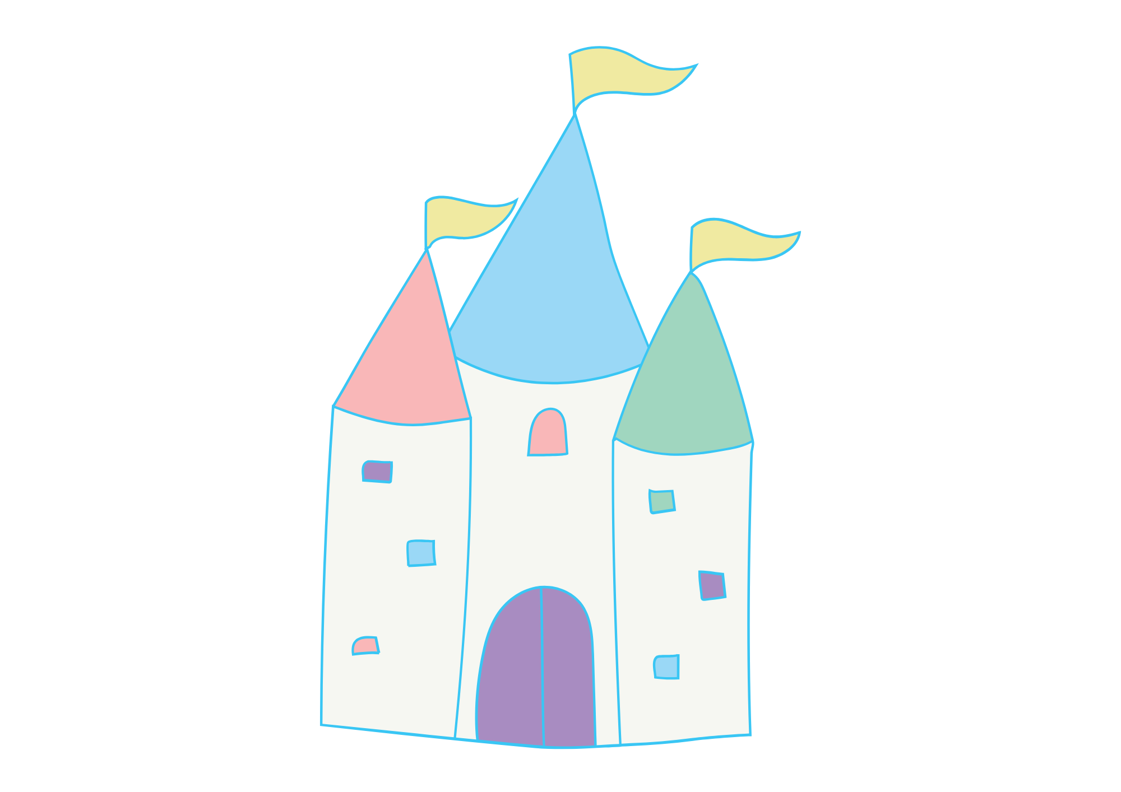
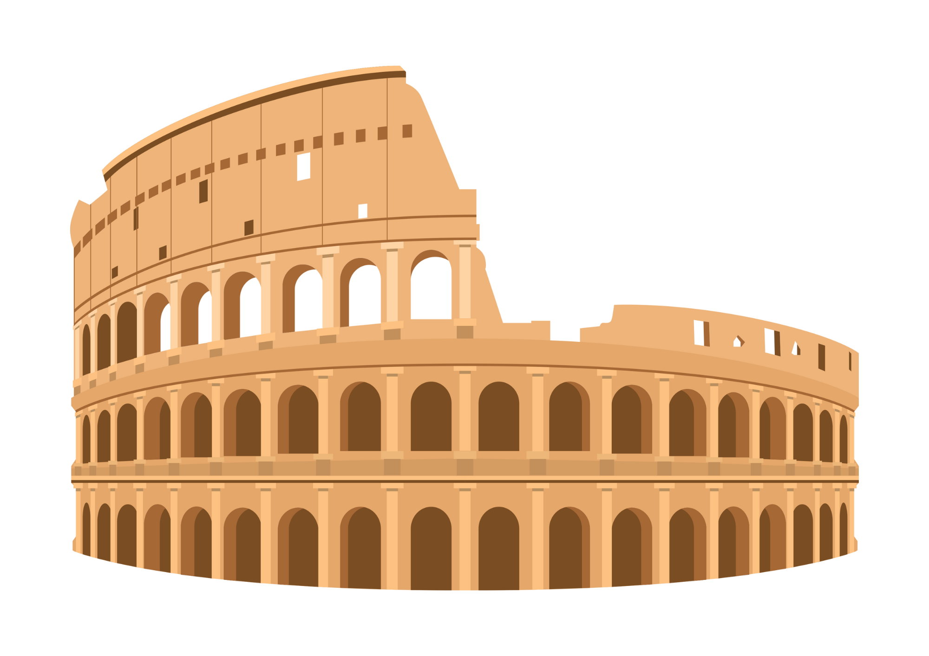
You Do
Monday
Proper Nouns
Rewrite the sentences in your book with correct capital letters.
emily went to disneyland last summer and met mickey mouse.
The eiffel tower in paris is a famous landmark.
sarah visited london and rome during her european vacation.
harry potter, ron weasley and hermione granger attended hogwarts school of witchcraft and wizardry.
nASA’s rover landed successfully on mars.
Emily
Disneyland
Mickey Mouse
Eiffel Tower
Paris
Sarah
London
Rome
European
Harry Potter, Ron Weasley and Hermione Granger
Hogwards
School of Witchcraft and Wizardry.
NASA’S
Mars

Slide 8
We Do
Tuesday
Proper Nouns
Work with a partner and choose the proper nouns.
thomas | feet | house | venus | tuesday | spring | tree | river | paris | statue of liberty | teacher | cat | monkey | friday | europe | play | soccer | china |

Slide 9
You Do
Tuesday
Proper Nouns
Choose the proper nouns from the box and put them in to sentences.
cheese | cat | palace | harry potter | mars | earth | chat | burger | asia | sunday | pizza | rome | bun | phone | canada | tiger | baseball | peter | italian

Slide 10
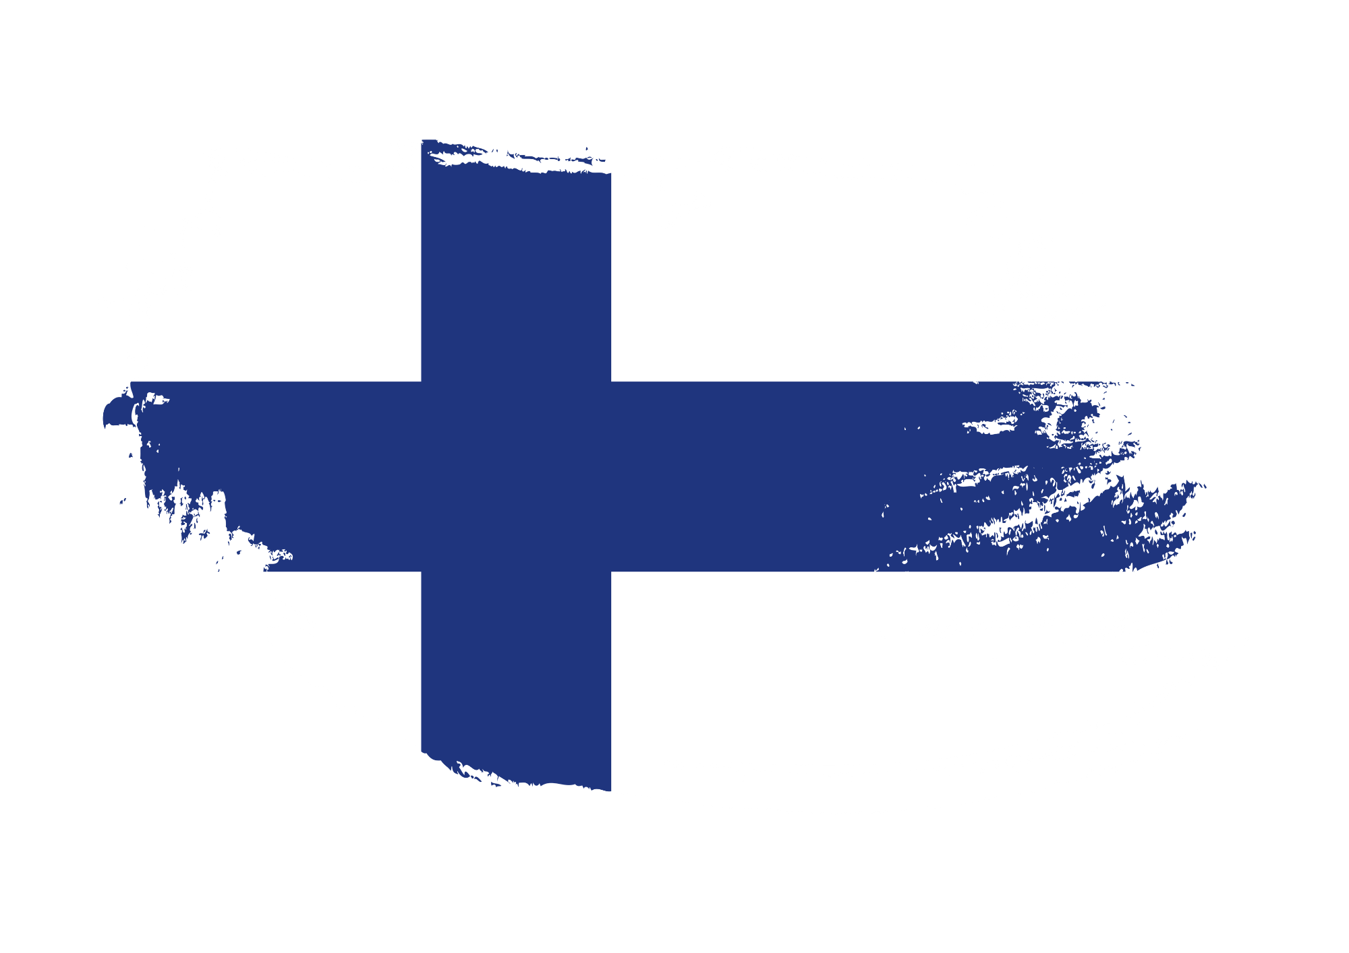

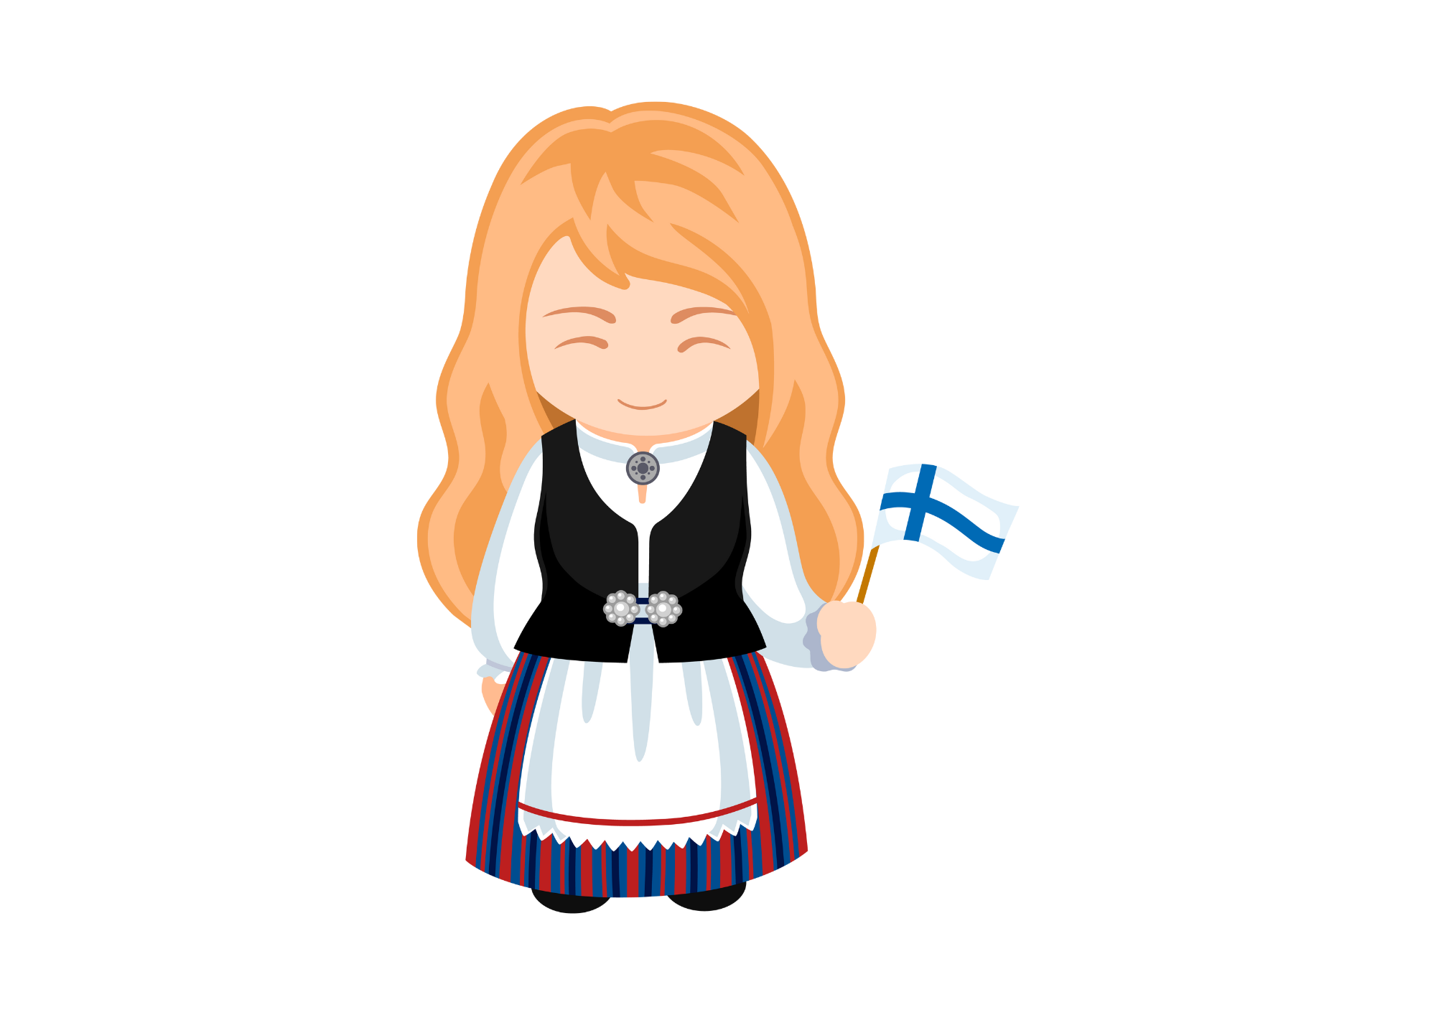
We Do
Wednesday
Proper Nouns
With a partner, read the short text and find the proper nouns that need capital letters. There are 18 capital letters needed! Find them all.
finland is a country in europe known for its beautiful landscapes, including forests, lakes, and islands. The capital city, helsinki, is famous for its architecture, like the helsinki cathedral. In lapland, visitors can enjoy winter activities and visit santa claus village. The longest river in finland is the kemijoki river, and the highest mountain is mount halti. The aurora borealis, or northern lights, is a stunning natural phenomenon seen in finland's far north.
Finland
Europe
Helsinki
Helsinki Cathedral
Lapland
Santa Claus Village
Kemijoki River
Mount Halti
Aurora Borealis
Northern Lights
Finland’s

Slide 11
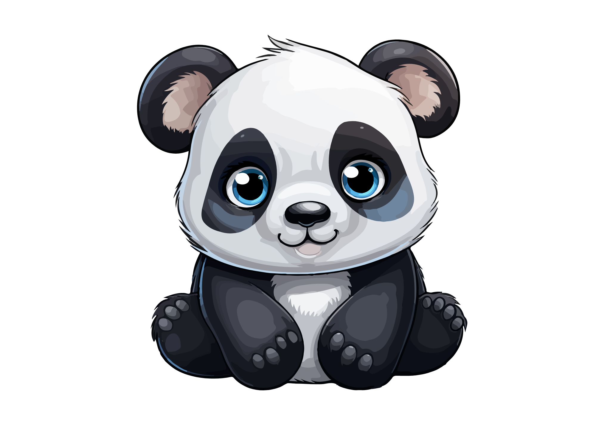
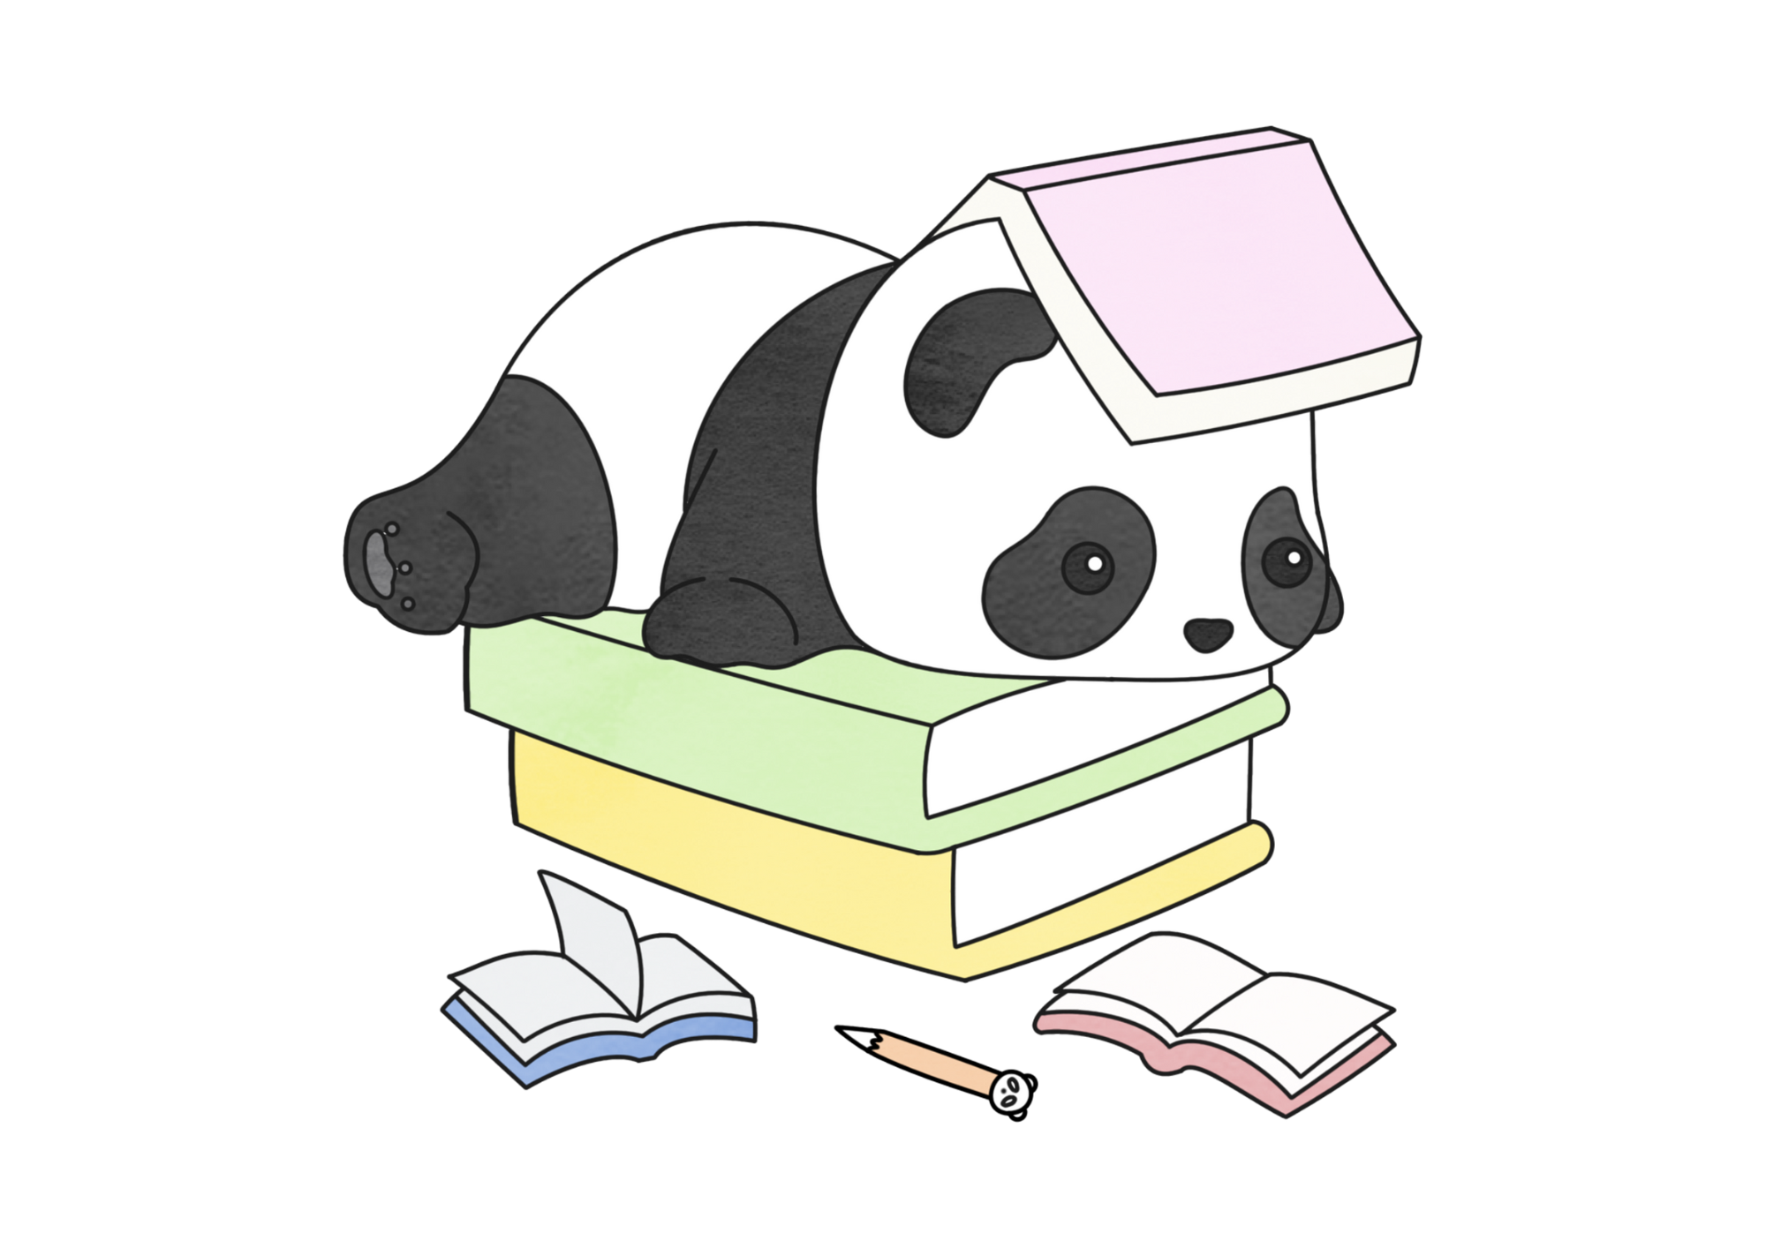
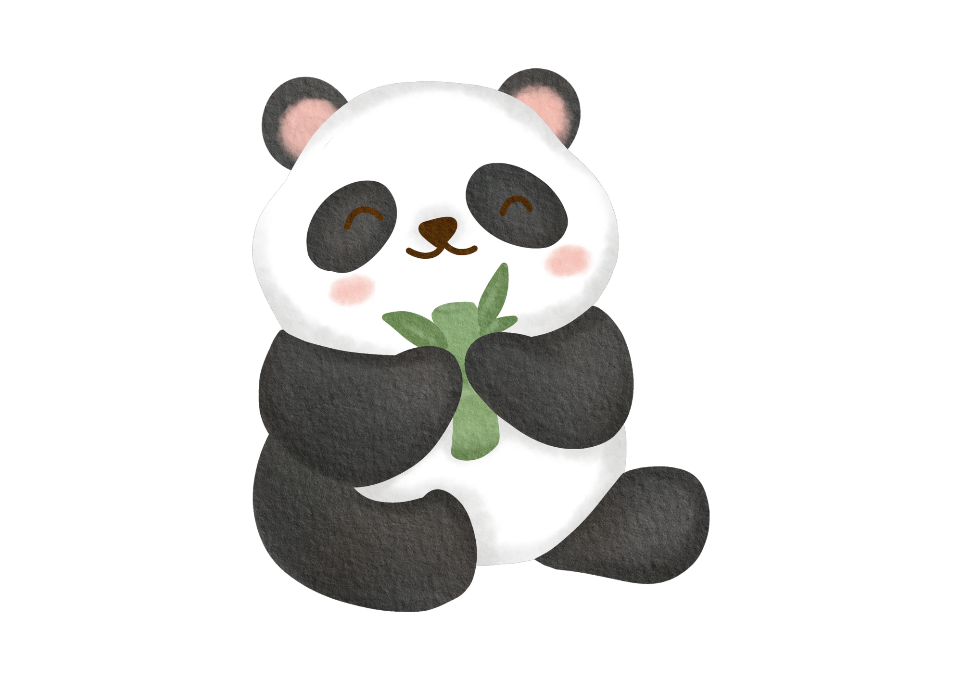
You Do
Wednesday
Proper Nouns
Rewrite the text with the correct capital letters. There are 17 capital letters needed! Find them all.
Whether you speak english, japanese or french, pandas are adorable! They are black and white bears native to china. One famous place to see pandas is in chengdu. chengdu is a city in the sichuan province. The wolong nature reserve and the foping nature reserve are places that protect pandas and are open monday to sunday. Pandas are loved all over earth, especially in asia.
English, Japanese or French
China
Chengdu
Chengdu
Sichuan
Wolong Nature Reserve
Foping Nature Reserve
Monday to Sunday
Earth
Asia

Slide 12

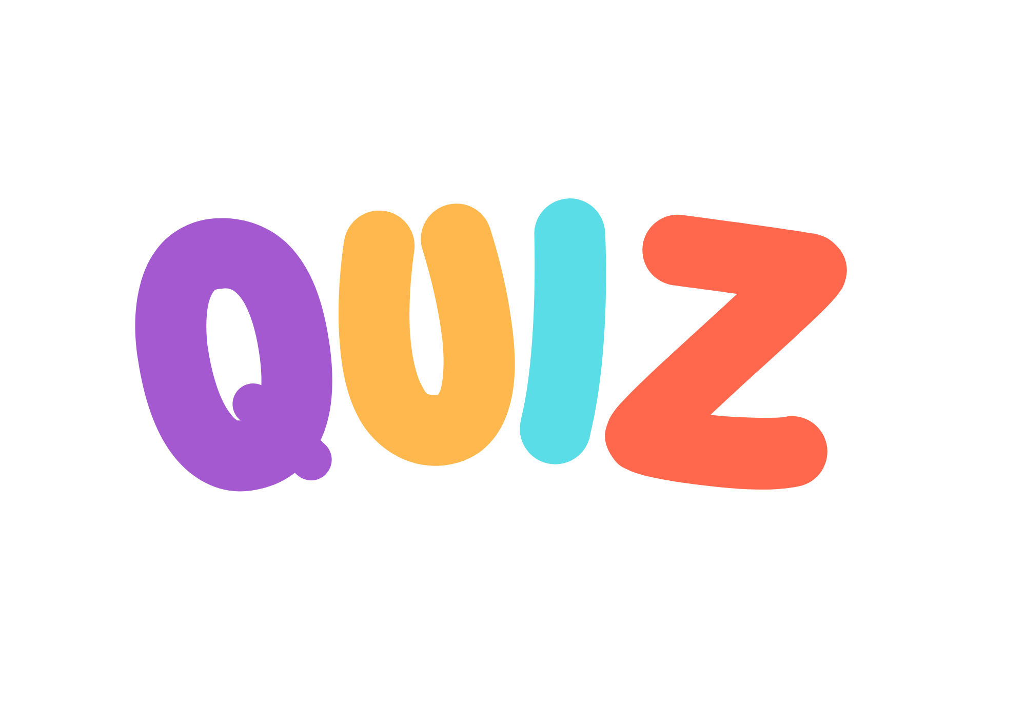
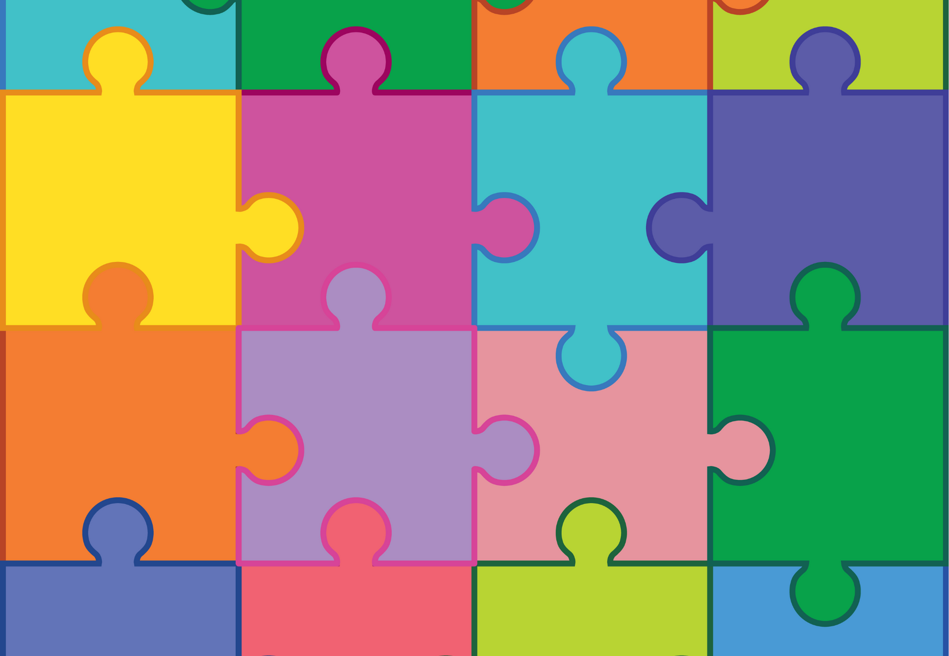
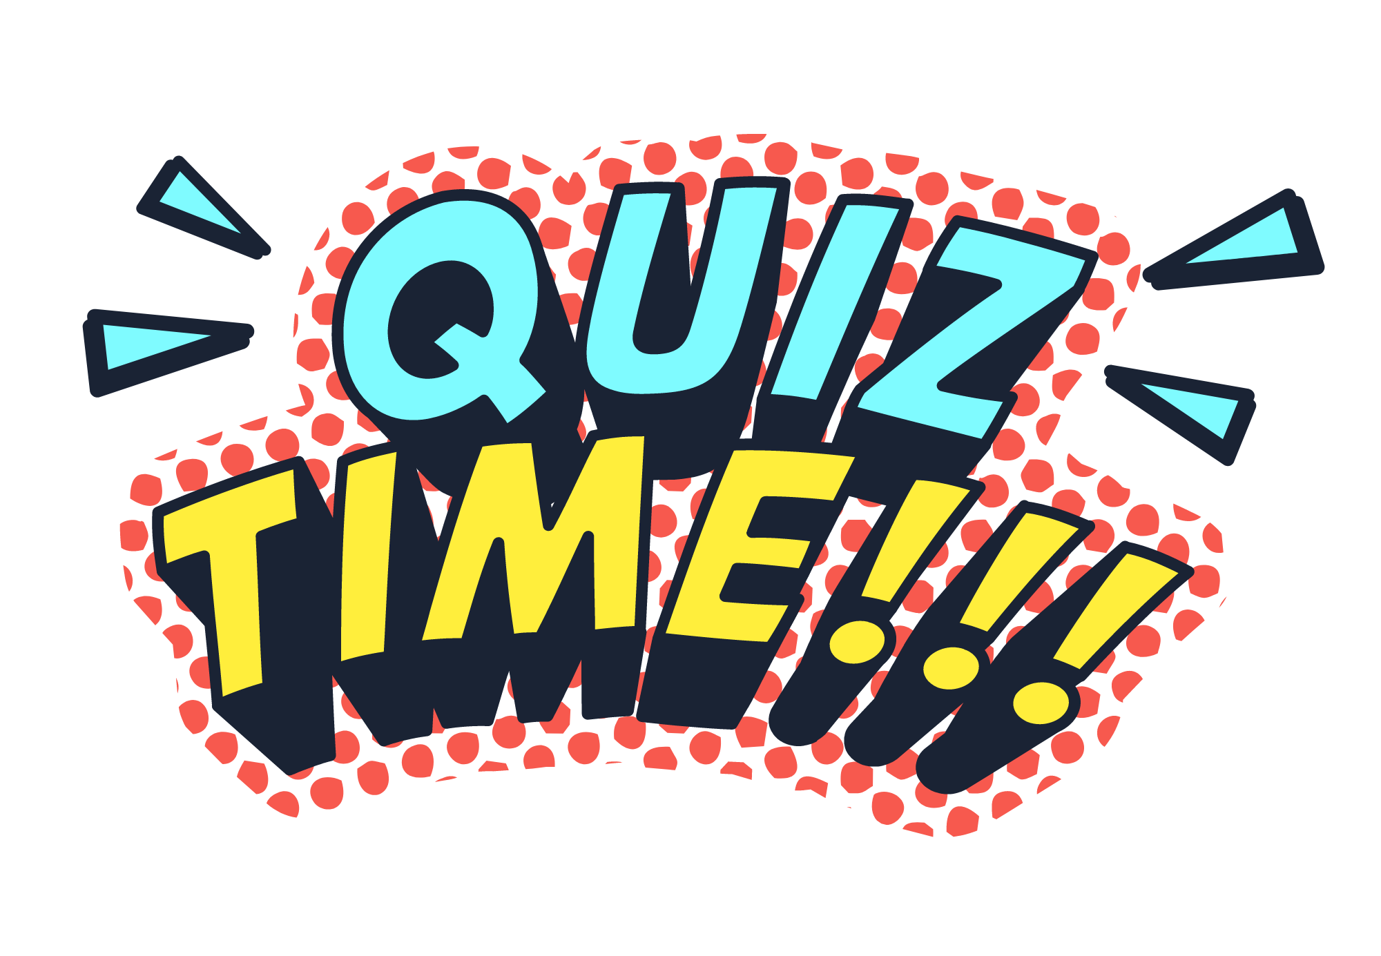
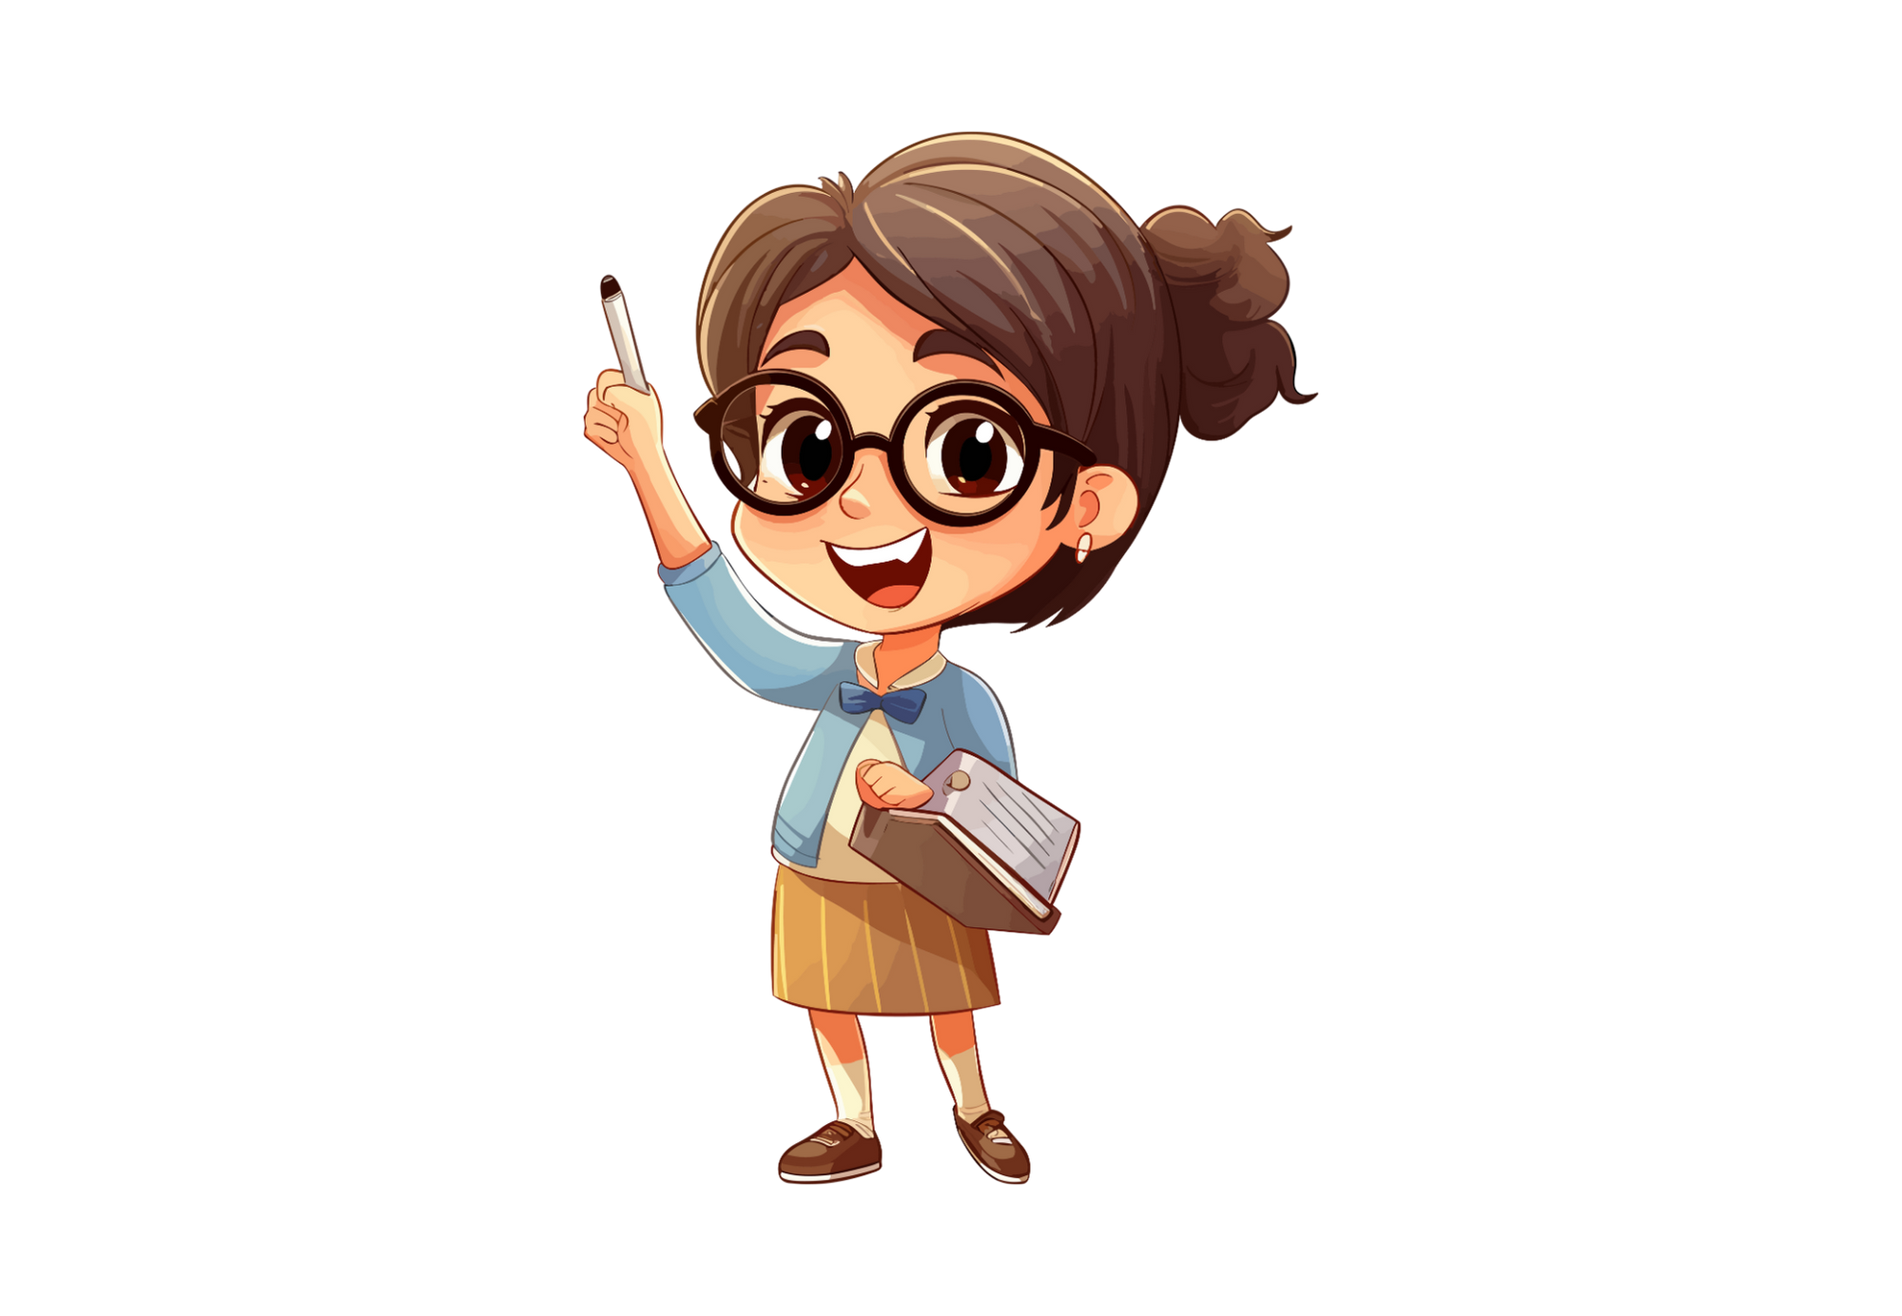
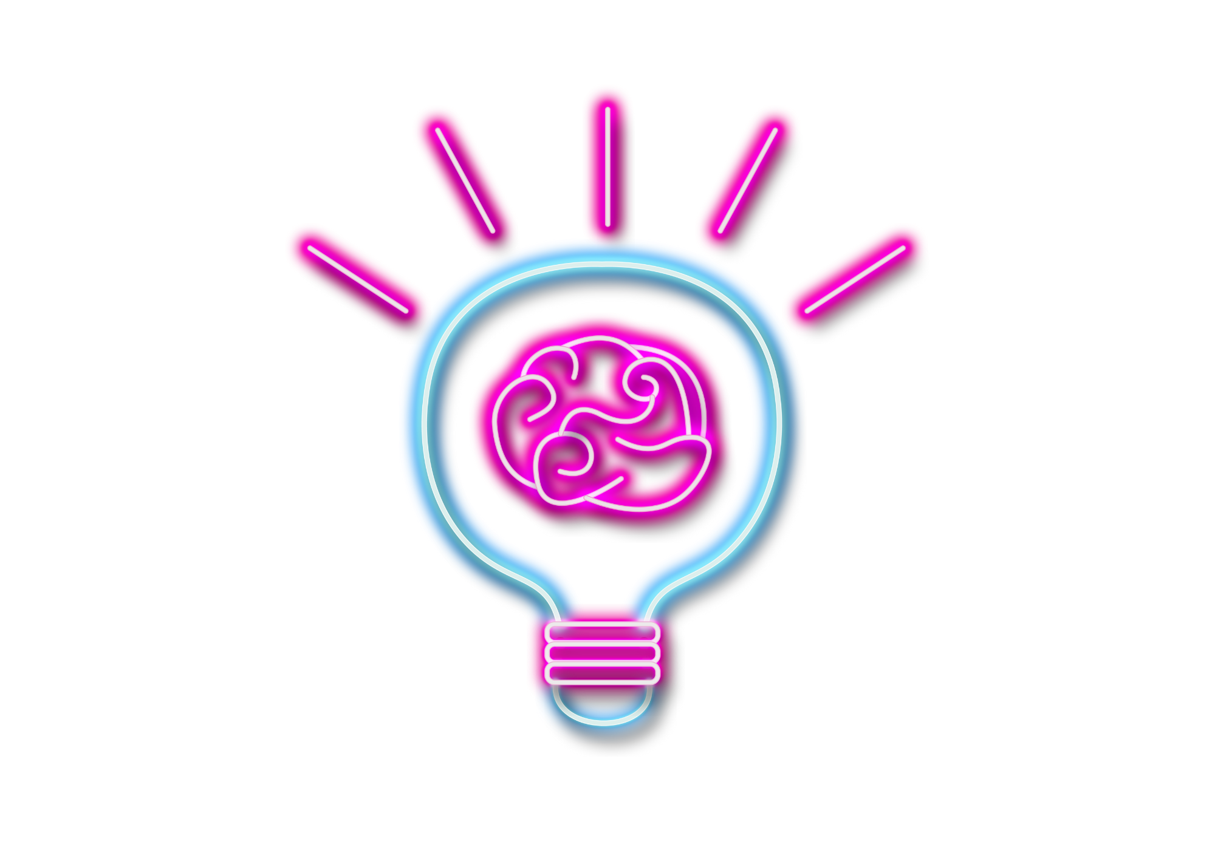
Capital Letter Quiz
Everyone stand up. On your whiteboard/paper, write ‘Yes’ if the word needs a capital letter, and ‘No’ if it doesn’t. If you’re correct, you’re still in. If you’re wrong, you have to sit down. Can you last until the final word??

Slide 13
monkey
Yes
No

Slide 14
tuesday
Yes
No

Slide 15
teacher
Yes
No

Slide 16
mount everest
Yes
No

Slide 17
car
Yes
No

Slide 18
winter
Yes
No

Slide 19
friend
Yes
No

Slide 20
jupiter
Yes
No

Slide 21
italian
Yes
No

Slide 22
french
Yes
No

Slide 23
house
Yes
No

Slide 24
mary
Yes
No

Slide 25
the white house
Yes
No

Slide 26
river
Yes
No

