Slide 1






Exploring Metaphors

Slide 2
Lesson Objectives
By the end of this lesson, I will be able to:
Define metaphor
Find metaphors in sentences
Identify the difference between metaphors and similes
Write my own metaphors

Slide 3

What is a Metaphor?
Metaphors are figures of speech that describe one thing by comparing it to another, unrelated thing.
Example: "Her smile is a ray of sunshine.“
Metaphors are like similes, except that don’t use the words ‘like’ or ‘as’. They simply state that one thing is another.
Simile = He is like a beast.
Metaphor = He is a beast.

Slide 4
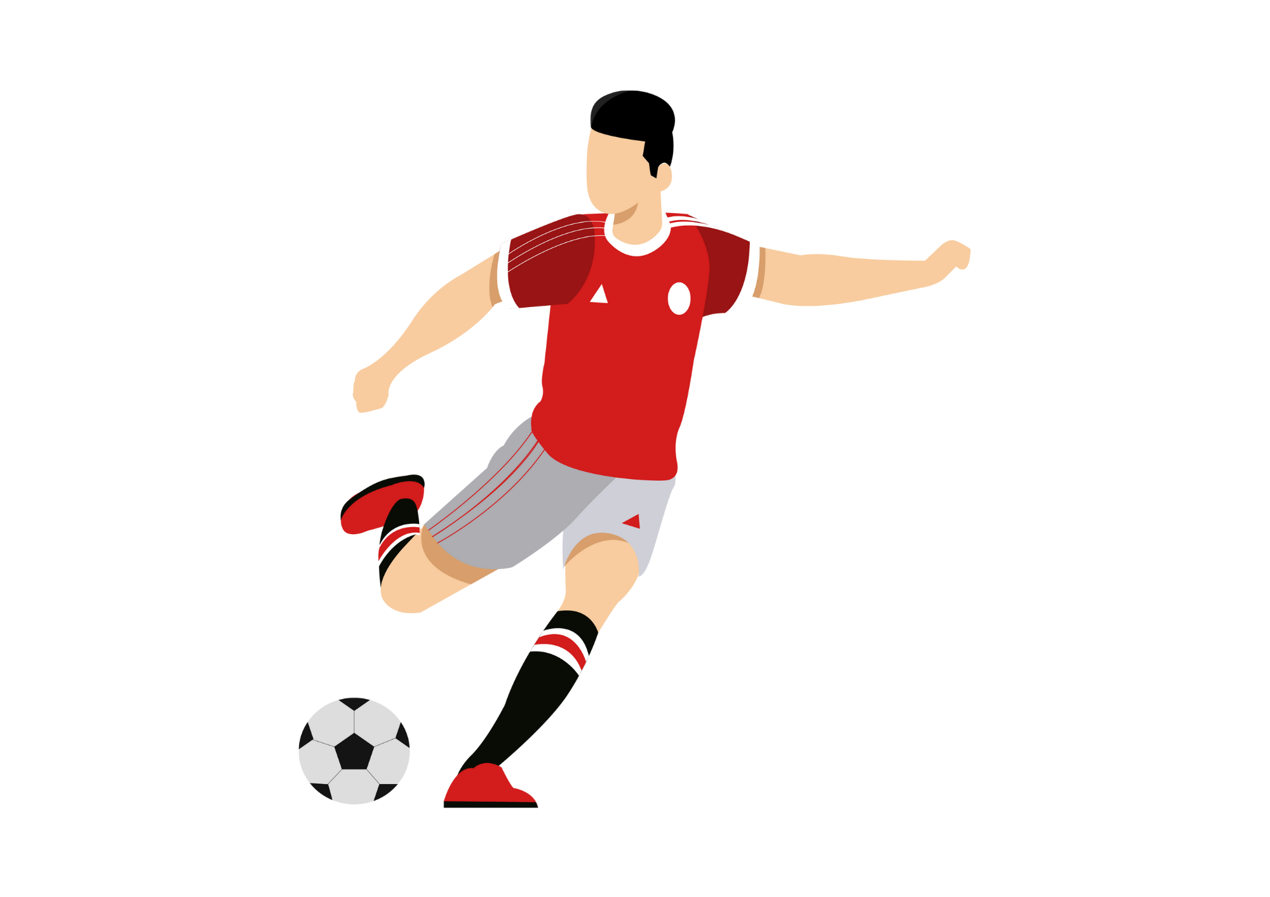
Metaphor Examples
Her dad is a beast on the soccer field.
This metaphor compares her dad to a beast. It suggests that he is really good on the soccer field.
Tom loves food, he is a pig.
This metaphor compares Tom to a pig. Pigs love to eat a lot, so it suggests that Tom loves to eat a lot, just like a pig.
He’s a couch potato.
This metaphor compares the man to a potato. Potatoes don’t move, so it suggests that the man likes to sit on the couch a lot.

Slide 5

Metaphor Examples
His anger is a volcano.
This metaphor compares his anger to a volcano. It suggests that his anger is bubbling, ready to erupt, just like a volcano.
Time is a thief.
This metaphor compares time to a thief, suggesting that time takes things away from us, much like a thief steals possessions.
His words were a dagger in my heart.
This metaphor compares hurtful words to a sharp weapon (dagger) piercing into the speaker's heart.

Slide 6


Let’s Try Together
State what is being compared and try to explain the metaphor.
Work was a nightmare.
Compares:
Meaning:
Jack’s bedroom is a pigsty.
Compares:
Meaning:
That athlete is a machine.
Compares:
Meaning:
Work to a nightmare.
Nightmares are terrible, so it is saying that work was terrible.
Jack’s bedroom to a pigsty.
A pigsty (home of a pig) is usually very messy/dirty, so it is saying that Jack’s bedroom is messy.
The athlete to a machine.
Machines are robotic and generally do everything perfectly, so it’s saying that the athlete is amazing.

Slide 7



Simile or Metaphor?
Write whether the sentence is a simile or metaphor.
The waves crashed against the shore like thunder.
Her laughter was as bright as the sunshine.
Time is a river flowing endlessly.
The city streets were a maze of confusion.
He ran as fast as a cheetah.
Her voice was a melody that soothed the soul.
Simile
Simile
Metaphor
Metaphor
Simile
Metaphor

Slide 8
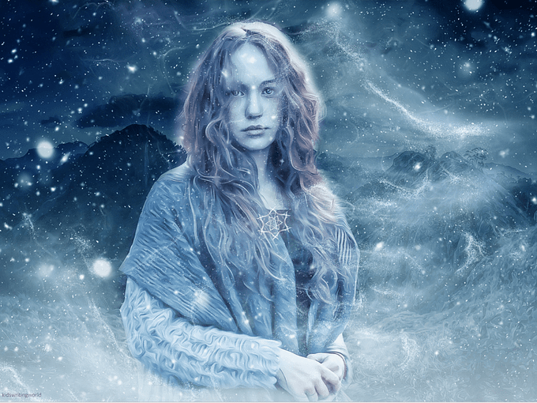
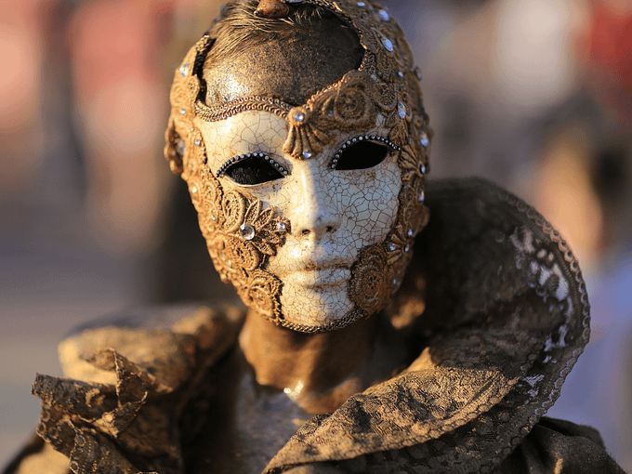

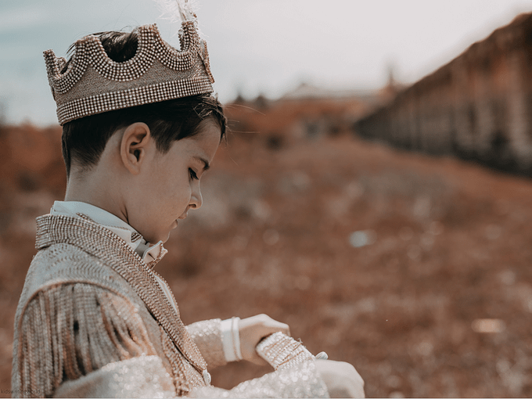
Metaphors
Work with a partner to write a metaphor for each picture.

Slide 9


Metaphor Hunt
Work in groups to find metaphors in books.
Divide into groups.
Choose a scribe – someone to write down your metaphors.
Each person in the group, scan through books to find metaphors.
See how many you can find and share them with the class.

Slide 10
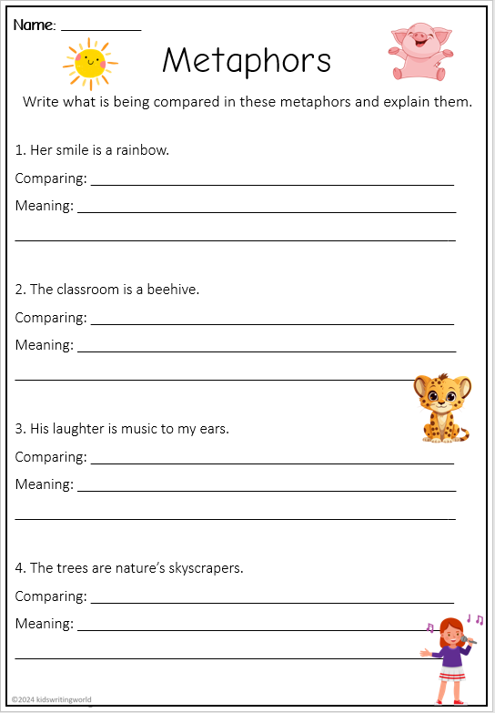
Independent Activity
Complete the metaphor worksheet.

