Slide 1






Onomatopoeia

Slide 2
Lesson Objectives
By the end of this lesson, I will be able to:
Define onomatopoeia
Find onomatopoeia in sentences
Use onomatopoeia in your writing

Slide 3
What is onomatopoeia?
Onomatopoeia is a word that imitates the sound it represents.
Examples: "Buzz!" "Crash!" "Meow!" "Boom!“
Onomatopoeic words make writing more interesting and descriptive!

Slide 4
How to find onomatopoeia
Look for words that sound like the noise they describe.
Listen for words that mimic the sounds around you.
Pay attention to words that make you imagine the sound in your head!

Slide 5
Onomatopoeia Examples
The thunder rumbled loudly in the distance.
The bees buzzed around the flowers.
The door creaked open slowly.
Discuss how these words make the writing more interesting and help readers imagine the scene.

Slide 6
Let’s Try Together
With a partner, try to find the onomatopoeia in each sentence.
The fire crackled and popped as we roasted marshmallows over the campfire.
The baby giggled with delight as the puppy licked her face.
The wind howled through the trees on the stormy night.
With a loud clang, the metal gate swung shut behind us.
As the car sped by, we heard the tires screech around the corner.

Slide 7
Onomatopoeia
This time, try by yourself. Read the story and see if you can find any onomatopoeia.
“Bing!” the alarm would ring every morning. Tim would wake up to the cheerful, "oink” of Rosie as she greeted him eagerly. Together, they would venture into the fields, where they could hear the rustle of the tall grass and the swoosh of the leaves. Tim would feed Rosie apples from the trees, and all they would hear is crunch for miles. As the sun set behind the mountains, Tim and Rosie would head back home, listening to the soothing squeak of the porch swing

Slide 8
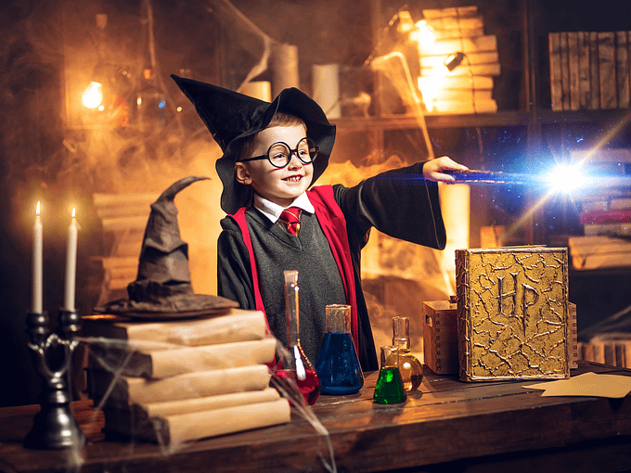
Onomatopoeia Stories
In groups, you will create a short story together. You must take turns writing sentences, trying to use onomatopoeia as you go.
Look at the story prompt.
Start your story with onomatopoeia.
Take turns writing a sentence.
See how many bits of onomatopoeia you can include.
You can even colour your onomatopoeia a different colour!
See how much you can write in 10 minutes.
“Whizz!” went Jack’s wand...And then heard a bang.

Slide 9
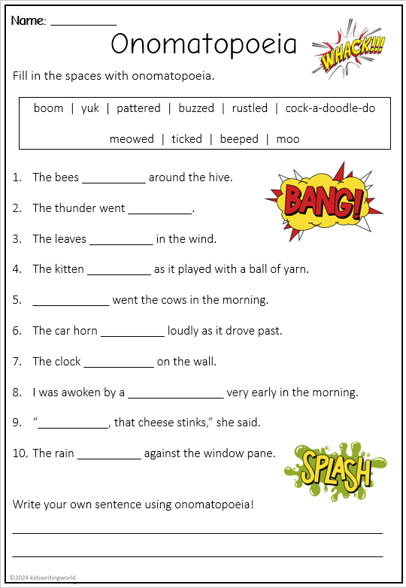
Independent Activity
Complete the onomatopoeia worksheet.

