Slide 1


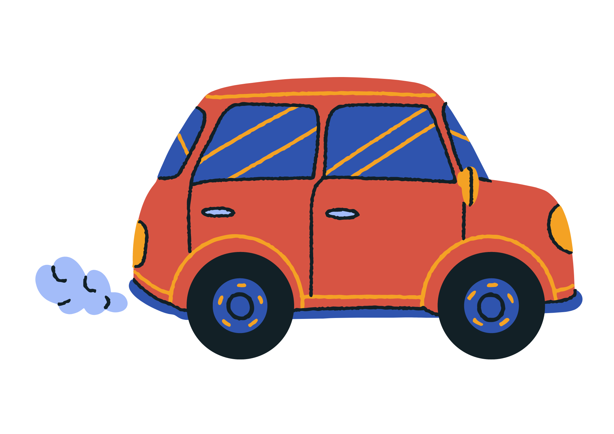


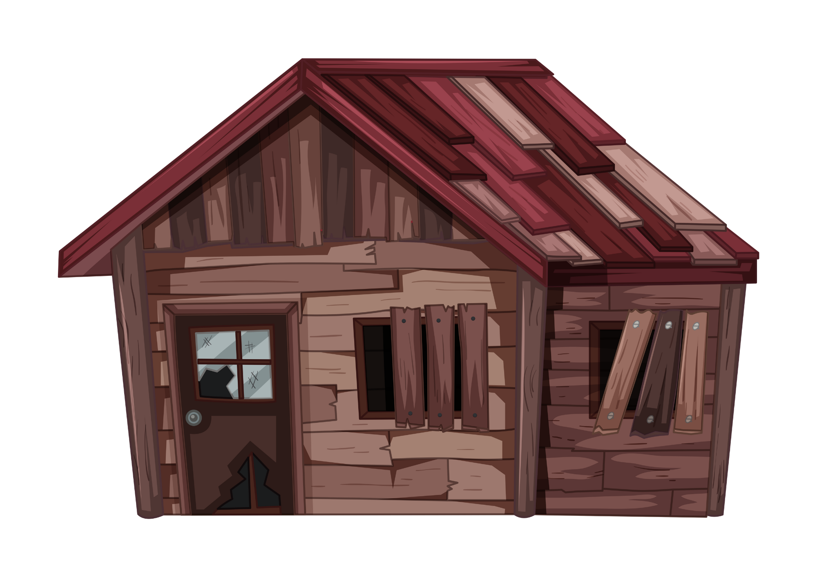
Personification

Slide 2

Lesson Objectives
By the end of this lesson, I will be able to:
Define personification.
Identify personification in sentences.
Explain the meaning of sentences with personification.
Use personification in sentences.

Slide 3
What is Personification?
Personification is when we give human qualities, feelings, or actions to things that are not human. It's like making objects or animals act or feel like people.
For example, if we say "the sun smiled down on us" we're giving the sun the human quality of smiling, even though the sun is not a person and can't really smile.
Or if we say "the wind whispered through the trees" we're giving the wind the human action of whispering, even though the wind can't really talk.

Slide 4



Why do we use personification?
We use personification in writing to make our words more exciting and interesting. It helps us describe things in a way that makes them seem alive, even if they're not.
When we give human qualities to objects or animals, it helps us imagine them better and understand them more. It's like bringing them to life in our stories or poems.
For example, instead of saying "the leaves fell from the tree," we could say "the leaves danced down from the tree." By using personification and saying the leaves danced, it makes the scene more vivid and fun to picture.
So, personification makes our writing more colourful and helps us create lively, imaginative worlds in our stories and poems!

Slide 5
Personification Examples
The sun smiled down on the playground.
The sun can't really smile, but saying it smiled helps us imagine it shining warmly, making the day feel happy and bright.
The stars whispered secrets to each other in the night sky.
Stars can't talk or whisper, but saying they whispered secrets adds a magical feeling to the night sky.
The river danced over the rocks on its way to the sea.
Rivers don't dance, but saying it danced helps us picture it flowing gracefully and joyfully over the rocks.

Slide 6
Let’s Try Together
Try to explain the personification in each sentence.
The moon peeked out from behind the clouds, playing hide-and-seek with the night.
The moon can't actually play games like hide-and-seek, but saying it did adds a playful feeling to the description of the night sky.
The wind whispered secrets as it rustled through the leaves of the trees.
Wind can't whisper secrets, but saying it whispered adds a mysterious and secretive atmosphere to the scene, making it more intriguing.

Slide 7
Let’s Try Together
Try to explain the personification in each sentence.
The lonely house sighed as it watched the world pass by outside its window.
Houses can't really feel loneliness or sigh, but saying it sighed adds a sense of longing, making the house seem more human-like.
The waves whispered secrets to the shore as they gently caressed the sand.
Waves can't whisper or share secrets, but saying they whispered secrets adds a sense of mystery to the relationship between the waves and the shore.

Slide 8
Writing Personification
Write your own personification.
The wind…
The thunder…
The book…
The old stairs…
The waves…

Slide 9
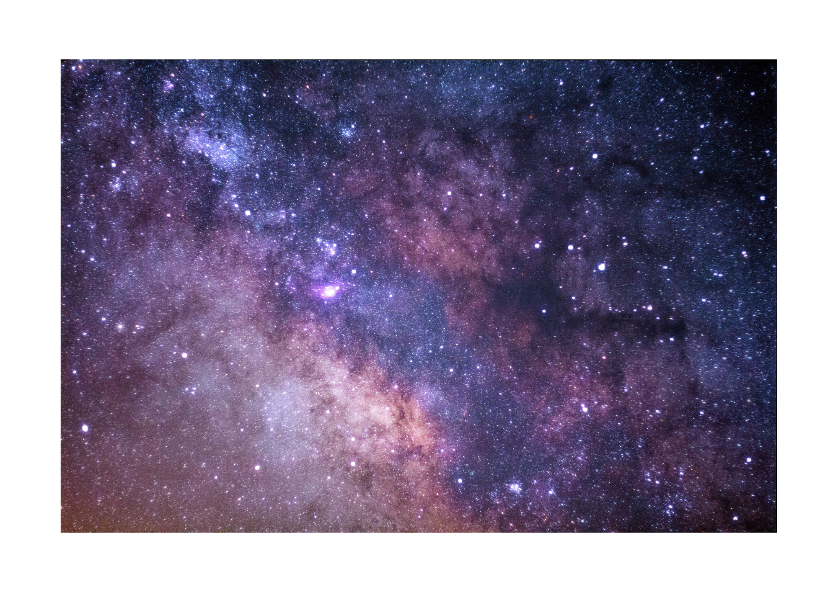
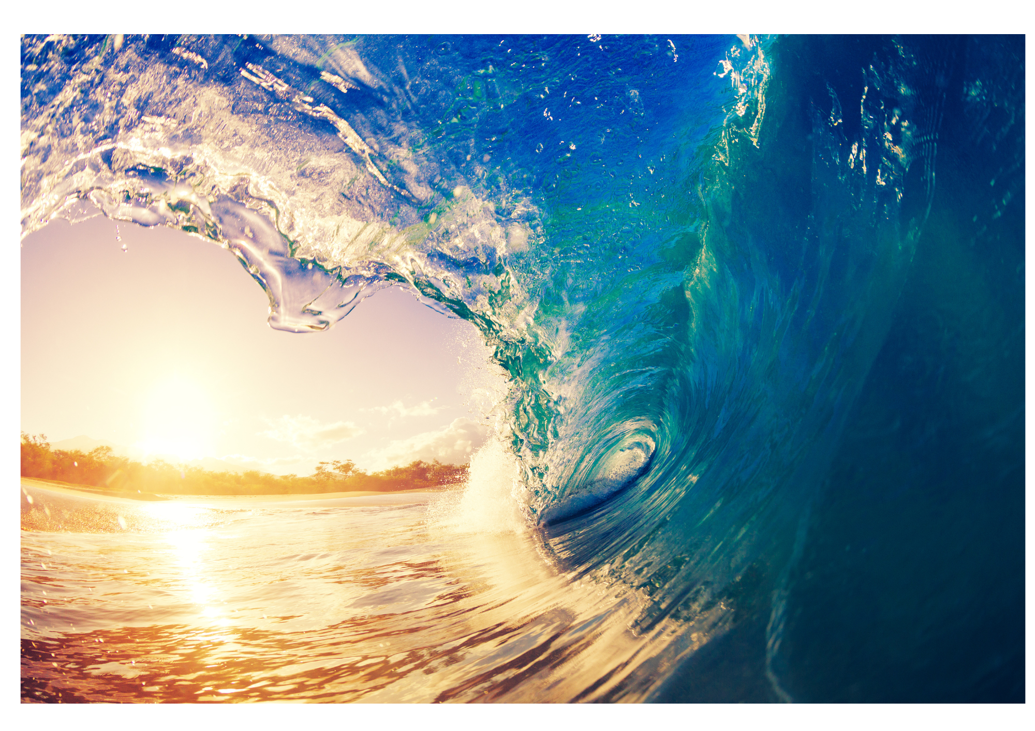
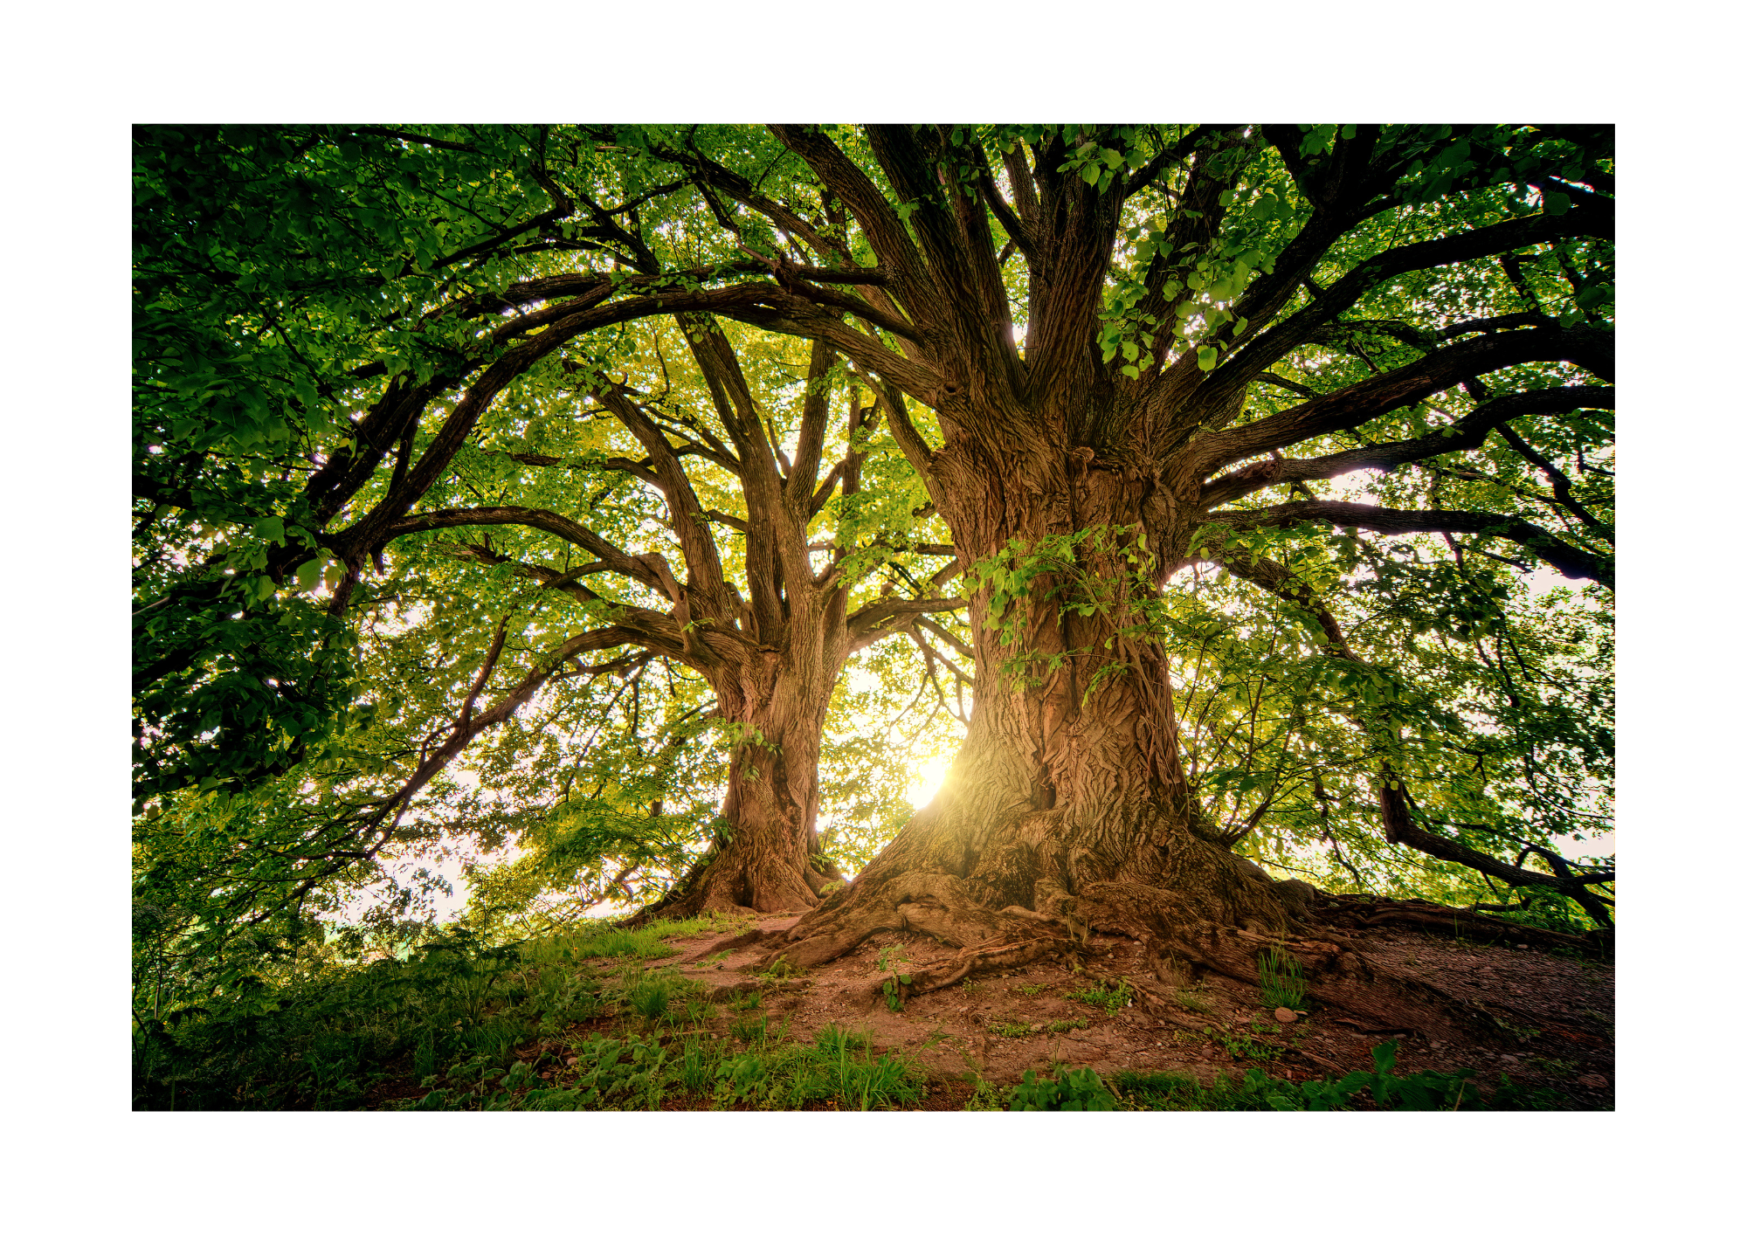

Personification
Choose one of the pictures and write a sentence using personification.

Slide 10
Partner Activity
Draw a picture for your partner (with personification in mind), and have your partner draw a picture for you.
See how many sentences you can write about the picture using personification.
Possible Pictures
With the Sun
With the moon
With trees & leaves
With the waves & ocean
With stars
With anything else that’s not human ☺

Slide 11
Class Activity
Choose one of the non-human things below and write a sentence using personification on your whiteboard/paper.
Walk around the classroom and share your sentence with other students.
Once you have read to 3 other people who have the same non-living thing as you, you can sit down. You have 5 minutes to all be seated!
The lonely house…
The library…
The Sun…
The Moon…
The flowers…
Feeling stuck? Steal this one!
The flowers begged for water in the terrible heat.

Slide 12
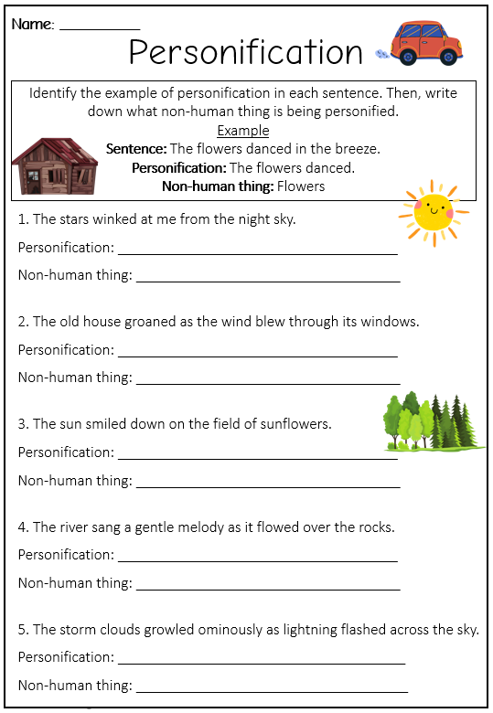
Independent Activity
Complete the personification worksheet.

Slide 13
Personification Task
On A3 paper, create a personification poster.
Choose a background that has a lot of non-human things.
Next to each of the non-human things, write a sentence with personification.
Challenge yourself to write at least 7 sentences!

Slide 14



Personification
The clouds ran across the blue sky.
The Sun smiled upon the land.
The blue sky glared down on them.
The mountains spoke to him as he climbed higher.
The trees danced in the wind.
The flowers begged for water.
The grass ran wild in the treacherous wind.

