Slide 1
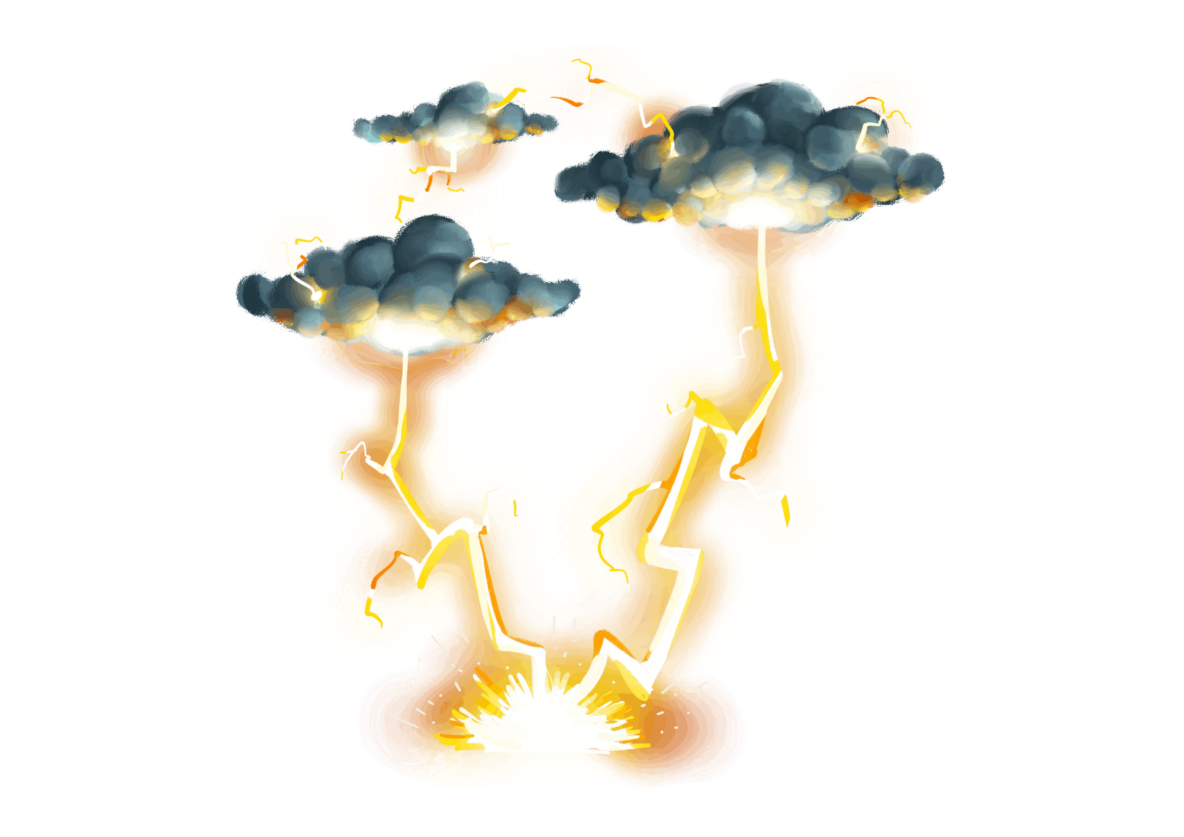

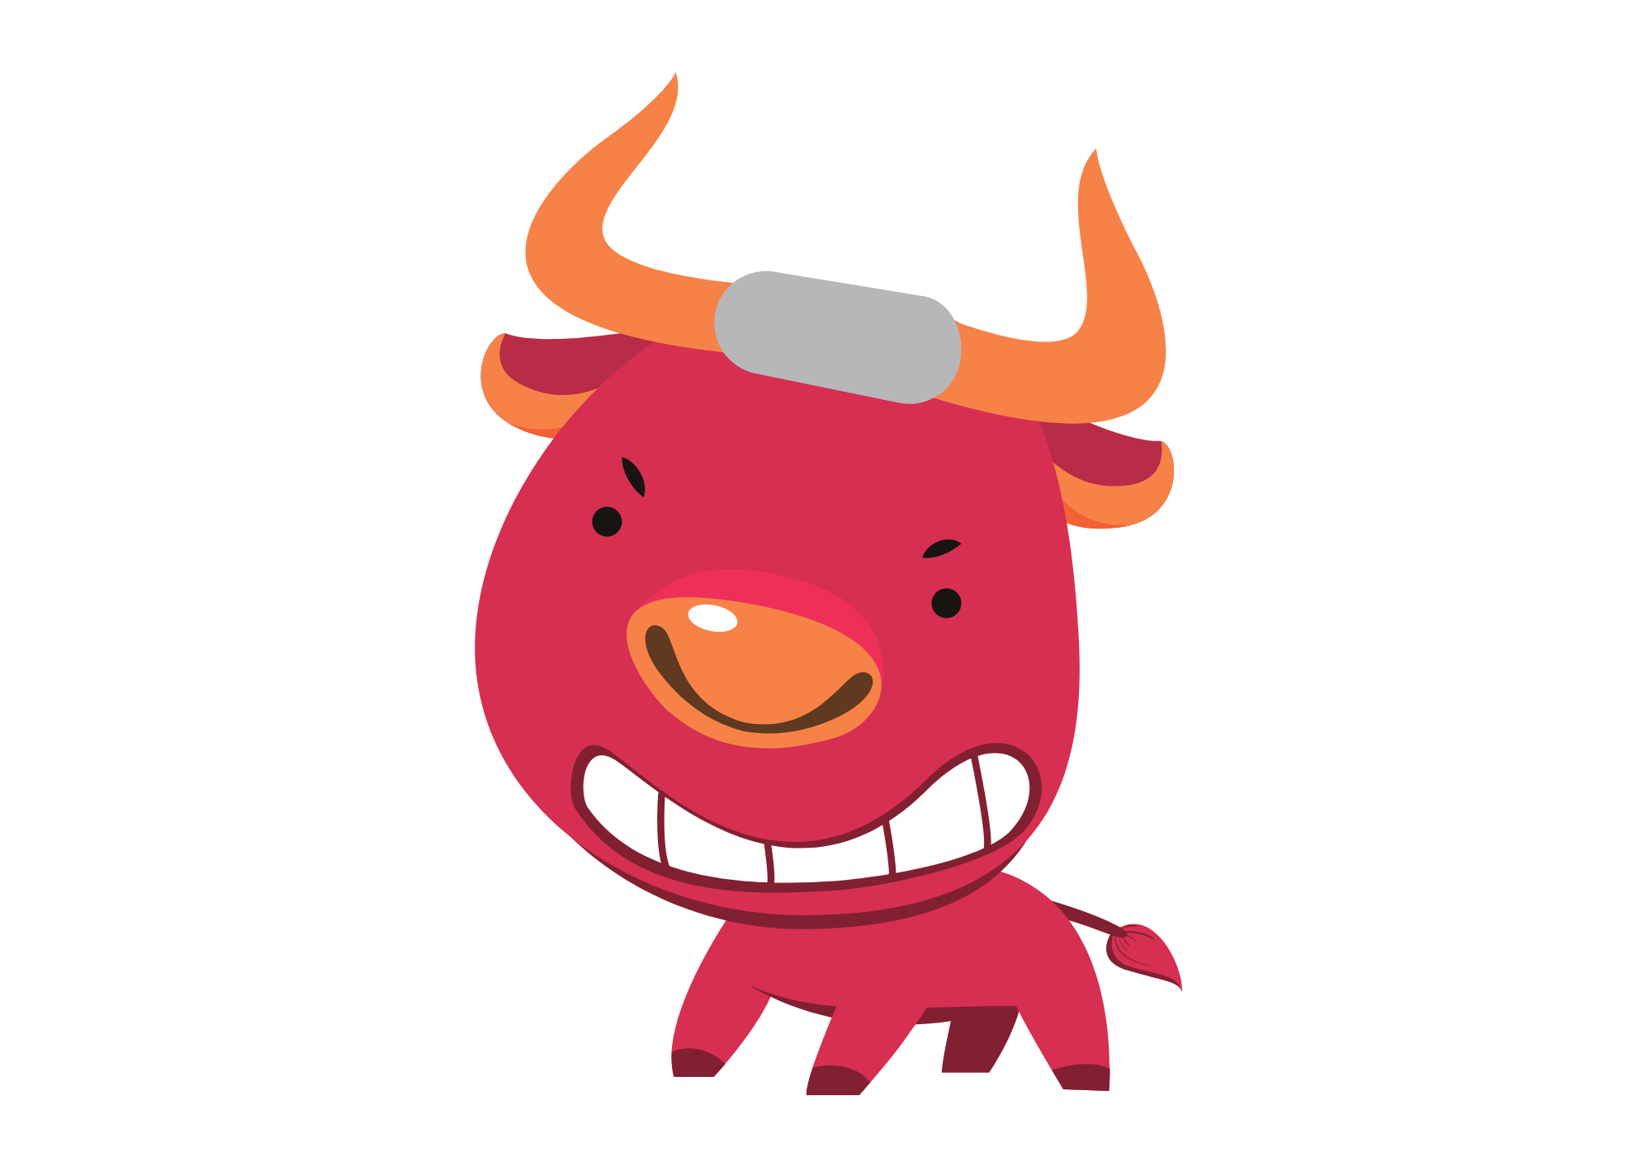
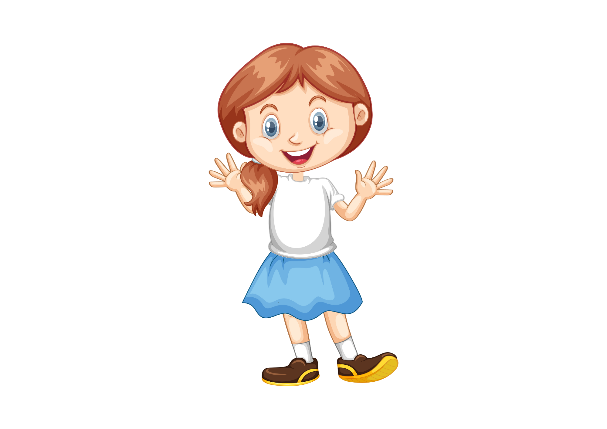

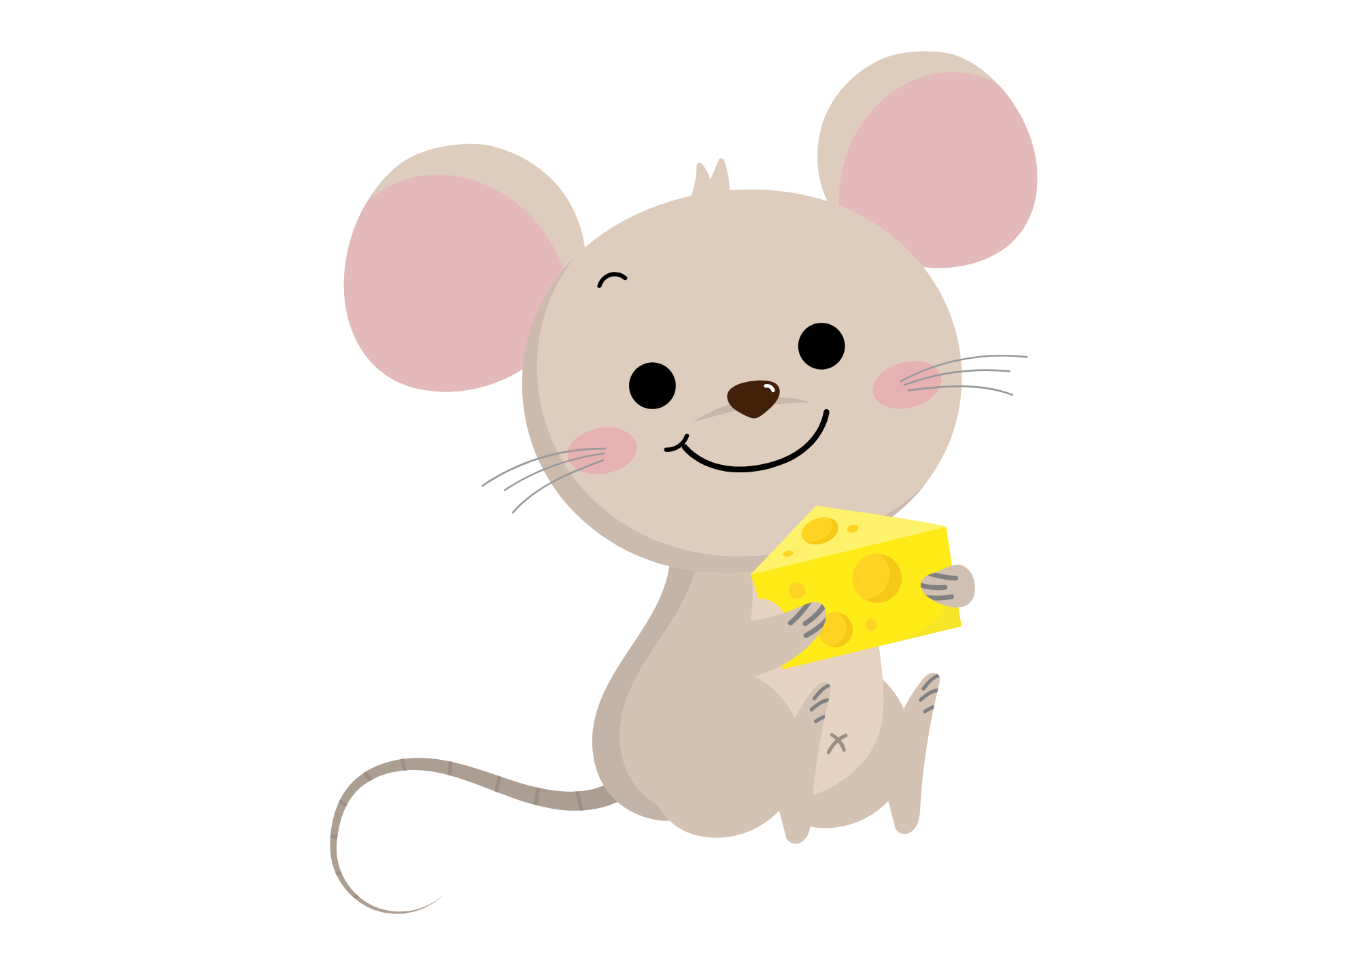
Similes

Slide 2
Lesson Objectives
By the end of this lesson, I will be able to:
Give a definition of simile.
Identify similes in sentences.
Use similes in sentences.

Slide 3
What are Similes?
Similes are comparisons that help us understand things better by saying something is like or as something else.
For example, if I say 'Her smile is as bright as the sun,' I'm comparing her smile to the brightness of the sun to show how happy and radiant it is.
Imagine if I said, 'He runs as fast as a cheetah.' This means that he runs really quickly, just like how a cheetah, which is the fastest animal on land, runs.
The key is to remember that you’re comparing 2 things, and you’re using the words – like or as.

Slide 4
Why do we use similes?
Similes help us paint pictures in our reader's mind by comparing things they know with things they might not know as well. They make our writing more fun to read and help readers understand things better.

Slide 5
Simile Examples
She was as brave as a lion during the performance.
This simile compares the girl to a lion. Lions are often seen as symbols of courage and strength, so this simile is saying that the girl is courageous.
The teacher's voice was like music to our ears.
This simile compares the teacher's voice to music. Music is something that brings joy, so this simile is saying that the student was glad to hear their teacher.
His laughter rang out as loud as thunder across the playground.
This simile compares the loudness of "his" laughter to thunder. Thunder is very loud, so this simile is saying that his laughter is loud.

Slide 6
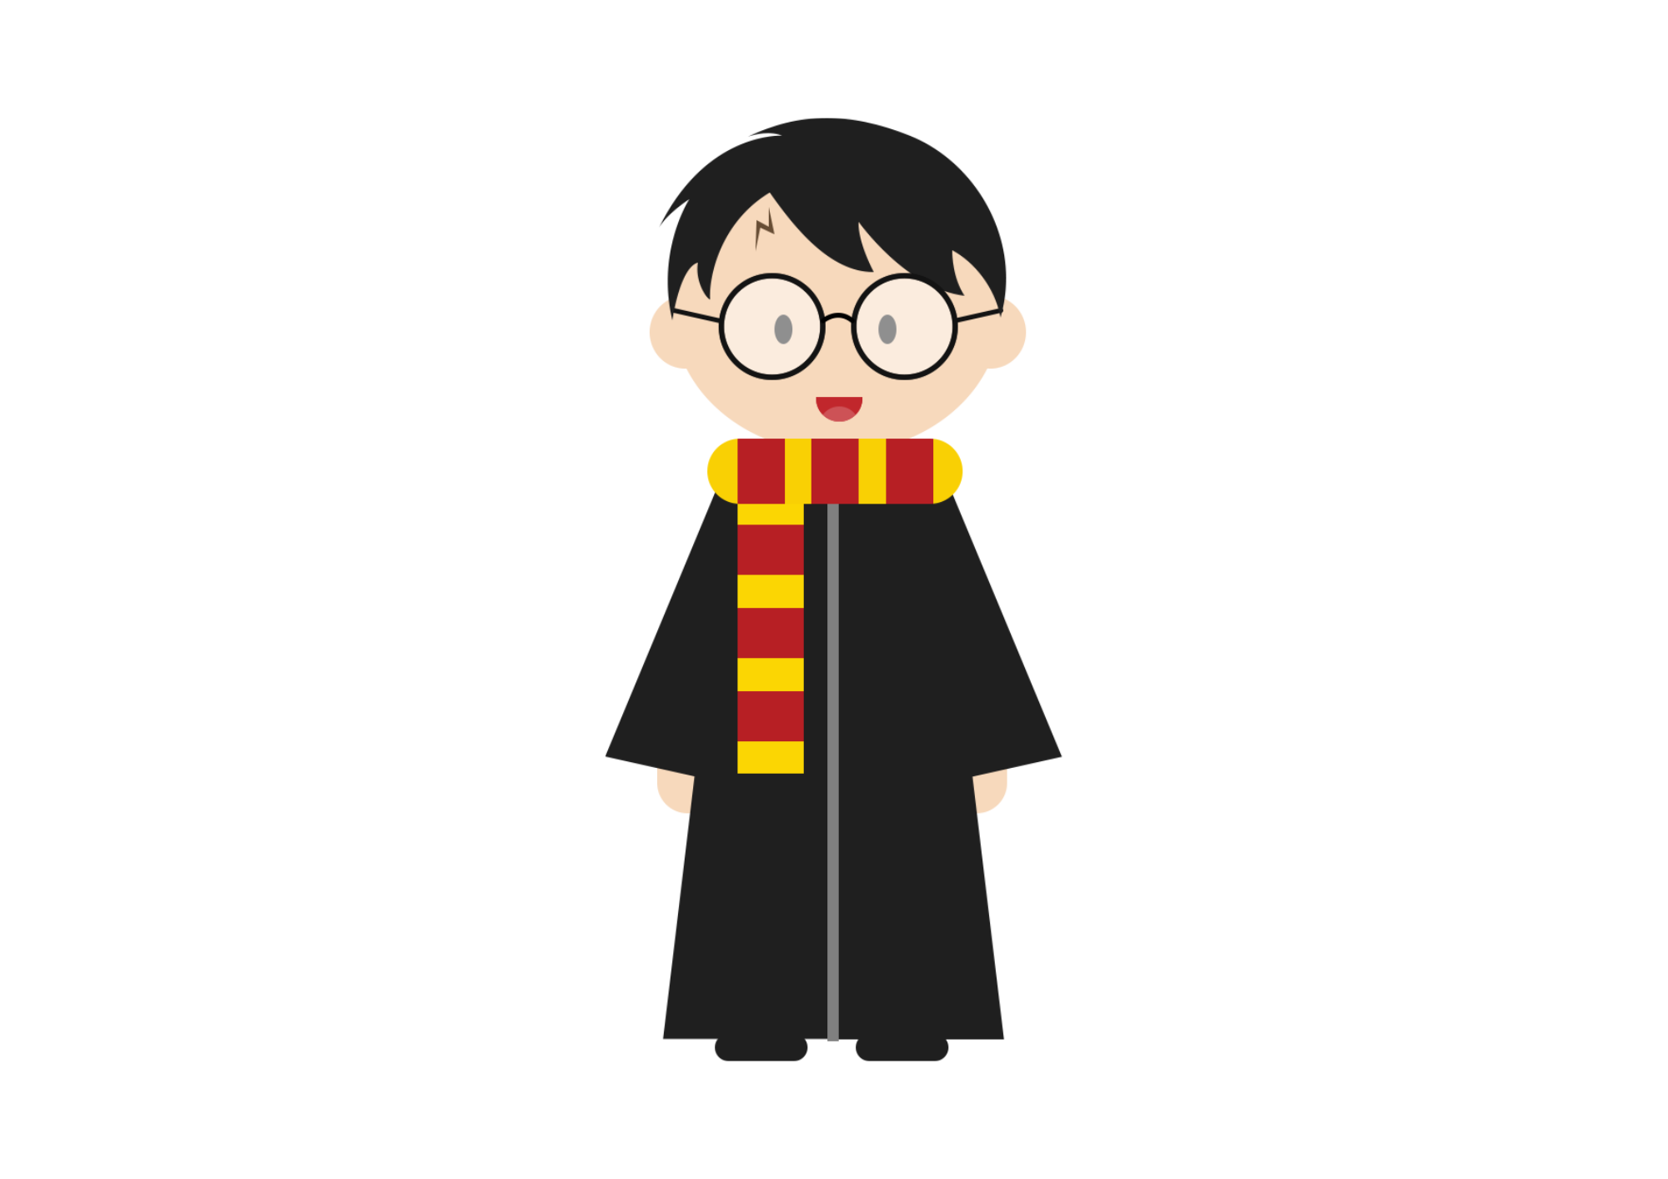
Guess the Book!
Many famous authors use similes to help their readers create vivid images in their minds. Can you guess the book in which these similes are found?
“Dudley looked like a pig in a wig.”
“Dumbledore’s silver hair shone as brightly as ghosts.”
Harry Potter

Slide 7
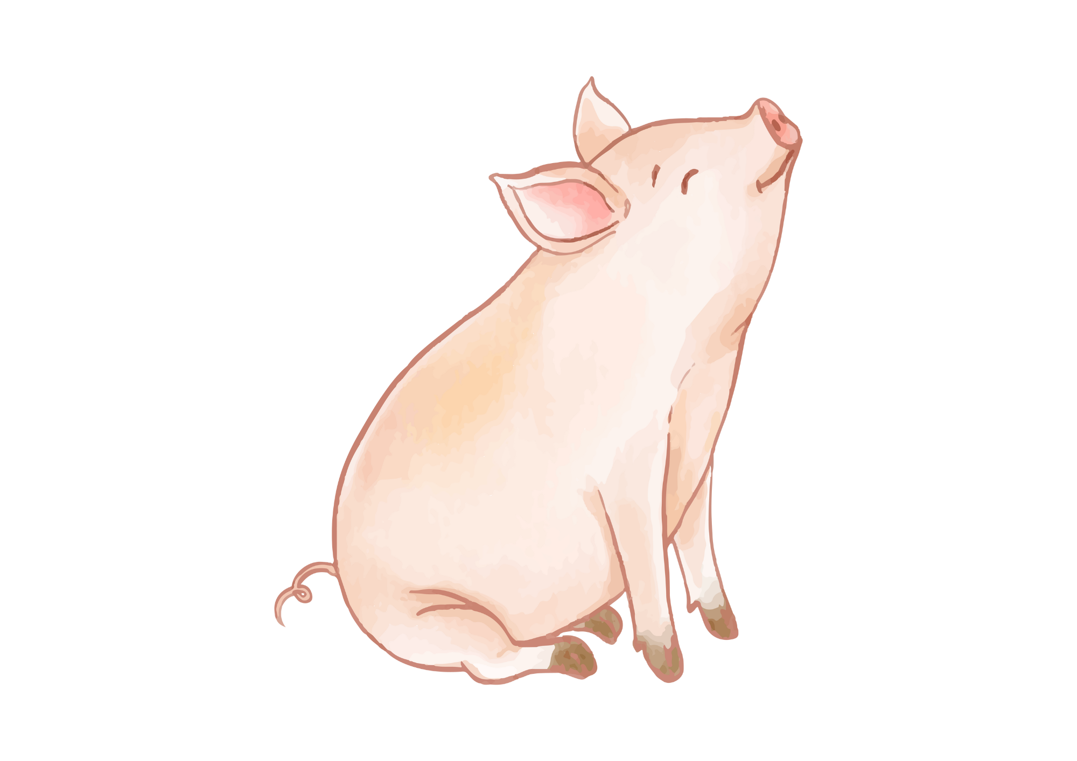

Guess the Book!
“The web glistened in the light and made a pattern of loveliness and mystery, like a delicate veil.”
“The grass looked like a magic carpet.”
“The asparagus patch looked like a silver forest.”
Charlotte’s Web

Slide 8

Guess the Book!
"Miss Trunchbull never walked, she always marched like a storm-trooper with long strides and arms swinging.“
"The parents looked upon Matilda in particular as nothing more than a scab.”
Matilda

Slide 9
Let’s Try Together
Try to explain the simile in each sentence.
Her smile was as bright as the Sun.
This simile compares her smile to that of the morning sun. The morning sun is often associated with warmth, light, and positivity, so it means that her smile was radiant and filled with warmth and happiness.
The water slid over the rocks like silk.
This simile compares the water sliding over rocks to the texture of silk. Silk is known for its smooth texture, so it means that the movement of the water was very smooth.

Slide 10
Let’s Try Together
Try to explain the simile in each sentence.
The old man's memory was as sharp as a tack.
This simile compares the old man’s memory to the sharpness of a tack. It means that the old man has a good (sharp) memory.
The wind whispered through the trees like a secret.
This simile compares the sound of the wind to the hushed tone of a secret. Secrets are often whispered, so it means that the wind was moving quietly.

Slide 11
Writing Similes
Finish these sentences to create similes.
Peter was strong. He was…
Sam had sharp nails. There were like…
Sally was mean. She was as…
Tom was sneaky like…
Alex was always as busy…

Slide 12
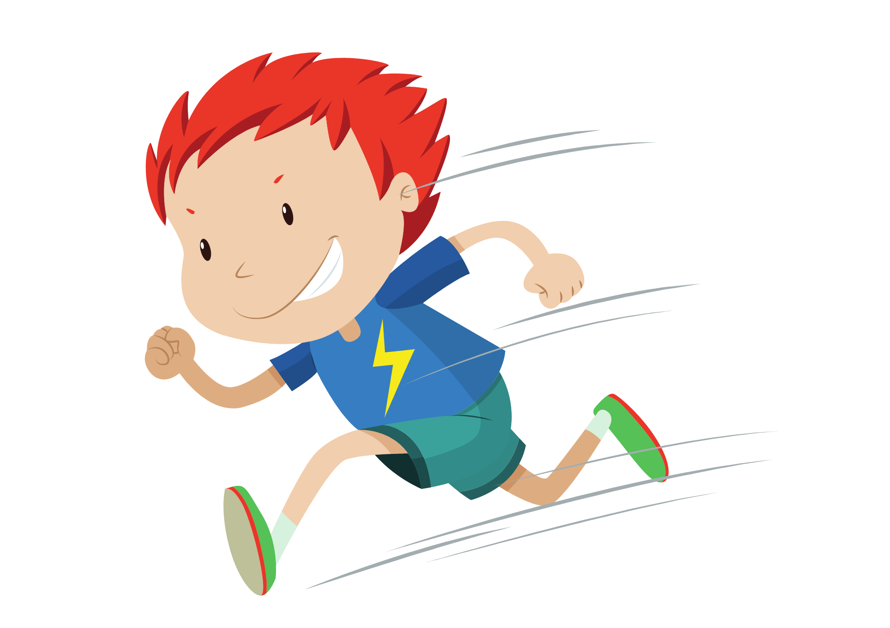
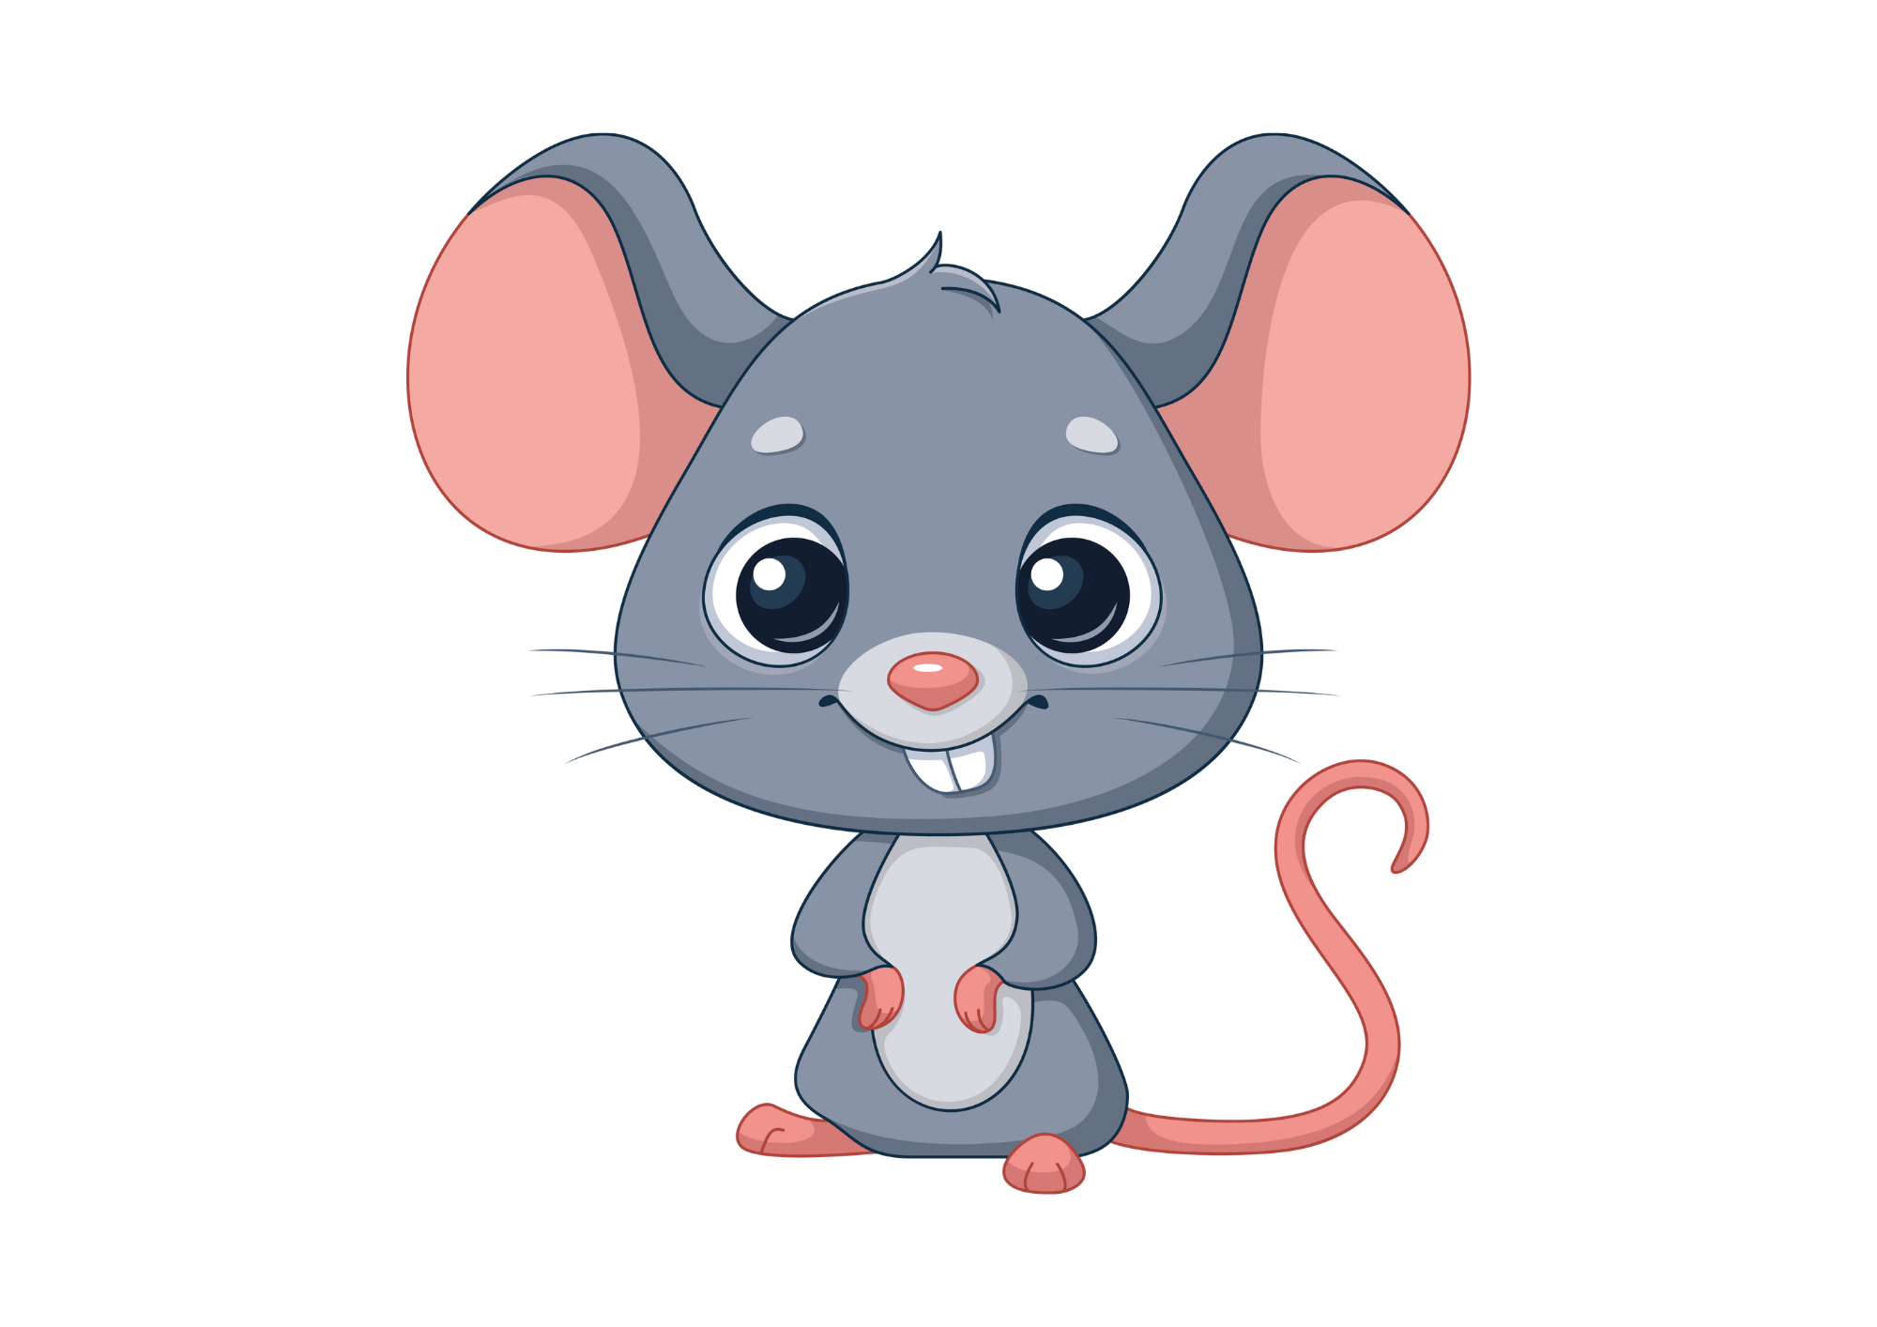

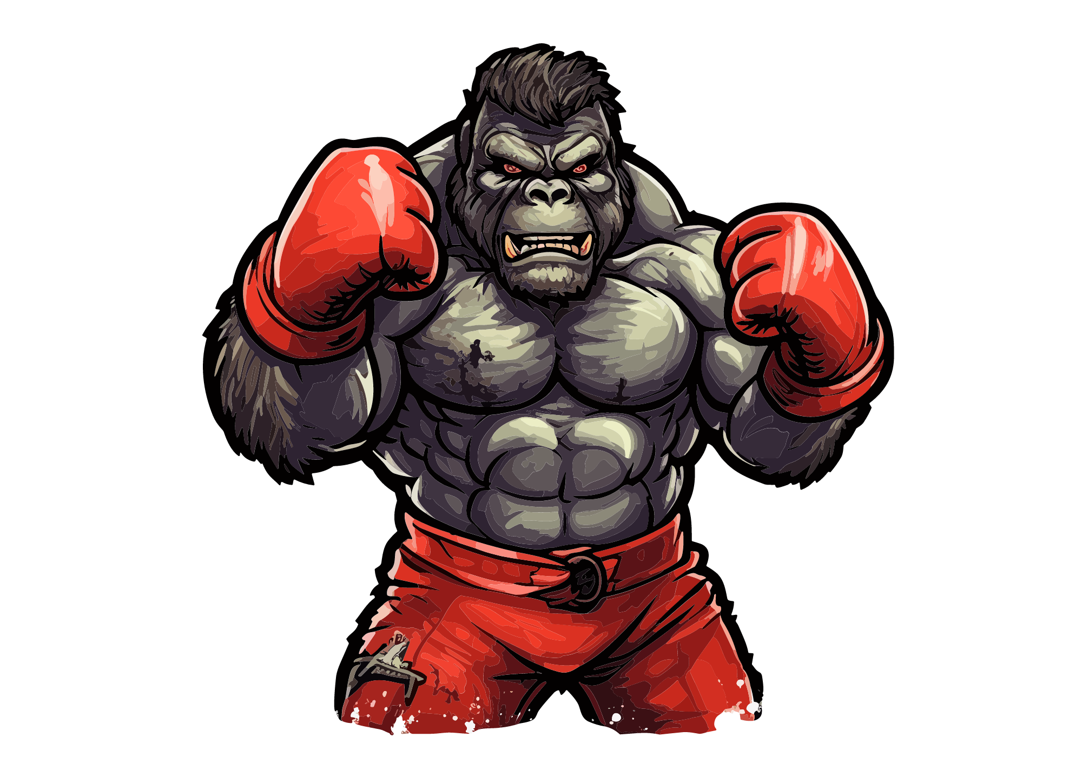
Similes
Write a simile for each of the pictures.

Slide 13
Partner Activity
5 similes will pop up down below. Race your shoulder partner to finish the sentence.
He’s as busy as a…
It’s as clear as…
She’s as happy as a…
He was fast like…
She’s as light as…
bee
crystal
clam
lightning
a feather

Slide 14
Class Activity
Inside – Outside Circle
Write a simile on your whiteboard/paper.
All of the boys, form a large circle around the class.
The girls need to pair up with a boy, which will form the inside circle.
Read the first half of your simile to your partner. They have to guess the second half. If they guess correct, they get a point (tally your points at the top of your whiteboard).
When everyone has read, the teacher will call, “move to the left”.
Example:
Simile: Mary was as strong as…
Answer: an ox.
Feeling stuck? Steal this one!
John was as fast as…

Slide 15
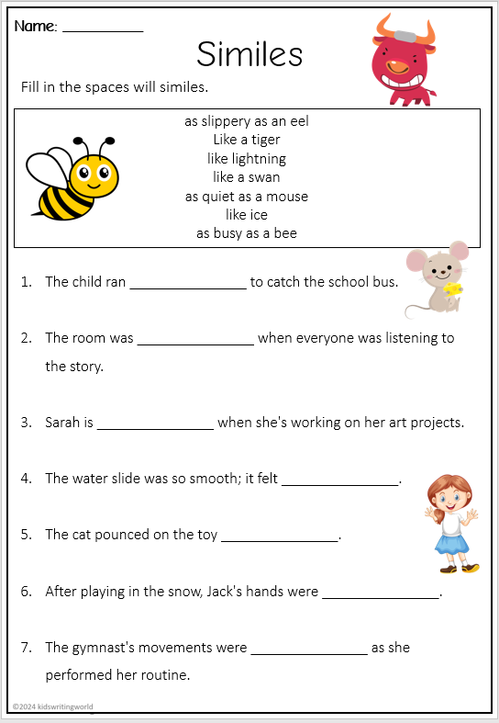
Independent Activity
Complete the simile worksheet.

Slide 16
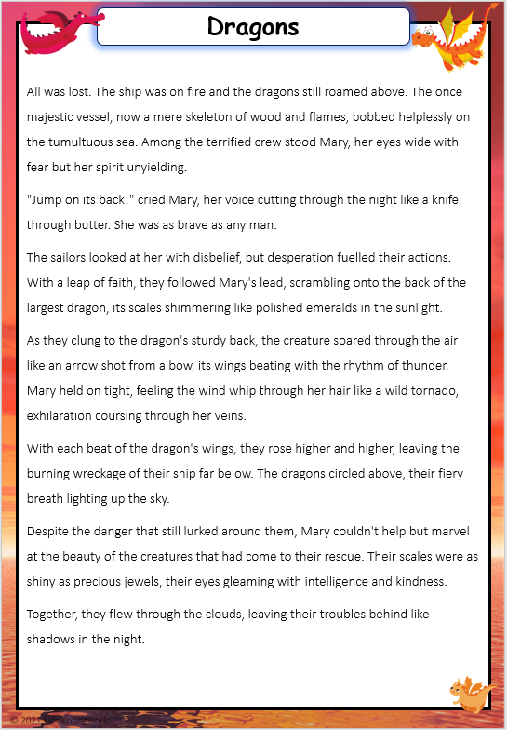
Simile Challenge
Read the text ‘Dragons’ and highlight any similes you can find. There are 6!

