Slide 1




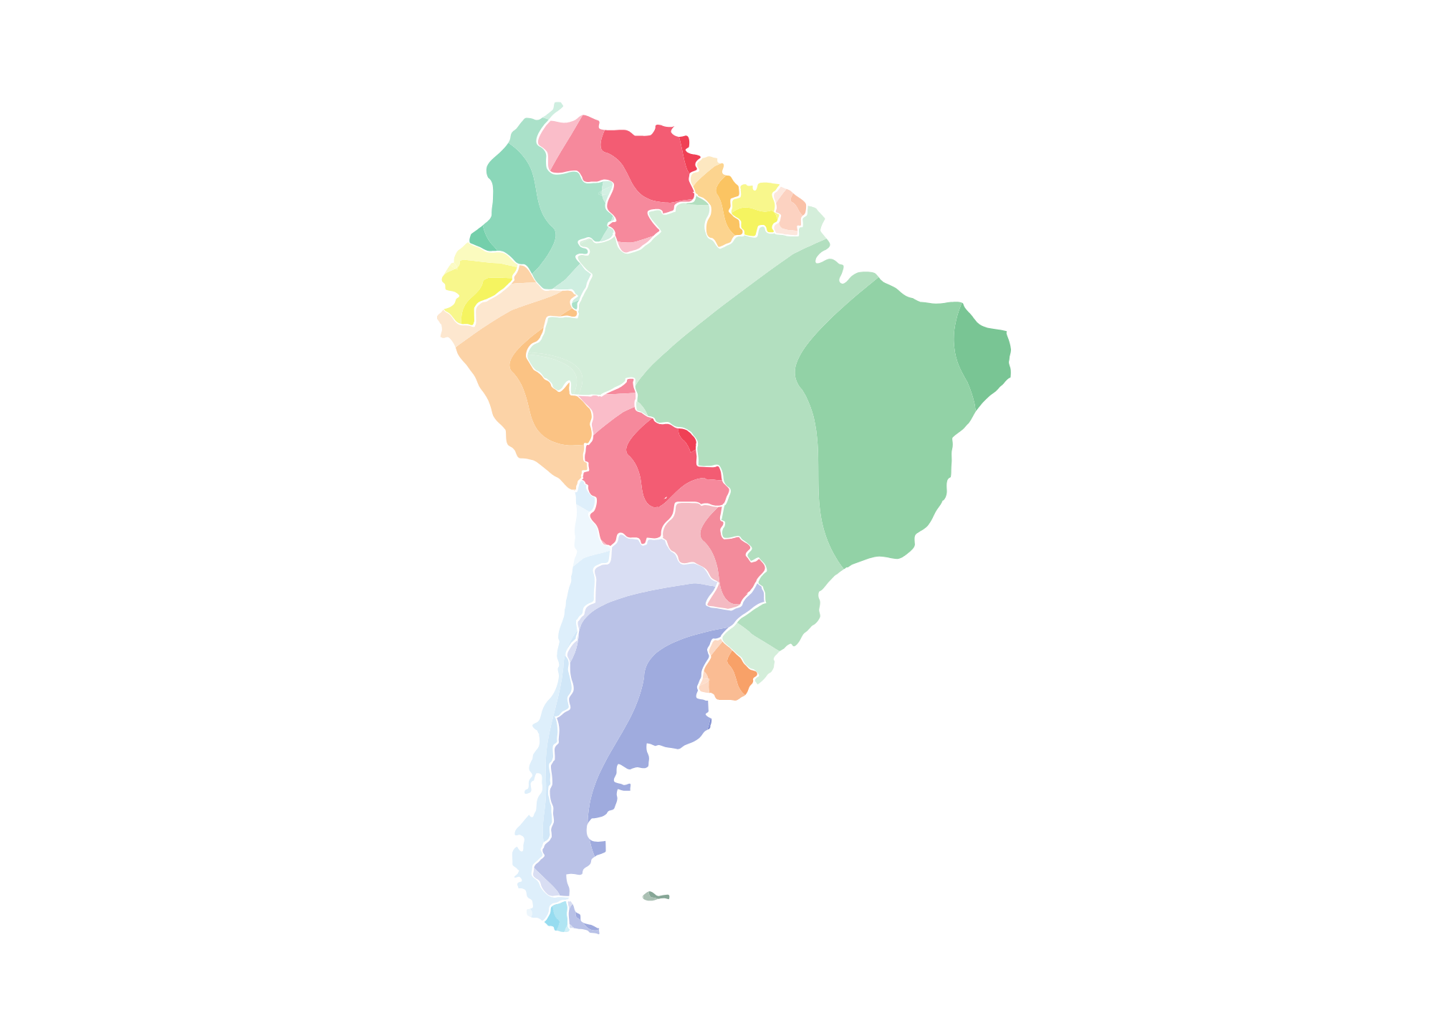


South America Report

Slide 2
Lesson Objectives
By the end of this lesson, I will be able to:
Give basic facts about South America
Paraphrase information
Plan a report about South America

Slide 3
Paraphrasing Strategies
It’s important to paraphrase information you read and put it in to your own words. These 3 strategies will help.
Read the entire text and put it all in to your own words.
Just as it says, read the entire text (maybe twice), look away and write what you remember. It’s a good strategy and ensures that you don’t copy.
Read a sentence and flip the information so it’s in your own words.
Brazil is the largest country in South America and is home to the Amazon rainforest.
→ Brazil is where you will find the Amazon rainforest and it is also the largest country on the continent.
Combine two sentences, but in your own words.
Machu Pichu is a famous historical site. You can visit it in the mountains of Peru.
→ High in the mountains of Peru, you can visit the famous historical site of Machu Pichu.

Slide 4
Note Taking
Read the following slides and take some notes. Use the notes to for your South America report.
Remember to paraphrase the information using one or more of the strategies.
Read the entire text and put it all in to your own words.
Read a sentence or two and flip the information so it’s in your own words.
Combine two sentences, but in your own words.

Slide 5
South America
South America, a continent of diverse landscapes and cultures, captivates with its stunning natural beauty and rich heritage. From the dense Amazon rainforest teeming with wildlife to the majestic peaks of the Andes Mountains, its geography is as varied as it is breathtaking. Home to vibrant cities like Rio de Janeiro, Buenos Aires, and Lima, South America pulsates with energy, art, and history. The continent's indigenous peoples, colonial past, and modern influences join to create a tapestry of traditions and identities. Whether exploring ancient ruins like Machu Picchu or savouring the flavours of Peruvian ceviche, South America offers an unforgettable journey of discovery for the adventurous traveller.

Slide 6
The Largest Countries
The three largest countries in South America—Brazil, Argentina, and Peru—each offer a unique blend of culture, geography, and history. Brazil, the continent's largest nation both in size and population, is known for its vibrant Carnival celebrations, iconic landmarks like Rio de Janeiro's Christ the Redeemer statue, and the vast Amazon Rainforest that covers much of its territory. Argentina, with its expansive grasslands known as the Pampas, is famous for its passionate tango dance, succulent beef dishes, and the breathtaking natural wonder of Iguazu Falls. Peru, home to the ancient Inca civilization, boasts the awe-inspiring Machu Picchu nestled high in the Andes Mountains, the mysterious Nazca Lines etched into its desert plains, and a rich culinary tradition that includes ceviche and guinea pig delicacies. These three diverse countries exemplify the richness and complexity of South America, each offering travellers a wealth of experiences to discover and savour.

Slide 7
Famous Places
South America is adorned with an array of famous sites that draw travellers from across the globe. Among them stands the iconic Machu Picchu, perched high in the Andes Mountains of Peru, shrouded in mystery and surrounded by breathtaking scenery. In Brazil, the colossal statue of Christ the Redeemer watches over Rio de Janeiro from atop Corcovado Mountain, offering panoramic views of the city below. Argentina boasts the awe-inspiring Iguazu Falls, where the thundering waters cascade over hundreds of individual waterfalls, creating a spectacle of nature's power and beauty. The enigmatic Nazca Lines in Peru captivate with their intricate geoglyphs etched into the desert floor, leaving archaeologists and visitors alike pondering their purpose. From the lush Amazon Rainforest to the stunning landscapes of Patagonia, South America is adorned with treasures both natural and man-made, each weaving a tale of history, culture, and wonder.

Slide 8
Languages
South America is a continent of linguistic diversity, where a multitude of languages reflect its rich cultural tapestry. Spanish reigns as the dominant language, spoken in countries like Argentina, Colombia, and Peru, a legacy of Spanish colonization. Portuguese holds sway in Brazil, the continent's largest nation, while Dutch is spoken in Suriname and French in French Guiana. Indigenous languages also play a significant role, with Quechua and Aymara prevalent in Peru and Bolivia, Guarani in Paraguay, and numerous others spoken by smaller communities throughout the region. African languages, brought by slaves during the colonial era, have influenced creole languages like Haitian Creole and Palenquero in Colombia. This linguistic mosaic illustrates the diverse heritage and cultural richness of South America, where language serves as a bridge between the continent's past and present.

Slide 9
Sport
Sport in South America is a vibrant tapestry woven with passion, skill, and tradition. Football, or soccer, reigns supreme as the continent's most beloved sport, uniting nations and igniting fervent rivalries. South American teams, such as Brazil, Argentina, and Uruguay, have left an indelible mark on the global stage, producing legendary players like Pelé, Diego Maradona, and Lionel Messi. The Copa Libertadores, South America's premier club competition, showcases the intense competition among the continent's top football clubs. Beyond football, South America boasts a rich tradition of sports ranging from volleyball on Brazil's golden beaches to rugby in Argentina's rugged terrain. Andean nations like Peru and Bolivia celebrate the ancient sport of llama racing, while Chile embraces the thrill of rodeo. From the high-altitude pitches of the Andes to the sun-drenched stadiums of Rio, sport in South America reflects the continent's boundless energy and competitive spirit.

Slide 10
South America Report
Are you ready for an exciting adventure? Your challenge is to become explorers of the amazing continent of South America! Your mission is to research and write a comprehensive report that will take your classmates on a journey through the diverse landscapes, cultures, and wonders of South America. You may want to write about:
The countries
Famous sites
Wildlife
The people
Sport
Culture
Languages
Remember to use reliable sources for your research and organize your report with clear headings and paragraphs. Use your creativity to make your report engaging and informative, and don't forget to include pictures, maps, and illustrations to bring South America to life for your classmates!

Slide 11
Report Structure
Remember to structure your report clearly. Here are some ideas.
P1. Opening paragraph
P2. Sport
P3. Food
P4. The people
P5. Conclusion
P1. Opening paragraph
P2. Brazil
P3. Culture
P4. The Amazon rainforest
P5. Conclusion
P1. Opening paragraph
P2. Famous sites
P3. History
P4. Wildlife
P5. Conclusion

Slide 12
Vocabulary
Vibrant
Breathtaking
Diverse
Passionate
Lush
Dynamic
Cultural
Colourful
Adventurous
Iconic
Exotic
Enchanting
Intriguing
Rich
Captivating
Mesmerizing

Slide 13






Report Writing Planner
Opening Paragraph
________________________________________________________________________________________________________________________________________________________________________________________________________________________
Mini Topic 1
________________________________________________________________________________________________________________________________________________________________________________________________________________________
Topic
Mini Topic 2
________________________________________________________________________________________________________________________________________________________________________________________________________________________
Mini Topic 3
________________________________________________________________________________________________________________________________________________________________________________________________________________________

