Slide 1

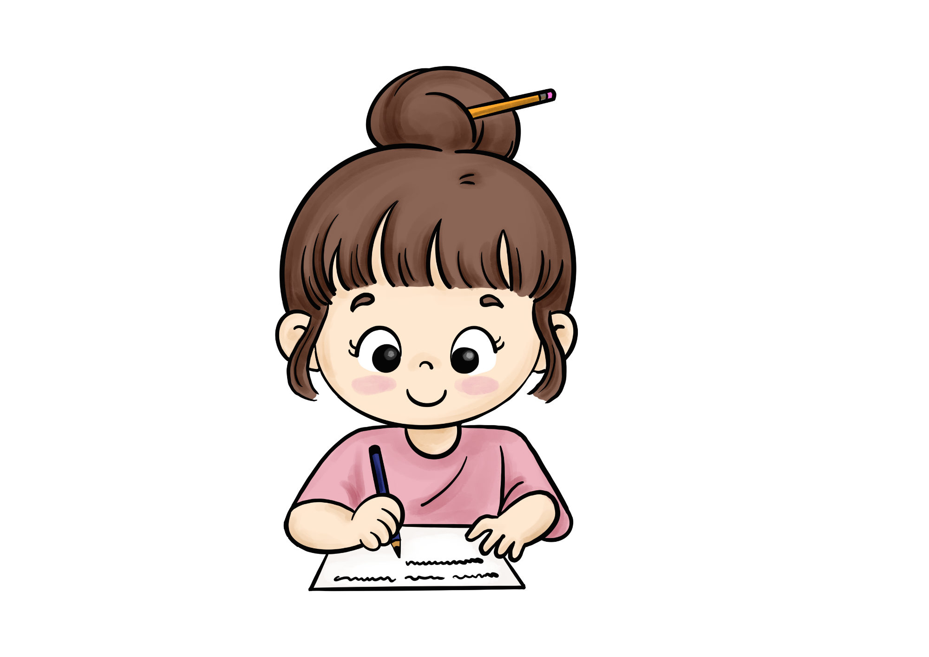
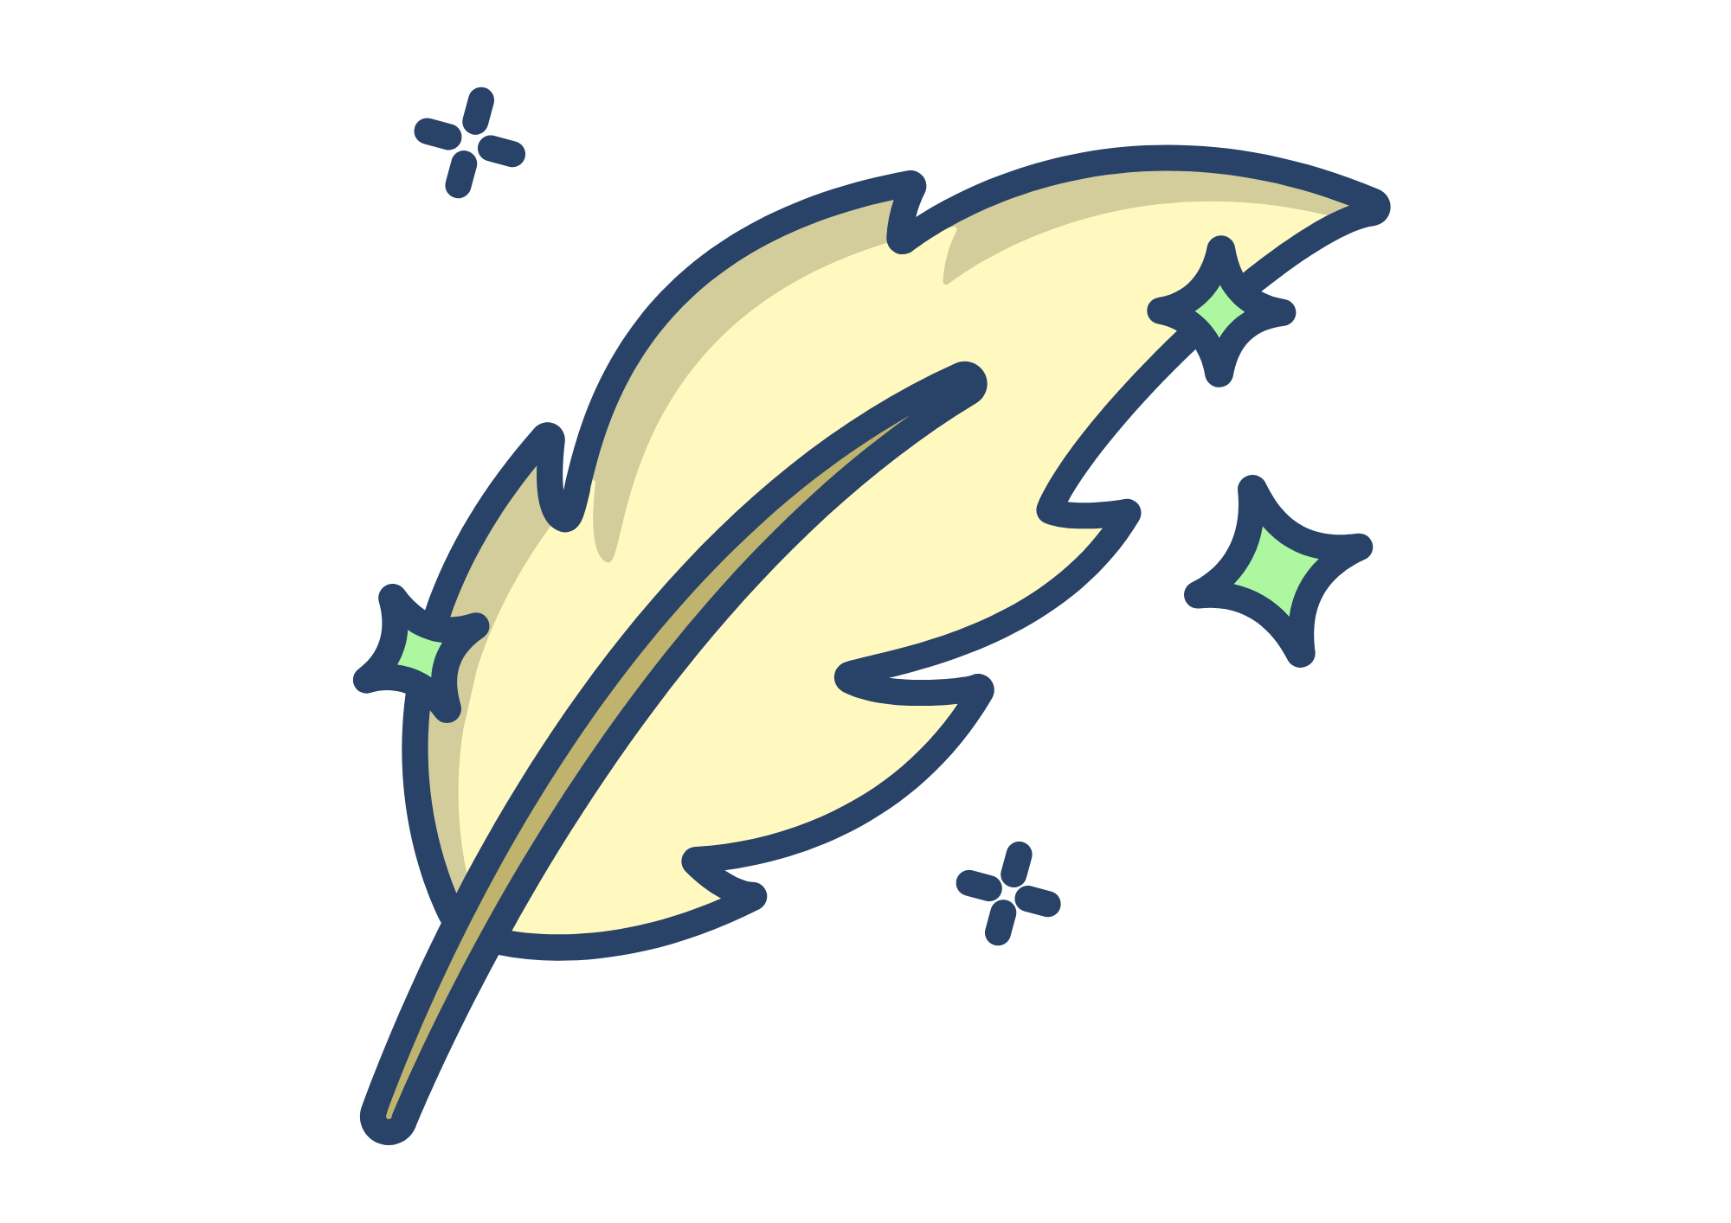
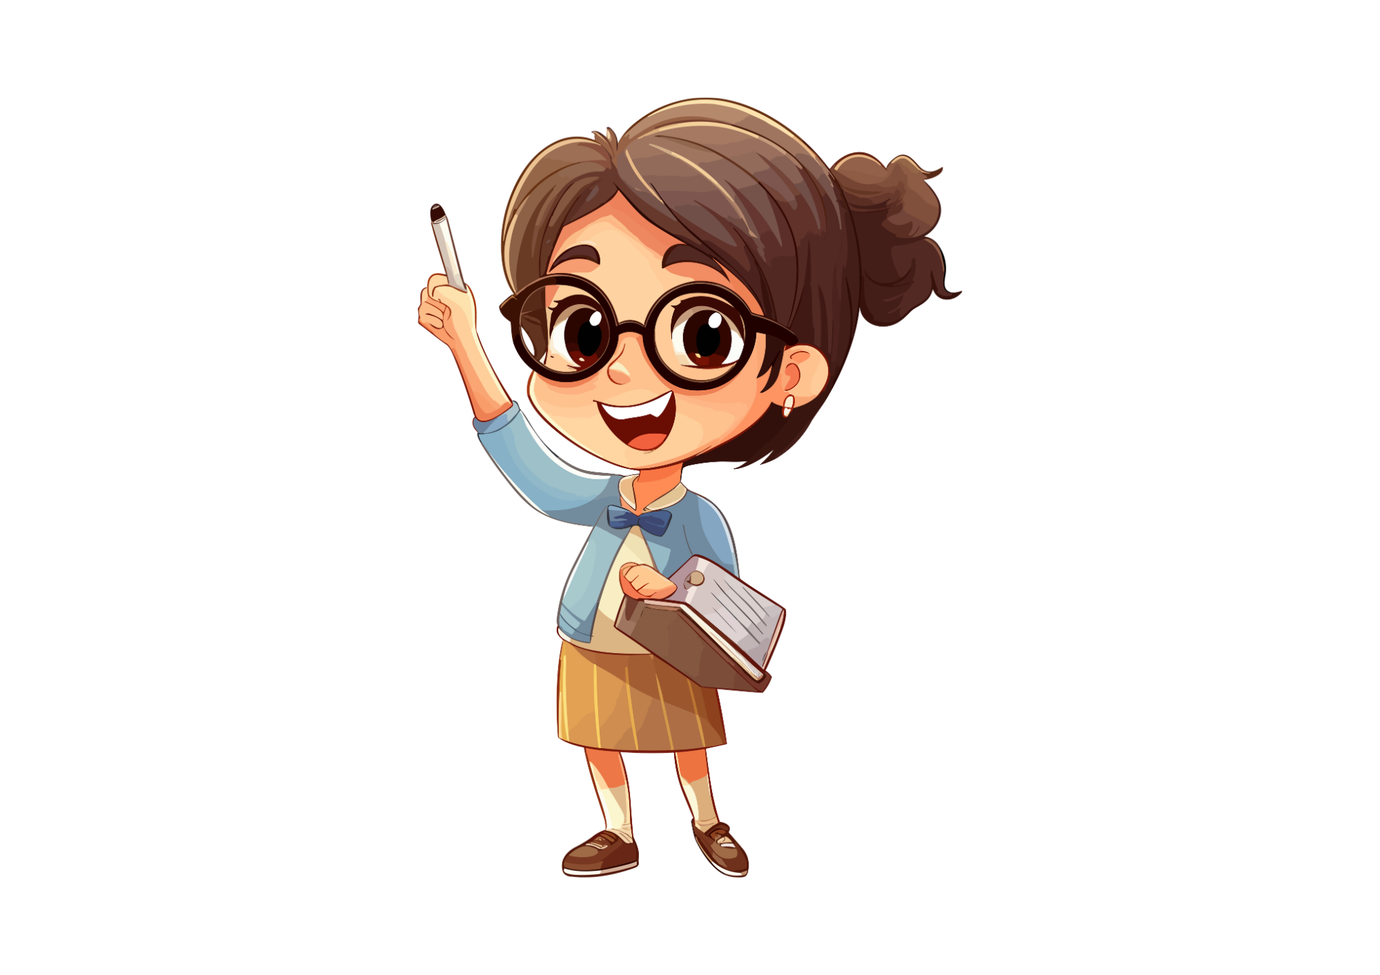
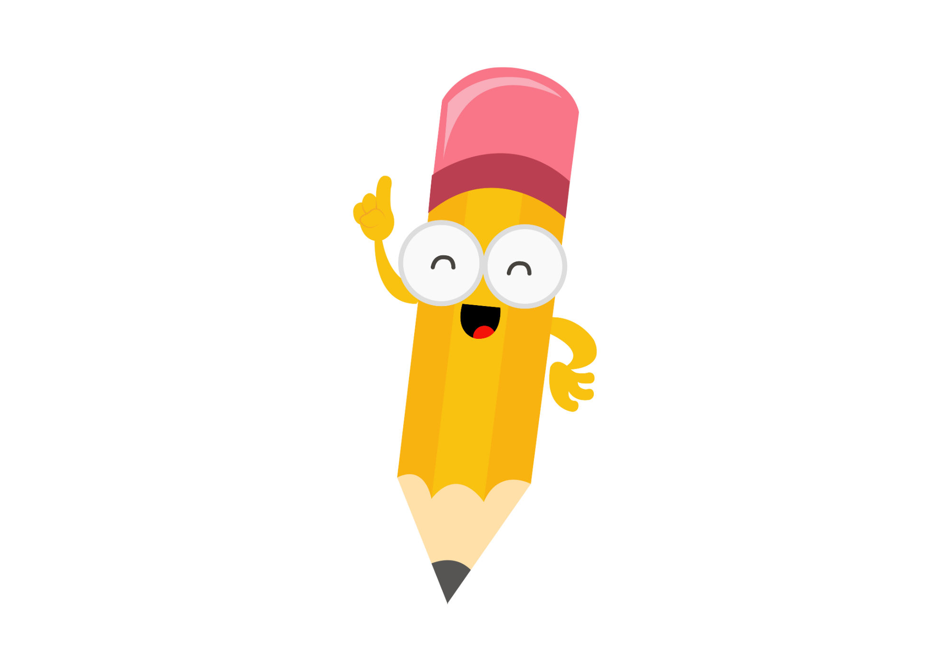

Speech Marks

Slide 2
Lesson Objectives
By the end of these lessons, I will be able to:
Explain 4 speech mark rules
Identify incorrect speech mark use
Add speech marks to sentences

Slide 3

I Do
What are Speech Marks?
Speech marks, also known as quotation marks, are punctuation marks used to show where speech begins and ends in writing. They’re used when characters are speaking.
Examples
"Hello," said Sarah.
Peter called out, “I’m over here!”
“Where are you going?” she asked.

Slide 4


I Do
Speech Mark Rules
Speech marks are used when someone is speaking.
Always need a full stop, comma, question mark or exclamation mark.
“I’m here” she said. “I’m here,” she said.
Speech marks go outside punctuation.
“That’s mine“, he said. “That’s mine,” he said.
If at the end, use a comma before you start the speech.
Sam called out to me “It’s mine.” Sam called out, “it’s mine.”
Don’t capitalize after a question mark.
“How are you?” He asked. “How are you?” he asked.

Slide 5
We Do
Monday
Speech Marks
Work with a partner and explain why each sentence is wrong.
"I'm so excited" exclaimed Maya.
Alex asked “can you pass me the crayons?"
“Where’s my hat?” Asked Tom.
"I finished reading my favourite book“, said Emily with a smile.
"Be careful, the floor is slippery” warned Mrs. Johnson.

Slide 6
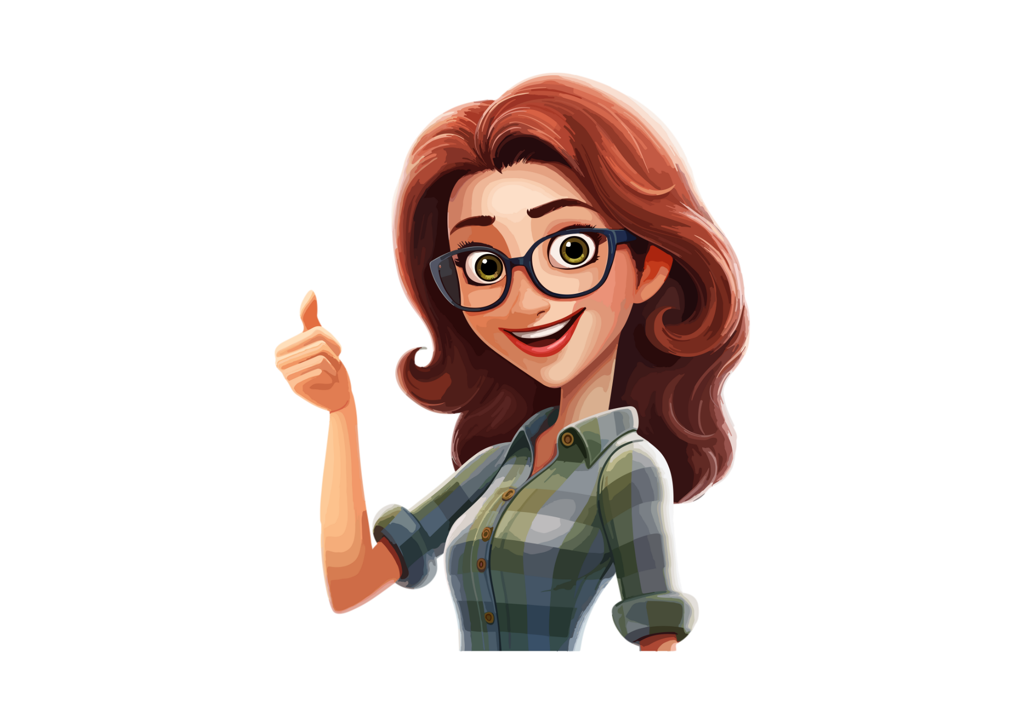
You Do
Monday
Speech Marks
Fix these incorrect speech marks and write them in your book.
"I can't wait to see my friends at the party“! exclaimed Jessica.
"Let's play hide and seek" suggested Jake to his friends.
Sally asked "Did you remember to bring your umbrella?"
“Where are you going?” Asked Jim.
"Be careful crossing the street“, reminded Sarah with concern.

Slide 7
We Do
Tuesday
Speech Marks
Work with a partner to add punctuation and speech marks to these sentences.
I'm going to study hard for the upcoming test declared Sam.
Please pass me the salt requested Grandma.
Anna said look at the beautiful rainbow.
Do you want to go to the movies tonight asked Tom
Let's go for a bike ride in the park suggested Emily.

Slide 8
You Do
Tuesday
Speech Marks
In your book, rewrite these sentences to have punctuation and speech marks.
What time does the movie start inquired Sarah eagerly.
I want to be a scientist when I grow up declared Mark.
Lily whispered Did you hear that noise?
Mom, can I have a cookie asked Tommy.
David said I'm sorry for being late

Slide 9
We Do
Wednesday
Speech Marks
Read the short text and add speech marks. Work with a partner.
Hello? Is anyone there? called Tommy. An old owl replied, I’m right here.
Are you a talking owl? asked Tommy in awe.
Yes, young one. What brings you here? replied the owl, its voice gentle.
I’m here to find my mother said Tommy.
Well… let me help you! exclaimed the old owl.

Slide 10
You Do
Wednesday
Speech Marks
Read the short text and add speech marks. Work with a partner.
Excuse me, can you help me find the Fairy Queen? Lily asked a butterfly.
You won’t find her here, replied the butterfly. She lives in the mountains, she continued.
Will you take me to her? asked Lily.
The butterfly thought and said, I’ll take you for $1,000.
Deal! said Lily, and they went on their way.

Slide 11
You Do
Wednesday
Speech Marks
Answers
Read the short text and add speech marks. Work with a partner.
"Excuse me, can you help me find the Fairy Queen?" Lily asked a butterfly.
“You won’t find her here,” replied the butterfly. “She lives in the mountains,” she continued.
“Will you take me to her?” asked Lily.
The butterfly thought and said, “I’ll take you for $1,000.”
“Deal!” said Lily, and they went on their way.

Slide 12
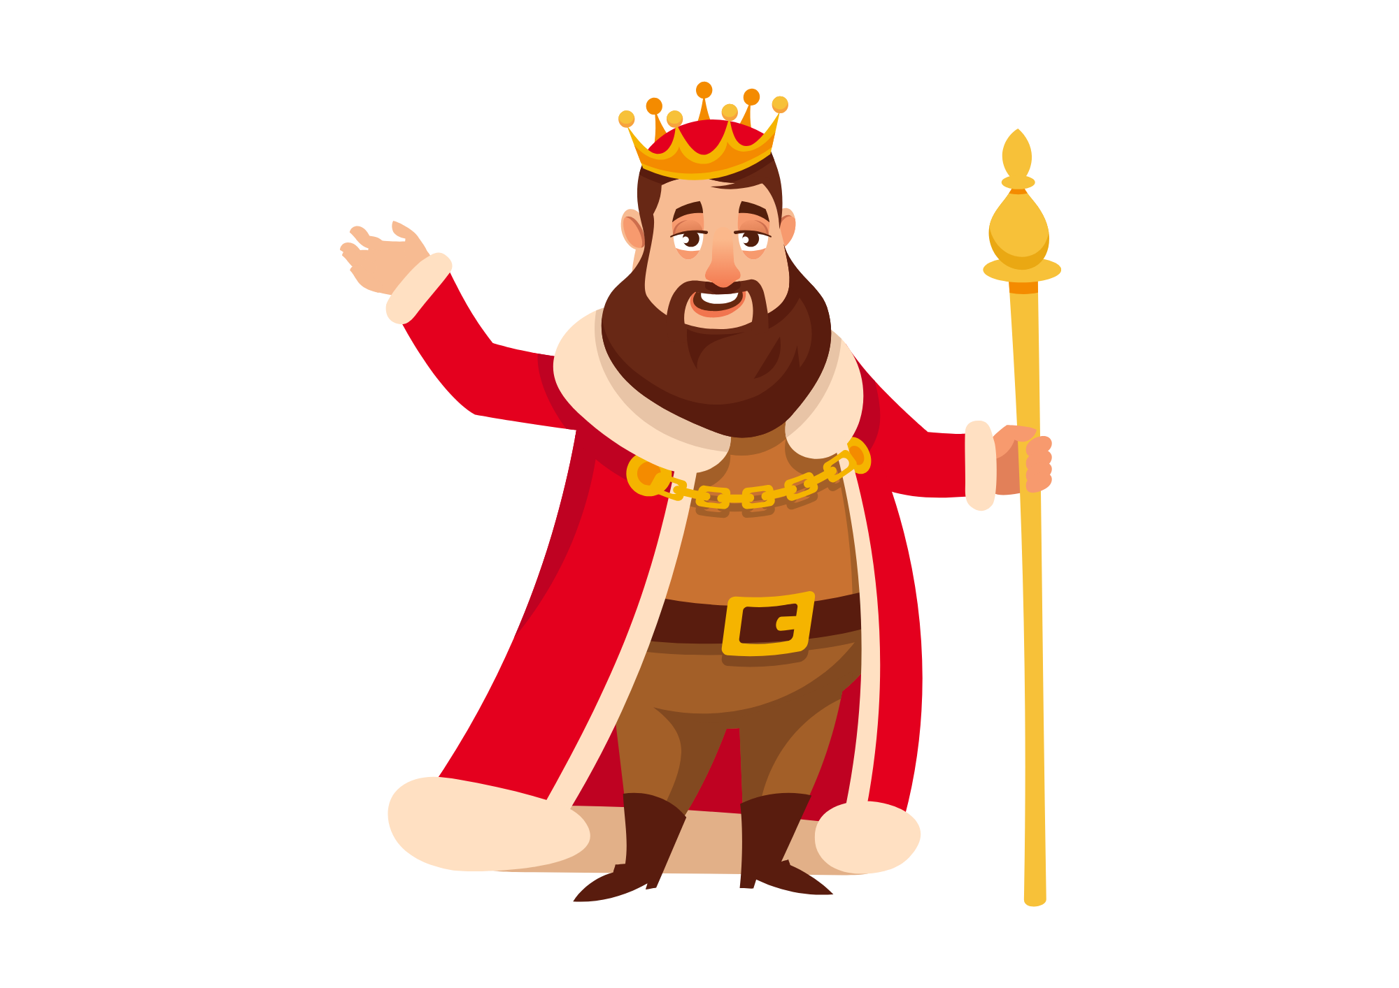
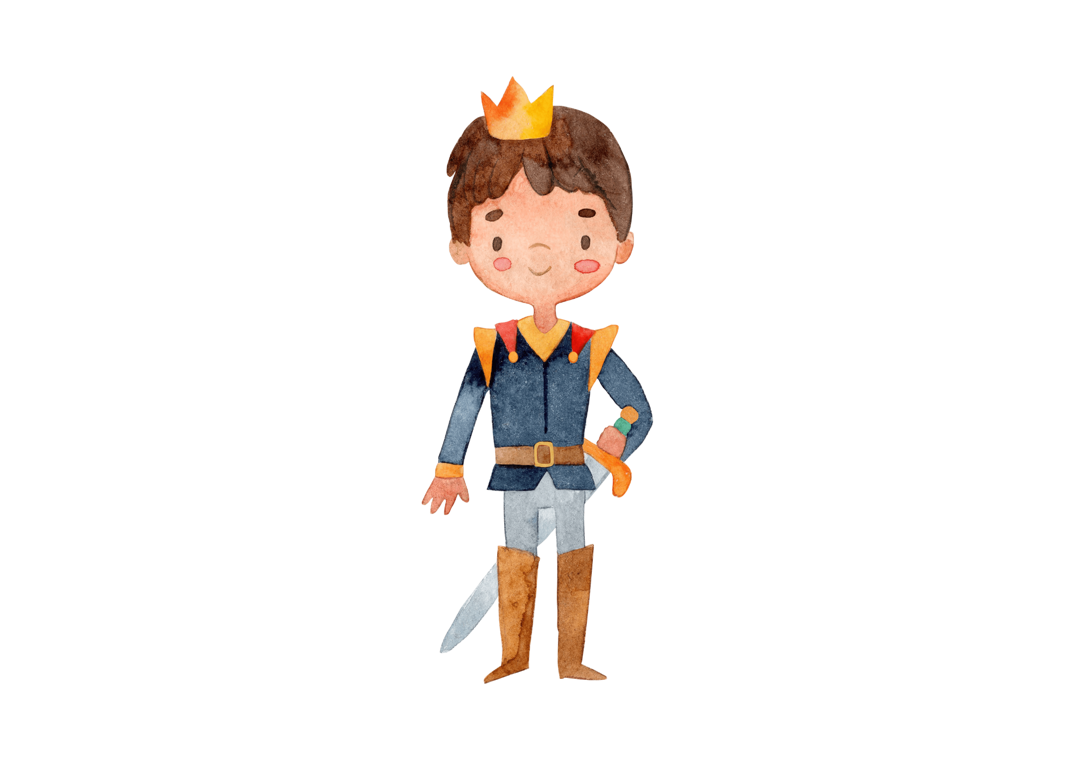

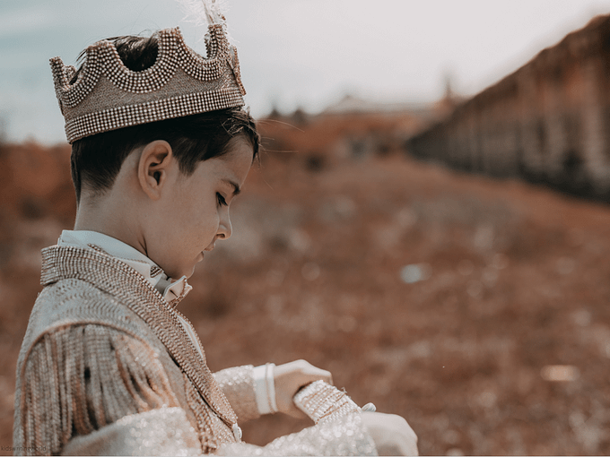
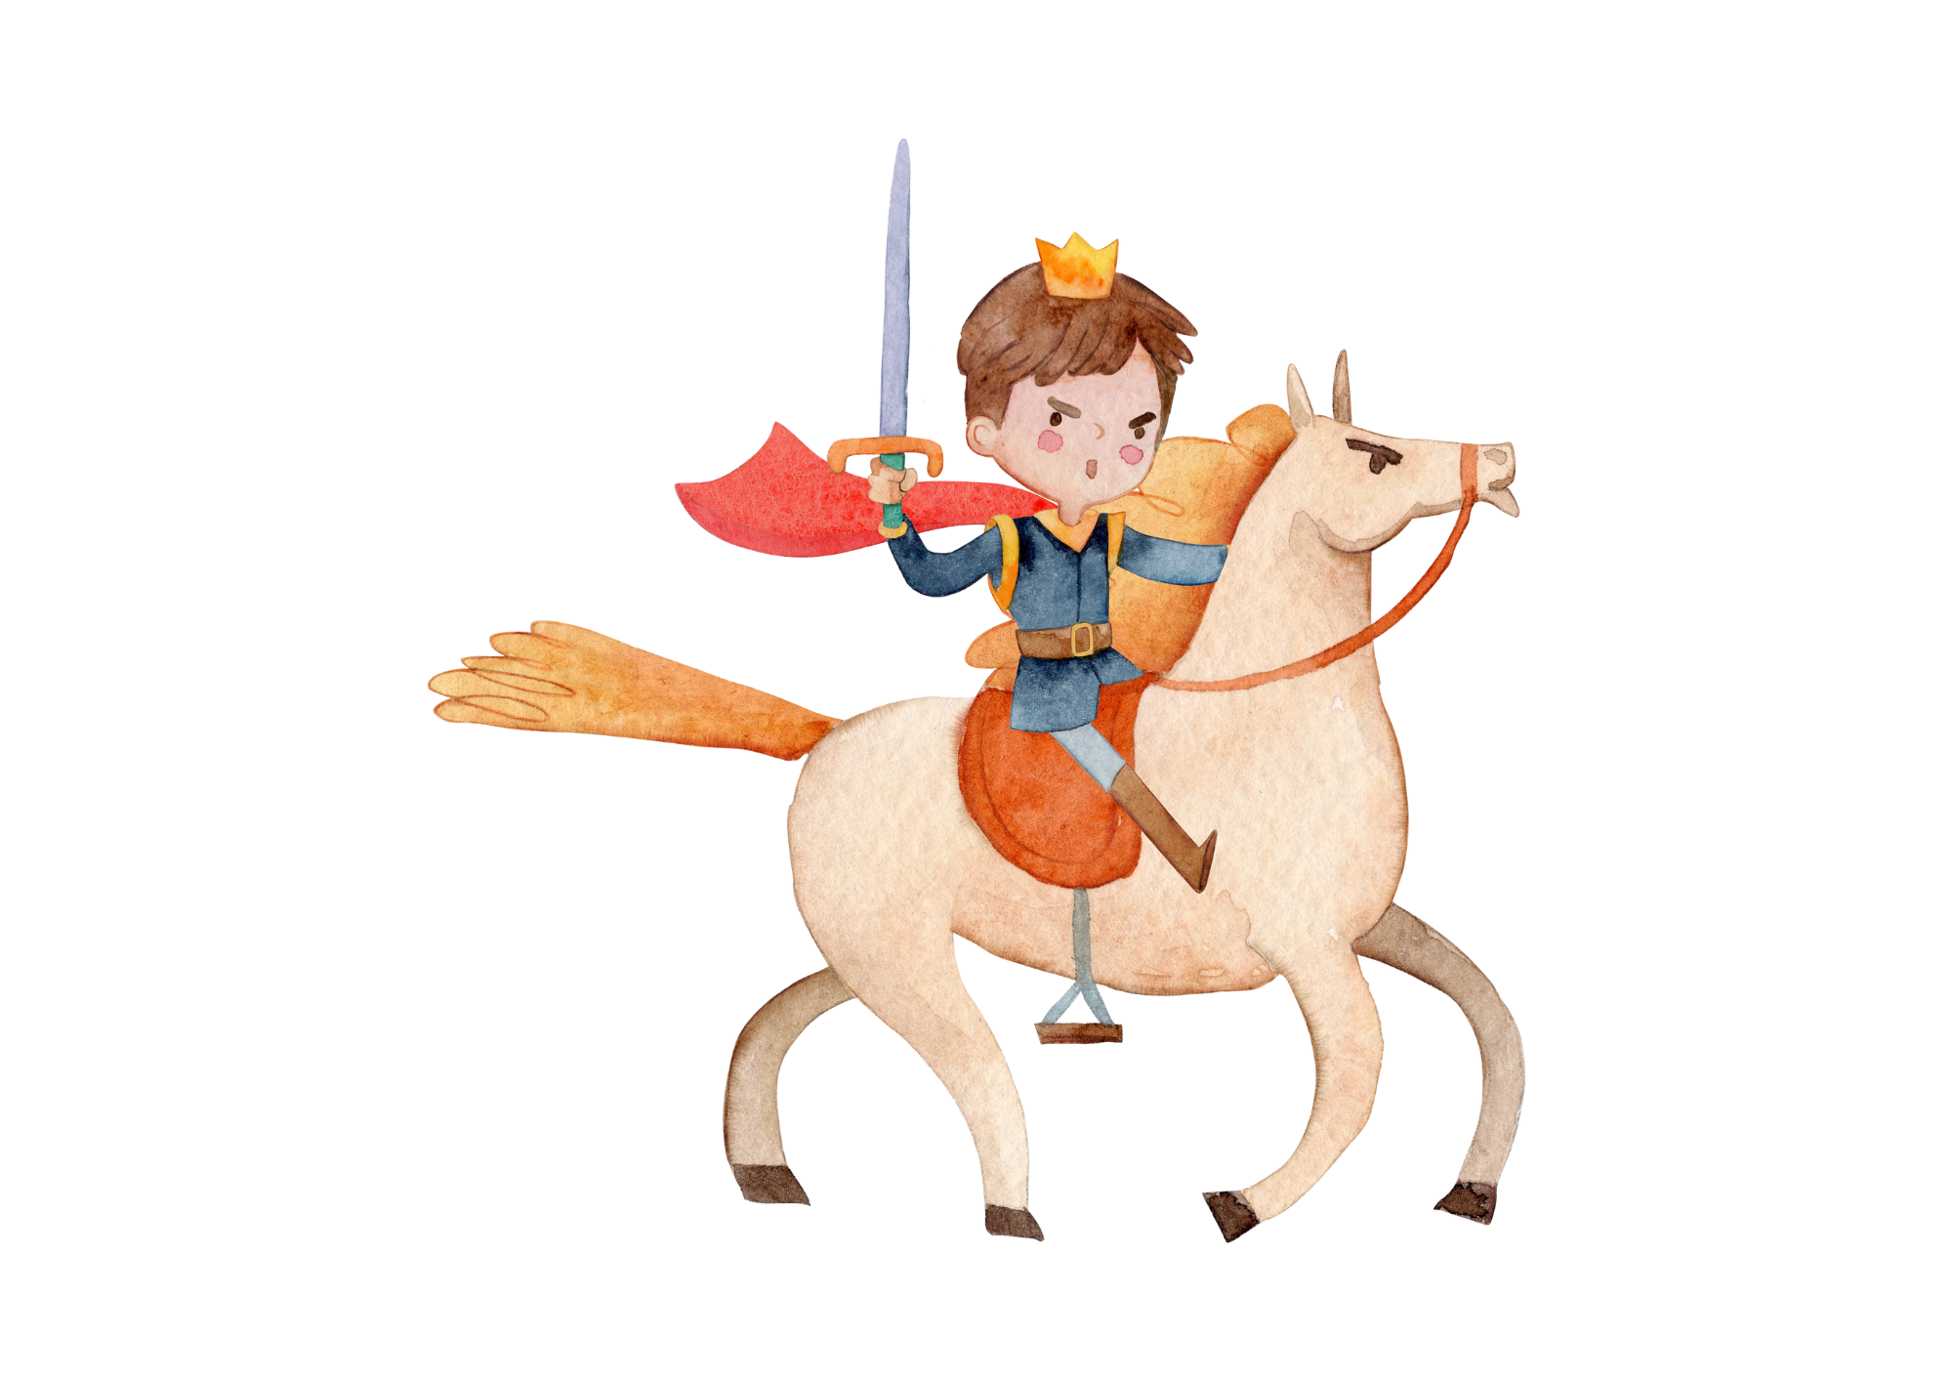

Speech Marks Short Story
Write a short story about the ‘Young King’ and use at least 4 speech marks. Highlight your speech marks in your story.
The Young King
Story Starter
Staring mindlessly at the crowds, Peter’s mind fell blank. His father was dead and he was now the king. He turned to his uncle and said, “arrest that man, he killed my father.”

