Slide 1
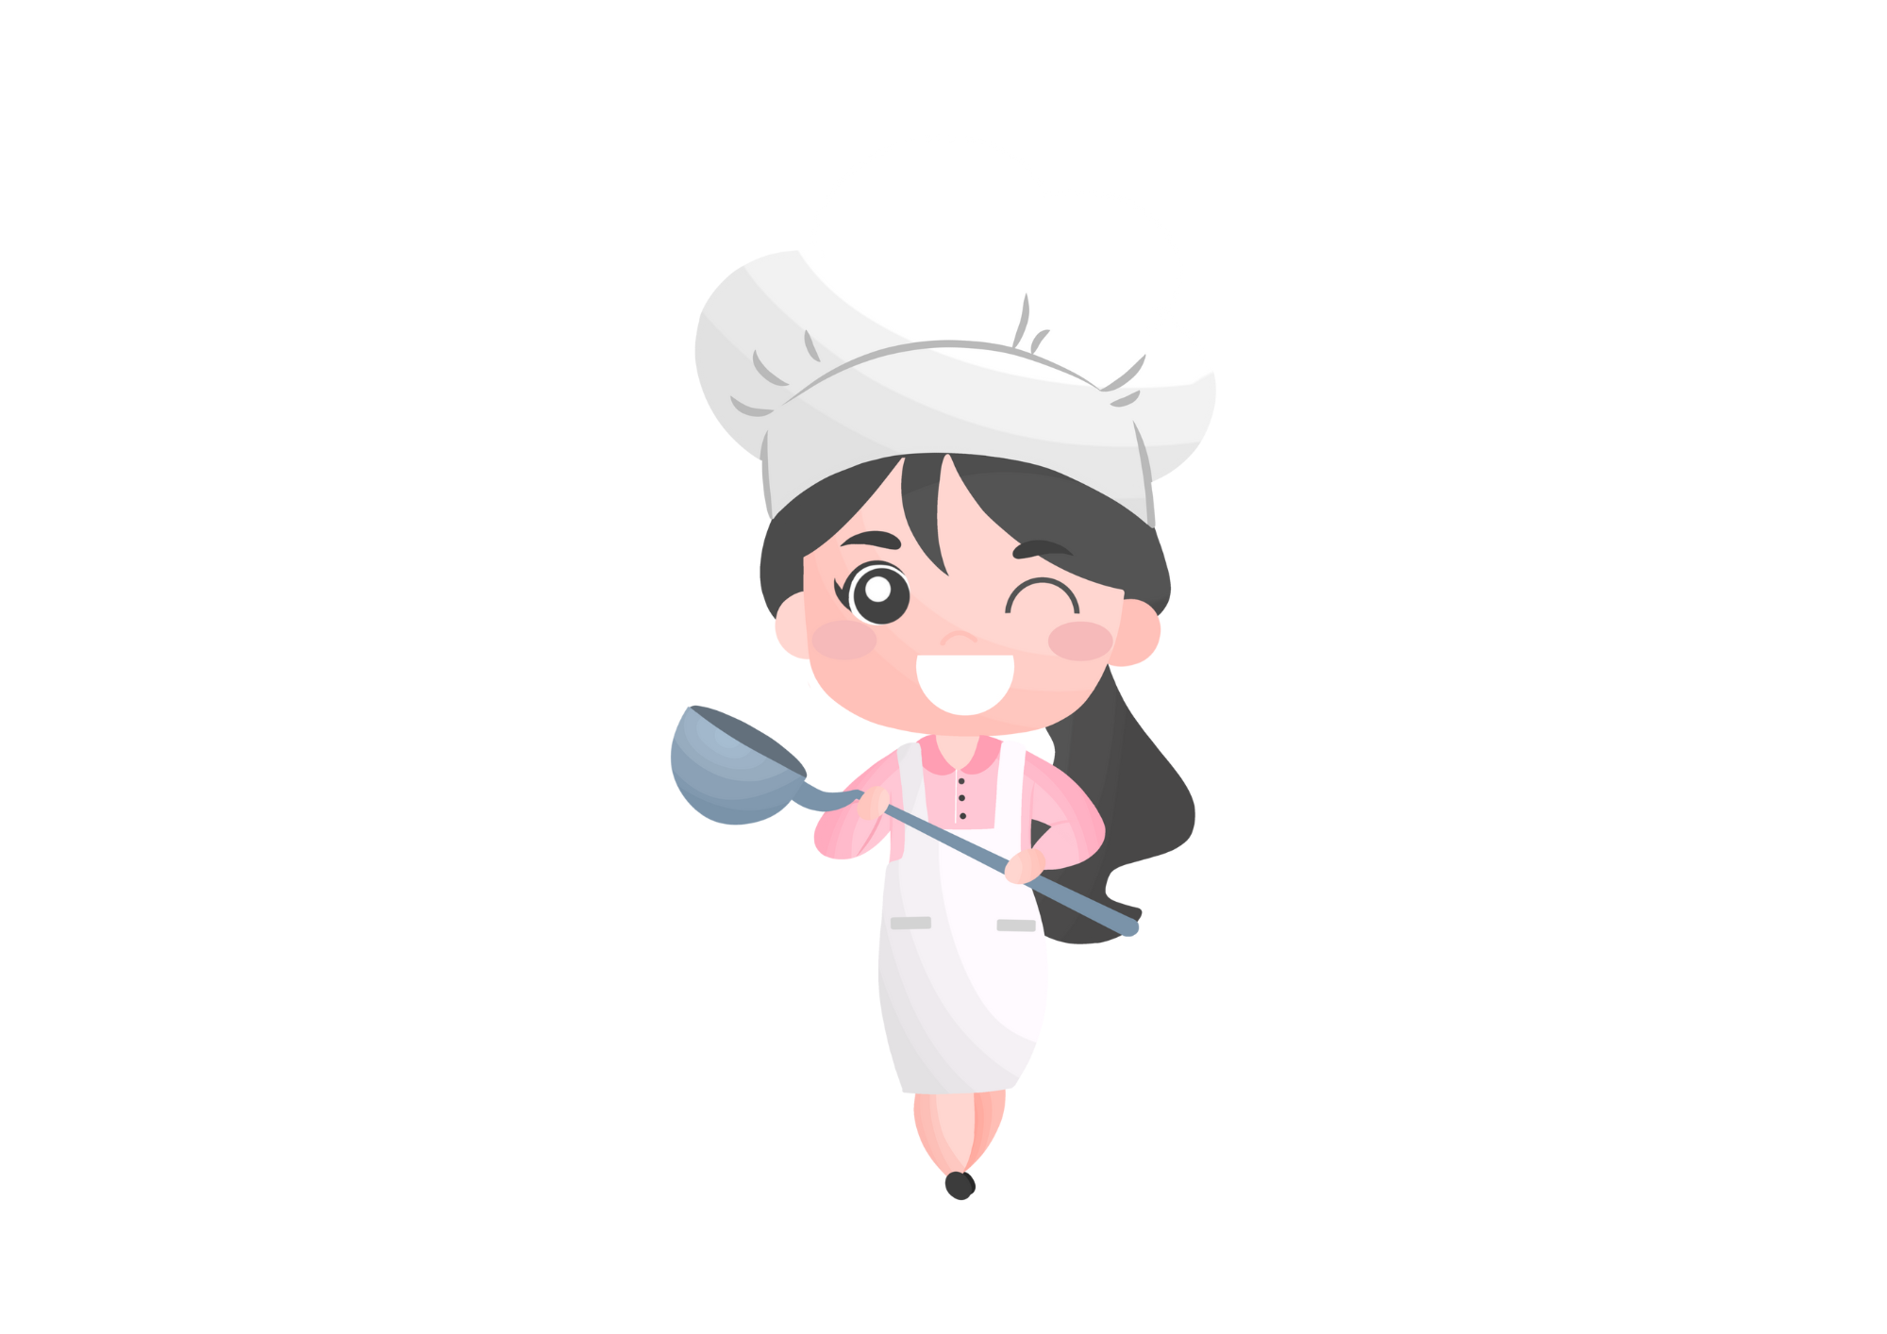

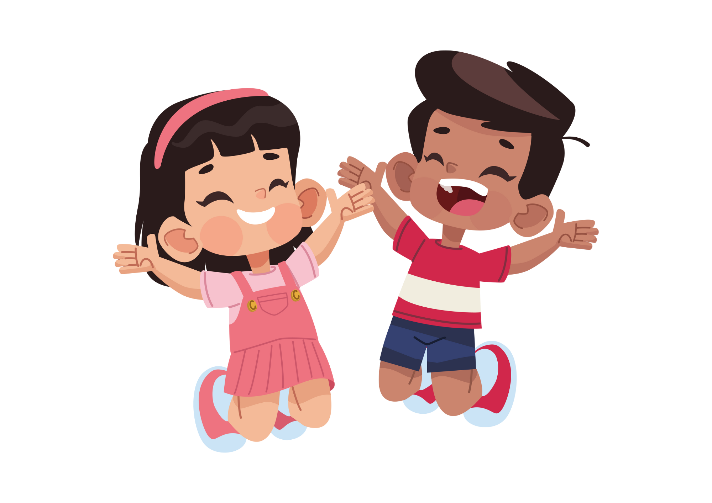
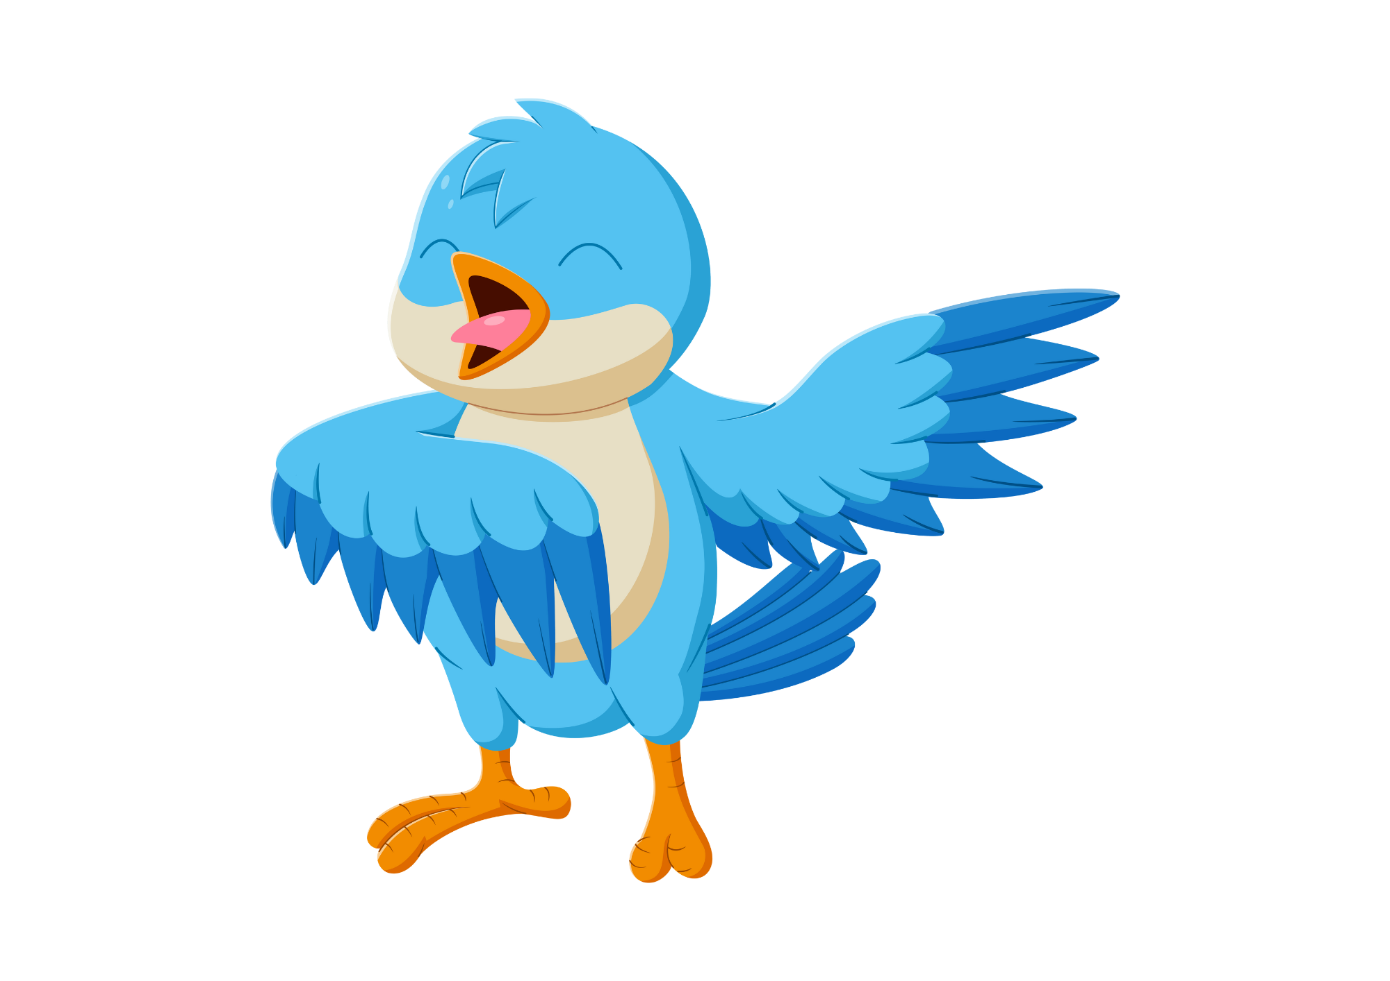
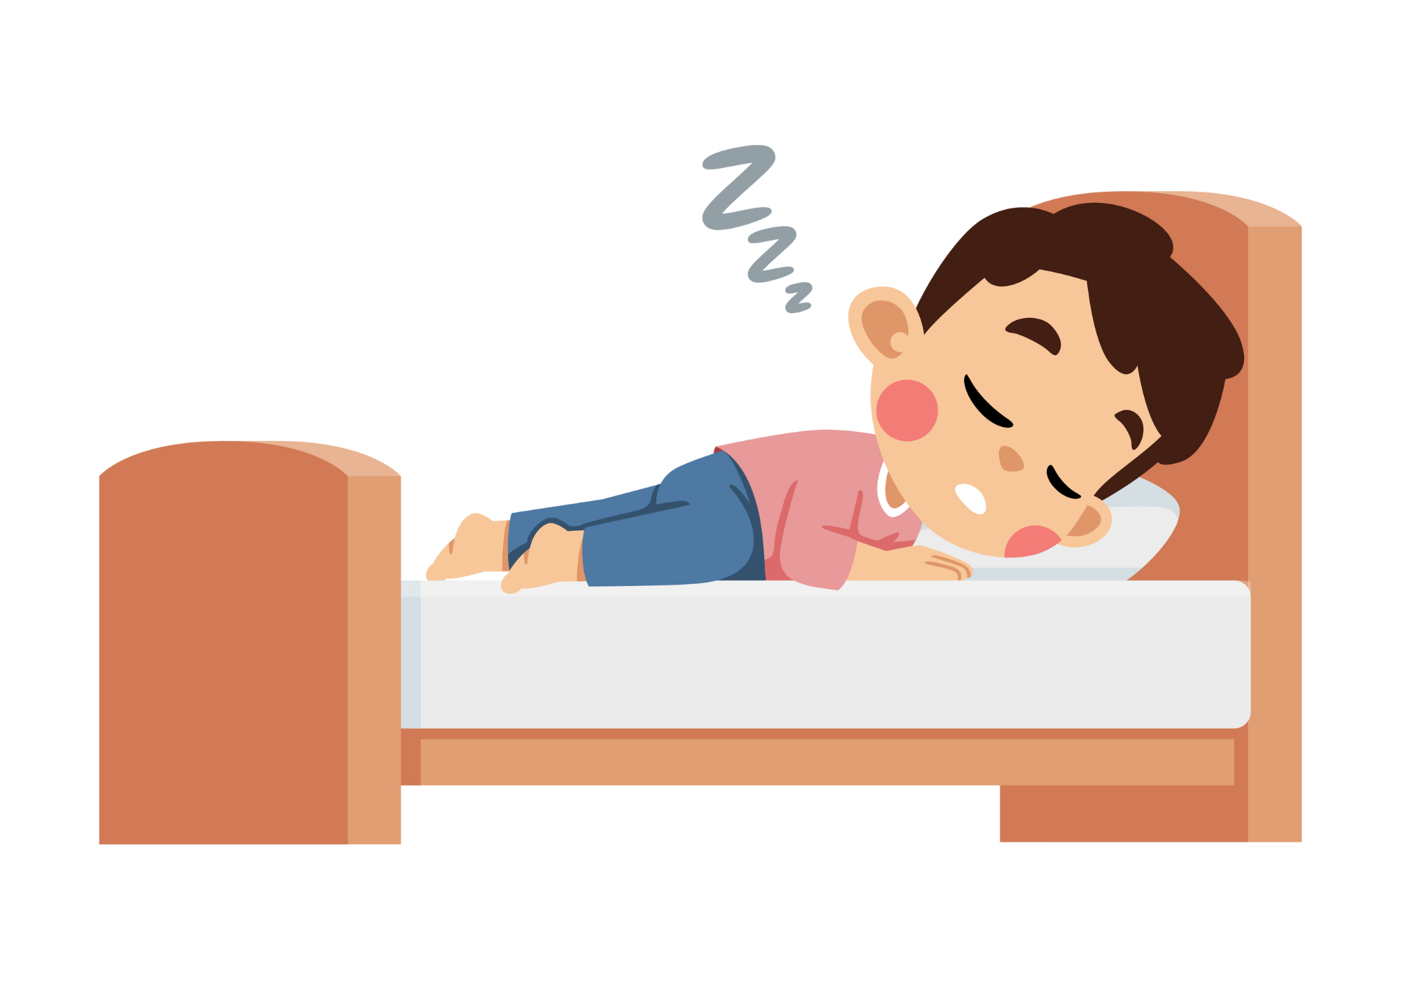
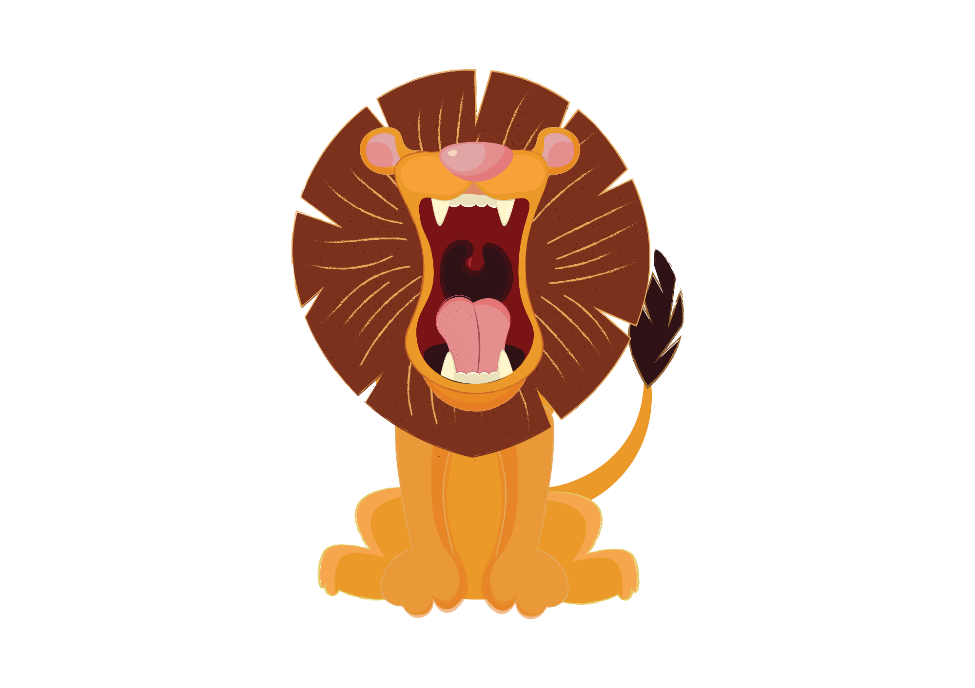
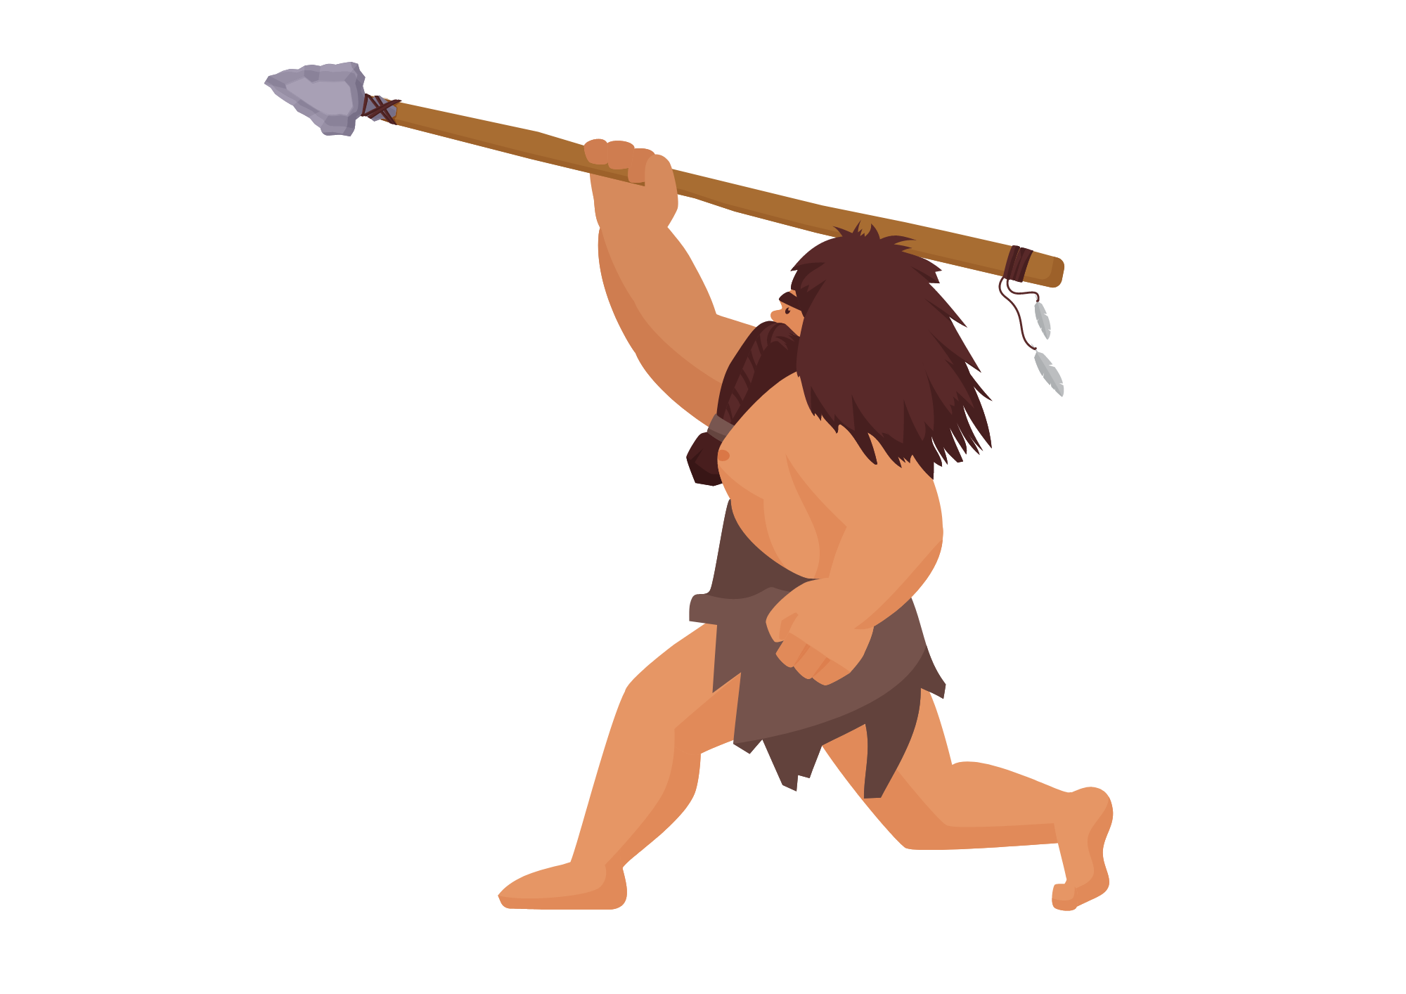

Verbs

Slide 2
Lesson Objectives
By the end of these lessons, I will be able to:
Explain what a verb is
Give examples of verbs
Identify verbs in sentences
Use verbs to create my own sentences

Slide 3
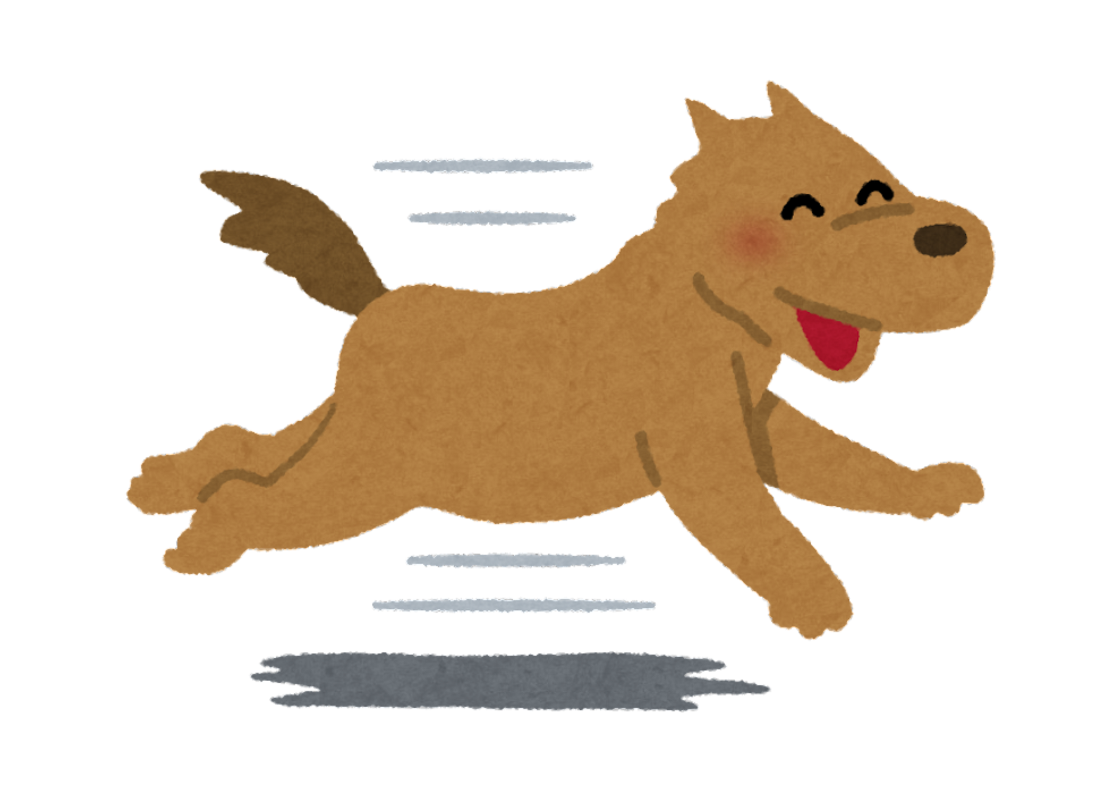
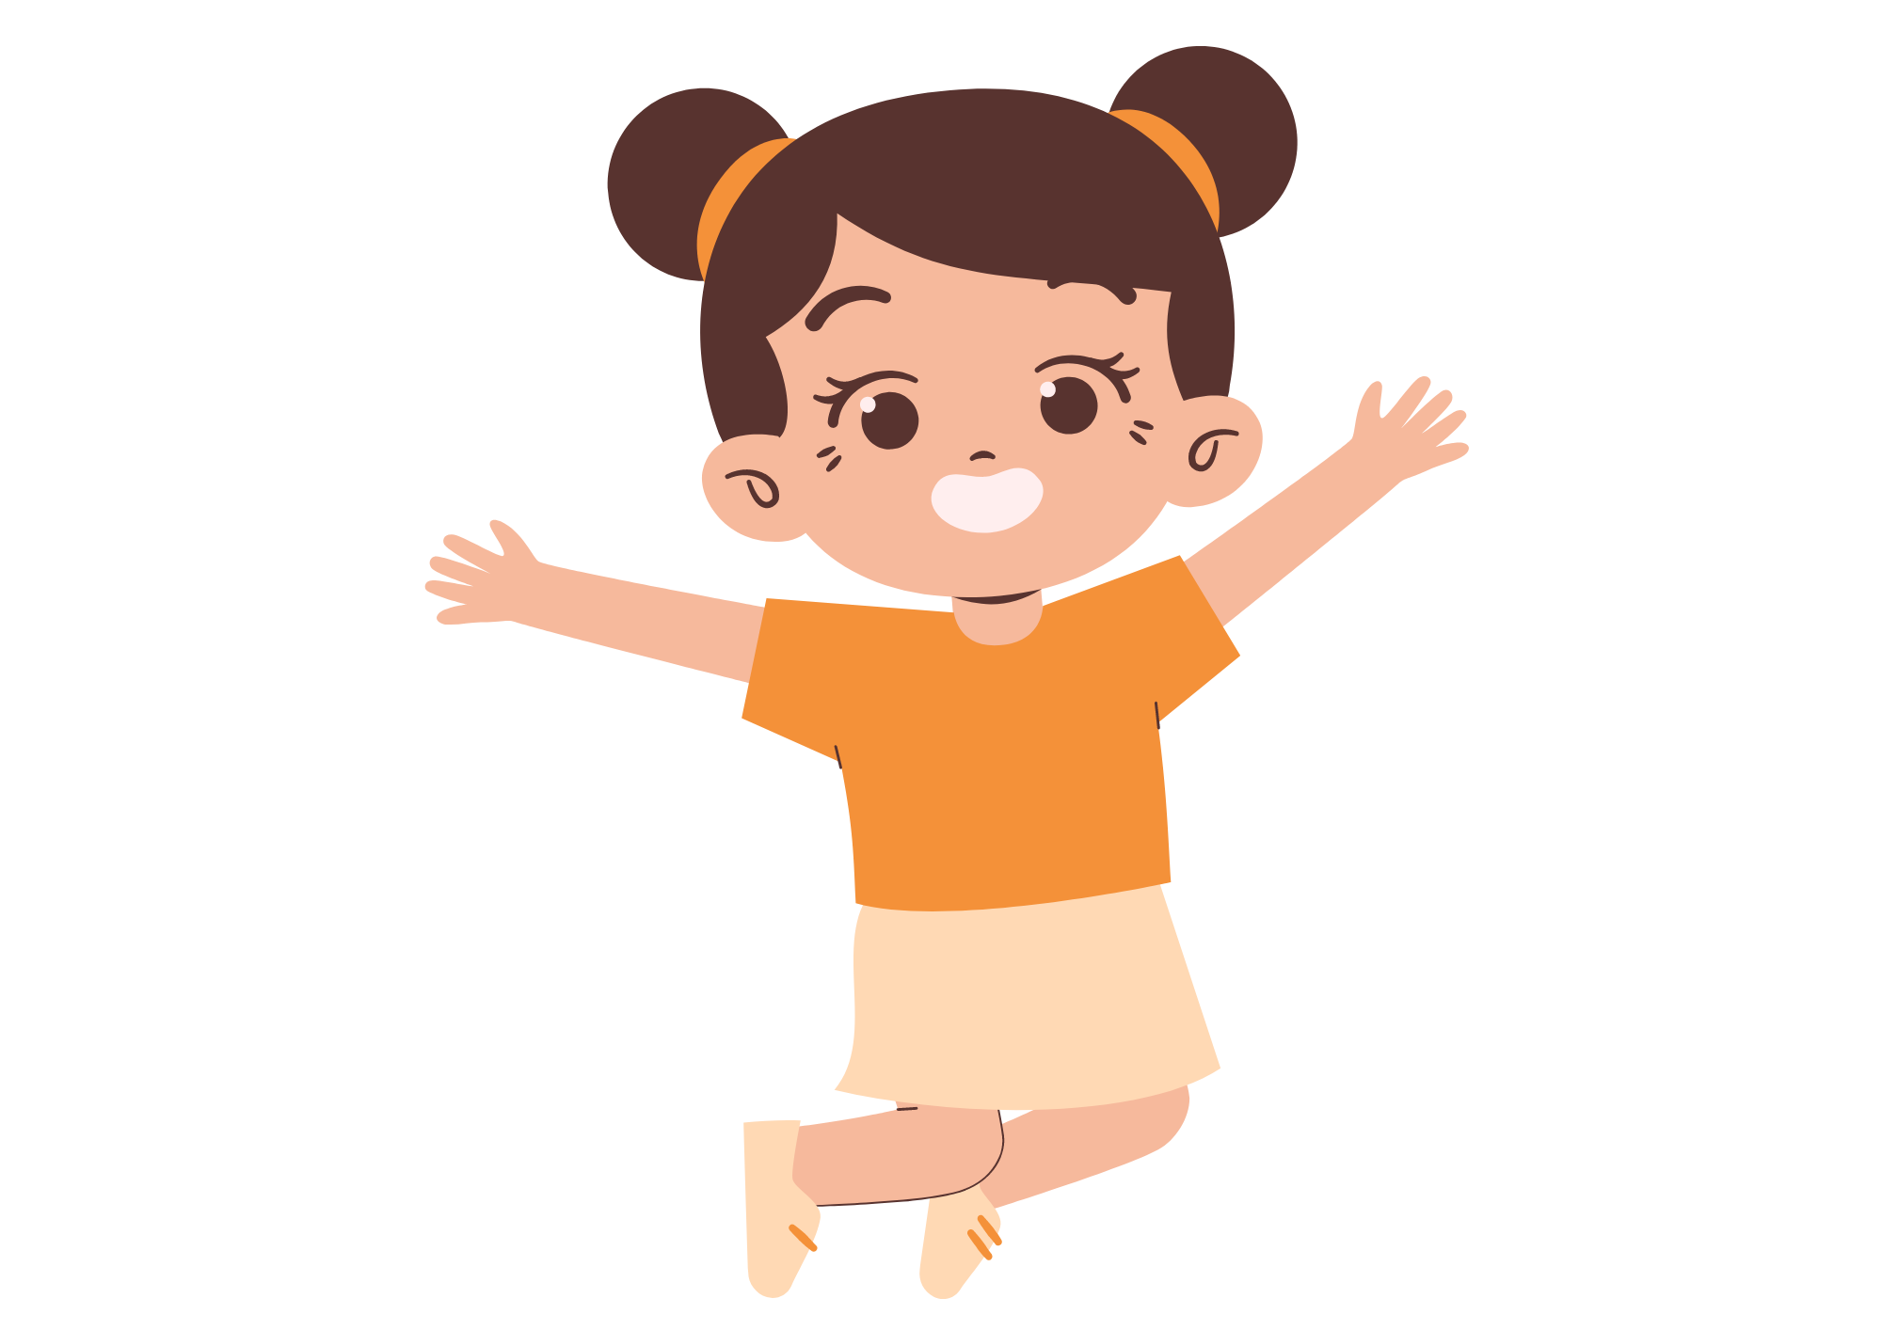

I Do
What are Verbs?
Verbs are words that show action or state of being. They tell us what someone or something is doing.
Action verbs: These verbs show actions. For instance, "run," "jump," "eat," "dance," and "sing" are action verbs because they describe things people or animals do.
Example: The dog runs in the park. The girl jumps on the sofa.
State of being verbs (be verb): These verbs show a state of existence. For example, "am," "is," "are," "was," and "were" are state of being verbs. They help us understand what someone or something is like or how they exist.
Example: She is happy. They are at school.
Remember, sentences don’t make sense without verbs!

Slide 4

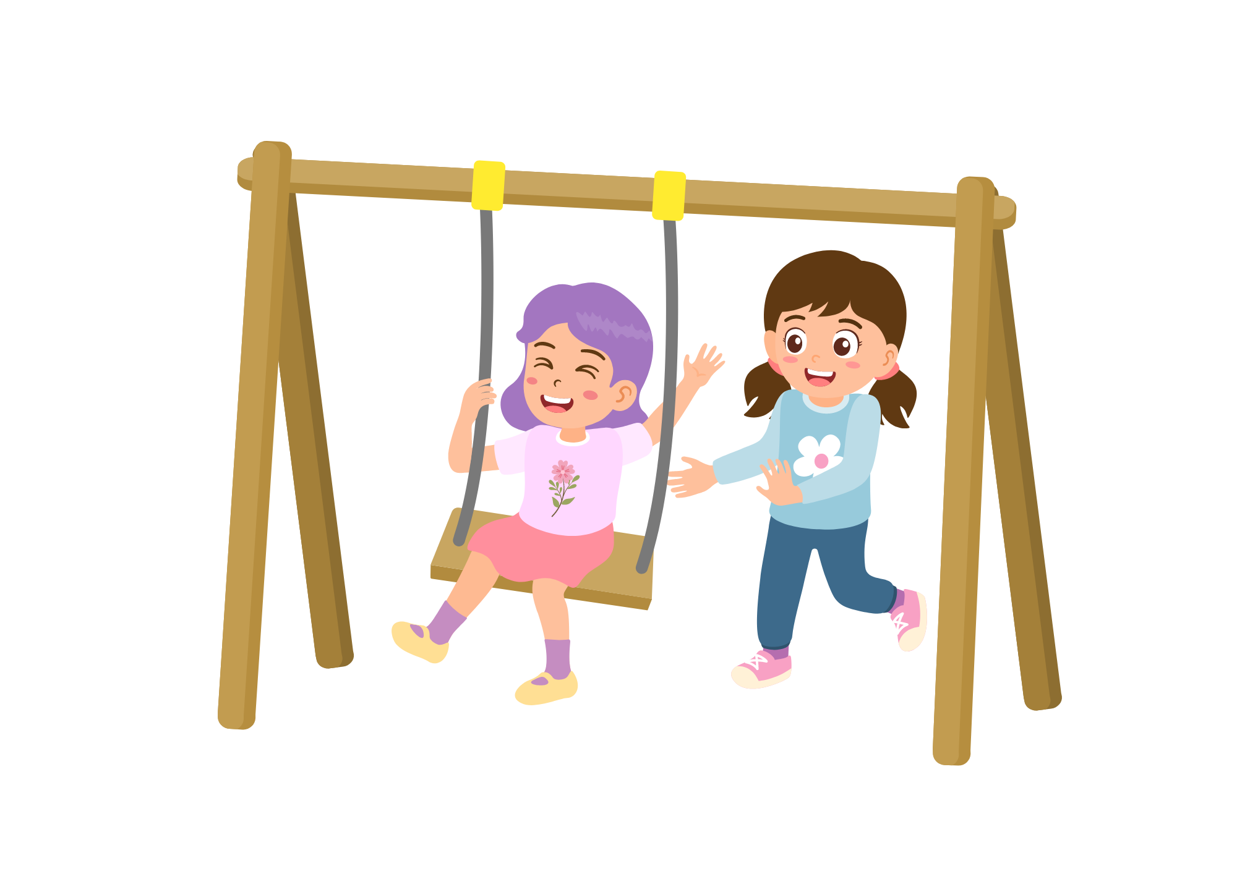
I Do
Verb Tips
Tip 1: Verbs are mostly actions – run, jump, slide, eat etc.
Tip 2: Verbs are often in the same position in the sentence, second or third. Example: The cat loves milk. The boy ran to school.
Tip 3: If you put the word ‘to’ in front of a verb, it will always make sense. So, if it doesn’t make sense, it’s not a verb. Example: To play, to jump, to swing. To cheese, to dog, to umbrella.

Slide 5

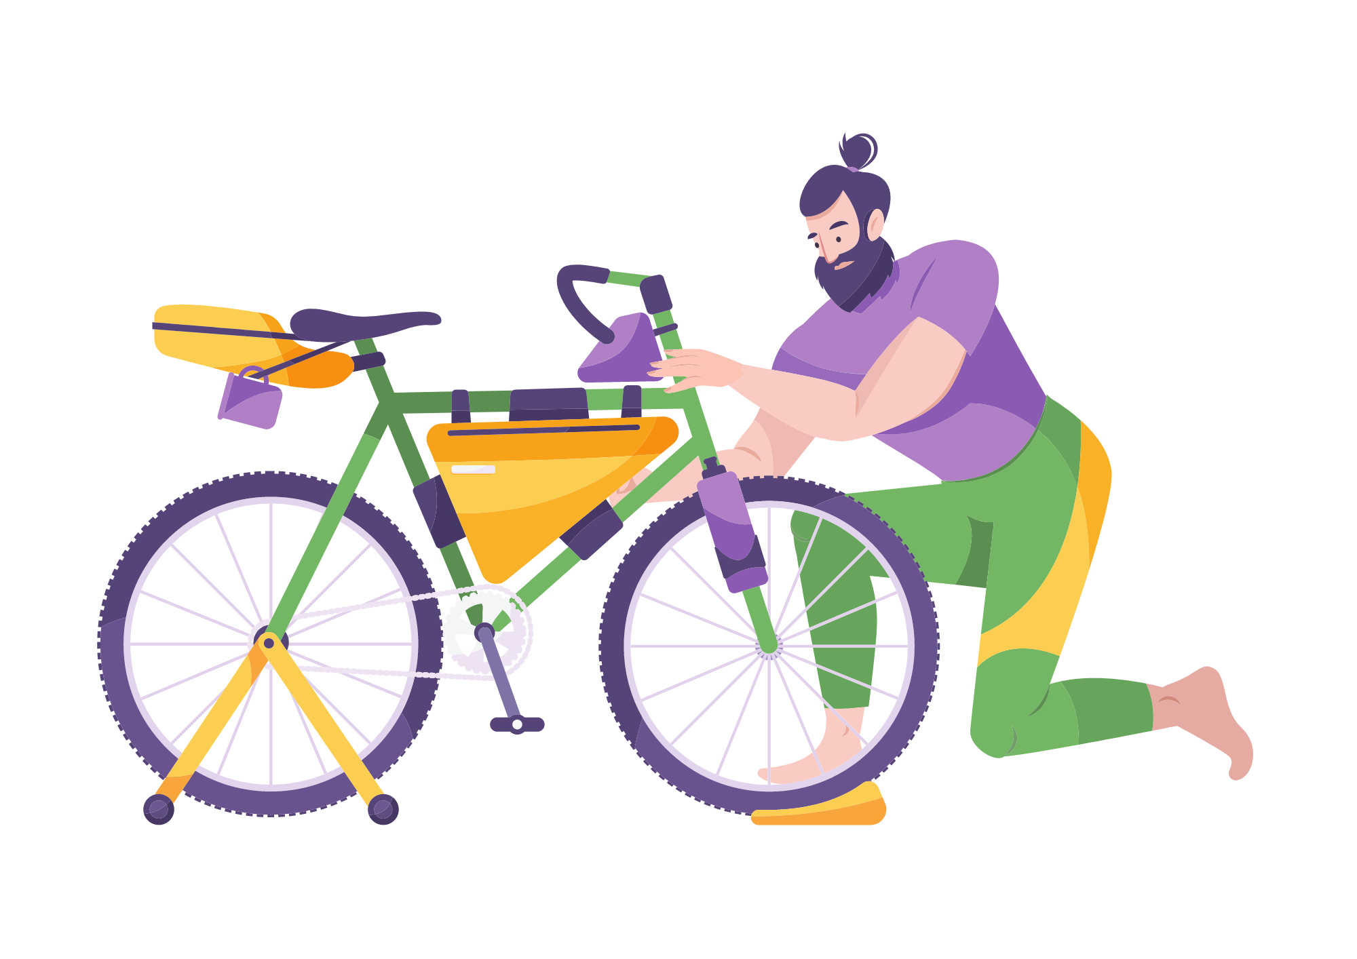
I Do
Verbs
Verbs are doing words!

Slide 6

I Do
Verbs
Circle the verbs in each sentence.
The birds sing sweet songs in the morning.
My mom cooks yummy pancakes for breakfast.
The dog chases its tail around the yard.
We play tag with our friends at recess.
The flowers bloom beautifully in the garden.

Slide 7


We Do
Monday
Verbs
Circle the verbs in each sentence.
The sun shines brightly in the sky during the day.
I read a book about dinosaurs at the library.
The teacher teaches us new things every day in class.
The butterfly flutters its wings gracefully.
My dad fixes my bike.

Slide 8
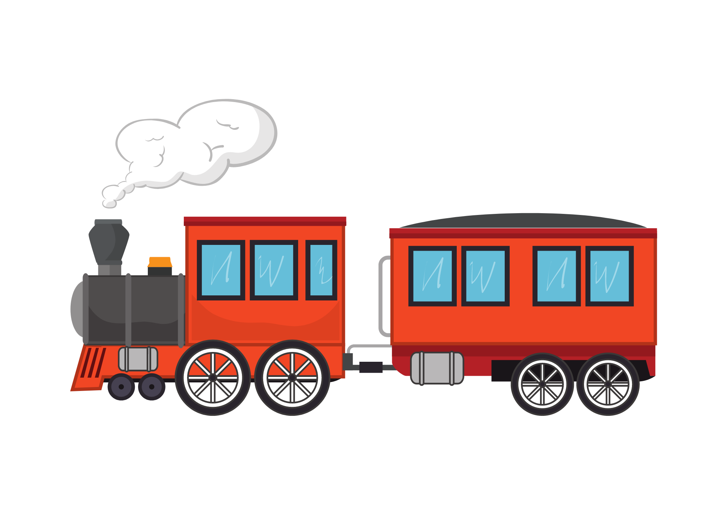
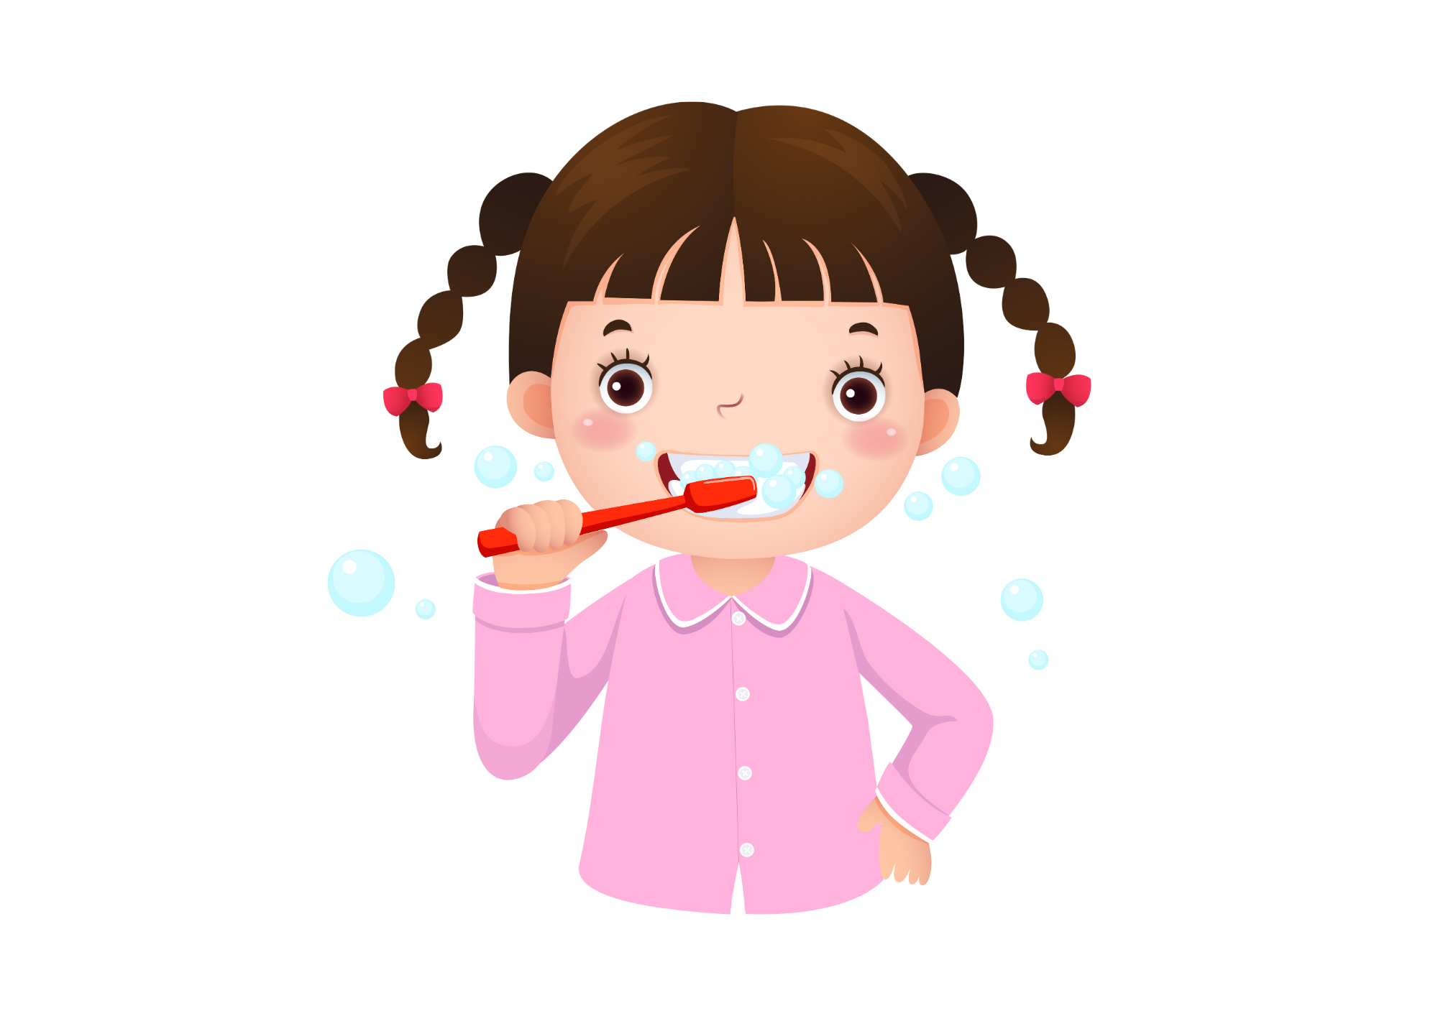
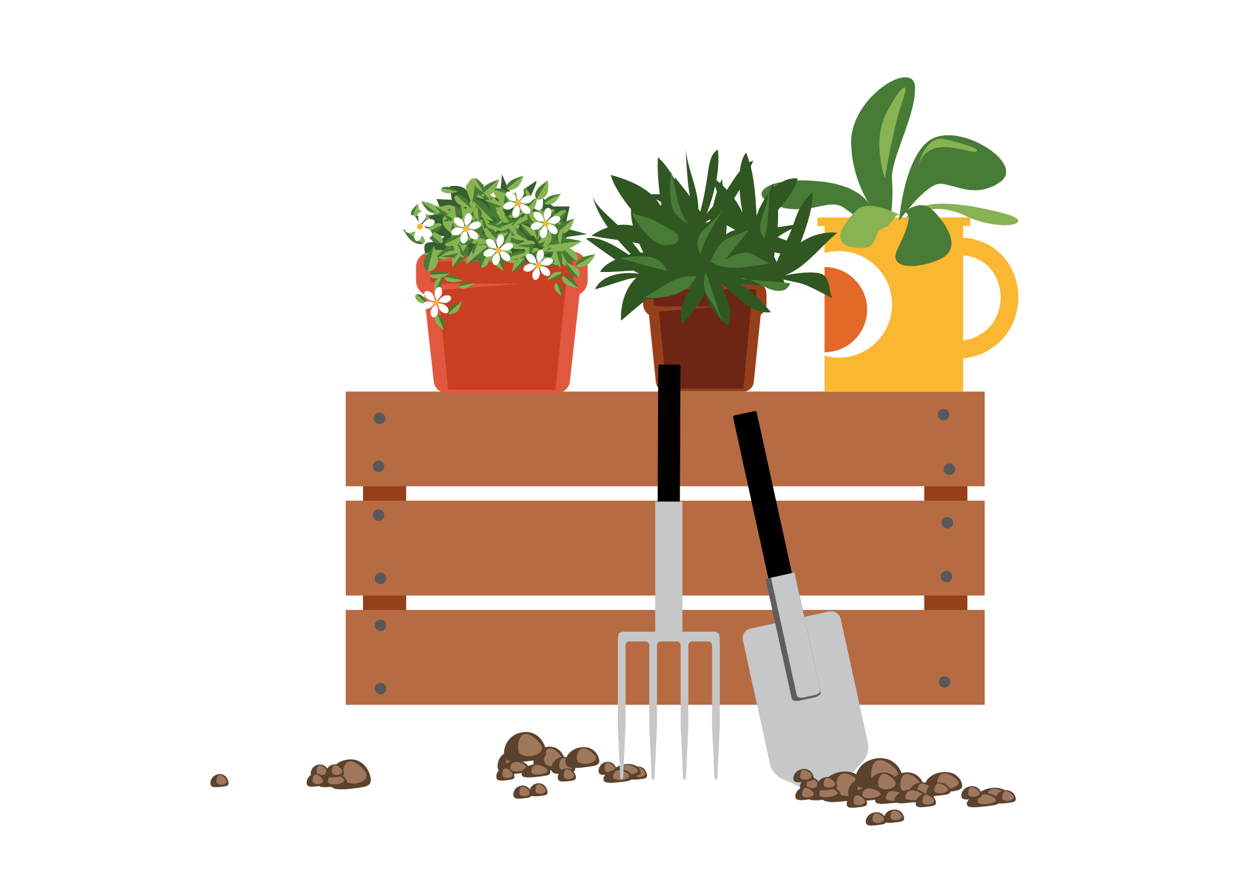
You Do
Monday
Verbs
Write the sentences in your book and circle the verbs in each sentence.
The cat pounces on the toy mouse.
I brush my teeth before bed.
The rain falls gently from the sky.
We plant seeds in the garden.
The train chugs along the tracks every day.

Slide 9
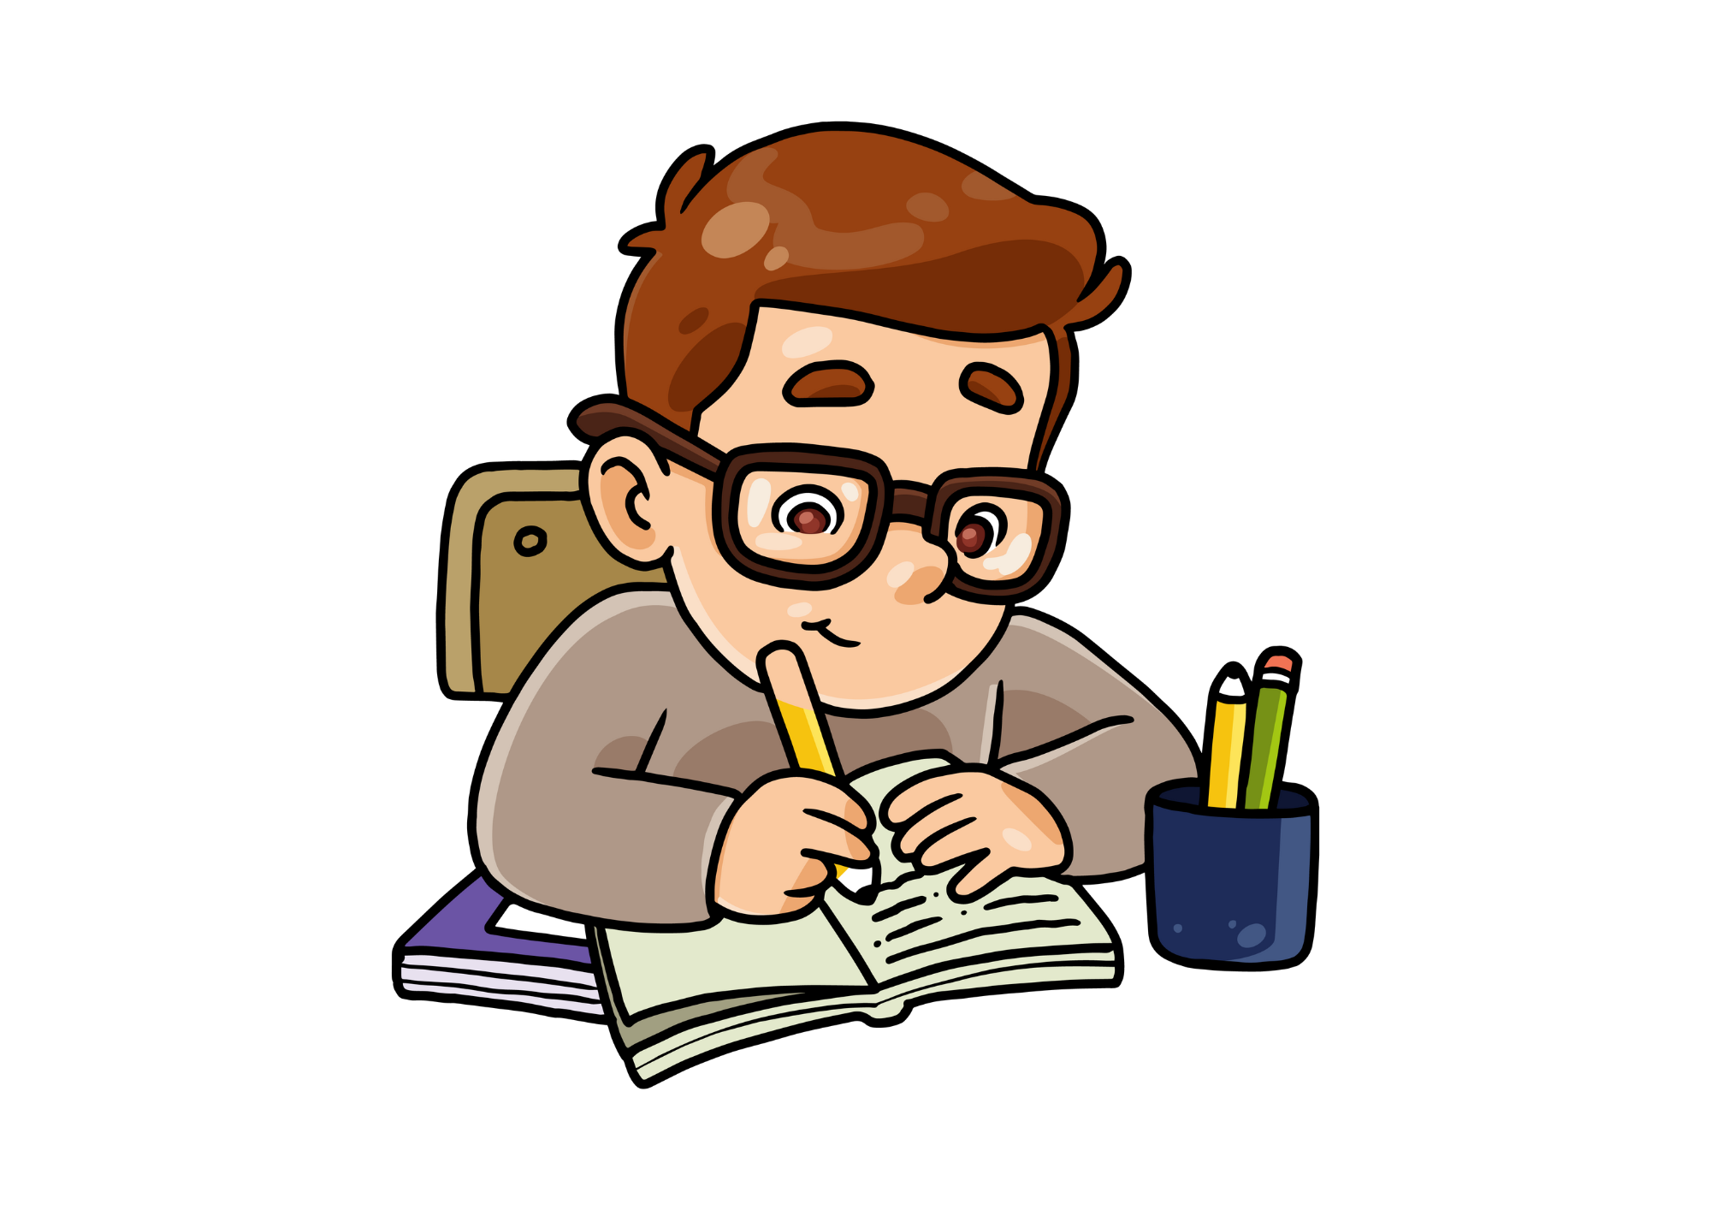


We Do
Tuesday
Verbs
Work with a partner and choose the words that are verbs. Not all words are verbs, so choose wisely!
Tip! Put ‘to’ in front of the word if you’re unsure.
Mouse | Cat | Sleep | Run | Yellow | Car | Eat | Play | Read | Dolly | Student | Toy | Nose | Try | Sad | Dolphin | Dog | Chair | Cook | Bake | Study

Slide 10
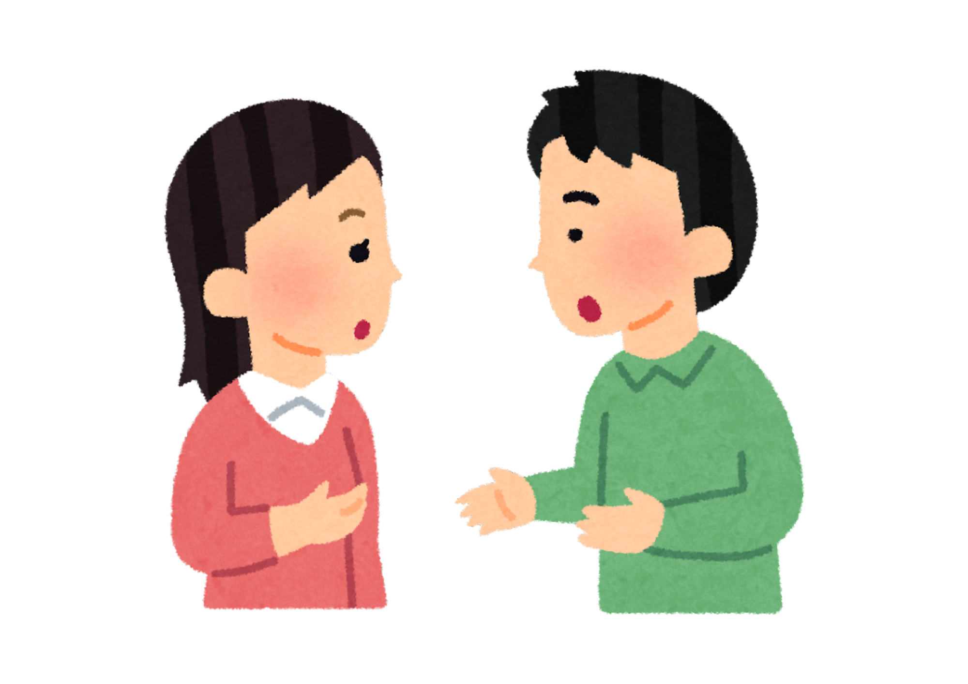
You Do
Tuesday
Verbs
Choose verbs from the box and write 3 of your own sentences. Circle the verbs in your sentences. Not all words are verbs, so choose wisely!
Tip! Put ‘to’ in front of the word if you’re unsure.
Toy | String | Hunt | Baby | Walk | Umbrella | Live | Tin | Bees | Roar | Feel | Mice | Rest | Homework | Talk | Pretty | Grow | Jump | Like | Diamond | Pig

Slide 11

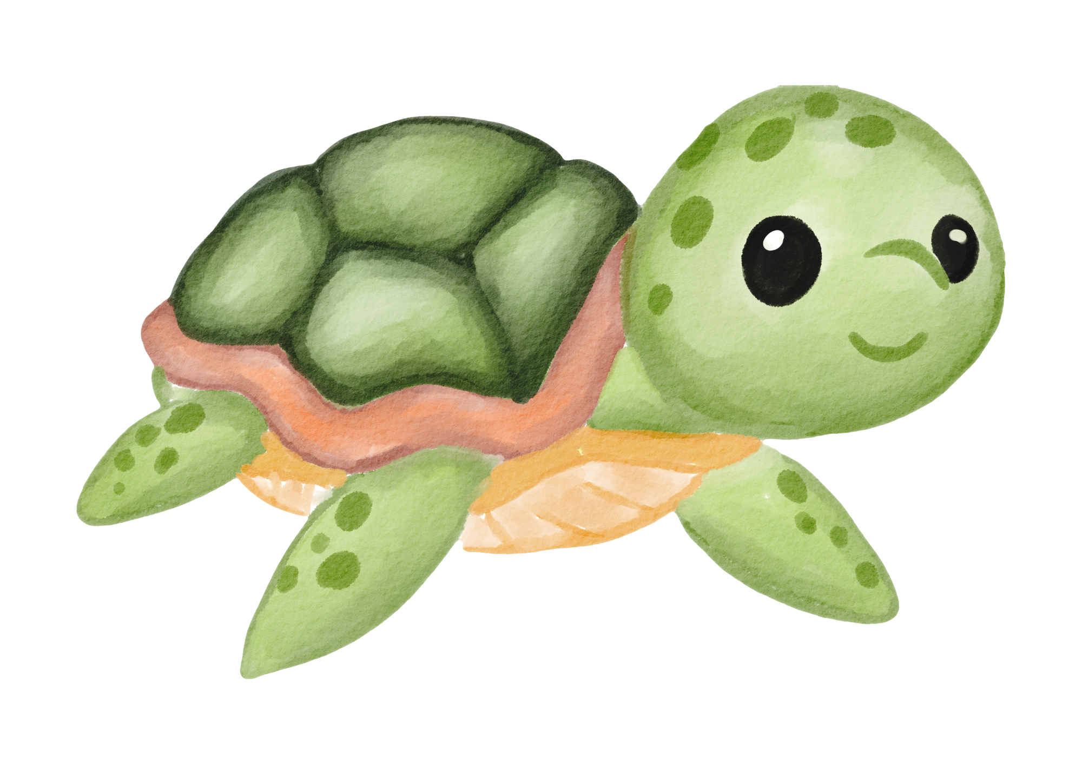

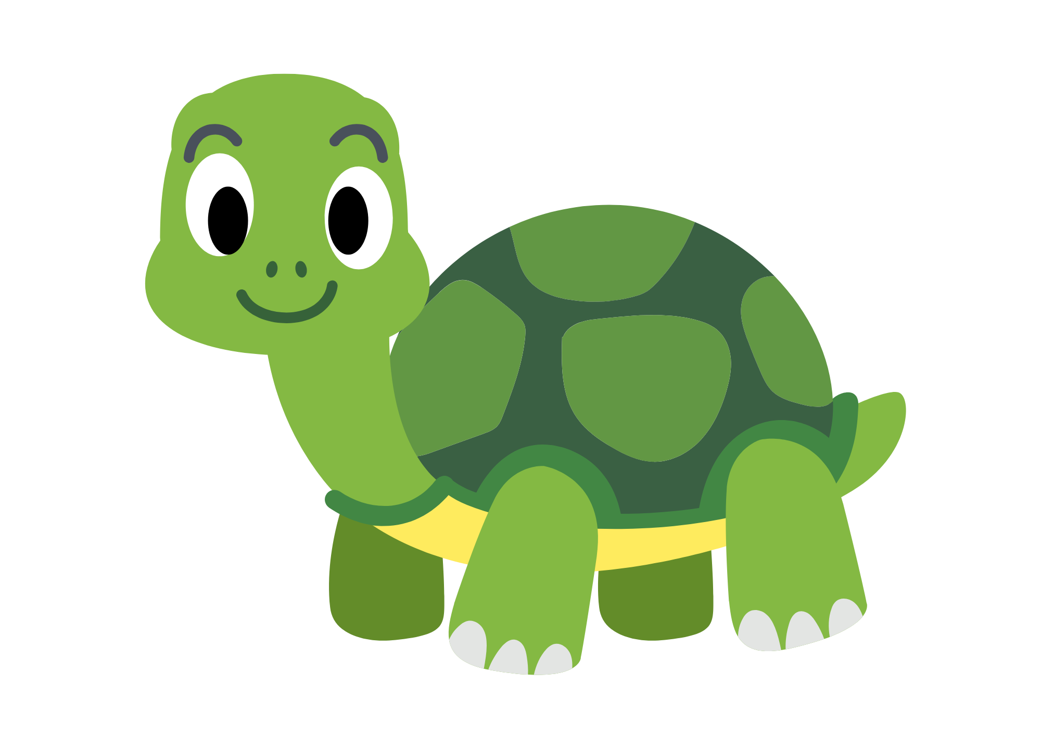
We Do
Wednesday
Verbs
With a partner, read the short text and circle the verbs. I’ll give you the ‘be’ verbs and you find the rest.
Turtles are cool animals. They live on land and in water. They move slowly. They walk on land and swim in the water. When they are scared, they hide in their shells. Turtles like to sit in the sun to get warm. They eat plants, bugs, and fish. Some turtles travel far, and some stay in one place. Turtles are special animals!

Slide 12

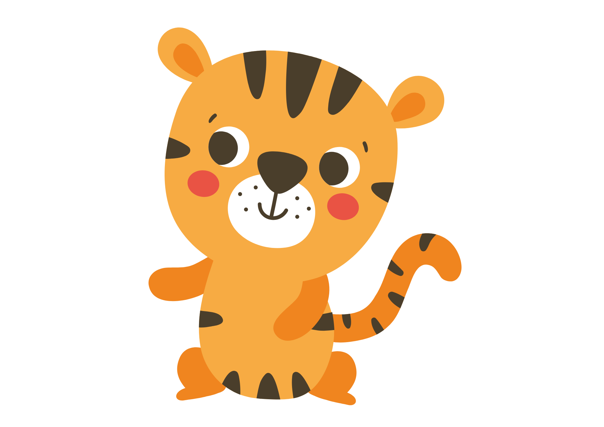
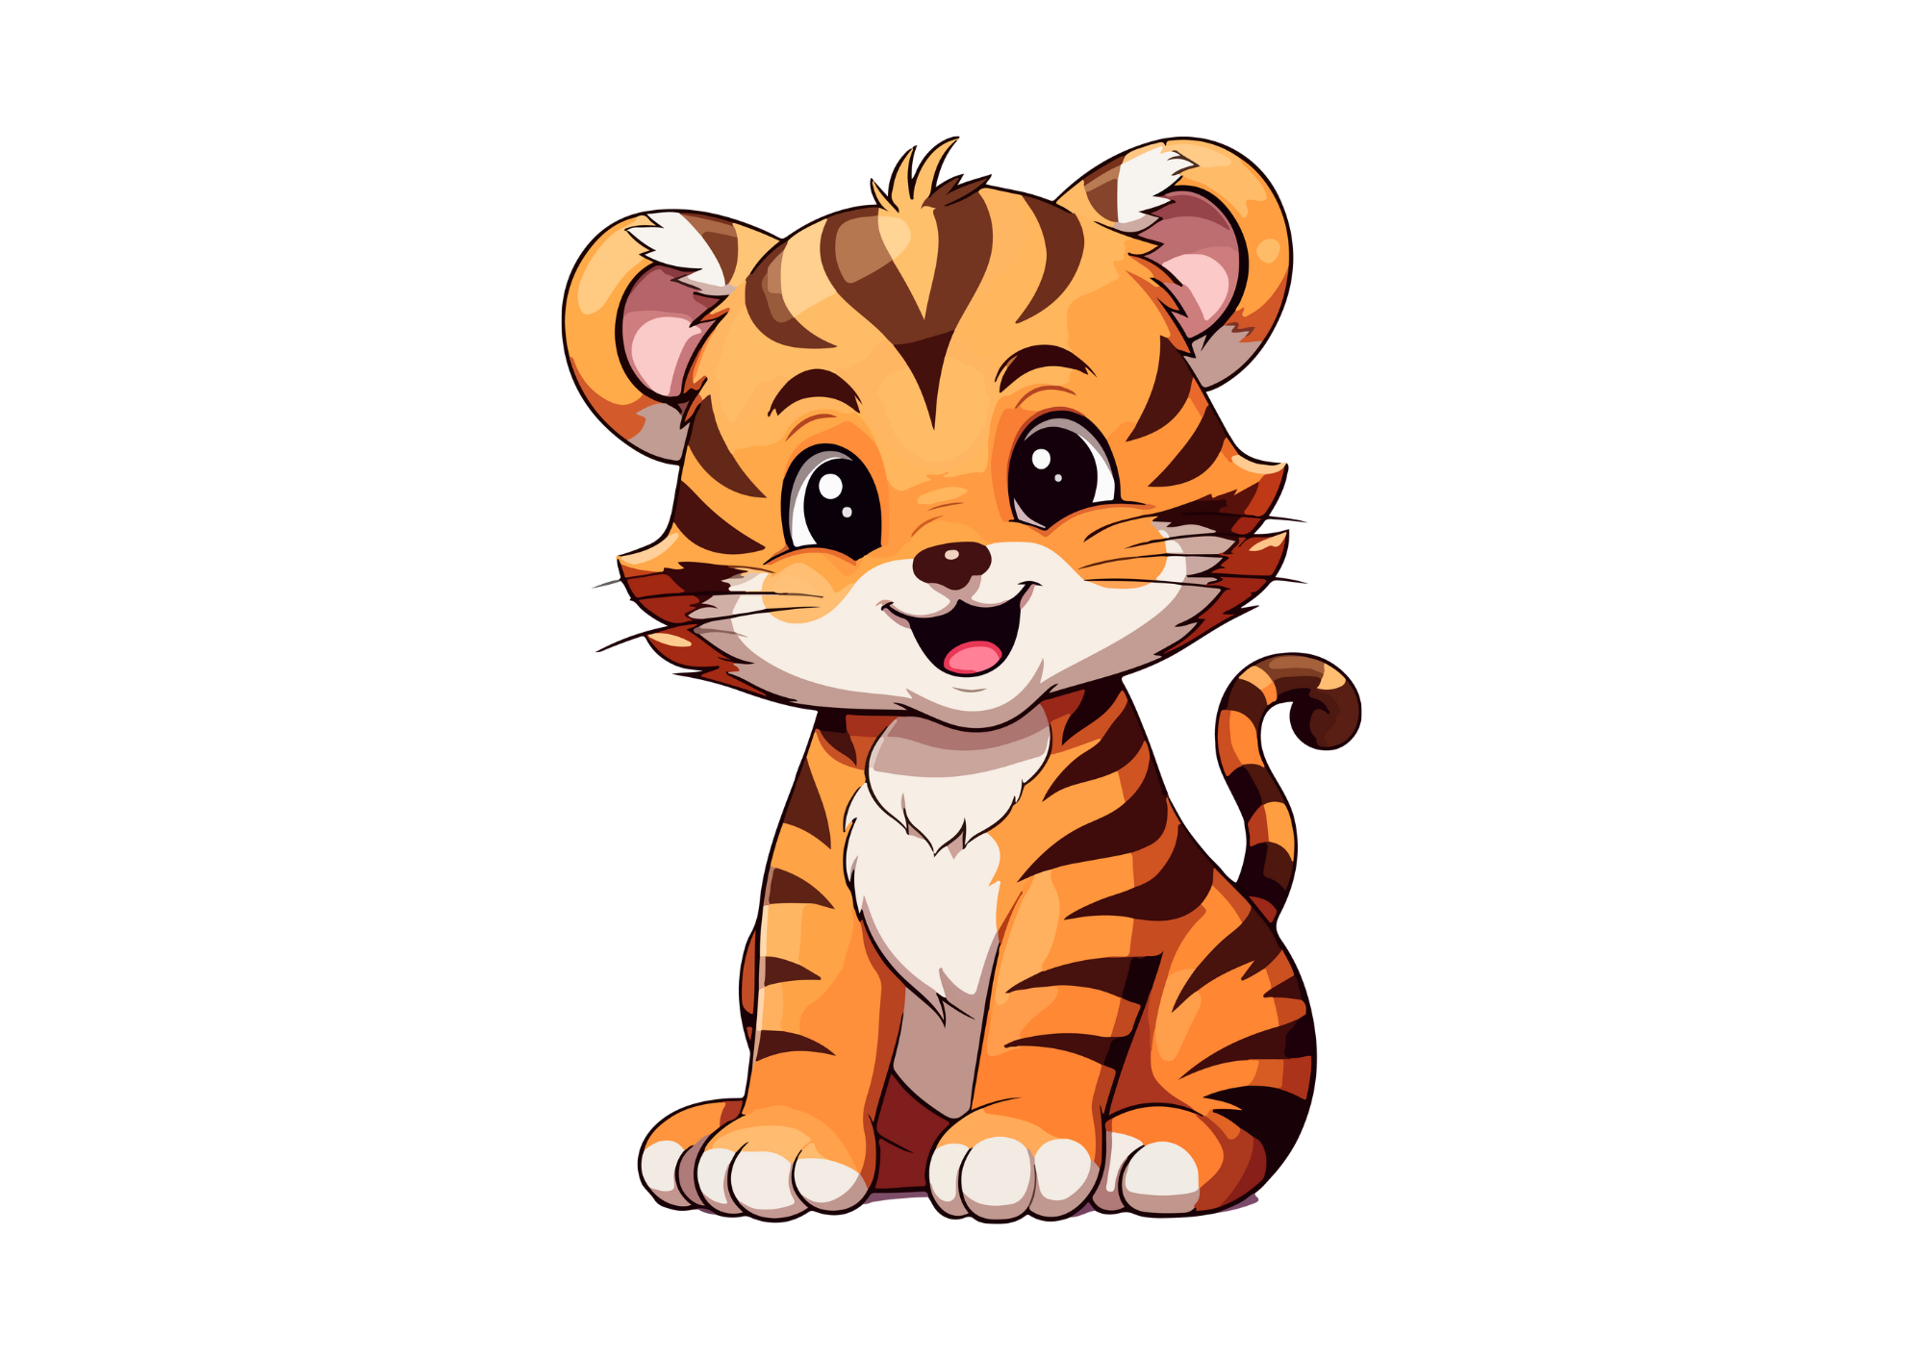
You Do
Wednesday
Verbs
This time, try alone. Write the text in your book and circle the verbs. I’ll give you the ‘be’ verbs and you find the rest.
Tigers are amazing animals. They live in forests and jungles. Tigers walk and run very fast. They hunt for food like deer and wild pigs. Tigers have sharp claws and strong teeth. They roar loudly to talk to other tigers. When they feel sleepy, tigers rest under trees. Cubs play with each other to learn. Tigers grow big and strong. They like to be alone. Tigers are fantastic creatures!

Slide 13






Verb Quiz
Everyone stand up. Use your whiteboard/paper for the quiz. 4 words will pop up. Write the colour of the verb. If you get it correct, stay standing. If you’re wrong, sit down.

Slide 14
Hat
Run
Teacher
Umbrella

Slide 15
Student
Sleep
Girl
T.V.

Slide 16
Roar
Glasses
Dolly
Tree

Slide 17
Chair
Table
Book
Like

Slide 18
Stand
Ham
Bricks
House

Slide 19
Kettle
Arm
Plate
Grow

Slide 20
Socks
Tools
Build
Shoes

Slide 21
City
Zoo
Climb
Tiger

Slide 22
Smell
Zebra
Canada
Door

