Slide 1





Setting The Scene
with the 5 Senses

Slide 2
Lesson Objectives
By the end of this lesson, I will be able to:
Explain why we need to set the scene
Use the five senses to set the scene
Write an opening paragraph in a group and by myself

Slide 3
I Do
Setting The Scene
Setting the scene in a story is important because it helps readers imagine where and when the story happens. It creates the mood, making the story feel happy, scary, or exciting. It also makes characters more real by showing how they interact with their surroundings. So, always include details about the place, time, and atmosphere to make your story come alive!

Slide 4
I Do
Five Senses
Use your five senses to set the scene.
Sight: What does the place look like? Describe the colours, shapes, and any interesting details.
Sound: What can be heard in this place? Think about the noises made by people, animals, or the environment.
Smell: Are there any distinctive smells? Maybe the scent of flowers, food, or even the air itself.
Touch: What textures or sensations can be felt? This could include the feeling of the ground, the air, or objects in the scene.
Taste: If your character eats or drinks something, what does it taste like? Or perhaps describe the general taste in the air, like the saltiness of the sea.

Slide 5
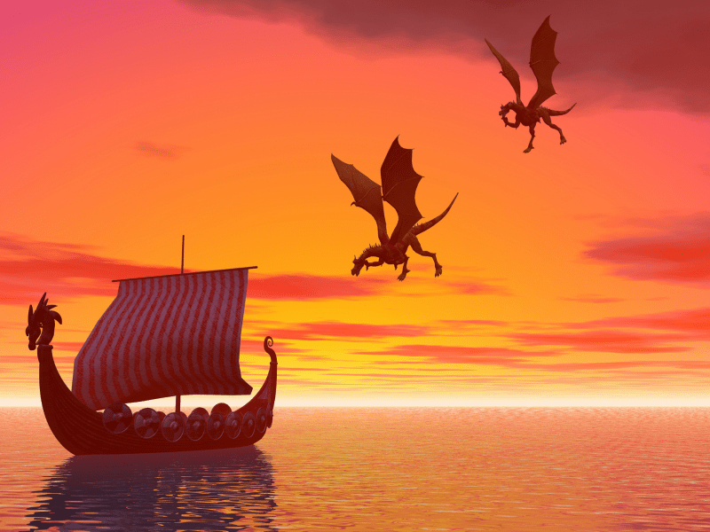
I Do
Five Senses
Use your five senses to set the scene.
The taste of ocean water lingered on the tip of his tongue.
The dragons’ screams echoed across the ocean.
Mountains could be seen on the distant land.
A shiver ran down his spine as the dragons flew above.
The smell of ash and fire drifted through the air.

Slide 6
I Do
Five Senses
Let’s put it all together.
The taste of ocean water lingered on the tip of Sam’s tongue. He knew he was in trouble. A shiver ran down his spine as the dragons flew above. They wanted their dragon eggs back. The smell of ash and fire drifted through the air as the dragons’ screams echoed across the ocean. Mountains could be seen on the distant land, offering a glimmer of hope and safety.
Tip: Use your 5 senses and add your story in as you go.

Slide 7

I Do
Five Senses
Here’s another example
The sun dipped below the horizon, casting a golden glow over the tranquil beach. The gentle sound of waves lapping against the shore mixed with the distant call of seagulls. The salty tang of the ocean air tickled her nose as she took a deep breath. She dug her toes into the cool, damp sand, feeling the grains slip between them. With each bite of her ripe, juicy mango, the sweet and tangy flavours burst in her mouth, making her smile. All of a sudden, a bottle appeared at her feet…

Slide 8
I Do
Pro Tip!
3 is enough…
5 senses is sometimes too much. When you’re using senses and characterization, writing can get a bit too descriptive. Try using 3 senses each time you set the scene. It creates a better balance, especially in the opening paragraph.

Slide 9
We Do
Guess the Sense
Is it smell, taste, touch, see or hear?
Smoke filled the air and stained her tongue.
The golden sun began to set, painting the sky with vibrant hues of orange and pink.
The scent of blooming jasmine filled the garden, its fragrance delicate and soothing.
The sound of waves crashing against the shore was rhythmic and calming.
The soft, velvety petals of the rose brushed against her fingertips, smooth and delicate.
The icy fingers of the wind caressed her delicate skin.
Taste
See
Smell
Hear
Touch
Touch

Slide 10
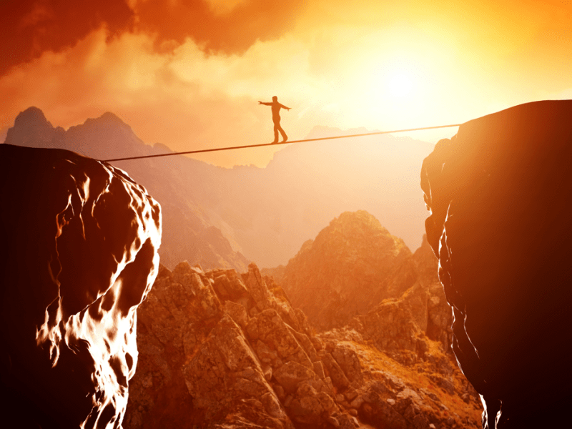
We Do
Set the Scene
Work in groups. For this prompt, write a sense each. Combine them to create an opening paragraph. If you get stuck, use some bits from the example below.
The golden sun began to set as Max made his way across the rope. Not a sound could be heard. Mountains ran for miles as the wind’s icy fingers swept across Max’s pale face. He was nervous and his throat was dry. All of a sudden…

Slide 11
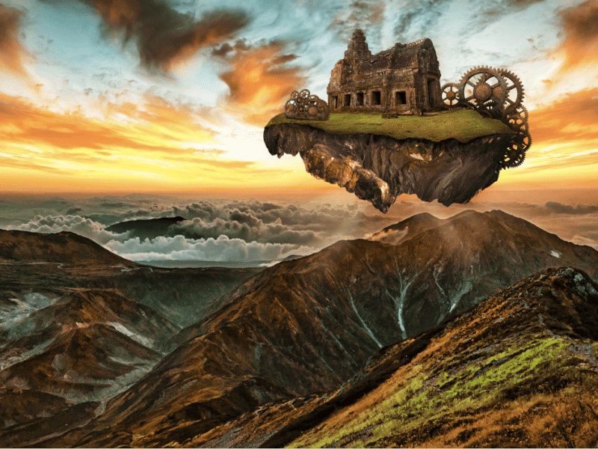
You Do
Set the Scene
Write an opening paragraph in your book using the five senses. Colour code your sentences for each sense. If you get stuck, use some bits from the example below.
The engines roared as Sarah began her adventure. The skies were clear and only the distant echo of birds could be heard. The soft, watery clouds drifted through the main cabin. She could taste adventure on the tip of her tongue.

Slide 12
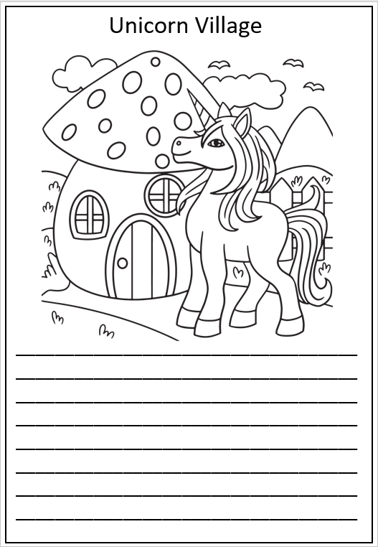
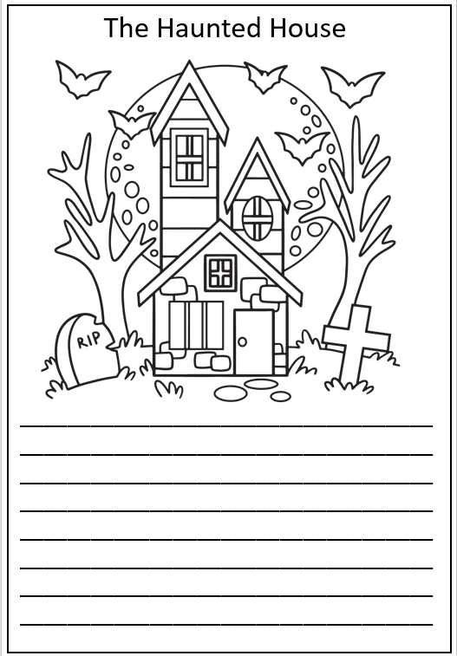
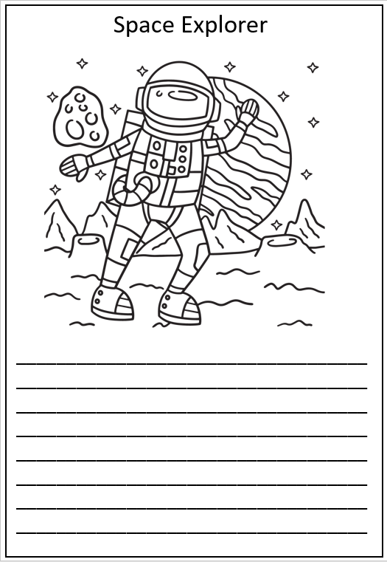

Activity
Choose one of the writing prompts below. Colour the picture and write an opening paragraph using the fives senses.

