Slide 1
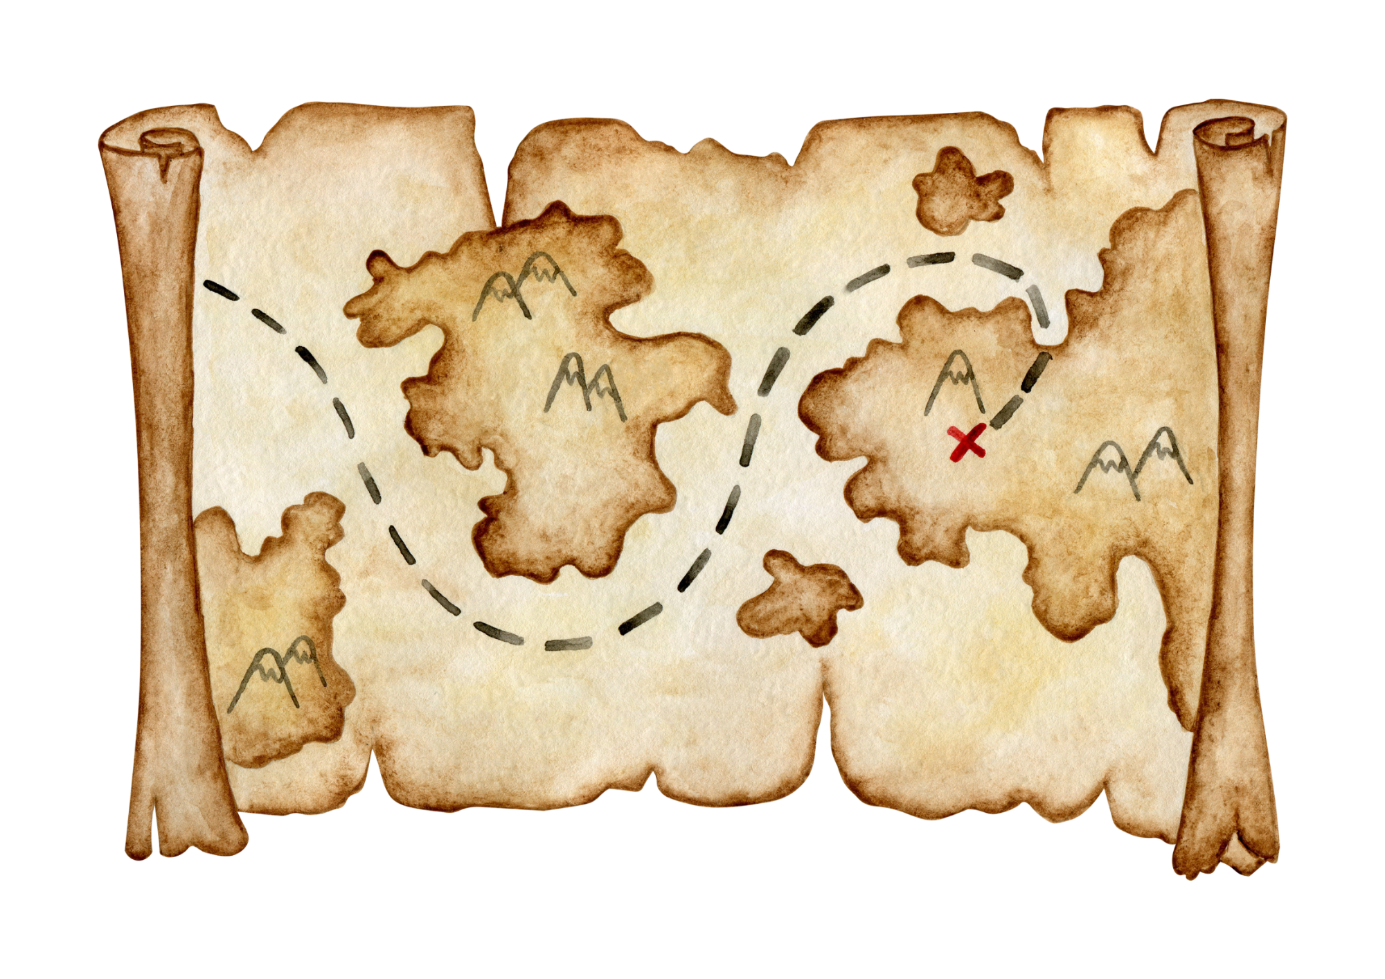

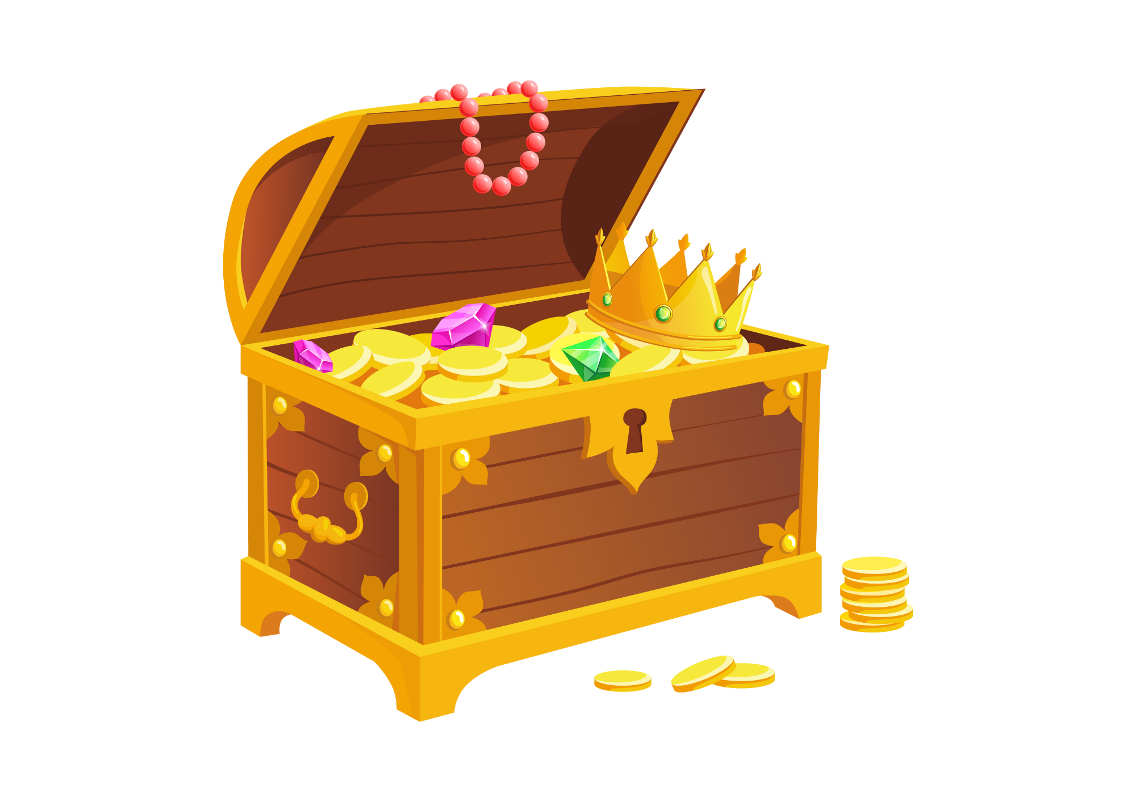
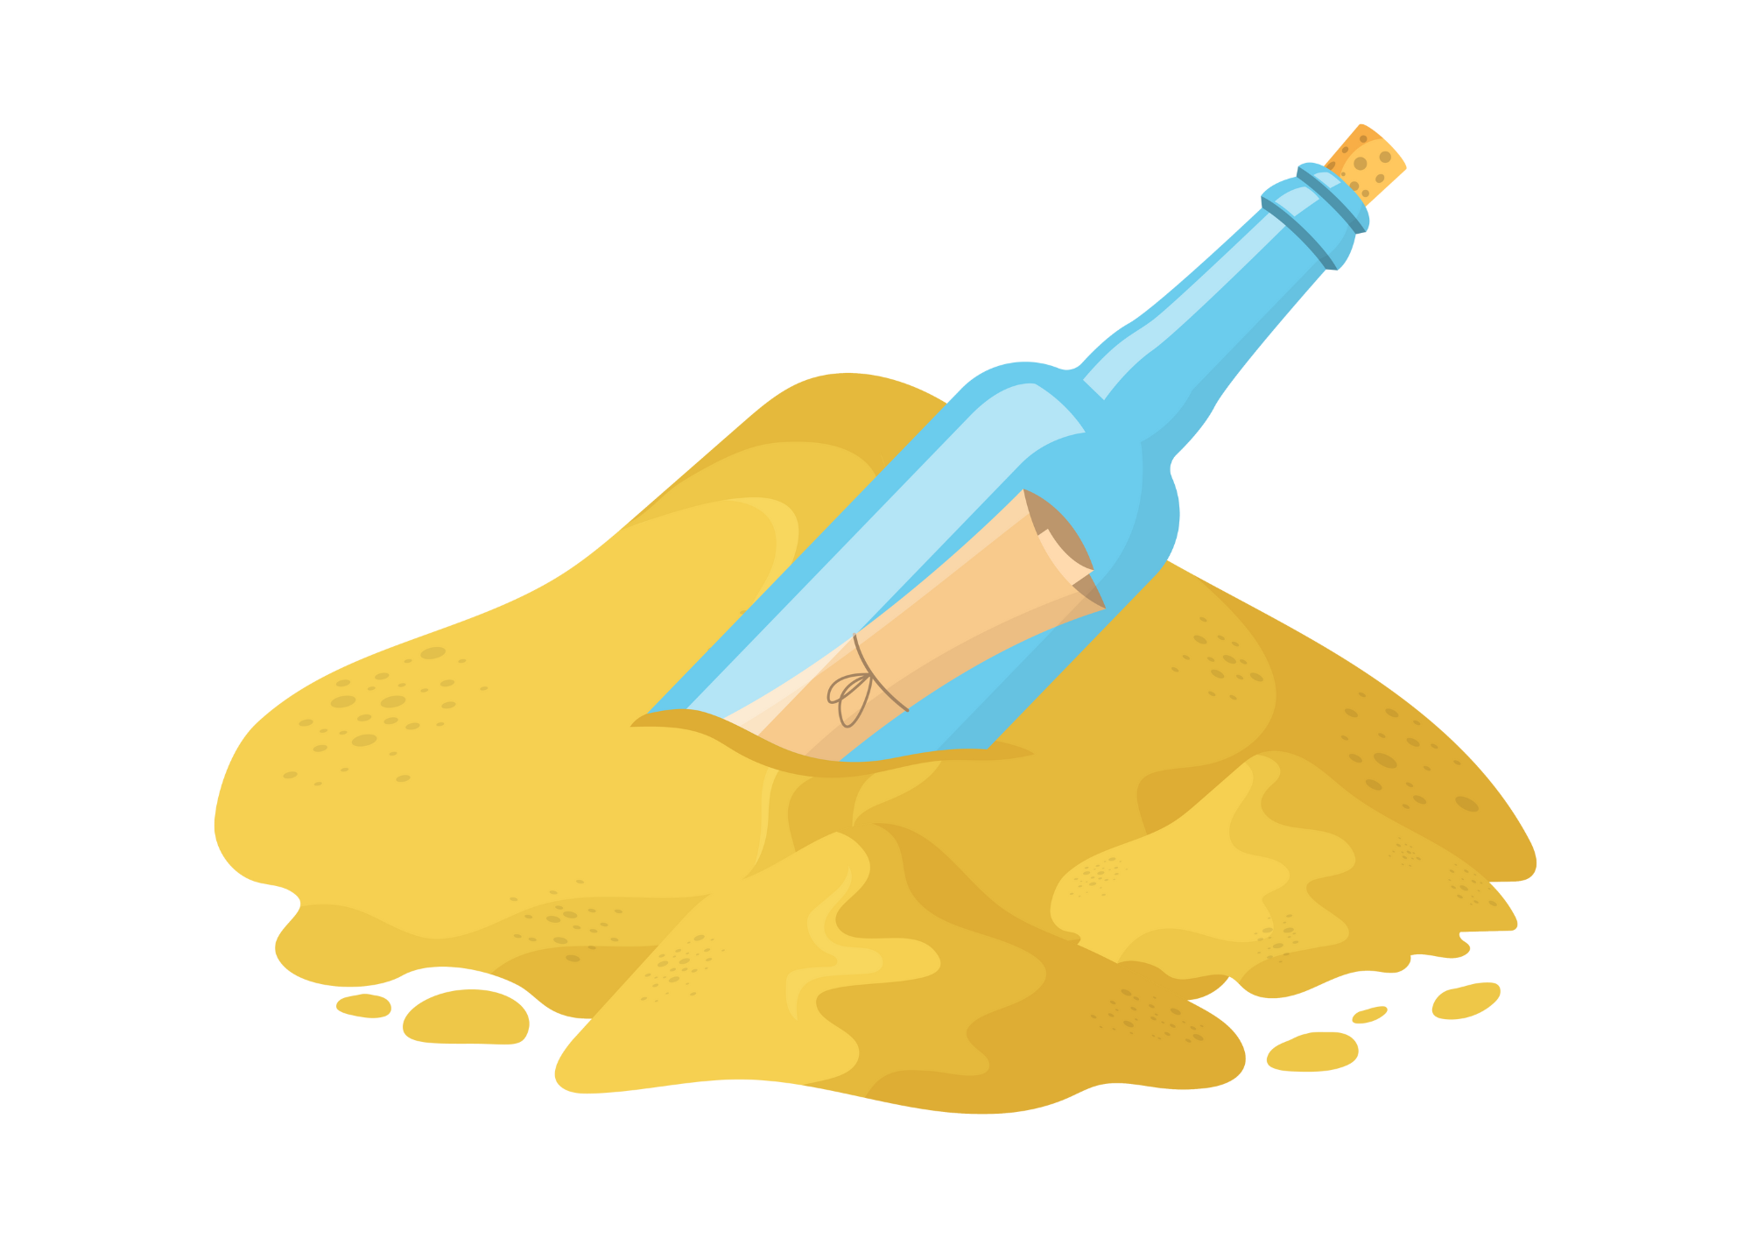
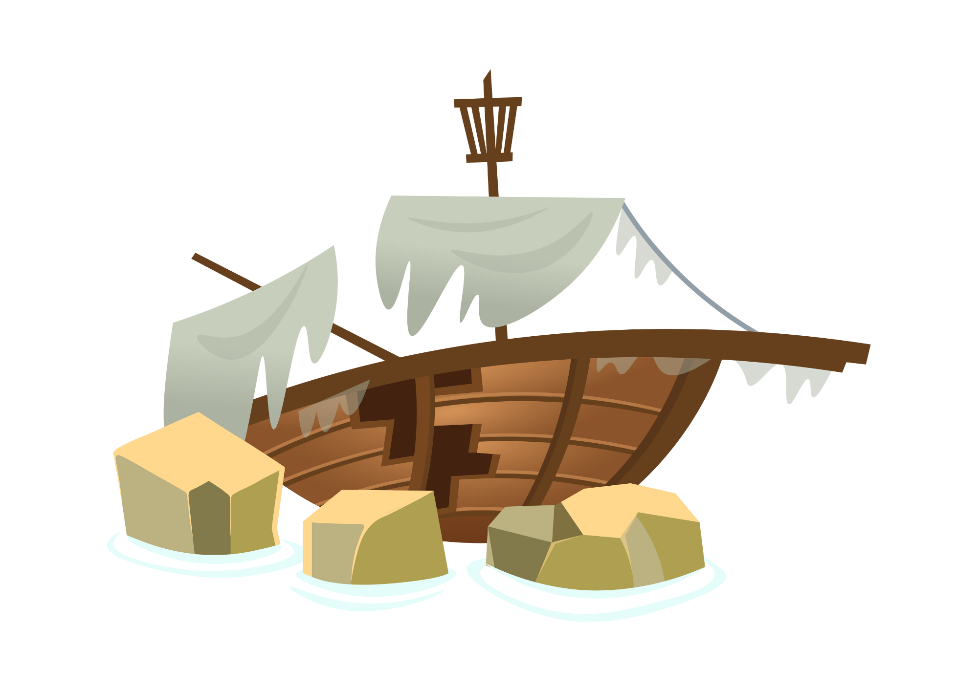

Show Don’t Tell
Message in a Bottle

Slide 2
Lesson Objectives
By the end of this lesson, I will be able to:
Explain ‘Show, don’t tell’
Magpie 3 strong ‘show’ sentences for my own writing
Examine an example text
Plan my own story

Slide 3
I Do
Show, Don’t Tell
The "show, don't tell" writing strategy encourages writers to use descriptive language rather than directly stating them. Don’t say John was angry, tell us what it looks like. Don’t say that Sarah was sad, tell us what it looks like.
Examples:
Telling: John was angry.
Showing: John's fists clenched at his sides, his jaw tightening as he stared daggers at the person in front of him. His face flushed red, and his breathing grew heavy.
Telling: Sarah was sad.
Showing: Sarah's shoulders slumped as she walked. She absentmindedly twirled a strand of hair around her finger whilst tears dripped from her eyes.

Slide 4
We Do
Message in a Bottle - Magpie
Choose one of these to magpie for your own writing.
Telling: The message in the bottle lay on the beach.
Showing: The message in the bottle lay half buried in the sand, its glass gleaming under the sunlight. Seaweed draped over its sides like a veil, hinting at its long journey through the ocean currents.
Telling: Clouds came over the beach.
Showing: Seagulls soared overhead, their cries growing fainter as they disappeared into the dark grey blanket above. A cool breeze whispered through the air as the weather began to change.

Slide 5
We Do
Show, Don’t Tell - Sort
Match the telling with the showing.
A. The beach was bustling with excitement! Families spread out their colourful towels, and kids played tag near the water's edge.
B. The beach was a quiet retreat. Waves whispered as they kissed the shore, and seashells glistened in the gentle sunlight.
C. The beach was like a wind tunnel! Gusts of air tousled our hair and sent seagulls soaring high above.
The beach was crowded.
The beach was windy.
The beach was peaceful.

Slide 6
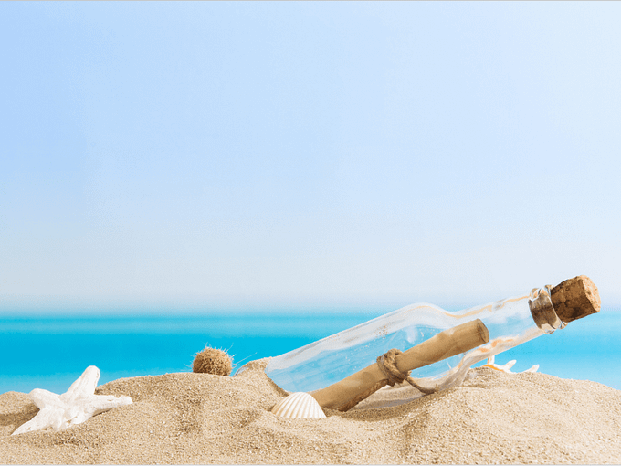
We Do
Message in a Bottle
Use show, don’t tell for today’s writing prompt. Work with a partner and change these sentences to ‘show’.
Telling: “The beach was golden.“
Telling: “The bottle was there floating on the waves.”
Showing: The sand stretched out in front of her like a blanket of crushed gold, shimmering under the midday sun. Each grain sparkled as if kissed by fire, radiating warmth that tingled against her bare feet.
Showing: The glass bottle bobbed and swayed atop the undulating waves, a lone voyager adrift in the vast expanse of the ocean. With each rise and fall of the tide, it seemed to beckon, a silent messenger carrying secrets whispered by the currents.

Slide 7
Vocabulary
Mysterious
Foreboding
Surreptitious
Vessel
Beacon
Expedition
Perplexed
Conundrum
Motionless
Unearthed
Trembling
Parchment
Squinting
Determined
Treacherous
Disastrous

Slide 8
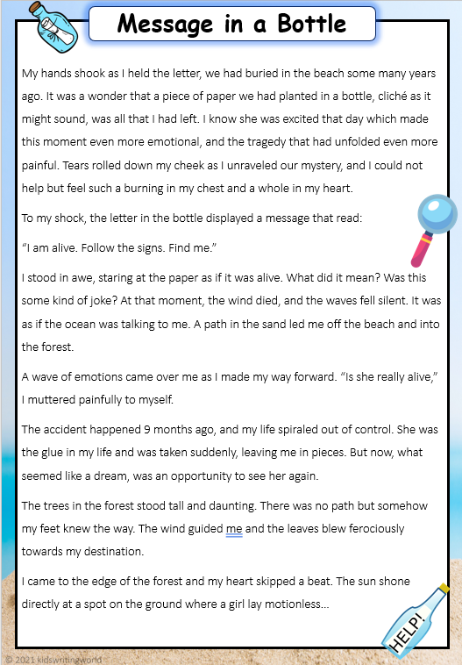
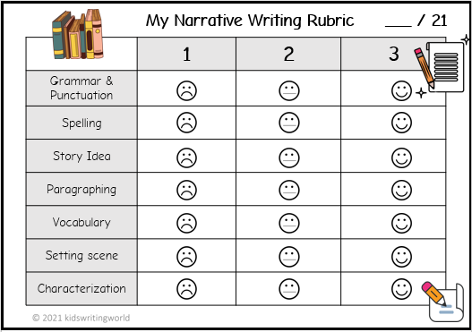
You Do
Example Text
Read the example, critique it and use it to help you write your story.

Slide 9
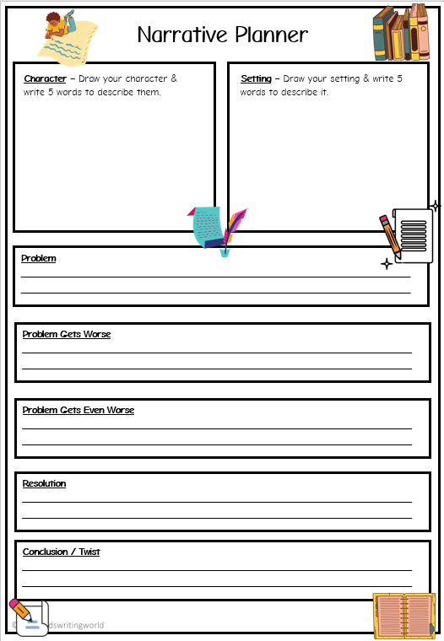
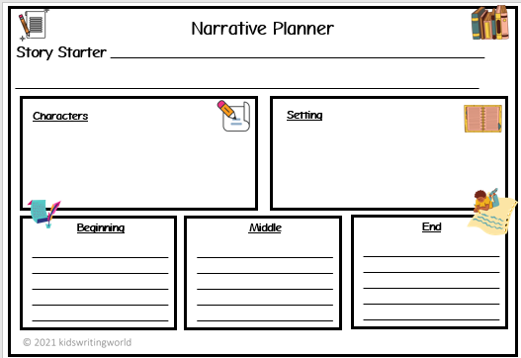
You Do
Planning
Make sure you plan before you write!

