Slide 1






Sizzling Starts

Slide 2
Lesson Objectives
By the end of this lesson, I will be able to:
Identify sizzling and boring starts
Write a sizzling start as a group
Write a sizzling start by myself

Slide 3
I Do
Sizzling Starts
“Sizzling starts" is a writing strategy aimed at capturing the reader's attention right from the beginning of a story or piece of writing. The idea is to start with a compelling and engaging opening that hooks the reader immediately and draws them into the narrative.
The clock struck midnight, casting eerie shadows across the abandoned mansion. Amelia crept through the overgrown garden, her heart racing with a mixture of fear and excitement.
The stage lights dimmed, plunging the theatre into darkness. In the hushed anticipation, Sarah stood backstage, her palms slick with sweat.

Slide 4
I Do
Sizzling Starts
Strategy: Start at the point of action. If you’re starting with, “Billy woke up feeling tired,” then keep the story going in your head until it gets to the most exciting part, then start there.
Example
Billy woke up feeling tired. He made his way downstairs to see his dad reading the newspaper. Billy made a bowl of cereal and began watching television. It was a perfect Saturday. All of a sudden, there was a knock at the door. Billy opened the door to find a cloaked man staring at him. “I need your help,” whispered the old man.
Instead of all of the unnecessary stuff, engage the reader by starting with the cloaked man at the door.

Slide 5
I Do
Boring Starts
John woke up to the sound of his alarm clock buzzing. He rubbed his eyes and stretched, feeling tired from a night of restless sleep.
It was a typical Monday morning, and Sarah dragged herself out of bed to get ready for work. She sighed as she glanced at the clock and realized she was running late.
The sun was shining brightly as Mark walked down the street towards the grocery store. He hummed a tune to himself, thinking about what he needed to buy for dinner.

Slide 6
I Do
Sizzling Starts
The gunshot echoed through the night, shattering the silence of the sleepy town. Sarah's heart raced as she crouched behind the dumpster, her hands trembling as she tried to catch her breath.
The ancient tomb stood in the moonlight; its stone walls etched with mysterious symbols. With a trembling hand, Emily reached out to touch the cold surface, unaware of the ancient curse she was about to awaken.
The rain pounded against the windshield as Jack drove through the stormy night. Lightning flashed across the sky, illuminating the figure standing in the middle of the road.

Slide 7
We Do
Sizzling or Boring
Which starters do you think are sizzling and which do you think are boring?
It was a typical Tuesday afternoon, and Jane sat at her desk, staring blankly at her computer screen. The fluorescent lights buzzed overhead as she sifted through a pile of paperwork, feeling utterly bored.
The explosion rocked the quiet neighbourhood, sending shards of glass and debris flying through the air. Amy's heart pounded in her chest as she stumbled out of her house, her ears ringing with the sound of chaos.
The train rattled along the tracks, its rhythmic motion lulling passengers into a sense of drowsiness. Tom sat by the window, watching the familiar landscape pass by with a sense of detachment.

Slide 8
We Do
Sizzling Start Ideas
Start with the main character in danger. Her eyes scanned the area but there was no way out. Sarah was trapped in the pit and the rain was coming.
Start with the main character on a mission. Peter knew he had to complete the mission, or the world was over. The trolls were strong, but he was determined.
Start with the weather. The clouds grew angry in the sky and a foreboding feeling fell upon the forest.
Start with the main character imprisoned. Dazed and confused, Sam wriggled hopelessly. The chains that bound him were tight.

Slide 9
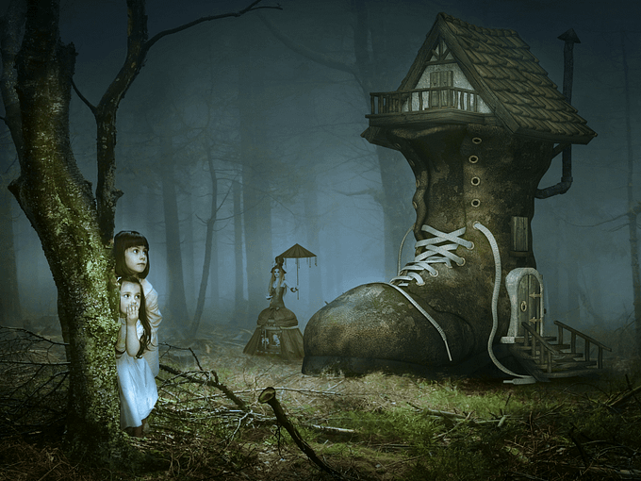
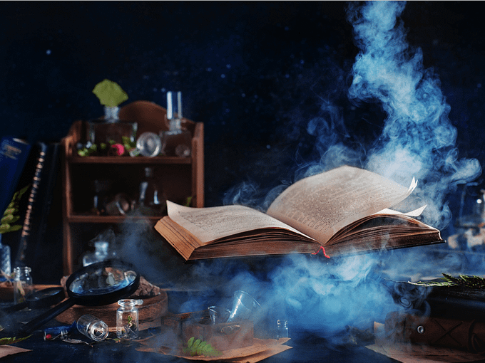
We Do
Sizzling Starts
In your group, choose one of the prompts and write a sizzling start. Work together to come up with the best start.
The Strange Forest
The Magic Book

Slide 10
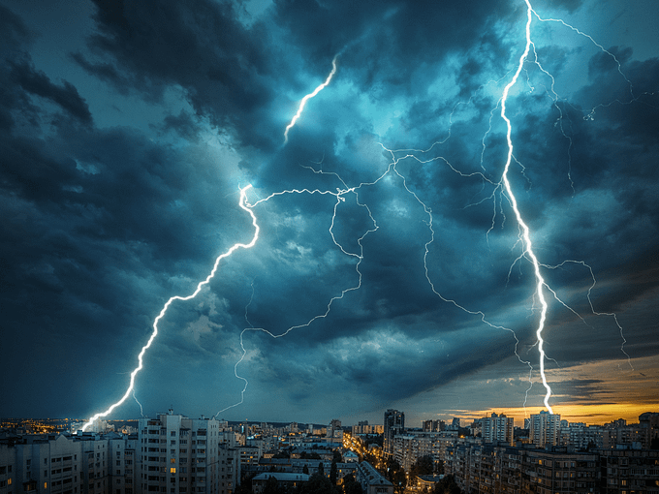
You Do
Sizzling Starts
In your book, write a sizzling start for this writing prompt. Can you write a better sizzling start than the example?
The Storm
We hid in the basement as the storm raged on. We were one of the last families left in town. We had decided to stay, a choice we began to regret.

