Slide 1
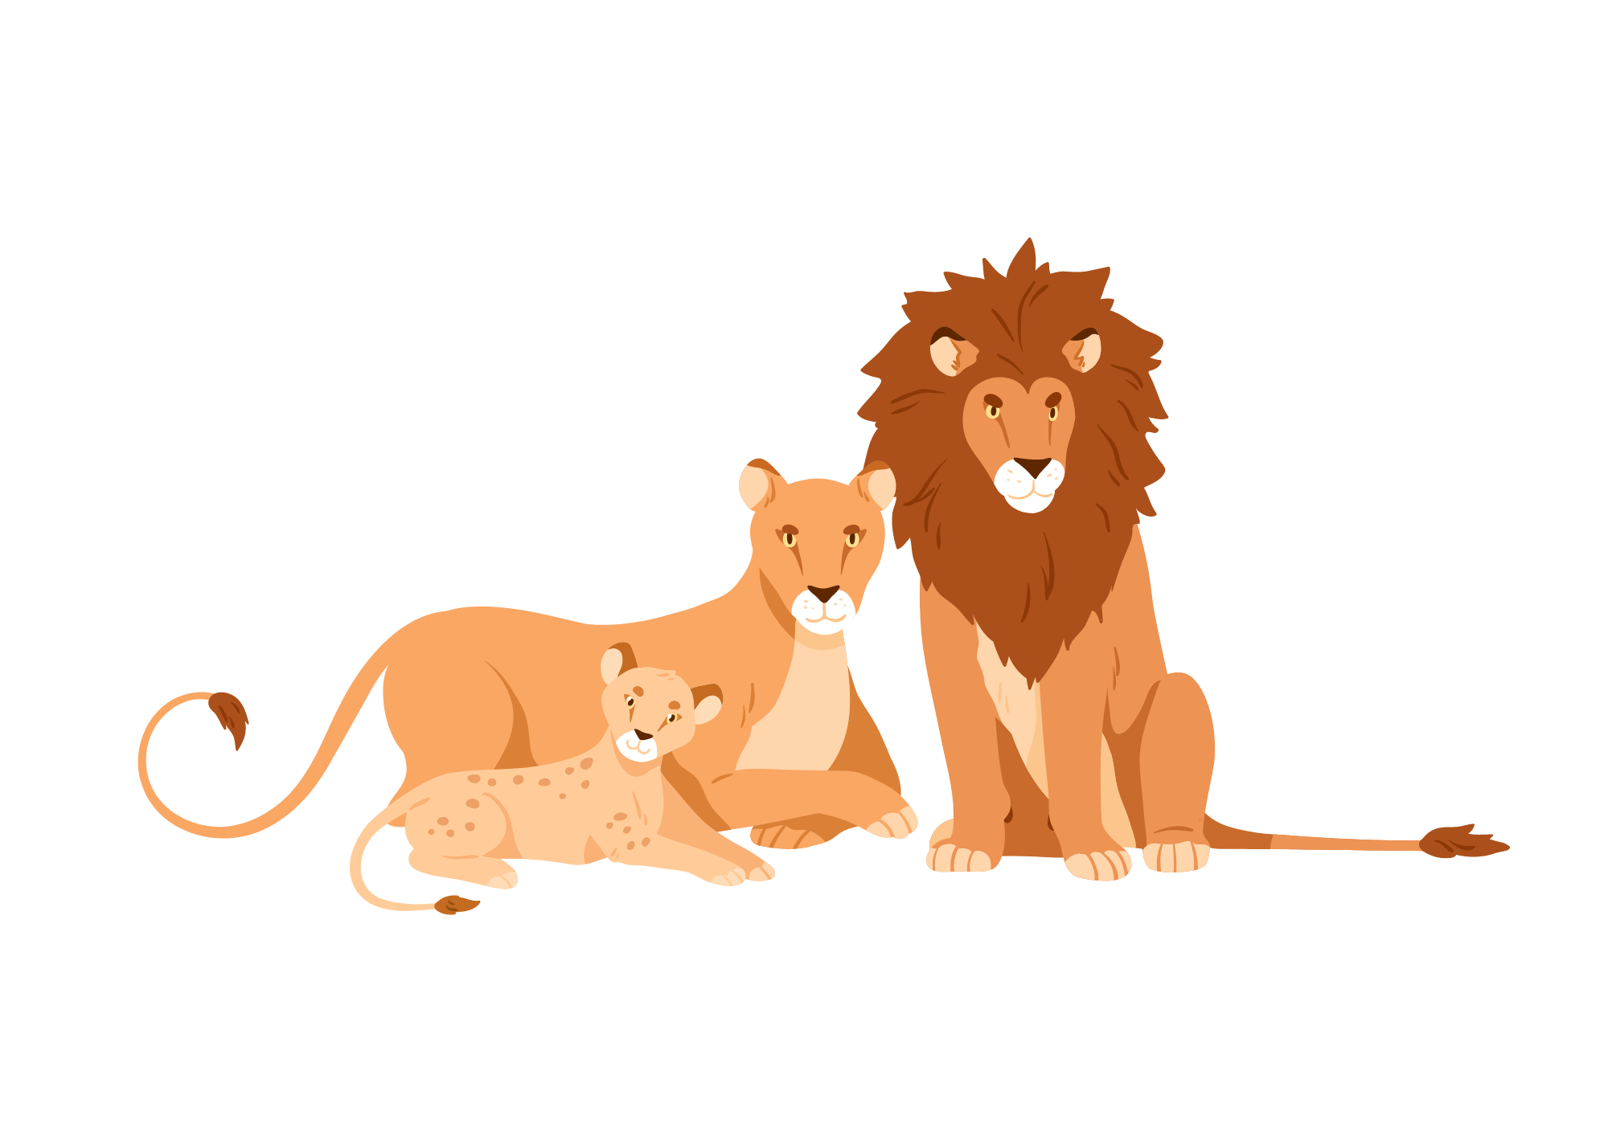

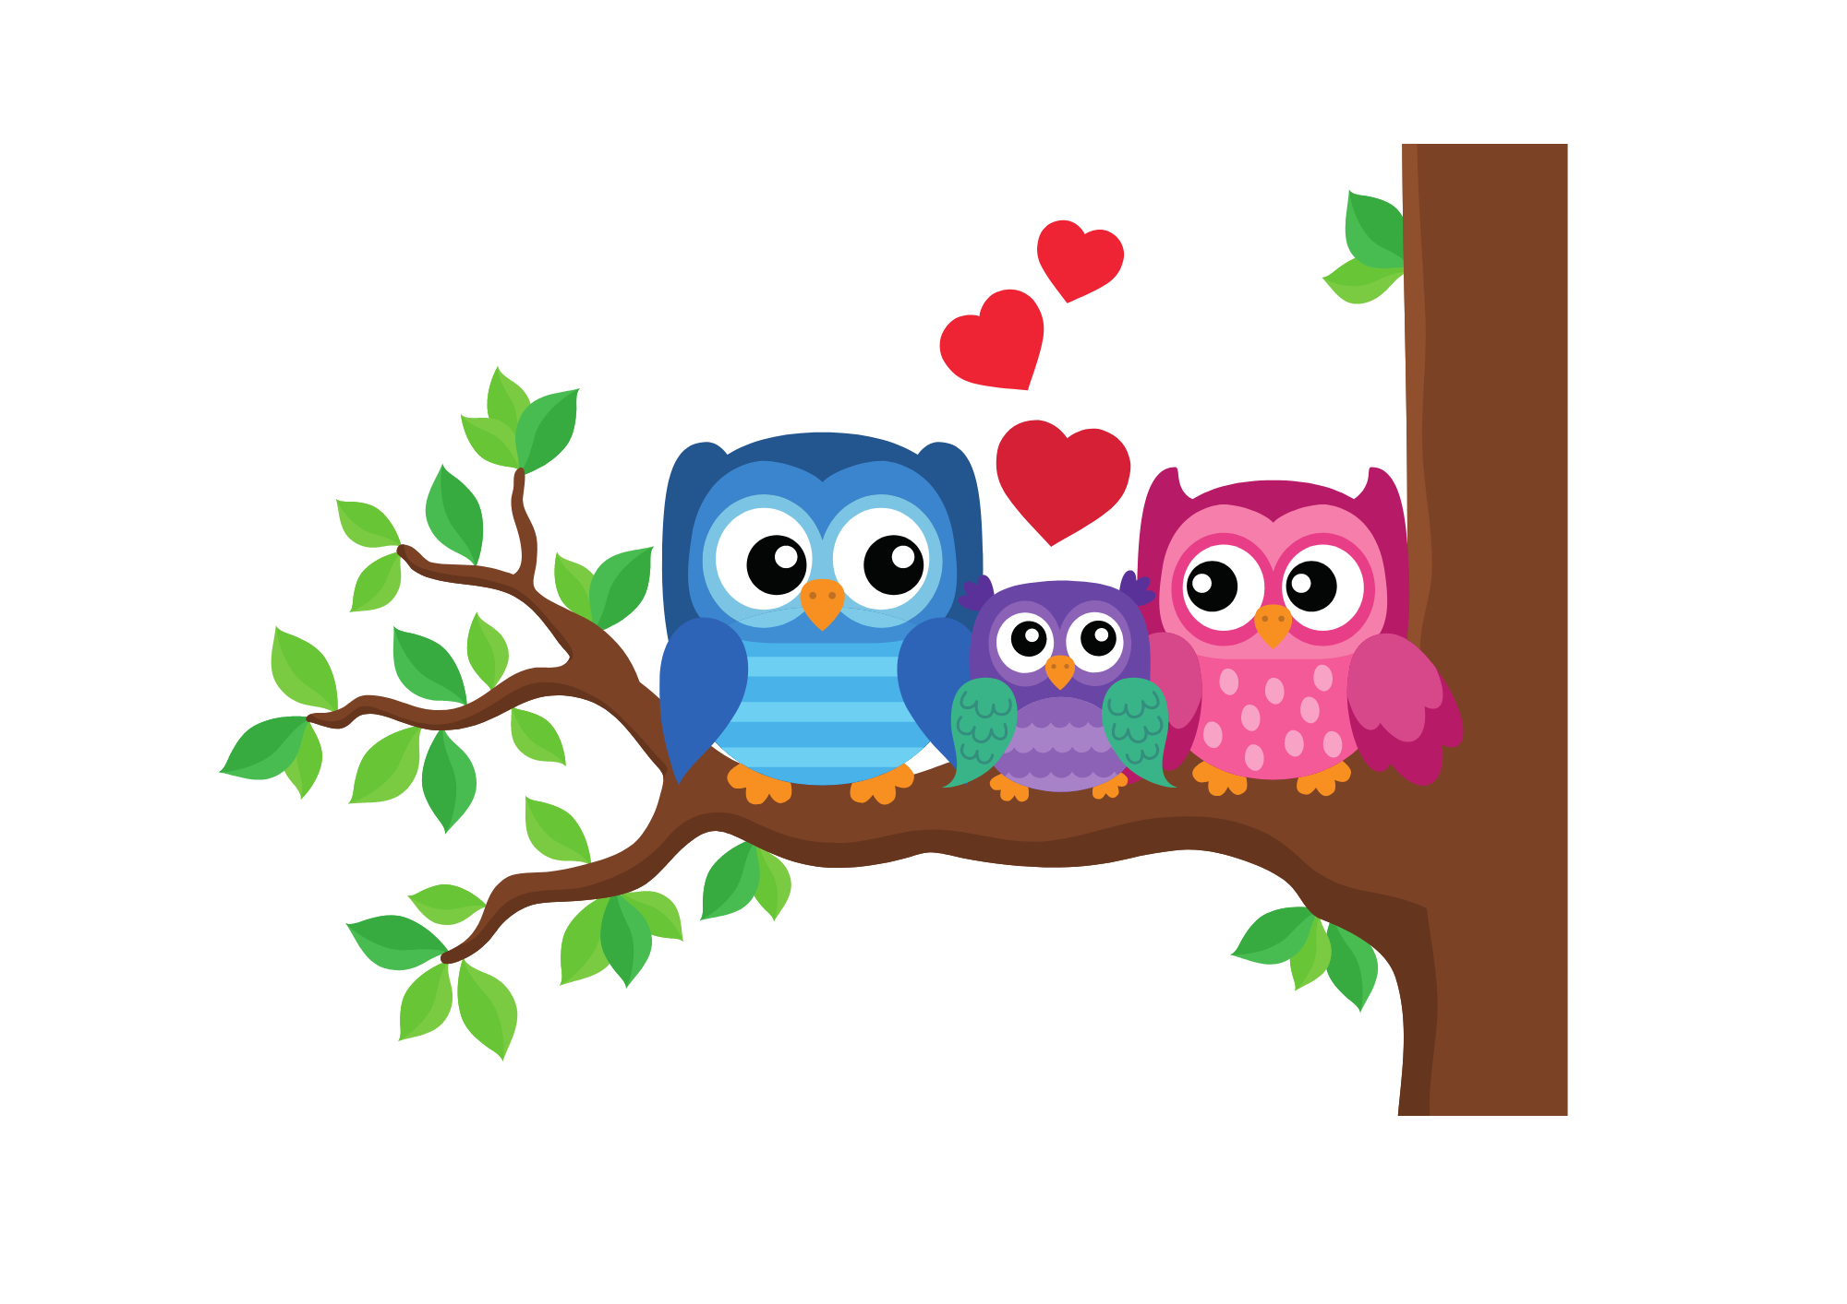
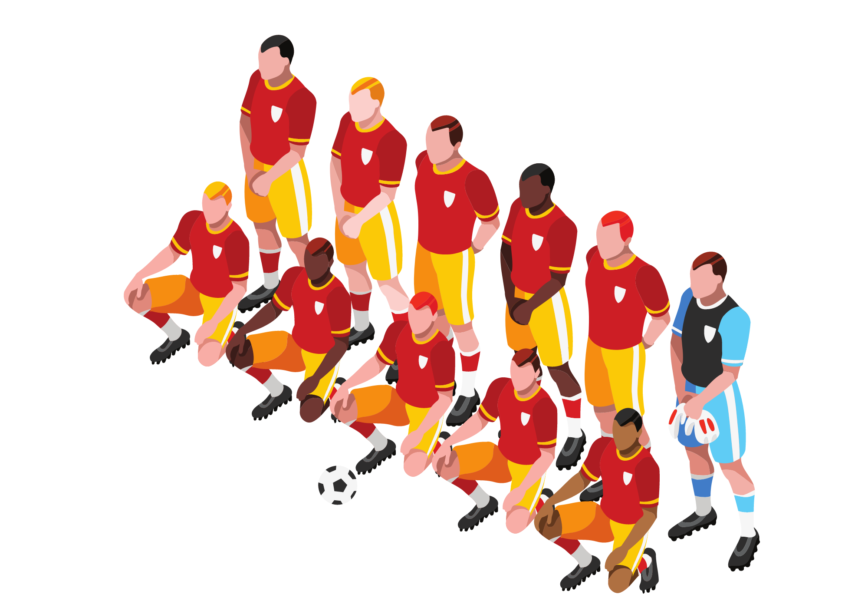
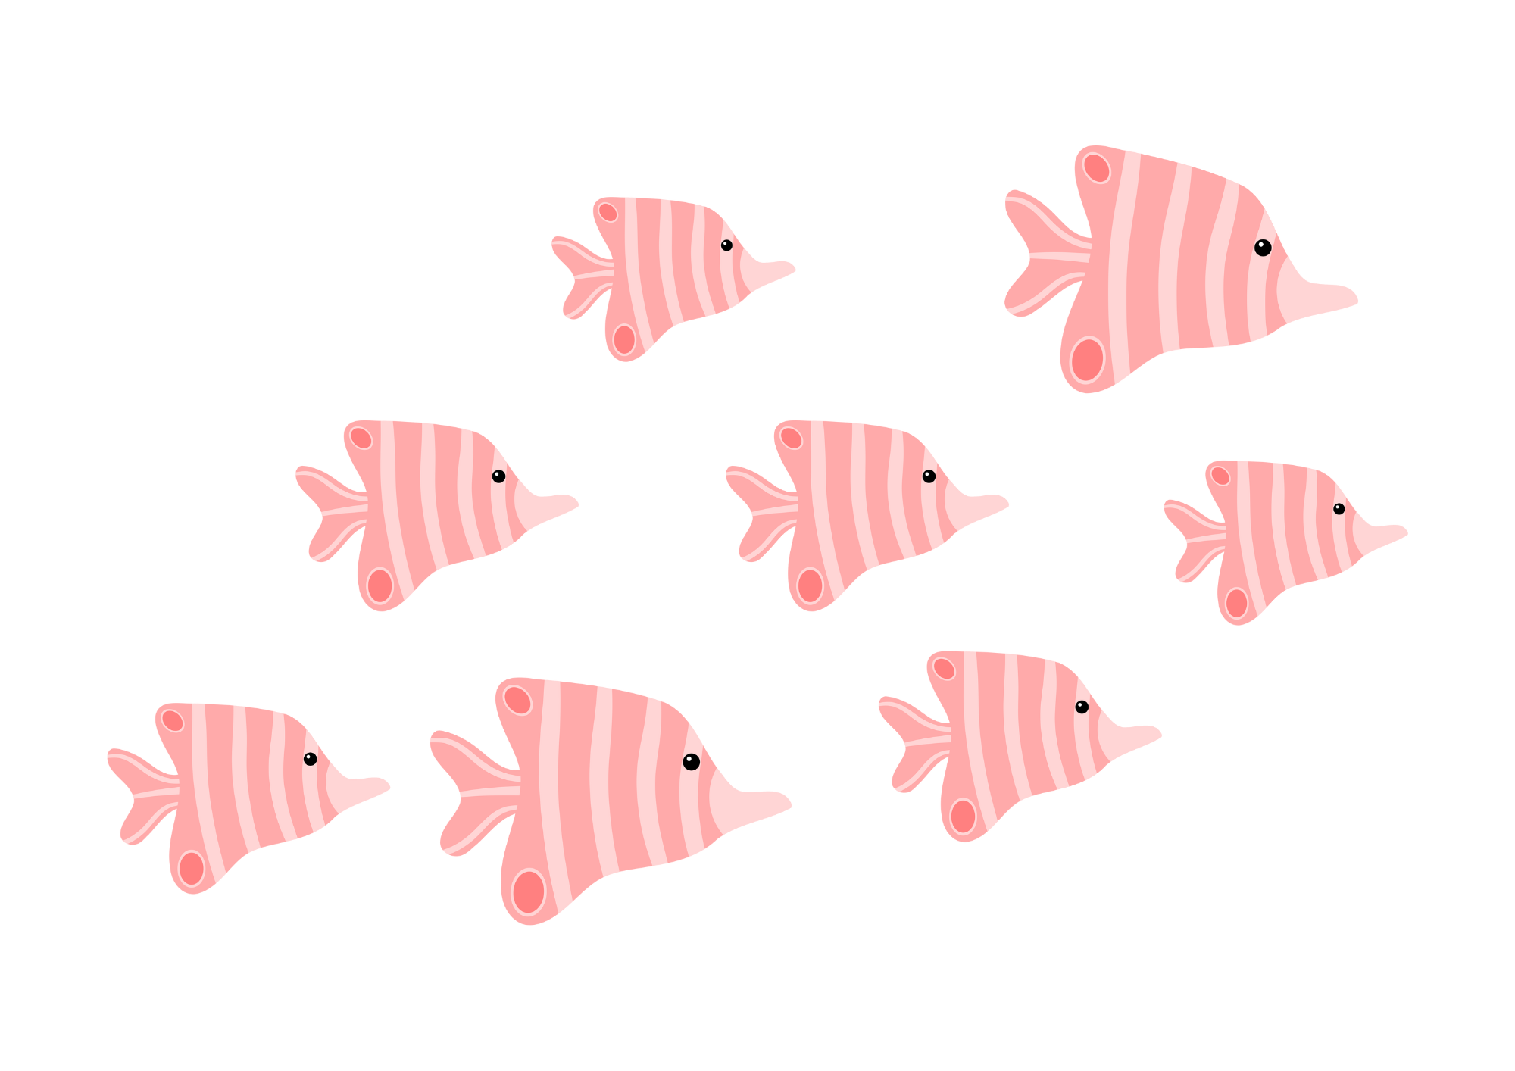
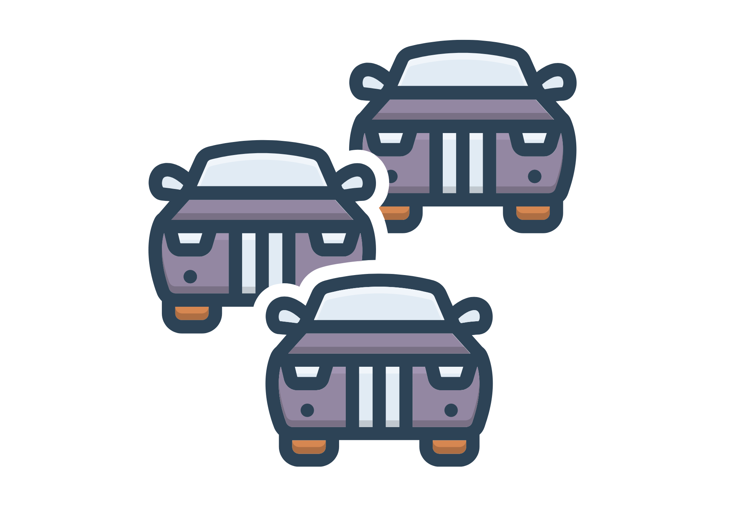
Collective Nouns

Slide 2
Lesson Objectives
By the end of these lessons, I will be able to:
Define collective nouns
Identify collective nouns
Use collective nouns in sentences

Slide 3
I Do
What are Collective Nouns?
Collective nouns are words used to describe a group of individuals or things. They are singular in form but refer to a collection of items or people. Here are some examples:
Animals: A pride of lions, a flock of birds, a school of fish.
People: A team of players, a crew of sailors, a crowd of spectators.
Objects: A bunch of grapes, a fleet of ships, a pack of cards.
Many animals, objects or people have more than one collective noun. For example: A group of people or a crowd of people.

Slide 4
We Do
Monday
Collective Nouns
How many of these do you already know? See how many you can memorise in 2 minutes!
A herd of sheep
A pod of dolphins
A pride of lions
A colony of ants
A school of fish
A parliament of owls
A crowd of spectators
A pack of wolves
A swarm of bees
A murder of crows
A nest of snakes
A troop of monkeys
A flock of birds
A pack of dogs
A gaggle of geese
A cluster of stars

Slide 5
We Do
Monday
Collective Nouns
Work with a partner and try to work out the collective nouns for these animals.
A herd of
Crows
Dolphins
Geese
Elephants
Owls
Wolves
Lions
Monkeys
A pride of
A parliament of
A pack of
A murder of
A troop of
A pod of
A gaggle of

Slide 6
You Do
Monday
Collective Nouns
Write these sentences in your book with the correct collective noun.
The _______ of birds flew gracefully across the sunset sky.
A _______ of bees buzzed around the blooming flowers.
The _______ of elephants moved slowly through the savanna.
A ______ of fish darted quickly through the clear waters.
The _______ of wolves howled under the full moon.

Slide 7
We Do
Tuesday
Collective Nouns
These collective nouns are a bit harder! See how many you can memorise in 2 minutes!
A clowder of cats
A parliament of owls
A crash of rhinos
A mob of kangaroos
A muster of peacocks
A parliament of owls
A drove of pigs
A skulk of foxes
A wake of vultures
A fleet of cars
A bundle of sticks
A batch of cookies
A pack of cards
A stack of books
A cluster of grapes
A pile of leaves

Slide 8
We Do
Tuesday
Collective Nouns
Work with a partner and try to work out the collective nouns.
A muster of
Owls
Rhinos
Kangaroos
Peacocks
Cars
Sticks
Cookies
Cards
A batch of
A fleet of
A bundle of
A parliament of
A stack of
A crash of
A mob of

Slide 9
You Do
Tuesday
Collective Nouns
In your book, write out the sentences with the correct collective nouns.
The _______ of owls perched on the tree watched as a _______ of cars sped down the highway.
A _______ of rhinos rested under the tree while a _______ of sticks lay scattered nearby.
A _______ of kangaroos jumped gracefully near a _______ of leaves that had fallen into the pond.
The _______ of rhinos ran over a _______ of cookies in the savanna.
A _______ of vultures flew past a ________ of cards on the ground.

Slide 10
We Do
Wednesday
Collective Nouns
These are getting very tricky! See how many you can memorise in 2 minutes!
A string of ponies
A cast of actors
A horde of hamsters
A plague of locusts
A nest of snakes
A bevy of quails
A drift of swans
A bouquet of flowers
A team of players
A gallery of art
A range of mountains
A forest of trees
A troop of baboons
A collection of stamps
A clutch of chicks
A bed of oysters

Slide 11
We Do
Wednesday
Collective Nouns
Work with a partner and try to work out the collective nouns for these animals.
A team of
Ponies
Quails
Swans
Players
Trees
Art
Stamps
Flowers
A collection of
A forest of
A gallery of
A string of
A bouquet of
A bevy of
A drift of

Slide 12
You Do
Wednesday
Collective Nouns
In your book, write out the sentences with the correct collective nouns.
A _______ of ponies lounged under the shade of a _______ of trees.
The children played with _______ of quails while their parents explored a _______ of art.
A ______ of swans swam around a _______ of flowers drifting in the water.
The _______ of players put a _______ of stamps in their suitcase.
A _______ of chicks lived quietly in the _______ of mountains.

Slide 13
Collective Nouns Poster
Create a collective nouns poster. See if you can have at least 6 collective nouns with pictures on your poster.
Collective Nouns
A pride of lions
A fleet of cars
A school of fish
A parliament of owls
A bouquet of flowers
A team of players

