Slide 1


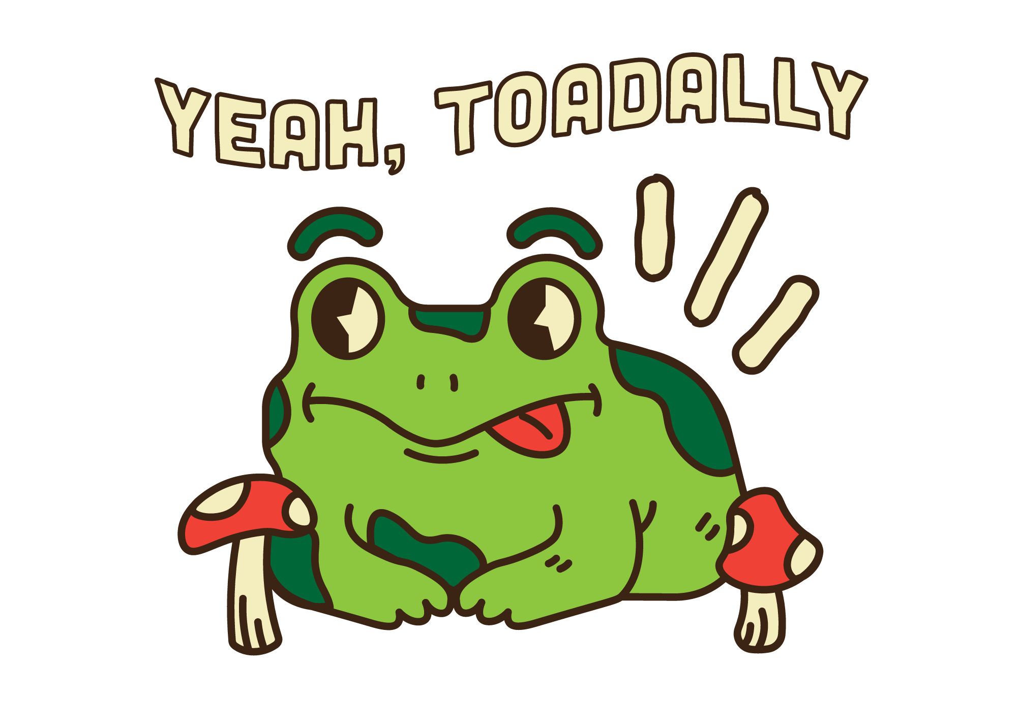

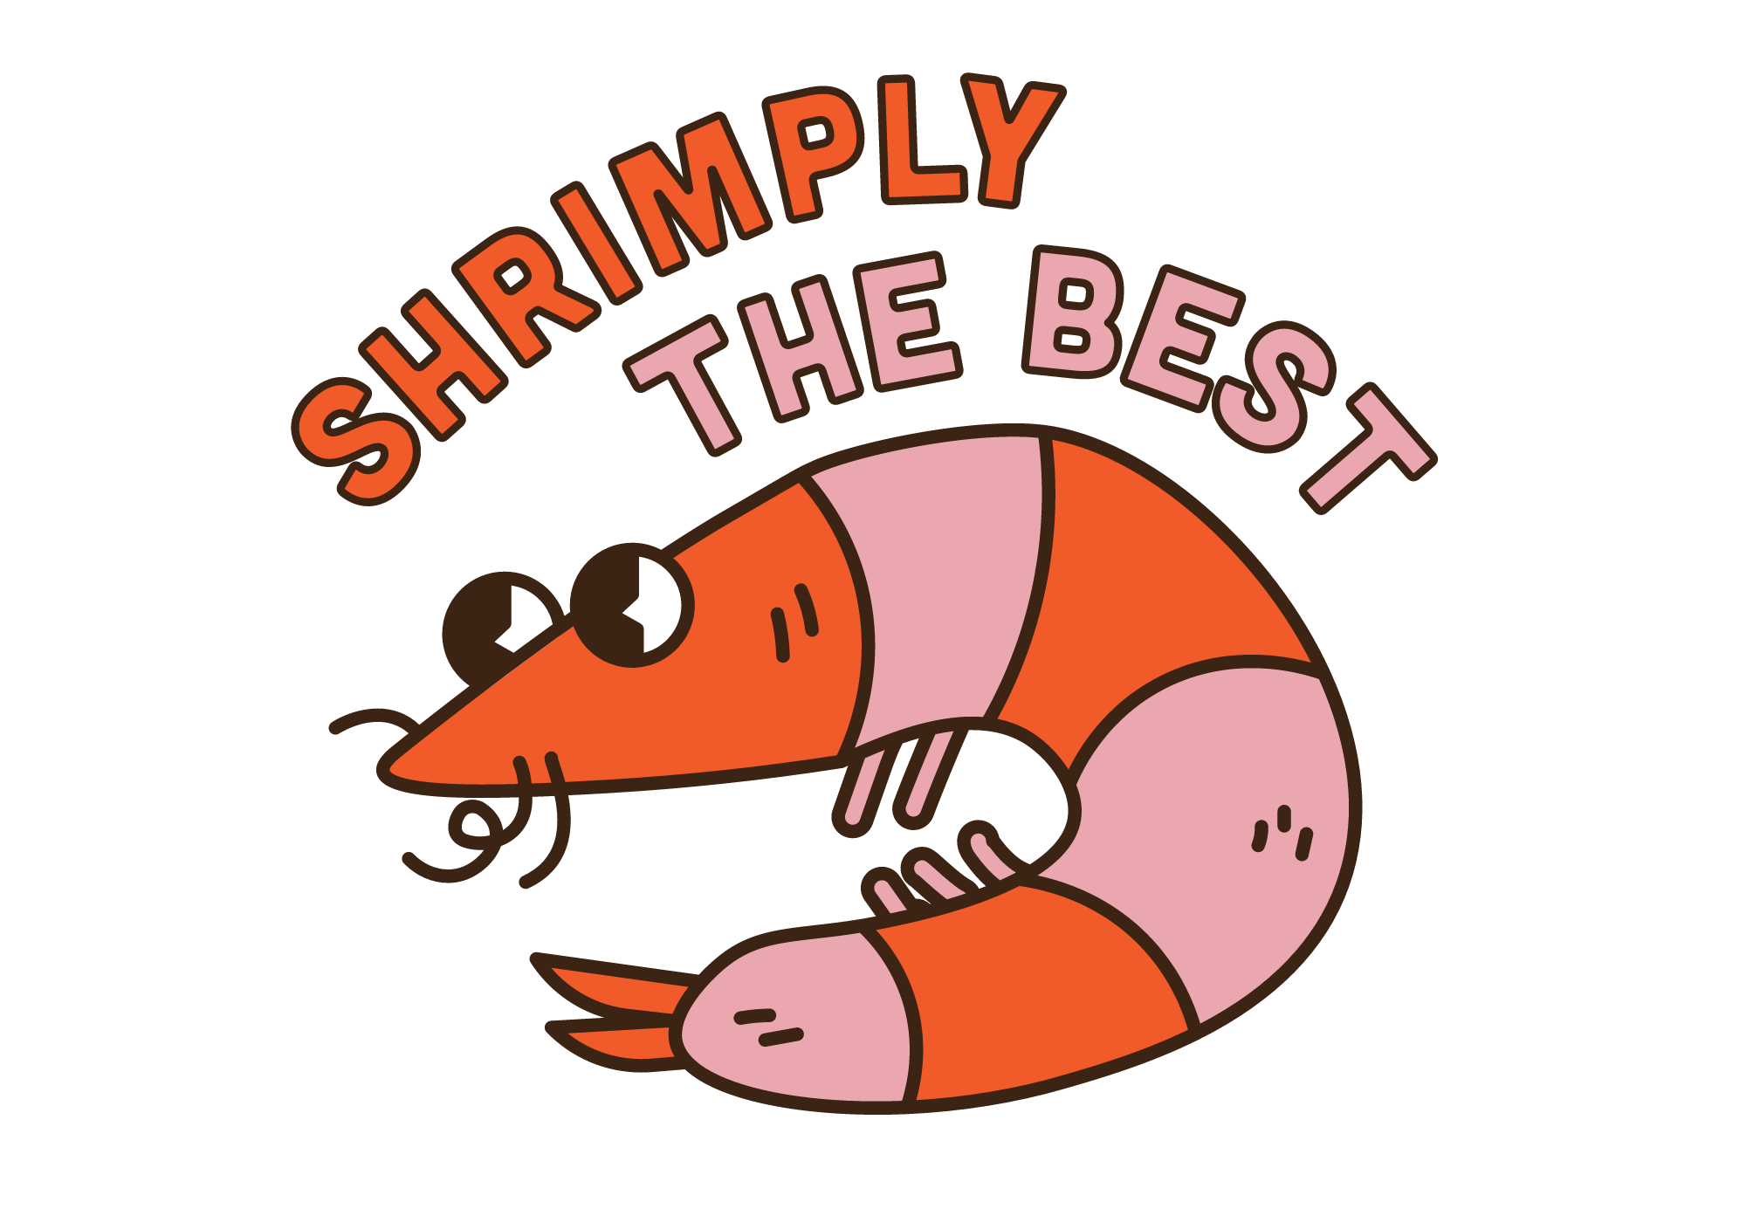
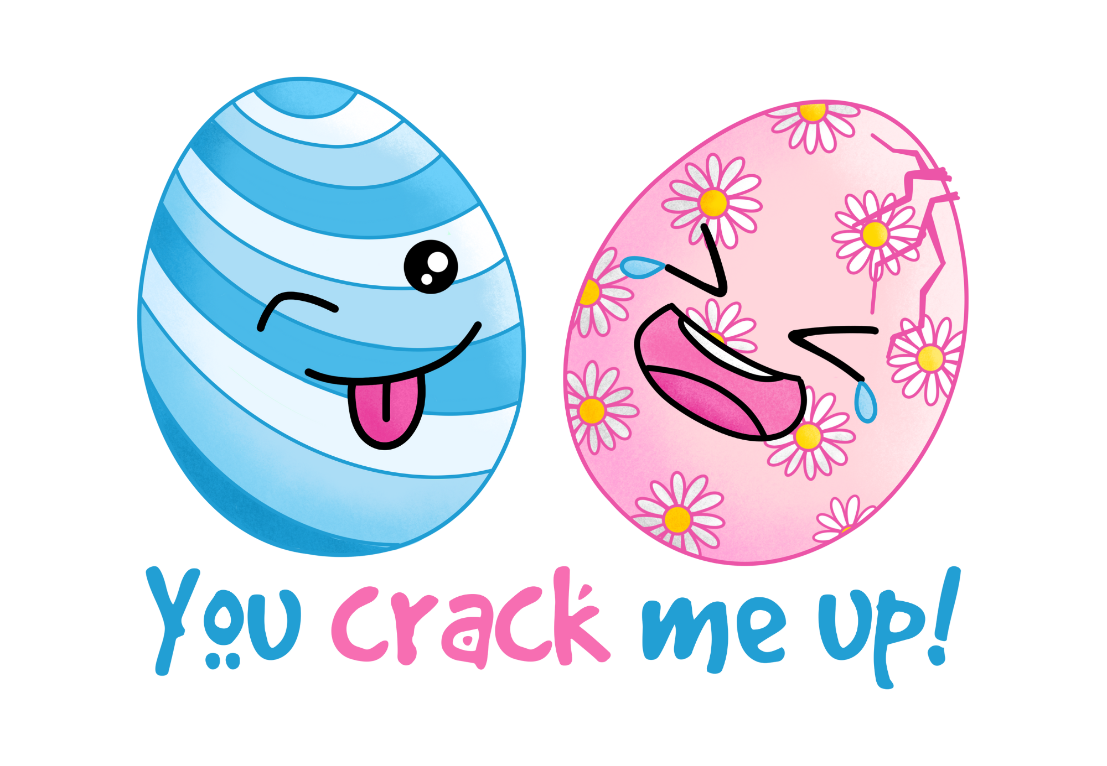
Puns

Slide 2
Lesson Objectives
By the end of this lesson, I will be able to:
Explain the meaning and purpose of puns.
Identify puns.
Give 5 examples of puns.

Slide 3
What is a Pun?
A pun is a type of joke that plays with words to create a humorous effect. It usually involves words that sound similar but have different meanings or a word that has multiple meanings. Puns can be clever and funny because they surprise us by connecting different ideas in an unexpected way.
For example:
I used to be a baker, but I couldn't make enough dough. In this pun, "dough" refers to both money and the mixture used to make bread.
Puns make us laugh because they play with the way we understand words and their meanings.

Slide 4

Pun Examples
Read the puns and work out the double meaning. The first one is done for you.
I don't trust stairs. They're always up to something.
This pun plays on the phrase “up to something,” which means doing something suspicious, but also, stairs go up.
I'm reading a book about anti-gravity. It's impossible to put down.
What do you call a sleeping bull? A bulldozer!
I would tell you a chemistry joke, but I know I wouldn't get a reaction.
Did you hear about the mathematician who’s afraid of negative numbers? He will stop at nothing to avoid them.

Slide 5
Pun or Not?
Work with a partner and read the sentences. Decide whether each sentence is a pun or not. Explain your answers.
I wondered why the baseball was getting bigger. Then it hit me.
The girl sang a beautiful song in the morning.
The teacher handed out pencils because she wanted to draw attention.
The scarecrow won an award because he was outstanding in his field.
He finished his homework before dinner.
Pun – plays on the phrase, “it hit me” – double meaning – getting hit and understanding something.
Not a pun.
Pun – plays on the phrase, “draw attention” – double meaning – pencils draw and getting someone’s attention.
Pun – plays on the phrase, “outstanding in his field” – double meaning – very good at something and literally standing in a field.
Not a pun.

Slide 6
Puns – Group Activity
Work in groups to complete these puns. See if you can get them all!
Why did the fly never land on the computer? It was afraid of the web.
Why did the tomato turn red? Because it saw the salad dressing!
Why did the light bulb go to school? It wanted to be brighter.
The thief who stole my lamp got a light sentence.
I told my watch to stand still, but it just kept ticking me off.
Why did the book join the police? To work undercover.
The bat couldn't see in the dark, so he decided to wing it.

Slide 7
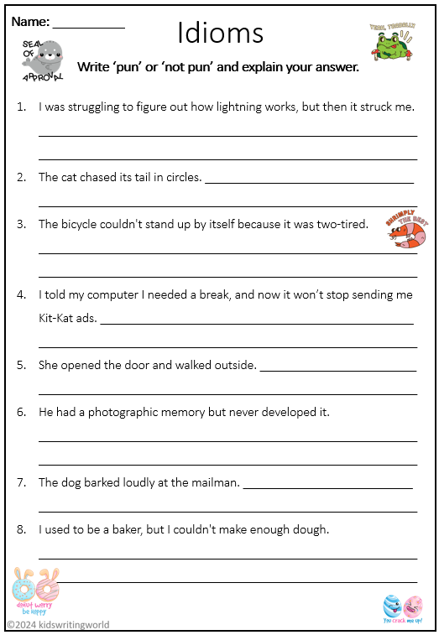
Independent Task
Complete the idiom worksheet.

